Slide 1
Is our Obsession with SUVs Secretly Killing us?
12/12/2021
Amelia Farrell
DSC530
Bellevue University

Slide 2
Agenda
1
5
Analytical Distribution - Pareto
Problem
Hypothesis
2
5
Scatter Plots
5
Hypothesis Testing - Welch’s t-test
3
Data Sets & Sources
Variables
4
5
Regression Analysis - Linear Regression
5
5
Descriptive Characteristics/Statistics
Conclusion & Future Steps
5
Probability Mass Function (PMF)
5
Refences
5
Cumulative Distribution Function (CDF)

Slide 3
Problem
The problem with pedestrian deaths has always been in existence. Even before there were cars, there were issues with horses killing by passers in the street. However, this issue became more apparent as cars became widely available to the general population in the early 20th century. More than 6,000 pedestrians in the U.S. alone, died from collisions with vehicles in 2019 (GHSA, 2020). However, it is important to note that things have gotten better since the 1970s. “Pedestrian deaths were 17 percent lower in 2019 than in 1975” (iihs.org, 2021). Although, this trend can not be seen when looking at more recent years. There was a 46% increase in pedestrian deaths from 2010 to 2019 (GHSA, 2020). Increasing an average of 15% year over year. Paul Marks noted an important finding from a study done by Devon E.Lefler and Hampton C.Gabler, “Someone struck by a large sports utility vehicle is more than twice as likely to die as someone hit by a saloon car travelling at the same speed” (Paul Marks, 2004). This study looked at pedestrians hit by motor vehicles and their survival rate. Clay Gabler, a lead researcher in this study, stated that “In the US, pedestrians are the forgotten crash victims,” due to the fact that studies like the one mentioned above have not been done before. While this study alone helps show that light trucks and SUVs are more likely to kill it’s victims over smaller passenger cars (supporting our hypothesis), this study was published in 2004. Meaning that this was a concern of Gabler’s before we even saw the significant increase in pedestrian deaths in 2010 to 2019. So, is this increase due to the increased number of SUVs on the road, or something else entirely?

Slide 4
Hypothesis
What is causing the significant rise in pedestrian deaths from 2010 to 2019? Are there more people on the road? More people walking to work? More people driving recklessly or distracted driving? One hypothesis, is that the increasing number of SUVs and light tucks (i.e. consumer trucks) on the road are the major contributors to the increased number of pedestrian deaths.

Slide 5
Data Sets & Sources
Due to the limited access to data and complicated nature of this analysis, we used two data sets that are concatenations of multiple other data sets. Source details shown below;
1. Deaths by State – Shows pedestrian deaths per capita by state and year. This will show us if there are any patterns in particular states or if the increase in deaths can be seem across all the U.S. We also added data on distracted driving laws as of 2019 in order to see how these laws interact with the number of deaths in each state.
Data Sources
State Laws on Distracted Driving - Ban on Hand-Held Devices and Texting While Driving - bts.gov
2019 Ranking of STATE Pedestrian Fatality Rates - State : USA - NHTSA
2. Deaths by Year – Shows total pedestrian deaths by year for all of the U.S. Methods of transportation to work were added in order to see if more or less individuals are walking on the streets increasing their chance of being hit by a moving vehicle. We also include data on the number of new/used passenger car and light truck (includes SUVs) sales and leases. As well as the number of Mobile cellular subscriptions per capita in order to identify possible relationships between the number of deaths, SUV sales, and the use of cell phones.
Data Sources
State Laws on Distracted Driving - Ban on Hand-Held Devices and Texting While Driving - bts.gov
Principal Means of Transportation to Work - bts.gov
New and Used Passenger Car and Light Truck Sales and Leases - bts.gov
World Development Indicators - bts.gov

Slide 6
Variables
Independent variables
Dependent variable
Below are the final variables in our combined data sets. We focused on the variables highlighted for our analysis.
2. Deaths by Year
Year – Year of data record
Pedestrians Killed – Number of individuals killed by moving vehicle (when struck outside of the vehicle)
Population (Thousands) – Population of state as of year recorded
FatalityRate – Deaths per 100,000
Drives self – Number of individuals driving to work alone
Carpool, total – Number of individuals carpooling to work
Public transportation – Number of individuals taking public transportation to work
Taxicab – Number of individuals taking Taxis to work
Bicycle – Number of individuals using Bicycles to get to work
Motorcycle – Number of individuals using Motorcycles to get to work
WalksOnly – Number of individuals walking to work
Works at home – Number of individuals working from home (not traveling to work
Passengercars – Number Passenger car sales and leases
Light trucks – Number Light trucks/SUVs sales and leases
CellSubscriptions (per 100 people) – Number cell phone subscriptions per 100 people.
1. Deaths by State
Year – Year of data record
Rank – State Rank by number of deaths
State – State name (USA)
Pedestrians Killed – Number of individuals killed by moving vehicle (when struck outside of the vehicle)
Population (Thousands) – Population of state as of year recorded
FatalityRate – Deaths per 100,000
handhelddeviceBan – States ban on hand-held devices while driving as of 2019 (1 – Yes, 0 – No)
textingBan – States ban on texting while driving as of 2019 (1 – Yes, 0 – No)

Slide 7
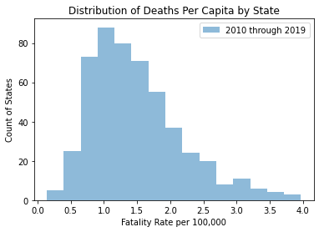
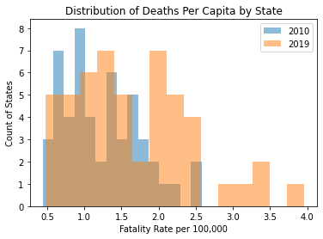
Histograms
Taking a closer look at some important variables by plotting their distribution using histograms.
1. State (USA)
Note how the distribution shifts to the right in 2019.

Slide 8
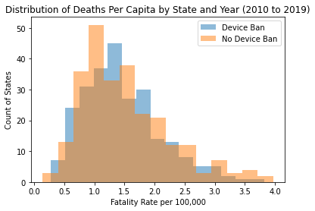
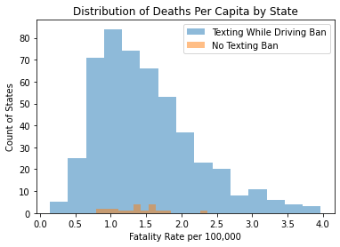
Histograms (cont.)
2. Mobile Device Ban (handhelddeviceBan)
3. Texting While Driving Ban (textingBan)
The low number of deaths per capita in the states without a ban on texting while driving, is due to the small number of states that do not have this ban (2 States). Due to this, we will not include the ban on texting while driving in our analysis.

Slide 9
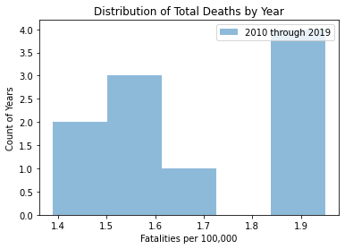
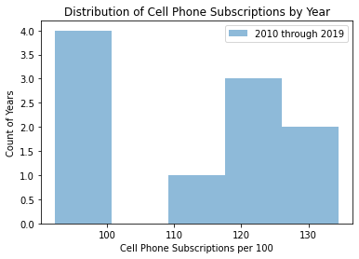
Histograms (cont.)
4. Year
5. Cell phone subscriptions (CellSubscriptions)
Correlated??
We can see from this distribution that 4 of the years are on the right are outliers. This is not a normal distribution and something worth investigating further.
We can also see 4 outliers in this distribution (on the left). Are these the same 4 years we see on the right in the “Year” histogram? We will need to run a correlation/scatter plot to see if this relationship exists.

Slide 10
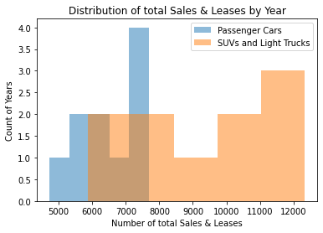
Histograms (cont.)
6 & 7. SUVs/Light Trucks vs Passenger Car Sales & Leases by year.
We can see from these two histograms that there are far more years with high sales of SUVs ana Light Trucks. However, neither provides much insight to other patterns behind the data. We will need to use other means to identify patterns in this data set (data set #2, 10 observations =10 Years).

Slide 11
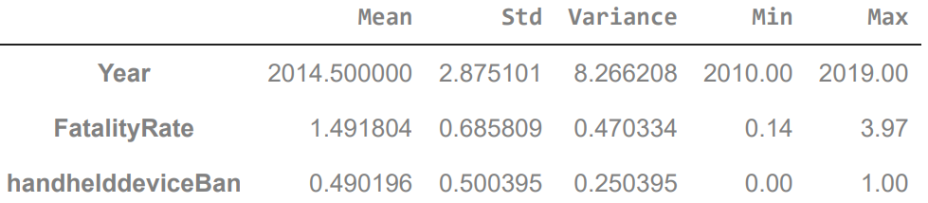
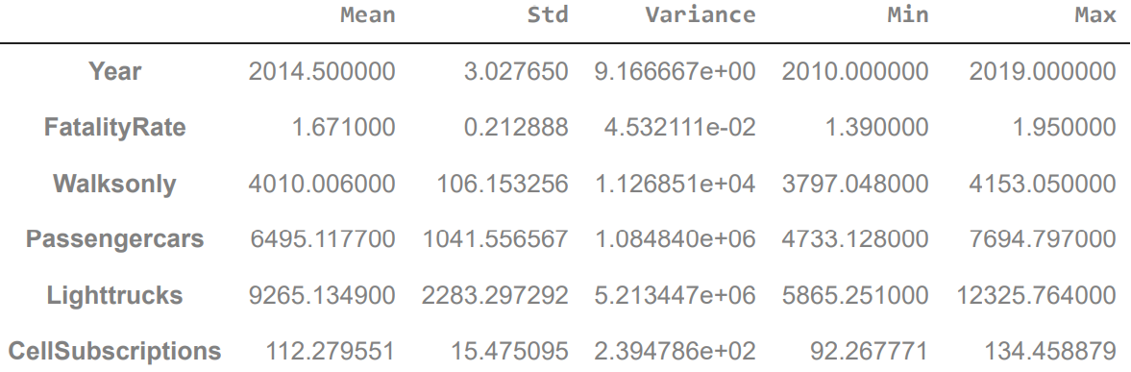
Descriptive Characteristics/Statistics
Summarizing our key variables in a meaningful way.
1. Deaths by State
1. Deaths by Year

Slide 12
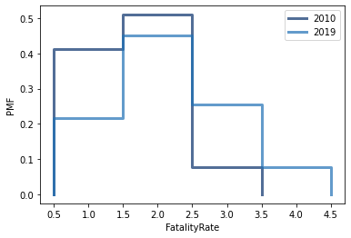
Probability Mass Function (PMF)
7 & 8. 2010 vs 2019 probability of fatality
Based on the comparison of PMFs from 2010 and 2019, we can clearly see the left skew in 2010 vs 2019. Meaning that we had a higher chance of living in a high fatality state in 2019 than we did in 2010. This shows the increase in deaths from 2010 to 2019 across states.
We don’t see any states with a fatality rate above 3.5 in 2010

Slide 13
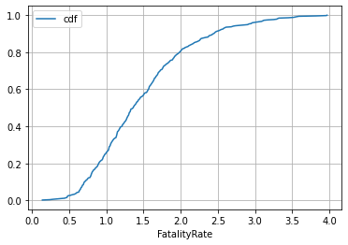
Cumulative Distribution Function (CDF)
9. CDF of fatality rates across years and states
Based our CDF of fatality rates across all years and states we can conclude that 80% of our observations have a fatality rate less than 2 per 100,000 individuals.

Slide 14
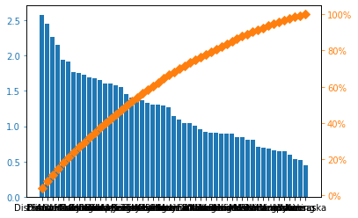
Analytical Distribution - Pareto
9. Pareto of fatality rate by state
Based on our Pareto distribution, we can say that 80% of the deaths come from over 50% of the states. This shows that there are in fact states with higher rates of deaths.

Slide 15
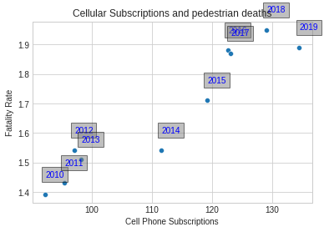
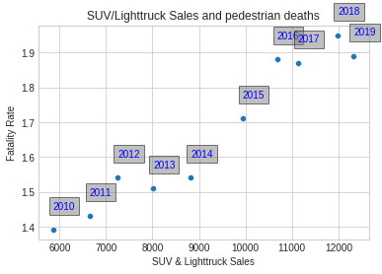
Scatter Plots
How are some of our variables related?
Pearson’s r = 0.949
Pearson’s r = 0.967
Note: While these plots may make it look as though SUV&Truck Sales are related to Cell Phone Subscriptions (the years appear to be in similar order as the number increase in both plots), based off our “industry knowledge” we can assume that the relationship is due to chance.
Both correlations above have a correlation coefficient over 0.9. Meaning that both have strong positive relationships to pedestrian deaths. Note that correlation does not indicate causation. This raises the question, which variable has a stronger influence on pedestrian deaths and what weight does each play in predicting these deaths?

Slide 16
Hypothesis Testing - Welch’s t-test
10. Welch’s t-test univariate test that tests for a significant difference between the mean of two unrelated groups. It is an alternative to the independent t-test when there are unequal variances. We will be using this test to see whether or not there is a difference in means between deaths and SUV sales. If there is no difference, this would indicate that the two are related and are truly correlated.
# Data frame of SUVs and Lighttrucks only
Lighttrucksbyyear = yeardf["Lighttrucks"]
# Data frame of Fatality per 100,000
totalfatalitybyyear = yeardf["FatalityRate"]
# Test for equal variances. We want to look for a difference less than 4
print((np.var(Lighttrucksbyyear))/(np.var(totalfatalitybyyear)))
>>> 115033510.75980507
# Since we got a value over 4 we will continue with Welch’s t-test
# testing the assumption of normality using the stats.shapiro()
# first value in the tuple is the W test statistic, and the second value is the p-value.
print((stats.shapiro(Lighttrucksbyyear)), (stats.shapiro(totalfatalitybyyear)))
# Welch’s t-test
stats.ttest_ind(Lighttrucksbyyear, totalfatalitybyyear, equal_var = False)
>>> Ttest_indResult(statistic=12.82953600693544, pvalue=4.3486425439362615e-07)
Since out p-value is significant (less than 0.5), we can reject the null hypothesis and say that there is a significant difference in means. Meaning that the increase in deaths may not be related to the increase in light trucks and suvs.

Slide 17
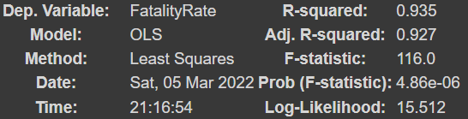
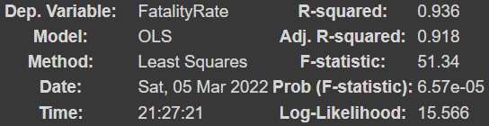

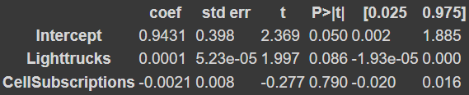
Regression Analysis - Linear Regression
11. We will be using a Multiple Linear Regression model in order to identify the variables effecting the total Fatality Rate by year. We used the Deaths by Year data set in order to test our hypothesis that the number of Light Trucks and SUVs impact the number of pedestrian deaths. In order to run the analysis, we first needed to choose the variables with the highest R-Squared value. These were Light trucks and Cell Subscriptions. The number of Passenger cars had the lowest R-Squared and since it was also correlated with Light trucks, we excluded it from the model. With these two predictor variables, we ran one simple linear regression model and one multiple linear regression model. Our results are shown below.
Multiple linear regression
model = smf.ols('FatalityRate ~ Lighttrucks + CellSubscriptions', data=yeardf)
Simple linear regression
model = smf.ols('FatalityRate ~ Lighttrucks', data=yeardf)
After adding CellSubscriptions, our R-Squared 0.001. This is not a significant increase and our Adj. R-Squared actually decreased. After looking at the p-value from CellSubscriptions we will use the Simple linear regression model over the Multiple.

Slide 18
Conclusion & Future Steps
12. We will be using a Multiple Linear Regression model in order to identify the variables effecting the total Fatality Rate by year. We used the Deaths by Year data set in order to test our hypothesis that the number of Light Trucks and SUVs impact the number of pedestrian deaths. In order to run the analysis, we first needed to choose the variables with the highest R-Squared value. These were Light trucks and Cell Subscriptions. The number of Passenger cars had the lowest R-Squared and since it was also correlated with Light trucks, we excluded it from the model. With these two predictor variables, we ran one simple linear regression model and one multiple linear regression model. Our results are shown below.

Slide 19
Refences
Visionzeronetwork, 2021, https://visionzeronetwork.org/about/what-is-vision-zero/
https://www.ghsa.org/sites/default/files/2021-03/Ped%20Spotlight%202021%20FINAL%203.23.21.pdf
SUVs double pedestrians' risk of death, Paul Marks, 2003, https://www.newscientist.com/article/dn4462-suvs-double-pedestrians-risk-of-death/#:~:text=Pedestrians%20struck%20by%20large%20SUVs,to%20kill%20than%20head%20injuries.
Devon E. Lefler, Hampton C. Gabler, The fatality and injury risk of light truck impacts with pedestrians in the United States, 2004
https://www.sciencedirect.com/science/article/abs/pii/S0001457503000071
2019 Ranking of STATE Pedestrian Fatality Rates - State : USA
https://www-fars.nhtsa.dot.gov/states/statespedestrians.aspx
Road condition data https://www.bts.gov/road-condition
Principal Means of Transportation to Work https://www.bts.gov/content/principal-means-transportation-work
State Laws on Distracted Driving - Ban on Hand-Held Devices and Texting While Driving https://www.bts.gov/content/state-laws-distracted-driving-0
New and Used Passenger Car and Light Truck Sales and Leases https://www.bts.gov/content/new-and-used-passenger-car-sales-and-leases-thousands-vehicles
World Development Indicators https://databank.worldbank.org/reports.aspx?source=2&series=IT.CEL.SETS.P2&country=

