Slide 1
Introduction to Digital Nonvisual Maps
Brandon Biggs
Smith-Kettlewell Eye Research Institute
XR Navigation

Slide 2
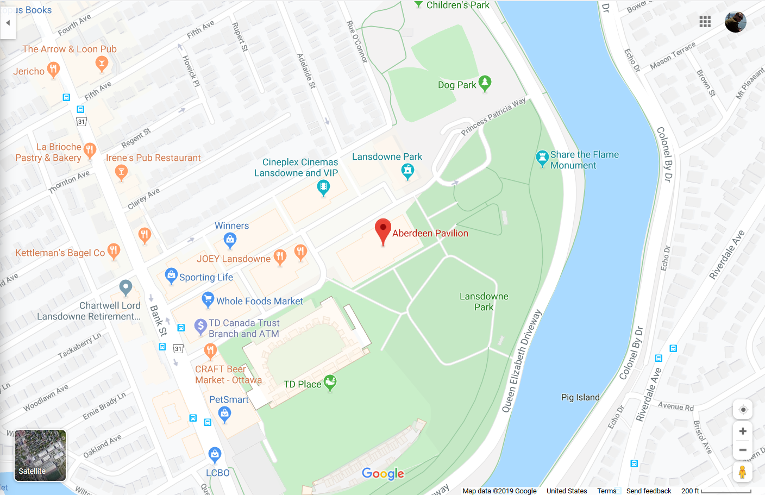
Most Web Maps Today...

Slide 3

Problem
Digital maps from Google, ESRI, Leaflet, and other places have always been made completely visual
Text descriptions are the "accessible" alternative to visual maps, but why have a map if text is the same?
Text does not give critical spatial information present in the visual map
There are at least 285 million nonvisual users in the world

Slide 4
Commonalities Between Nonvisual Maps
All features in a dataset have a "name" attribute
All systems use collision detection
No system works with only a point to label an empty space with walls (use a polygon instead)

Slide 5
Vibro-audio maps (VAMs)
Use vibration and text to speech to represent geometries
Are used on a touchscreen
Vibrate when the user touches a line on the tablet
Announce when the user enters a polygon

Slide 6
Vibro Haptic Map References
Giudice, N. A., Palani, H. P., Brenner, E., & Kramer, K. M. (2012, October). Learning non-visual graphical information using a touch-based vibro-audio interface. In Proceedings of the 14th international ACM SIGACCESS conference on Computers and accessibility (pp. 103-110).
Poppinga, B., Magnusson, C., Pielot, M., & Rassmus-Gröhn, K. (2011, August). TouchOver map: audio-tactile exploration of interactive maps. In Proceedings of the 13th International Conference on Human Computer Interaction with Mobile Devices and Services (pp. 545-550).

Slide 7
Digital Auditory Maps
Use binaural audio (and other auditory properties) along with sounds, and text to speech to represent data
Are Interactive and controlled through keyboard and touch screen

Slide 8
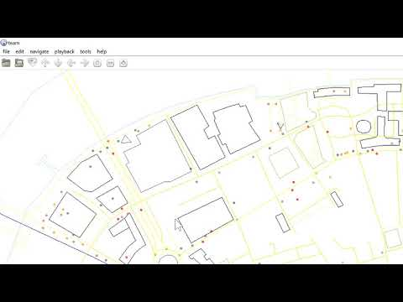
City Map Example

Slide 9
City Map References
Loeliger, E., & Stockman, T. (2014). Wayfinding without visual cues: Evaluation of an interactive audio map system. Interacting with Computers, 26(5), 403-416.
http://team.sourceforge.net/

Slide 10
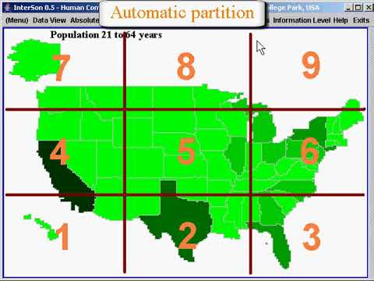
Heatmap Example

Slide 11
Heatmap References
Zhao, H., Plaisant, C., Shneiderman, B., & Lazar, J. (2008). Data sonification for users with visual impairment: a case study with georeferenced data. ACM Transactions on Computer-Human Interaction (TOCHI), 15(1), 1-28.
http://www.cs.umd.edu/hcil/iSonic/

Slide 12
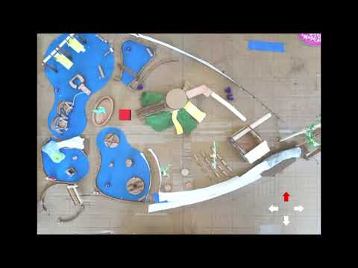
Enclosed Space Map (Building/Playground/park) Example

Slide 13
Enclosed Space Map References
Biggs, B., Coughlan, J. M., & Coppin, P. (2019). Design and evaluation of an audio game-inspired auditory map interface. In Proceedings of the... International Conference on Auditory Display. International Conference on Auditory Display (Vol. 2019, p. 20). NIH Public Access.
https://xrnavigation.io/audio-map-examples

Slide 14
Thank you!
Contact me:
brandon.biggs@xrnavigation.io
xrnavigation.io/contact

