Slide 1

Advanced analytics for geospatial data
Nicolas Rafael Palomino
Advanced Analytics for Geospatial Data
Monday, Sep 28, 2020 @ 12:00 AM EDT
(2020-09-28 04:00UTC)
W3C/OGC Joint Workshop Series on Maps for the Web
w3.org/2020/maps/

Slide 2
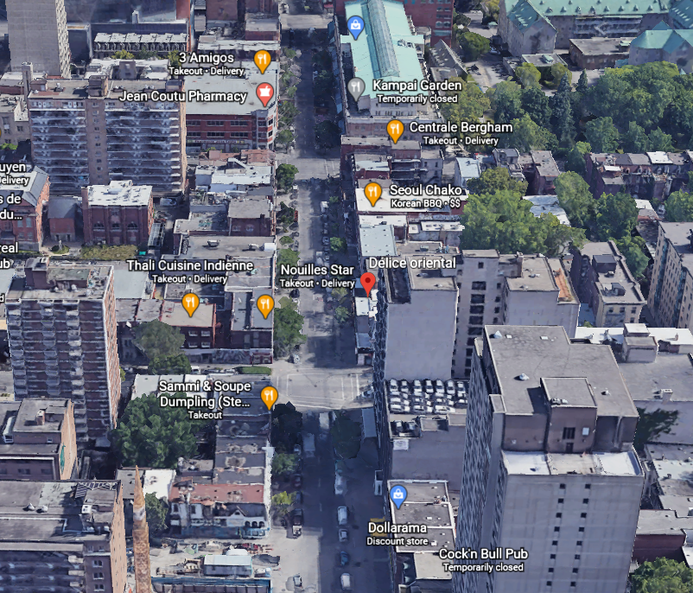
Interactive Maps Widgets
Based on location or non-location
New technologies include advanced computing, “Big Data" analytics, artificial intelligence and machine learning bringing automation
*Cloud-connect IoT devices, data analytics and AI integration

Slide 3
Bringing Life to Things(I.T system)
Connected in-Context, predictive and self-aware devices will help drive boundaryless, pervasive and Expericience Rich entreprise ecosystems. (Global Plateform)
Connect in-Context
Boundaryless
Advanced analytics
Predictive
Pervasive
Experience
Most Efficient
Autonomous
Cloud Connected IoT Devices
GDPR Ready

Slide 4
Unlocking Exponential Value
Enhanced Quality of Life
Improves Safety
Security
Quality
Optimized and Responsive Value Chains
Increase speed to market with mass customization
In-context predictive and persuasive
New Business Models
Connected networks
Hybrid Cloud Computing
Seamless Customer Experience
Client-centerized systems
Predictive and Pervasive
AI, Machine Learning, Advanced Analytics

Slide 5
Basic Uses
Restauration
Retail Stores(Commercial Uses)
Social
5G
Enables direct connectivity with Restauration chains for Private or Social events. Local or non-local
Interaction with services and disponibilities (Individualized Data Symbiosis)
Enables direct connectivity with Retail Supply Chain for Private or Social events. Local or non-local
Interaction with merchandise and stock disponibilities (IDS) (E-Commerces)
Social Mobile Application, Social Benefits, Social Behaviours Designs
5G More speed and reliability, Big Data, Long-lasting relationship with customers
The industrial revolution will be powered by both established and emerging technologies, including the IoT,
Advanced data analytics integrated with artificial intelligence, robotic process automation, robotics, edge
computing(Digital twin virtual and augmented reality)

Slide 6
Commercial components and Industry 4.0
Vertical and Horizontal Integration Systems
Key to automate data transmission in smart factories and communicating
with providers and clients(MES,ERP, IoT)
CPS Systems
Processing, storing and communication Capabilities controlling more than
one physical process. Interconnected through the Internet. Decentralized
data analysis and decision-making. Enables real-time responses.
Big Data and Data Analytics
Helps processing and analysing huge amount of data predicting future
problems or necessities
Simulation Software
Collected information processed to model the behaviour of machines.
Simulates future scenarios to determine necessities, predic problems, reduce
configuration costs and improves quality. Digital Twin Concept
Real-World factory through visual interfaces enabling monitoring and
supervising operations
Cloud and Edge Computing
Fog Computing or Cloudlets enable offloading part of
processing from the cloud to the edge of the network,
decreasing latency response. Limitation when maintenances
Software problems or attacks.
CyberSecurity
Key to provide secure and reliable communications,
authentication systems and preserve data privacy in order to
avoid cyber attacks. Required to protect industrial critical
systems.

Slide 7

Social features exploitation for Geospatial Data
Private Usergroups
Public Usergroups
Individualized Usergroups
Location Meetings Functionality
Geospatial Data avalaiblity from non-local or local point.
Social Transports and Private transports services
Different Social Media Interconnections(IG, FB, Spotify, SN, Uber)

Slide 8
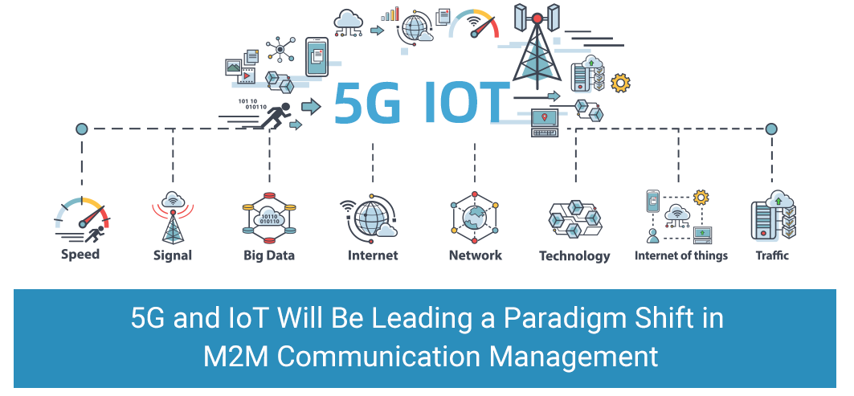
The fifth generation technology
Data-Transfer Speeds
Greater Network Reliability
Integrated Advanced analytics with AI, IoT and 5G for real-time insights & recommendations
Next Generation Digital Commerce With 5g

Slide 9
Industry 4.0
Interconnections
Information Transparency
Technical Assistance
Decentralized Decisions
The re-infrastructure and implementation of such systems will take years but is critical to technological and industrial revolution that is happening.
Main technologies.
CPS
IoT
On-Demand availability of computer system resources
Cognitive Computing

Slide 10
Conclusion
Understanding and address the ethical, legal and societal implications
Ensure the Safety and Security of AI Systems
Develop shared public datasets and Environments for AI training and Testing
Expand Public-Private Partnerships to accelerate Advances in AI
Shifting in modernization,
Governmental technology(DoD)
Futur of Industry, Government and Academia datasets
Expending Network Grid

Slide 11
THANK YOU!
Nicolasrafael.palomino@gmail.com
Monday, Sep 28, 2020 @ 12:00 AM EDT
(2020-09-28 04:00UTC)
W3C/OGC Joint Workshop Series on Maps for the Web
w3.org/2020/maps/

