Slide 1


Connection of the MapML initiative with OGC standards such as the new OGC API Tiles candidate or the old WMS
Joan Masó
Maps for the Web 2020

Slide 2
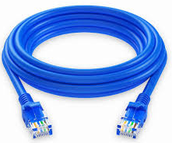
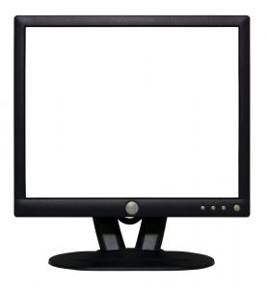
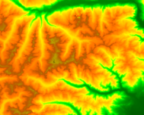

Who to send a map to a client
Client
Server
Data
Protocol
123.0
120.0
121.5
120.6
127.1
129.0
123.0
120.0
121.5
120.6
127.1
129.0
123.0
120.0
121.5
120.6
999.9
999.9
123.0
120.0
121.5
999.9
999.9
999.9
123.0
120.0
121.5
999.9
999.9
999.9
function CarregaDataViewsCapa(dv, i_nova_vista, i_data, valors)
{
for (ver i_v=0; i_v<valors.length; i_v++)
{
if (i_nova_vista==-1)
array_buffer=valors[i_v].arrayBuffer;
else if (i_nova_vista==-2)
array_buffer=valors[i_v].arrayBufferPrint;
else if (i_nova_vista==-3)
array_buffer=valors[i_v].capa_rodet[i_data].arrayBuffer;
else if (i_nova_vista==-4)
array_buffer=valors[i_v].capa_video[i_data].arrayBuffer;
else
array_buffer=(valors[i_v].nova_capa && valors[i_v].nova_ }
return n_v;
}
JavaScript code
HTML
MicroXML
<map is="web-map" zoom="17" lat="45.398043" lon="-75.70683"
width="700" height="400" controls hidden>
<layer id="osm" src="https://geogratis.gc.ca/mapml/en/osmtile/osm/"
label="Open Street Map" checked hidden></layer>
<area is="map-area"id="marker2" href="https://example.com/marker/"
alt="Marker" coords="265,185" shape="marker">
</map>

Slide 3
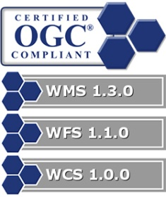

The common client-server diagram
Client
Server

OWS services
123.0
120.0
121.5
120.6
127.1
129.0
Data
Protocol
OpenAPI
120.0
121.5
127.1
129.0

123.0
120.6
123.0
120.0
121.5
120.6
999.9
999.9
123.0
120.0
121.5
999.9
999.9
999.9
123.0
120.0
121.5
999.9
999.9
999.9
function CarregaDataViewsCapa(dv, i_nova_vista, i_data, valors)
{
for (ver i_v=0; i_v<valors.length; i_v++)
{
if (i_nova_vista==-1)
array_buffer=valors[i_v].arrayBuffer;
else if (i_nova_vista==-2)
array_buffer=valors[i_v].arrayBufferPrint;
else if (i_nova_vista==-3)
array_buffer=valors[i_v].capa_rodet[i_data].arrayBuffer;
else if (i_nova_vista==-4)
array_buffer=valors[i_v].capa_video[i_data].arrayBuffer;
else
array_buffer=(valors[i_v].nova_capa && valors[i_v].nova_ }
return n_v;
}
JavaScript code
HTML
MicroXML
<map is="web-map" zoom="17" lat="45.398043" lon="-75.70683"
width="700" height="400" controls hidden>
<layer id="osm" src="https://geogratis.gc.ca/mapml/en/osmtile/osm/"
label="Open Street Map" checked hidden></layer>
<area is="map-area"id="marker2" href="https://example.com/marker/"
alt="Marker" coords="265,185" shape="marker">
</map>

Slide 4


The common client-server diagram
Client
Server

Data
Protocol
123.0
120.0
121.5
120.6
127.1
129.0

123.0
120.0
121.5
120.6
127.1
129.0
123.0
120.0
121.5
120.6
999.9
999.9
123.0
120.0
121.5
999.9
999.9
999.9
123.0
120.0
121.5
999.9
999.9
999.9
function CarregaDataViewsCapa(dv, i_nova_vista, i_data, valors)
{
for (ver i_v=0; i_v<valors.length; i_v++)
{
if (i_nova_vista==-1)
array_buffer=valors[i_v].arrayBuffer;
else if (i_nova_vista==-2)
array_buffer=valors[i_v].arrayBufferPrint;
else if (i_nova_vista==-3)
array_buffer=valors[i_v].capa_rodet[i_data].arrayBuffer;
else if (i_nova_vista==-4)
array_buffer=valors[i_v].capa_video[i_data].arrayBuffer;
else
array_buffer=(valors[i_v].nova_capa && valors[i_v].nova_ }
return n_v;
}
JavaScript code
Map API

maps
HTML
MicroXML
<map is="web-map" zoom="17" lat="45.398043" lon="-75.70683"
width="700" height="400" controls hidden>
<layer id="osm" src="https://geogratis.gc.ca/mapml/en/osmtile/osm/"
label="Open Street Map" checked hidden></layer>
<area is="map-area"id="marker2" href="https://example.com/marker/"
alt="Marker" coords="265,185" shape="marker">
</map>

Slide 5
The common client-server diagram
Client
Server

Data
Protocol
123.0
120.0
121.5
120.6
127.1
129.0

123.0
120.0
121.5
120.6
127.1
129.0
123.0
120.0
121.5
120.6
999.9
999.9
123.0
120.0
121.5
999.9
999.9
999.9
123.0
120.0
121.5
999.9
999.9
999.9
function CarregaDataViewsCapa(dv, i_nova_vista, i_data, valors)
{
for (ver i_v=0; i_v<valors.length; i_v++)
{
if (i_nova_vista==-1)
array_buffer=valors[i_v].arrayBuffer;
else if (i_nova_vista==-2)
array_buffer=valors[i_v].arrayBufferPrint;
else if (i_nova_vista==-3)
array_buffer=valors[i_v].capa_rodet[i_data].arrayBuffer;
else if (i_nova_vista==-4)
array_buffer=valors[i_v].capa_video[i_data].arrayBuffer;
else
array_buffer=(valors[i_v].nova_capa && valors[i_v].nova_ }
return n_v;
}
Map API

maps
HTML
MicroXML
MapML
<map is="web-map" zoom="17" lat="45.398043" lon="-75.70683"
width="700" height="400" controls hidden>
<layer id="osm" src="https://geogratis.gc.ca/mapml/en/osmtile/osm/"
label="Open Street Map" checked hidden></layer>
<area is="map-area"id="marker2" href="https://example.com/marker/"
alt="Marker" coords="265,185" shape="marker">
</map>
(OWS context)

Slide 6
4 levels of complexity
Traditional OGC Web services (protocol) on top of HTTP: WMS, WMTS, WFS, WCS...
NextGen OGC services based on OpenAPI. Use HTTP to server resources on the web


JavaScript API to be able to embbed maps on a web page
HTML extension to declare map resources in a document in the same way that you add an image.



Slide 7
4 levels of complexity
Coming soon
Manually build JavaScript code that
builds GET KVP request
interpret GML (XML)
extract and show the information
Automatically
create some code from the OpenAPI document
parse JSON
Manually extract and show the information


Create a HTML <div>
Call a javascript API:
var map = L.map(mapDiv, mapOptions);
var wmsLayer = L.tileLayer.wms('https://demo.boundlessgeo.com/geoserver/ows?', { layers: 'nasa:bluemarble' }).addTo(map);
MapML
Add a MapML document into the <map> element of your HTML page



Slide 8
The connection of MapML with OGC
OGC Testbed-16: MapML Clients
MapML as an output of a Machine Learning process.
OGC Testbed-15: Quebec Model MapML Engineering Report
19-046r1 Scott Serich
Suggestion for OGC API Features to negotiate MapML content in the /items response for retrieving <features>
OGC Testbed-14: MapML Engineering Report
18-023r1 Joan Masó
Suggestion for MapML to include URI templates instead of explicit references to tiles
Incorporated in the MapML standard draft
OGC Testbed-13: MapML Engineering Report
17-019 Joan Maso
Comparing MapML with OWS Context

Slide 9
It is all about tiles (and features)
OGC and MapML share exactly the same TileMatrixSet concept. MapML calls it Tiled Coordinate Reference System
MapML defines 4 Tiled Coordinate Reference Systems that you can use. OGC allows for any TileMatrixSet
3 of the 4 "tcrs" in MapML are also defined in Annex D of the OGC Two Dimensional Tile Matrix Set standard
OSMTILE
CBMTILE
APSTILE
WGS84
WebMercatorQuad
CanadianNAD83_LCC
Not yet. DIY is possible
WorldCRS84Quad

Slide 10
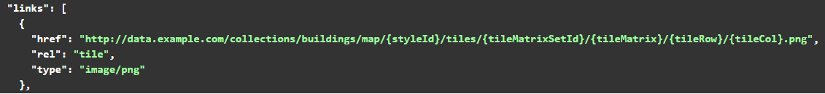
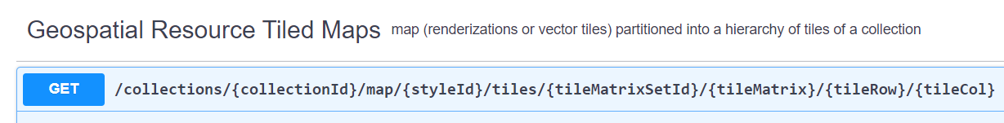
Tilesets
Tilesets are represented by URI templates both in OGC API Tiles (and in the old WMTS) and in the MapML
OGC API
WebMercatorQuad
<title>tiles form USGS<title>
<extent units="OSMTILE">
<input name="tilematrix" type="zoom" value="15" min="0" max="15">
<input name="tileRow" type="location" units="tilematrix" axis="row">
<input name="tileCol" type="location" units="tilematrix" axis="column">
<link rel="tile" tref="https://.../tiles/WebMercatorQuad/{tileMatrix}/{tileRow}/{tileCol}/">
</extent>
MapML

Slide 11
OGC API Tiles and Maps
MapML need tiles but it does not specify who will produce them
An API conformant to OGC API Tiles can generate tiles for a MapML.
OpenAPI and MapML will share the same URL template
MapML does not specify how to produce a MApML document
In OGC API - Tiles
Collections can be distributed as tiles.
Tiles are available as URI template
There is a tileset metadata document
MapML is a kind of tileset metadata document
New feature in OGC API Tiles

Slide 12
OGC API Tiles
GET
/ (landing page)
Provides the conformance and API description pages
/conformance
List of conformance classes supported by the implementation
/api
The API definition. Currently only in OpenAPI 3.0
/collections
The list of geospatial data in the API
/collections/{collectionId}
A geospatial data [description]
/collections/{collectionId}/tiles
List of tilesset (one for each TileMatrixSet) in the collection
GET
GET
GET
GET
GET

Slide 13
OGC API Tiles
/collections/{collectionId}/tiles/{TileMatrixSetId}
Returns a JSON file describing the tileset.
It provides a bit of metadata
It points to the TileMatrixSet definition
It states TileMatrixSetLimits
It points to the tile URI template
It provides a description of the content of the tiles

Slide 14
OGC API Tiles
\collections\{collectionId}\tiles\{TileMatrixSetId}
Returns a JSON file describing the tileset.
It provides a bit of metadata
It points to the TileMatrixSet definition
It states TileMatrixSetLimits
It points to the tile URI template
It provides a description of the content of the tiles
A MapML document is actually another way of describing a tileset.
<title>tiles form USGS<title>
<extent units="OSMTILE">
<input name="z" type="zoom" value="15" min="0" max="15">
<input name="y" type="location" units="tilematrix" axis="row">
<input name="x" type="location" units="tilematrix" axis="column">
<link rel="tile" tref="https://.../tile/{z}/{y}/{x}/">
</extent>

Slide 15
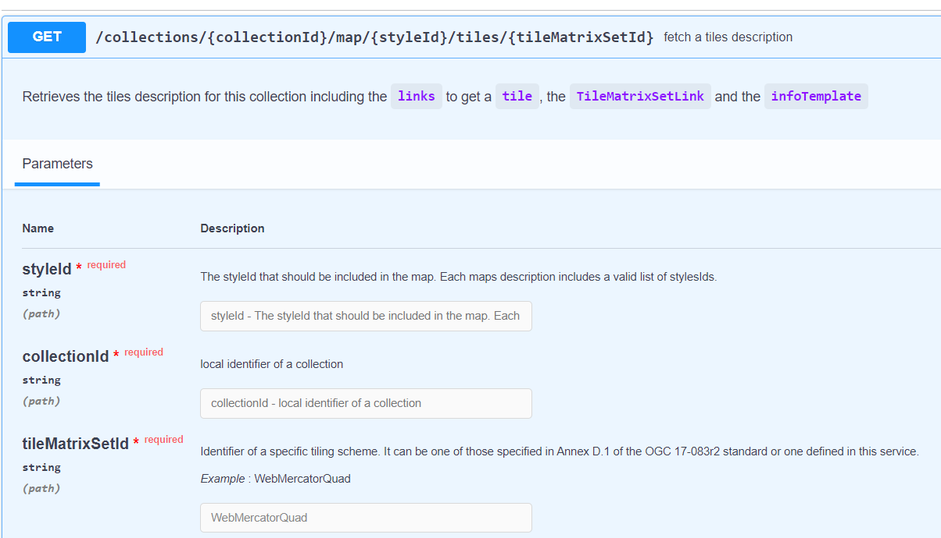
OpenAPI for OGC API Tiles with a MapML

Slide 16
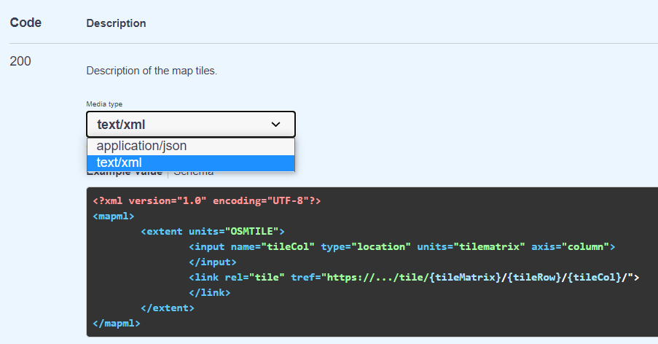
OpenAPI for OGC API Tiles with a MapML

Slide 17
Conclusions
MapML is the simplest way of adding geospatial information in web browsers
MapML makes the use of OGC API - Tiles simpler in browsers
It provides a way to communicate two resources (tileset and tile URI template) of the OGC API - Tiles to browsers
OGC API - Tiles provides a way to automatically generate MapML documents that are connected to the OGC API tilesets
OGC API – Tiles is the CGI of the MapML documents.
OGC should consider to describe how to generate MapML documents in the OGC API – Tiles, part 1
as an alternative format for a tileset metadata (as in OGC 2D TMS standard).
another alternative format considered is TileJSON (for "mapbox vector tiles")

Slide 18
JoanMaso@uab.cat

