Slide 1
How GeoPose Aligns with Web Map Use Cases and Requirements
Christine Perey (PEREY Research & Consulting) and Josh Lieberman (OGC)
September 29, 2020

Slide 2
Agenda
Duration | Item
5 min | What is (and is not) GeoPose
7 min | Alignment to Web Map Use Cases & Requirements
3 min | New Use Cases and Next Steps

Slide 3
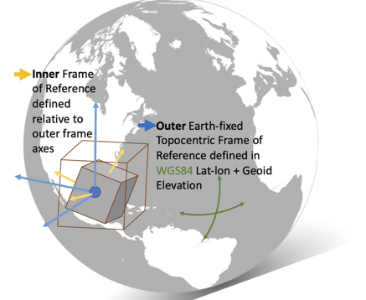
What is GeoPose?
Pose: (Cartesian) Frame relative position + orientation (6DOF)
GeoPose: Pose with (ultimate) geocentric frame of reference
Frame graph: collection of frames of reference connected by poses into a graph.
Fundamentally 3D but relevant to placing objects (real, virtual, symbolic) into 2D projections such as maps
Frames can be fixed to feature orientations, to feature perspectives, or to observer viewpoints

Slide 4
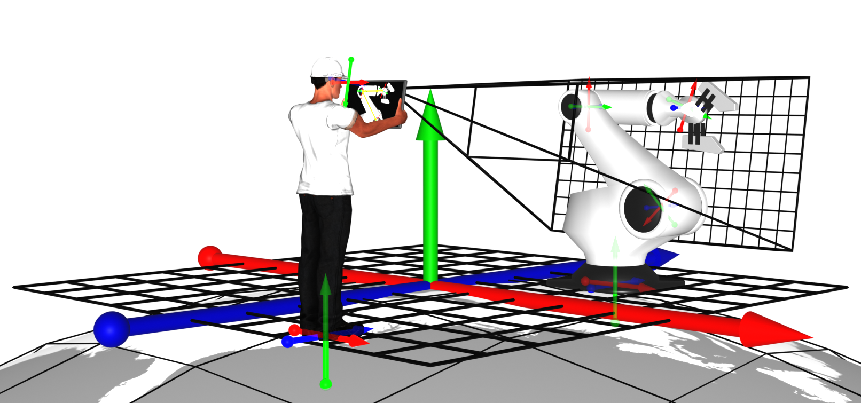
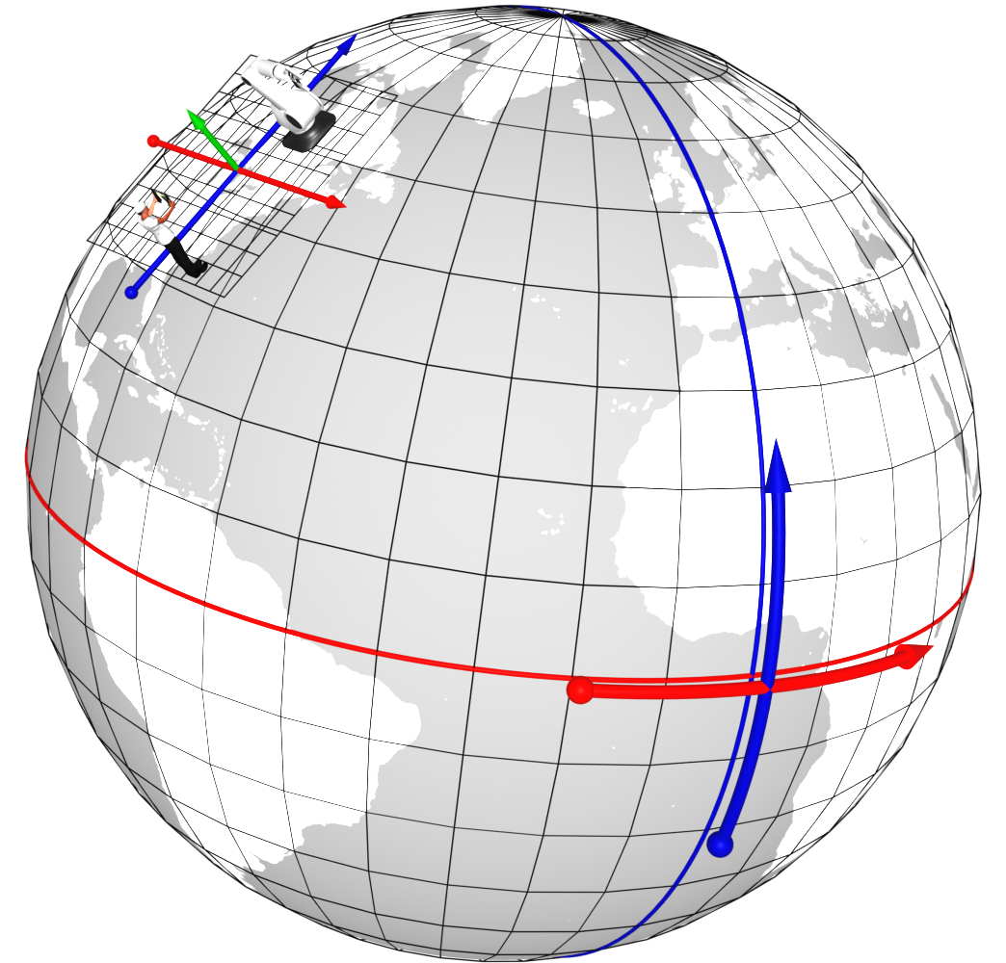
3D Requirements and Use Cases
GeoPose and the capabilities that can use it are fundamentally 3D

Slide 5

Web Map Target Actors
Publish
Web Site Visitors
Content Authors
Application Developers
https://maps4html.org/HTML-Map-Element-UseCases-Requirements/

Slide 6
Content Author Use Cases
 | Use Case | GeoPose role
3.1.1 | Display an Interactive map within a web page
3.1.2 | Display a map centered on a point location | Map oriented and/or scaled to user’s viewpoint
3.1.3 | Display a region of map data as a static image
3.1.4 | Display multiple point locations as map markers
3.1.6 | Display routes/paths or regions | 2/3D posed route indicators
3.1.6 | Display custom web content describing map features | 2/3D content posed with respect to the map
3.1.7 | Display custom imagery as a map layer
3.1.8 | Combine multiple layers of map tile data or features | Layers of 2/3D objects
3.1.9 | Provide alternative map layers which the user can select
3.1.10 | Display drawings or schematics without geographic coordinates
3.1.11 | Include animated spatial data in a layer | Insert and maintain position + orientation in 6 DOF
3.1.12 | Require interaction before allowing pan/zoom (or opt-out of such potentially default behavior)

Slide 7
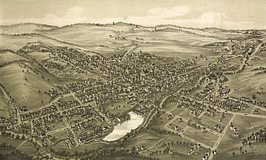
GeoPose-Assisted Creator Paradigm
Position content in a map
Position a map according to user viewpoint
Assemble a map layer from diverse features
Insert and/or track animated or moving objects in a map

Slide 8
Web Site Visitor Use Cases
 | Use Case | With GeoPose
3.2.1 | Reposition or scale a map to find more context for the displayed locations | Track user viewpoint
3.2.2 | Reset the map to the initial view
3.2.3 | Rotate a map, or reset the bearing | Track user viewpoint or feature perspective
3.2.4 | Access additional information about a point on the map | Add more detailed object (3D)
3.2.6 | Show/hide map layers or feature sets
3.2.6 | Bookmark a location | With 2.5/3D view perspective
3.2.7 | Search or sort within a set of geographic features | Distinguish elevation or perspective
3.2.8 | Customize the color scheme (light/dark or high contrast)
3.2.9 | View the current location on a map, without disclosing to the website
3.2.10 | View a map in fullscreen mode
3.2.11 | View a map as a Picture-In-Picture media object
3.2.12 | View a map in Augmented Reality | 6DoF map scene perspective
3.2.13 | Save map content for offline use | Store object positioning

Slide 9

GeoPose-Assisted Viewer Paradigm
Orient & scale map to my viewpoint
Retrieve & view detailed objects for points of interest
Filter content by 6DoF positioning
Save objects offline with 6DoF positioning

Slide 10
Application Developer Use Cases
 | Use Case | With GeoPose
3.3.1 | Add a custom control to a map
3.3.2 | Provide feedback to a user as they manipulate the map | Map plane extent positioning in user viewpoint
3.3.3 | Move a map to a new position and/or zoom level | In 2.5/3D
3.3.4 | Animate a map through a sequence of points | In 2.5/3D using a GeoPose sequence
3.3.6 | Change the bearing of a map | Relative to 2.5/3D user viewpoint
3.3.6 | Control which layers are currently visible & which can be hidden by the user
3.3.7 | Generate new vector features from data | 6 DoF feature positioning from GeoPose
3.3.8 | Generate a heatmap overlay from point intensity data
3.3.9 | Enable drag & drop for map layers | Of (geo)posed 2.5/3D features

Slide 11
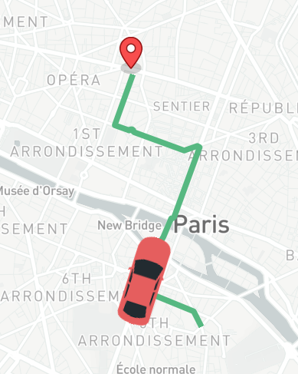
GeoPose-Assisted Developer Paradigm
Leverage user GeoPose for map plane and extent positioning
GeoPose sequences for animation of map positioning
Generate new features from data including GeoPoses
Drag and drop GeoPosed features
New: drag and drop GeoPoses to reposition / animate map features.

Slide 12
Functional Requirements
Rendering Base Layers
Vector Features and Overlays
Interpreting Locations and Map Positions
User Navigation

Slide 13
Rendering Base Layers
 | Capabilities | With GeoPose
5.1.1 | Embed an interactive map viewer, using HTML markup
5.1.2 | Generate a default map for a given area | In 2.5/3D
5.1.3 | Display an image file as a map layer | Positioned as a swath
5.1.4 | Display a map using tile data from an author-specified web map service
5.1.6 | Display a basic map without JavaScript
5.1.6 | Display map content in a users preferred language

Slide 14
Vector Features and Overlays
 | Capabilities | With GeoPose
5.2.1 | Show pinpoint locations or custom markers on the map | 6 DoF marker positioning
5.2.2 | Draw polygons or polylines as stylable, interactive vector graphic
5.2.3 | Support hyperlinks from markers or vector features
5.2.4 | Display a map using tile data from an author-specified web map service | In 2.5/3D

Slide 15
Interpreting Locations and Map Positions
 | Capabilities | With GeoPose
5.3.1 | Select map view from latitude and longitude point | Including 6DoF orientation
5.3.2 | Select map view from street address or place name | Including 6DoF orientation
5.3.3 | Display map tiles defined in various common coordinate systems | In 2.5/3D
5.3.4 | Reproject map tile data into a new projection or globe view | In 2.5/3D

Slide 16
User Navigation
 | Use Case | With GeoPose
5.4.1 | Zoom the map independently from the rest of the page
5.4.2 | Pan the map display
5.4.3 | Load additional map tiles when they pan into view | User viewpoint in 6DOF
5.4.4 | Wrap/duplicate data tiles when panning around the globe
5.4.6 | Maintain reasonable scale of labels and lines when zooming
5.4.6 | Dynamically load different resolution map tile on zoom
5.4.7 | Hide or show (and maybe dynamically load) vector features and labels on zoom

Slide 17
Summary
GeoPose can address and extend many Web Map use cases and requirements
GeoPose can also support new Web Map use cases
Maps can leverage GeoPose to position, orient, and scale maps to user viewpoints
Content Authors can publish sets and layers of objects with 6DoF symbol orientation defined by GeoPoses
Visitors with devices that meet requirements can experience maps and objects corresponding to their viewpoints, optionally in 3D
Developers can
Create animations with GeoPose sequences of map viewpoints or mapped object positions.
Implement drag and drop of GeoPosed data to add oriented objects to a map view or re-orient objects already within the view

Slide 18
Questions?
18

