Slide 1

SQL workshop
Overview of SQL
Recap/intro of the UK Biobank duckDB
Practice exercises using SQL
(command line on a dummy database)

Slide 2
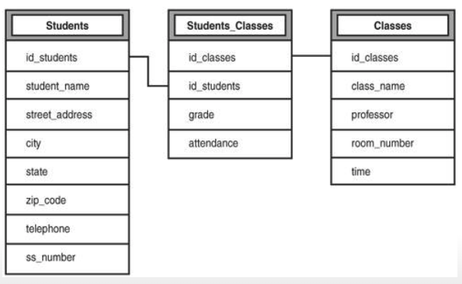
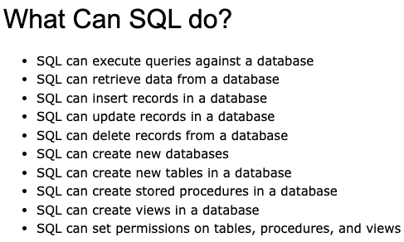
SQL Introduction
Structured Query Language
Allows you to access and manipulate relational databases
Different types of SQL:
Eg. MySQL, SQL Server, MS Access, Oracle
Some SQL synataxes can vary between these different types of database systems
https://www.w3schools.com/sql/

Slide 3
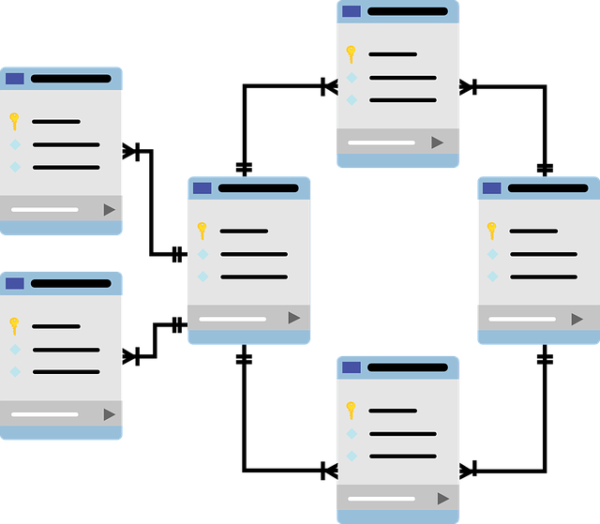
The aim
Relational databases are more memory efficient when you have lots of data
We can query different tables to extract the specific data we need for our analysis into a flat table

Slide 4
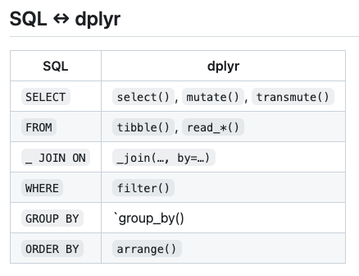
How to query the database
https://www.w3schools.com/sql/
SELECT
SELECT DISTINCT
WHERE
ORDER BY
GROUP BY
INNER JOIN, LEFT JOIN, RIGHT JOIN, FULL JOIN, SELF JOIN
https://github.com/ccbs-stradl/coding_club/blob/main/Sessions/2023_04_05_ukb_duckdb.md

Slide 5
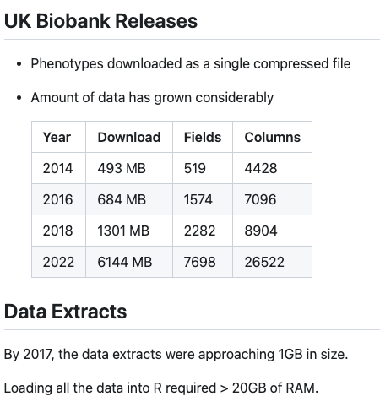
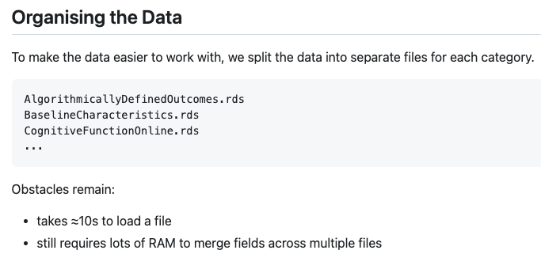
UK Biobank duckdb
Created by Dr Mark Adams: https://github.com/ccbs-stradl/coding_club/blob/main/Sessions/2023_04_05_ukb_duckdb.md

Slide 6
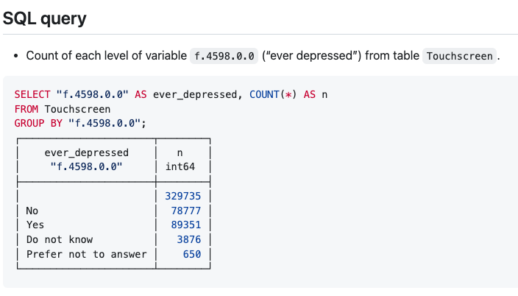
UK Biobank duckdb
Created by Dr Mark Adams: https://github.com/ccbs-stradl/coding_club/blob/main/Sessions/2023_04_05_ukb_duckdb.md

Slide 7
Intro to sql Exercises
https://www.sql-practice.com/
I’ll share my screen and we can work through a few examples together so you can see what SQL queries look like in the command line.
Next session we can try this with the UKB DuckDB to make tables useful for your analyses
By next session:
Practice some SQL exercises to get a feel for the main functions used
Try and connect to the UKB duckDB (ask for help if stuck or you want a group zoom call for this)
Other coding practice exercises resources:
https://www.codewars.com
https://www.hackerrank.com

