Slide 1
GitHub: Collaboration and Code Review
KT Coding Club
28 Oct 2020

Slide 2
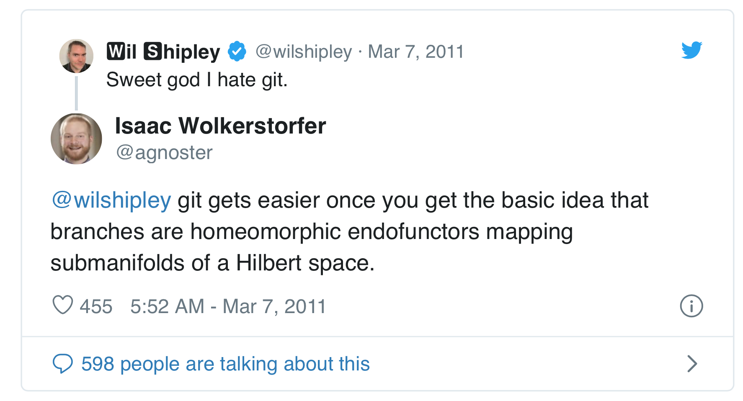
Notes:
Funny tweet based on the classic monad joke

Slide 3


Grasping git
A "repository" is a linked series of content changes ("commits")
Each commit is identified with a cryptographic hash (hexadecimal) of changes and a reference to the commit it was based off ("parent")
Commit: 96120d18
Commit: bd9720b
Commit: 86733075
file1.R
file1.R
file1.R
file2.R
First commit adds file1.R
Second commit adds and deletes lines in file1.R
Third commit adds lines to file1.R and adds file2.R
Notes:
Each commit contains only the content changes that were made at that time and a reference to the previous version (arrows point from child commit to parent commit).

Slide 4





Example git session
$ git clone user@remote.server:repository-name.git
$ git add analysis.R
$ git commit –m 'Fix bug'
$ git add analysis.R helper.R
$ git commit –m 'Helper functions in external file"
$ git rm helper.R
$ git commit –m 'Replace helper functions with package"
$ git push
Remote
repository
[“origin”]
(E.g., on GitHub)
96120d18
bd9720b8
6152e1c9
Dfddcf3e
4c5f0569
clone
push
Local
repository
(E.g., on laptop)
Working copy
.git
analysis.R
helper.R
Stage (index)
4c5f0569
dfddcf3e
6152e1c9
bd9720b8
96120d18
analysis.R
helper.R
helper.R
analysis.R
helper.R
analysis.R
analysis.R
analysis.R
helper.R
"Replace…"
"Helper functions…"
"Fix bug"
"Create model"
"Data munging"
Notes:
Example of what is happening under the hood. When a repository is copied (cloned) a directory is contained with the most recent version of each file. The local copy also contains a hidden folder called “.git” containing the internal data structure git uses to record and manage the history of the repository. “Staging” changes gets them ready to be part of the next commit. All commits are private until shared back to the cloud (“pushed”).

Slide 5
Branching and merging
$ git add file1.R
$ git branch NewIdea
$ git add file1.R; git commit -m "add lines"
$ git checkout NewIdea
$ git add file1.R; git commit –m "remove lines"
$ git checkout master
$ git merge NewIdea
96120d18
d5ae2e0b
86733075
file1.R
file1.R
file1.R
branch: master
branch: NewIdea
bd9720b
file1.R
Notes:
The power of branching. Branching lets you try alternative changes and then merge or discard them later. The default branch is called “master”. Here we create another branch called “NewIdea”. The “git branch” command creates a new branch, but it does not update the working copy. So the first “add” command is committed to the master branch. “git checkout” command updates the working copy with the last commit on the specified branch. We then make a new commit then switch back to the master branch. Finally, we merge the changes from the NewIdea branch into the master branch.

Slide 6
Merge conflicts
Git will automatically merge changes unless the same part of a file has two different sets of edits
Git will tell you which file has the conflict
Conflicting sections will be wrapped in <<<<<<< >>>>>>> symbols
Manually edit the file to resolve the changes, then git add file.txt git commit -m “message”
<<<<<<< BRANCH_A:file.txt CHANGES FROM BRANCH_A ======= CHANGES FROM BRANCH_B >>>>>>> BRANCH_B:file.txt
Notes:
Handling merge conflicts, when two parts of the same file have been changed by different commits that need to be merged together. The conflicting portions of each file will be surrounded in less than/greater than symbols. Manually resolve the conflict and then “git add …; git commit” the file.

Slide 7
Command | Description
git clone user@remote.server:repository-name.git | Make a local copy of a repository
git status | Compare state of working copy to last commit
git diff | Display changes in working copy against last commit
git add file1 file2 | Add changes to the staging area
git add -i | Modify the staging index
git rm file1 | Stage a file for removal
git mv file1 fileOne | Rename a tracked file
git commit –m “Description of changes” | Commit staged changes to the repository
git push | Send changes to a remote copy
git pull | Receive changes from a remote copy
git branch topic | Create a new branch
git checkout topic | Set the working copy to a branch or previous commit
git merge topic | Merge specified branch with the currently checked-out branch
Learn more: Free “Pro Git” book https://git-scm.com/book/en/v2
Notes:
A list of the most common git commands.

