Slide 1

KT Coding Club
Brief introductory meeting
30/09/2020 2pm

Slide 2
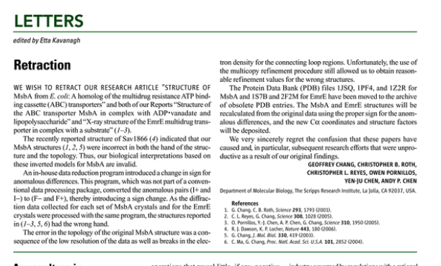
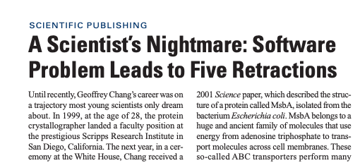
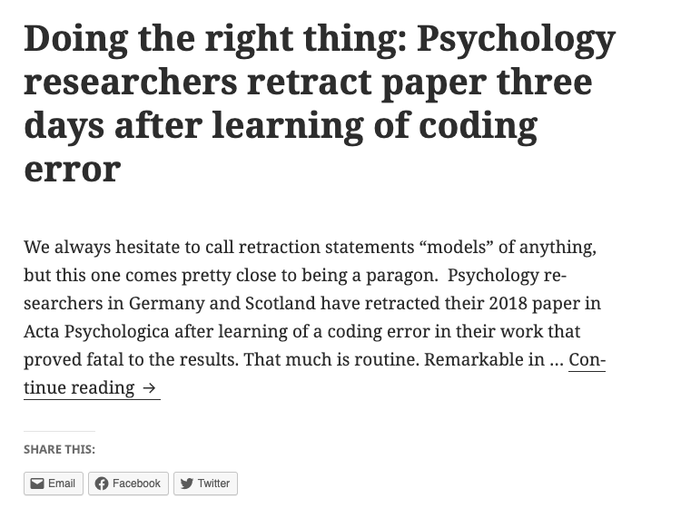
Why should we care?
Notes:
Most researchers aren’t really taught the skills for research computing.
In general, there’s a difference between the way software developers code in industry, which is quite standardised, compared to academia, where we just code to get our results.

Slide 3
What can we do?
Having tidy data, systematic naming in place etc.
Documentation navigating datasets eg. DataStore
README files
Commenting your code
Use of automatic versioning, eg. Git, Github.
Independent code review
Use of containers/Conda environments for easier replication

Slide 4
How can we learn these things?
Through a coding club…
Benefit from different skills and abilities in the group.
One person solving something and sharing it saves time.
Tackling problems together is less daunting.

Slide 5
This should be group directed… - What do you all want to get out of it? - What skills/topics do you want to focus on? - How do you think this group would best work for you? - When and how often shall we meet? - Buddy system for code review?

