Slide 1
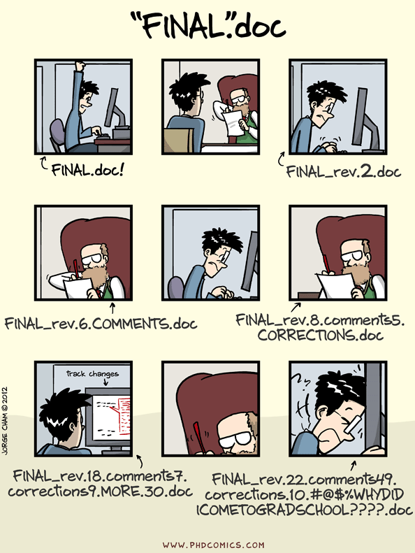
Coding Club March 2024 git and GitHub

Slide 2
What is git and GitHub
Git is a version control software
GitHub is a platform for hosting your git tracked project/repository

Slide 3
Plan for today
Show a few example of github repos form our group eg. https://github.com/AmeliaES/ALSPAC_inflam_2022
Walk through what I do when I start a new project/create a new repo including:
Show you what the .gitignore file is for
Do a demo of the git work flow I use (using the terminal):
Git pull
Make some changes to code
Git commit
Git push
If there’s time I’ll show you how to do branches too..

Slide 4
Resources
Github cheat sheet: https://education.github.com/git-cheat-sheet-education.pdf
https://docs.github.com/en/get-started/start-your-journey/git-and-github-learning-resources
Info about git branches: https://www.nobledesktop.com/learn/git/git-branches

