Slide 1





Workshop understanding synthpop session2 find course material at https://blogs.ed.ac.uk/graab/workshop/
Gillian M Raab
University of Edinburgh
Administrative Data Research Centre - Scotland
EU meeting Feb 2024

Slide 2
High fidelity
c
Not an aim of today’s course
To find an introduction to this go to
https://blogs.ed.ac.uk/graab/idpln
And download slides and other stuff
Today I will just talk you though it and answer questions
There is also a very short file high_fidelity.R that you can look at later

Slide 3
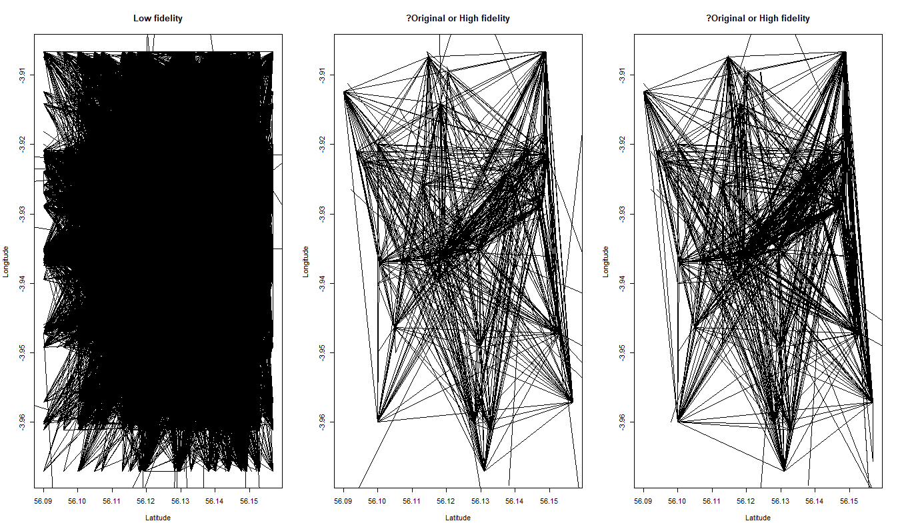
Can you tell the difference

