Slide 1





Workshop understanding synthpop session2 find course material at https://blogs.ed.ac.uk/graab/workshop/
Gillian M Raab
University of Edinburgh
Administrative Data Research Centre - Scotland
EU meeting Feb 2024

Slide 2
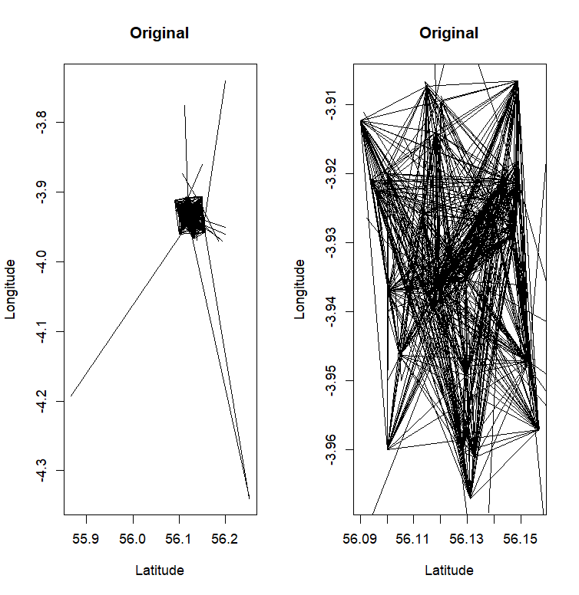
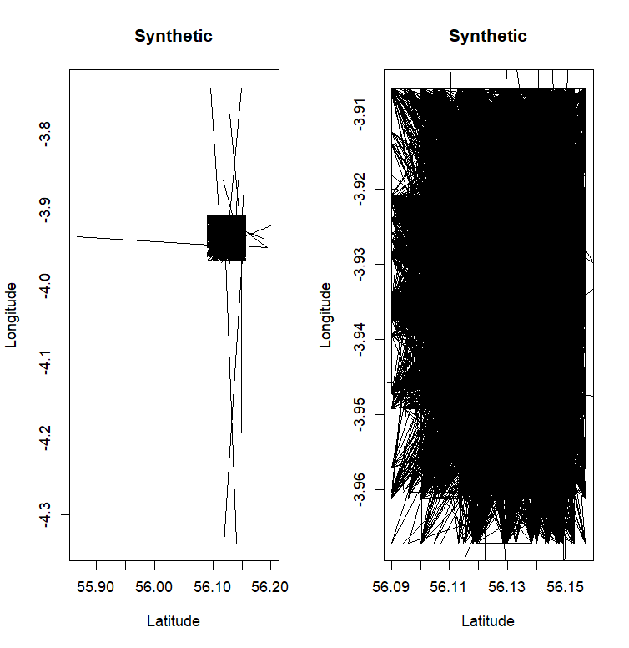
Low fidelity only one way tables

Slide 3
More Low fidelity
c
What you can do with it:
Export the data
Assess utility (3 functions)
Statistical disclosure control (sdc)
Adds labels to show not real
Remove replicated uniques
Top and/or bottom coding
Smoothing
Write.syn(syn1, “syn1”,”csv”)
utility.tables(syn1,bike1)
newSynObject <- sdc(syn1,bike1,….)
Parameters of sdc
Label = “Not real data”
rm.replicated.uniques = TRUE
Recode.vars = “dur_minutes” bottom.top.coding = c(NA,7)
Smooth.vars = “dur_minutes”

