Slide 1





Workshop understanding synthpop find course material at https://blogs.ed.ac.uk/graab/workshop/
Gillian M Raab
University of Edinburgh
Administrative Data Research Centre - Scotland
EU meeting Feb 2024

Slide 2
Workshop aims
To use synthpop to create a low-fidelity synthetic data set
To understand some of the components of the synthetic data object (Of class synds) created by the function syn()
To learn about some of the parameters of the function syn() for creating synthetic data
To get general advice on using synthpop to create synthetic data and the difficulties some data sets may pose.

Slide 3
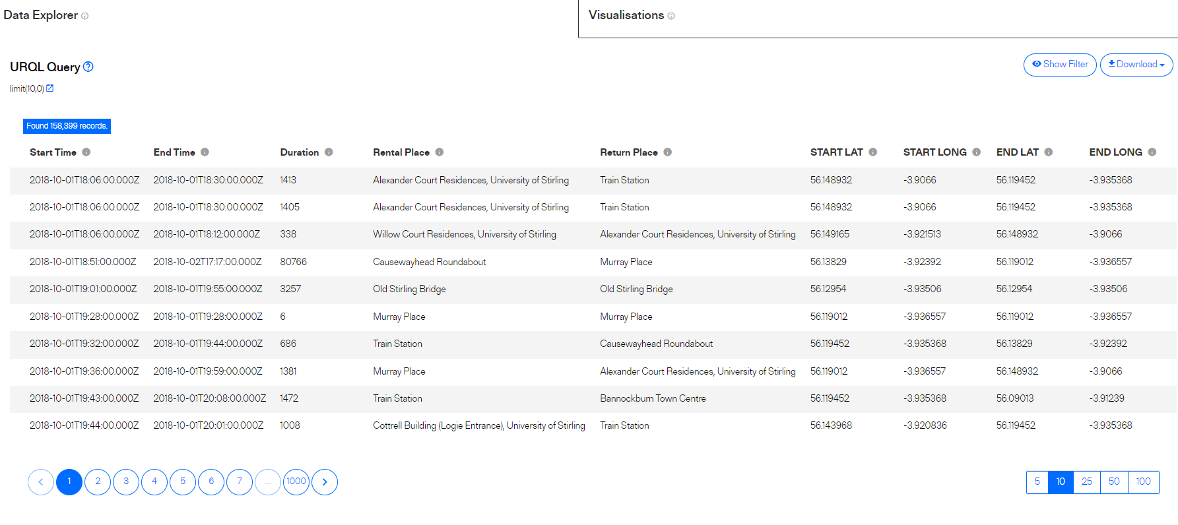
Data set – bike hire in Stirling 2018-2023
https://usmart.io/org/cyclingscotland/discovery/discovery-view-detail/bc613ae3-3325-4f19-92b0-d03
f68459200

Slide 4
A little R recap
c
All R objects have a class for example:
class(1:5)
[1] "integer“
class(c("A","B"))
[1] "character"
An important class of object is a list
> L <- list(int = 1:5,char = c("A","B"));L
$int
[1] 1 2 3 4 5
$char
[1] "A" "B"
> L[[2]]
[1] "A" "B“
Lists allow different classes of objects to be combined
The function codebook.syn(data) gives a list with one or more components. The first is a table $tab with information about variables in data:
The first component is the table of variable types and later components are labels for any variables where the list of labels is too long to fit in the table
To see only the table do
codebook.syn(data)$tab or
codebook.syn(data)[[1]]

Slide 5
Getting and examining data file bike1
Download and save bike1 from https://blogs.ed.ac.uk/graab/workshop/
Load into R and explore a little
How many records?
How many variables?
Explore it a bit to understand the variables
Make the synthpop package available [library(synthpop)]
Use the function [codebook.syn()]to summarise things that matter for synthpop – check the help file. You will want the $tab component

Slide 6
Now create your low fidelity synthetic data
Use the method “sample” for all variables
Remember to include a value for seed so you can get it again
Save it as a named object and summarise it e.g.
mysyn <- syn(bike1, method =“sample”, seed =123)
summary(mysyn)
Now use the compare function to get univariate comparisons
compare(mysyn, bike1)
BREAK HERE FOR FEEDBACK AND TO BRING GROUP TOGETHER

Slide 7
Understanding your synthetic data object
Mysyn is a synthetic data object (class synds)
Functions like print, summary, compare recognise that it is a synds object and apply the appropriate method
A synds object is a list of many components (see help file for syn)
> names(syn1)
[1] "call" "m" "syn" "method"
[5] "visit.sequence" "predictor.matrix" "smoothing" "event"
[9] "denom" "proper" "n" "k"
[13] "rules" "rvalues" "cont.na" "semicont"
[17] "drop.not.used" "drop.pred.only" "models" "seed"
[21] "var.lab" "val.lab" "obs.vars" "numtocat"
[25] "catgroups"

Slide 8
Look at a few important ones
"call"
"m"
"syn"
"method"
"visit.sequence"
"predictor.matrix“
“n"
“k"
Use the help file and/or examine the components of your synds object

