Slide 1
Art assets!
By Amelia

Slide 2
Main slime sprites

Slide 6
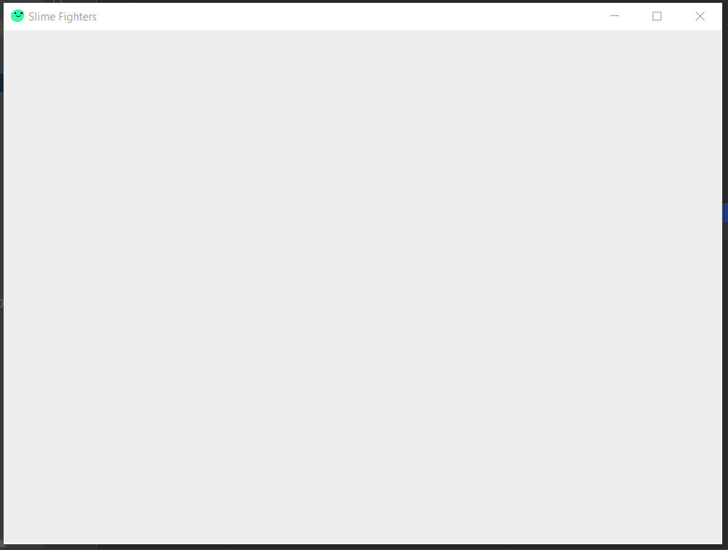
Notes:
Room design

Slide 7
Notes:
Outside design

