Slide 1
Art assets!
By Amelia

Slide 2


Slide 3


Main slime sprites

Slide 4



Slide 6
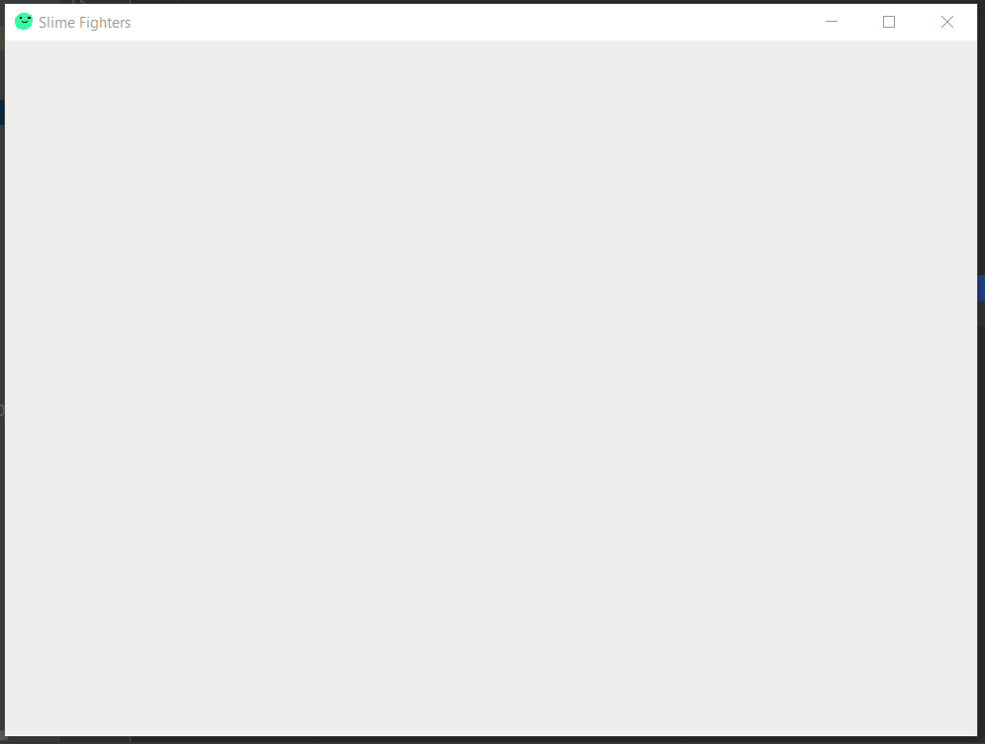
Notes:
Room design

Slide 8



Home
Notes:
Outside design

Slide 9
Home

Slide 10


Slide 11



Path 1

Slide 12

Path 2

Slide 13

Path 3

Slide 14
Path 4

Slide 15

Path 5

Slide 18




