Slide 1
Art assets!
By Amelia

Slide 2


Slide 3
Slime sprites

Slide 4


Main slime sprites

Slide 5



Slide 7
Home and town

Slide 8
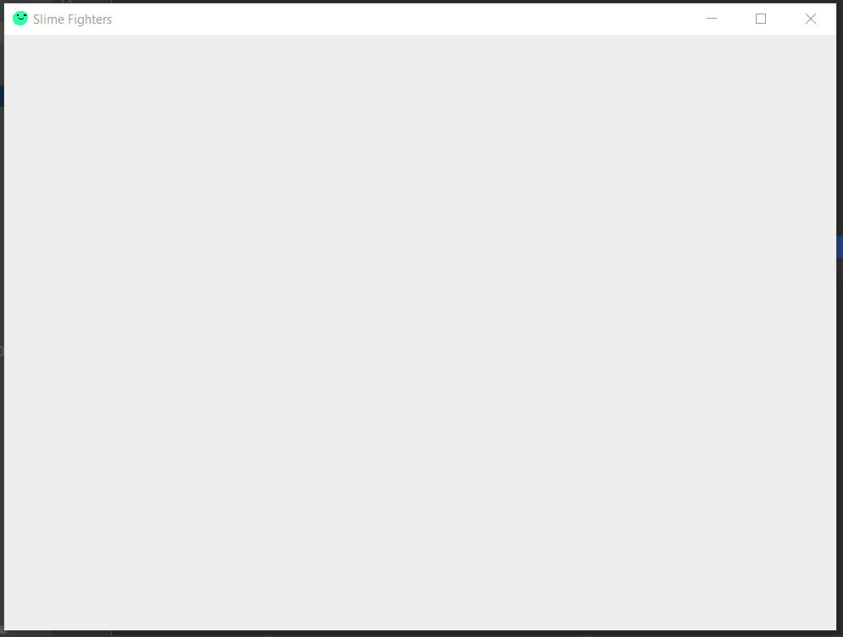
Notes:
Room design

Slide 9


Slide 10



Home
Notes:
Outside design

Slide 11
Home

Slide 12
Adventure locations

Slide 13


Slide 14



Path 1

Slide 15

Path 2

Slide 16

Path 3

Slide 17


Path 4

Slide 18

Path 5

Slide 19





Slide 20



Slide 21
Combat layout

Slide 24




Slide 26
Diary

