Slide 1
Art assets!
By Amelia

Slide 2



Main slime sprites

Slide 3


Slide 6
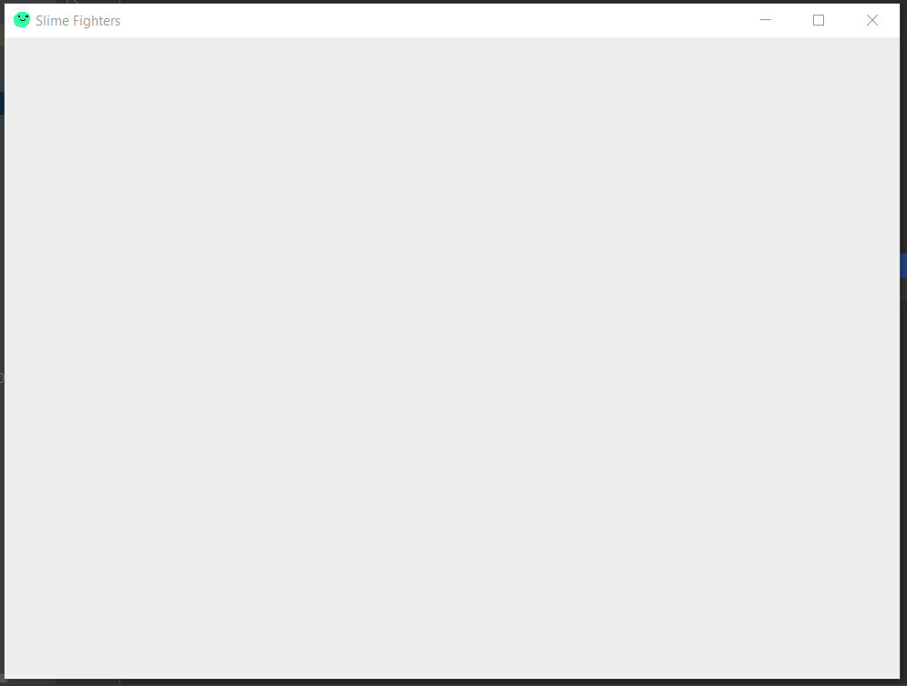
Notes:
Room design

Slide 8



Home
Notes:
Outside design

Slide 9
Home

