Slide 1
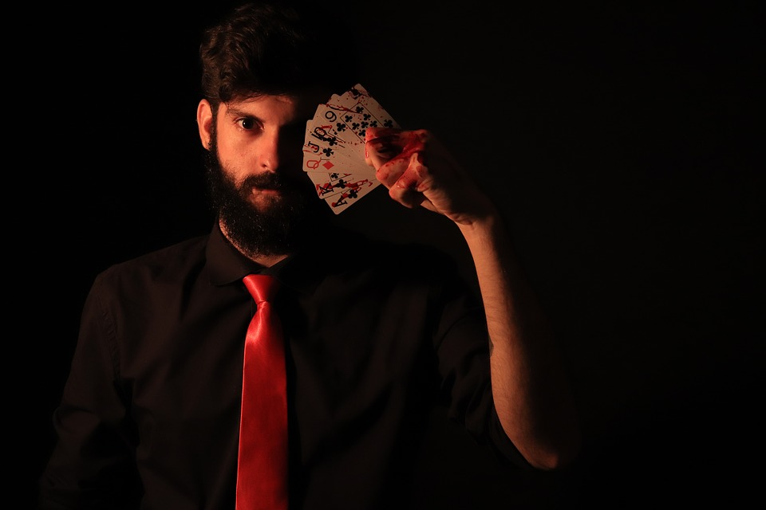
un petit tour de magie ou de sorcellerie...

Slide 2
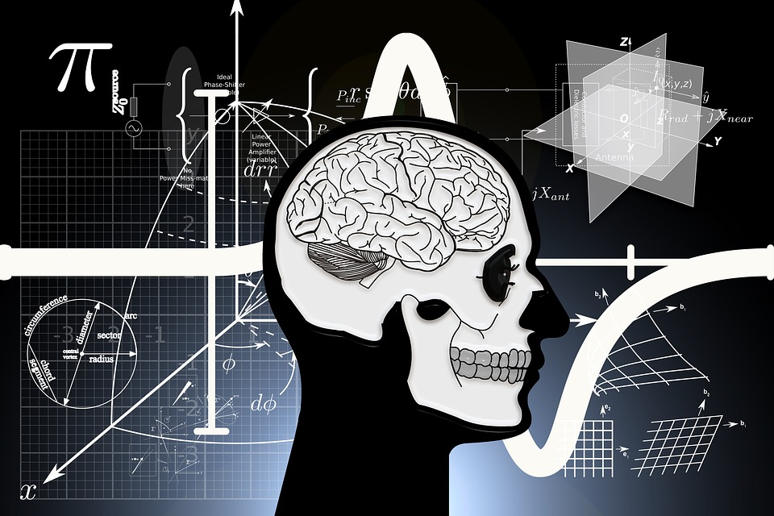
tous vos cerveaux n’ont pas de secret pour moi !

Slide 3
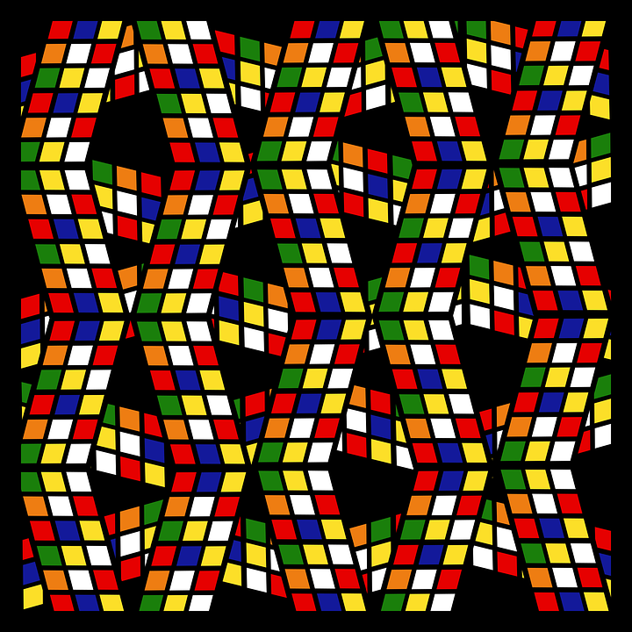

Slide 4
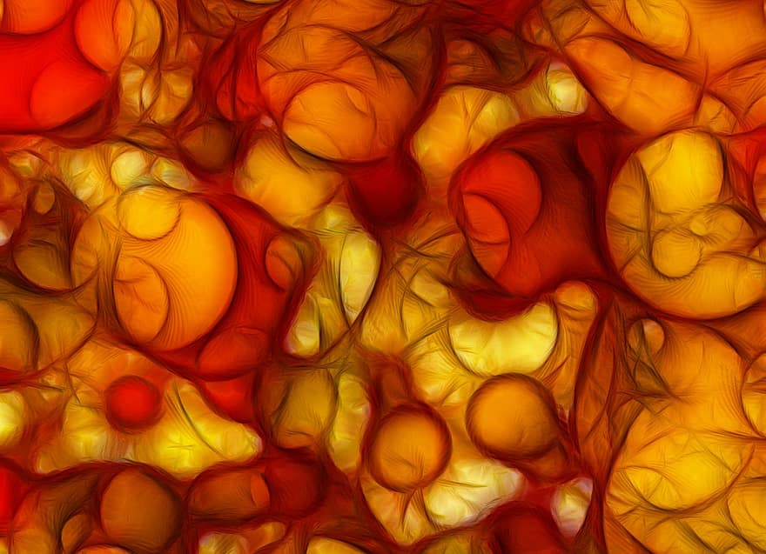
16 | 17 | 18 | 19 | 20 | 21 | 22 | 23
24 | 25 | 26 | 27 | 28 | 29 | 30 | 31
48 | 49 | 50 | 51 | 52 | 53 | 54 | 55
56 | 57 | 58 | 59 | 60 | 61 | 62 | 63

Slide 5

1 | 3 | 5 | 7 | 9 | 11 | 13 | 15
17 | 19 | 21 | 23 | 25 | 27 | 29 | 31
33 | 35 | 37 | 39 | 41 | 43 | 45 | 47
49 | 51 | 53 | 55 | 57 | 59 | 61 | 63

Slide 6

4 | 5 | 6 | 7 | 12 | 13 | 14 | 15
20 | 21 | 22 | 23 | 28 | 29 | 30 | 31
36 | 37 | 38 | 39 | 44 | 45 | 46 | 47
52 | 53 | 54 | 55 | 60 | 61 | 62 | 63

Slide 7

32 | 33 | 34 | 35 | 36 | 37 | 38 | 39
40 | 41 | 42 | 43 | 44 | 45 | 46 | 47
48 | 49 | 50 | 51 | 52 | 53 | 54 | 55
56 | 57 | 58 | 59 | 60 | 61 | 62 | 63

Slide 8

2 | 3 | 6 | 7 | 10 | 11 | 14 | 15
18 | 19 | 22 | 23 | 26 | 27 | 30 | 31
34 | 35 | 38 | 39 | 42 | 43 | 46 | 47
50 | 51 | 54 | 55 | 58 | 59 | 62 | 63

Slide 9

8 | 9 | 10 | 11 | 12 | 13 | 14 | 15
24 | 25 | 26 | 27 | 28 | 29 | 30 | 31
40 | 41 | 42 | 43 | 44 | 45 | 46 | 47
56 | 67 | 58 | 59 | 60 | 61 | 62 | 63

Slide 10
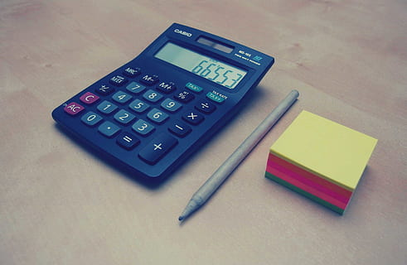
Explication

Slide 11

Base 10

Slide 12
Base 10
Exemple: 403 = 4 × 10² + 0 × 10¹ + 3 × 10⁰

Slide 13
Base 10
Exemple: 403 = 4 × 10² + 0 × 10¹ + 3 × 10⁰
Base 2

Slide 14
Base 10
Exemple: 403 = 4 × 10² + 0 × 10¹ + 3 × 10⁰
Base 2
Exemple: 403 = 1 × 2⁸ + 1 × 2⁷ + 0 × 2⁶ + 0 × 2⁵ + 1 × 2⁴ + 0 × 2³ + 0 × 2² + 1 × 2¹ + 1 × 2⁰

Slide 15
Base 10
Exemple: 403 = 4 × 10² + 0 × 10¹ + 3 × 10⁰
Base 2
Exemple: 403 = 1 × 2⁸ + 1 × 2⁷ + 0 × 2⁶ + 0 × 2⁵ + 1 × 2⁴ + 0 × 2³ + 0 × 2² + 1 × 2¹ + 1 × 2⁰
Donc son écriture en base 2 est 110010011

Slide 16

N | Binaire | 2⁵ = 32 | 2⁴ = 16 | 2³ = 8 | 2² = 4 | 2¹ = 2 | 2⁰ = 1
1 | 1 |  |  |  |  |  | X
2 | 10 |  |  |  |  | X
3 | 11 |  |  |  |  | X | X
4 | 100 |  |  |  | X
5 | 101 |  |  |  | X |  | X
6 | 110 |  |  |  | X | X
7 | 111 |  |  |  | X | X | X

Slide 17
N | Binaire | 2⁵ = 32 | 2⁴ = 16 | 2³ = 8 | 2² = 4 | 2¹ = 2 | 2⁰ = 1
8 | 1000 |  |  | X
9 | 1001 |  |  | X |  |  | X
10 | 1010 |  |  | X |  | X
11 | 1011 |  |  | X |  | X | X
12 | 1100 |  |  | X | X
13 | 1101 |  |  | X | X |  | X
14 | 1110 |  |  | X | X | X

Slide 18
N | Binaire | 2⁵ = 32 | 2⁴ = 16 | 2³ = 8 | 2² = 4 | 2¹ = 2 | 2⁰ = 1
15 | 1111 |  |  | X | X | X | X
16 | 10000 |  | X
17 | 10001 |  | X |  |  |  | X
18 | 10010 |  | X |  |  | X
19 | 10011 |  | X |  |  | X | X
20 | 10100 |  | X |  | X
21 | 10101 |  | X |  | X |  | X

Slide 19
N | Binaire | 2⁵ = 32 | 2⁴ = 16 | 2³ = 8 | 2² = 4 | 2¹ = 2 | 2⁰ = 1
22 | 10110 |  | X |  | X | X
23 | 10111 |  | X |  | X | X | X
24 | 11000 |  | X | X
25 | 11001 |  | X | X |  |  | X
26 | 11010 |  | X | X |  | X
27 | 11011 |  | X | X |  | X | X
28 | 11100 |  | X | X | X

Slide 20
N | Binaire | 2⁵ = 32 | 2⁴ = 16 | 2³ = 8 | 2² = 4 | 2¹ = 2 | 2⁰ = 1
29 | 11101 |  | X | X | X |  | X
30 | 11110 |  | X | X | X | X
31 | 11111 |  | X | X | X | X | X
32 | 10000 | X
33 | 10001 | X |  |  |  |  | X
34 | 10010 | X |  |  |  | X
35 | 10011 | X |  |  |  | X | X

Slide 21
N | Binaire | 2⁵ = 32 | 2⁴ = 16 | 2³ = 8 | 2² = 4 | 2¹ = 2 | 2⁰ = 1
36 | 100100 | X |  |  | X
37 | 100101 | X |  |  | X |  | X
38 | 100110 | X |  |  | X | X
39 | 100111 | X |  |  | X | X | X
40 | 101000 | X |  | X
41 | 101001 | X |  | X |  |  | X
42 | 101010 | X |  | X |  | X

Slide 22
N | Binaire | 2⁵ = 32 | 2⁴ = 16 | 2³ = 8 | 2² = 4 | 2¹ = 2 | 2⁰ = 1
43 | 101011 | X |  | X |  | X | X
44 | 101100 | X |  | X | X
45 | 101101 | X |  | X | X |  | X
46 | 101110 | X |  | X | X | X
47 | 101111 | X |  | X | X | X | X
48 | 110000 | X | X
49 | 110001 | X | X |  |  |  | X

Slide 23
N | Binaire | 2⁵ = 32 | 2⁴ = 16 | 2³ = 8 | 2² = 4 | 2¹ = 2 | 2⁰ = 1
50 | 110010 | X | X |  |  | X
51 | 110011 | X | X |  |  | X | X
52 | 110100 | X | X |  | X
53 | 110101 | X | X |  | X |  | X
54 | 110110 | X | X |  | X | X
55 | 110111 | X | X |  | X | X | X
56 | 111000 | X | X | X

Slide 24
N | Binaire | 2⁵ = 32 | 2⁴ = 16 | 2³ = 8 | 2² = 4 | 2¹ = 2 | 2⁰ = 1
57 | 111001 | X | X | X |  |  | X
58 | 111010 | X | X | X |  | X
59 | 111011 | X | X | X |  | X | X
60 | 111100 | X | X | X | X
61 | 111101 | X | X | X | X |  | X
62 | 111110 | X | X | X | X | X
63 | 111111 | X | X | X | X | X | X

Slide 25


