Slide 1
GROUP ACE
Ismael Kipkoech Scm222-1104/2021- Presenter
Philip Mwasi Scm222-1305/2021- Presenter
Teresa Mitchelle Scm222-0496/2021
Samira Mohamed Scm222-0461/2021
Violet Momanyi Scm222-0532/2021
Predictive Analytics :
HIV Patient Risk Stratification in ART Discontinuation

Slide 2
PROBLEM STATEMENT
To create a model to classify patients into high, medium, or low risk groups using demographic, clinical and behavioral data. This will help health care providers identify patients needing more care, improving health outcomes and resource management.
Main Objectives
Build a risk stratification model to classify into high, medium or low risk categories based on demographic, clinical and behavioral factors.
Identify key risk factors by determining which risk factors most significantly predict patient risk levels.
Derive insights from data by analyzing and interpreting the data to uncover patterns that explain the differences between high, medium, and low risk patients.
Demographic Features | Patient Clinical History | Patient Lateness History | Regimen History
Occupation Gender Age at Enrollment Age at Last minute Marital status | Viral Load ART Adherence Depression Assessment Score(PHQ9 Rating) | Lateness Percentage (no. of times late to all visits) Last 3 Lateness Percentage (no. of times to the last 3 visits) | Start Regimen administered Last Regimen administered

Slide 3
Methodology
Data Visualization
Conducted some visualizations on some variables to understand their behavior and distributions.
Obtained 6 datasets from NDW and applied data cleaning on each. The datasets were merged after cleaning.
Data Preparation
Feature Generation
We engineered 4 features that reflected the patient lateness and clinical history, which were used in machine learning.
Model Building
Deep Learning
The models that were used were RNN & LSTM.
Random forest & KNN were built, but Random-Forest was the best performing model.

Slide 4
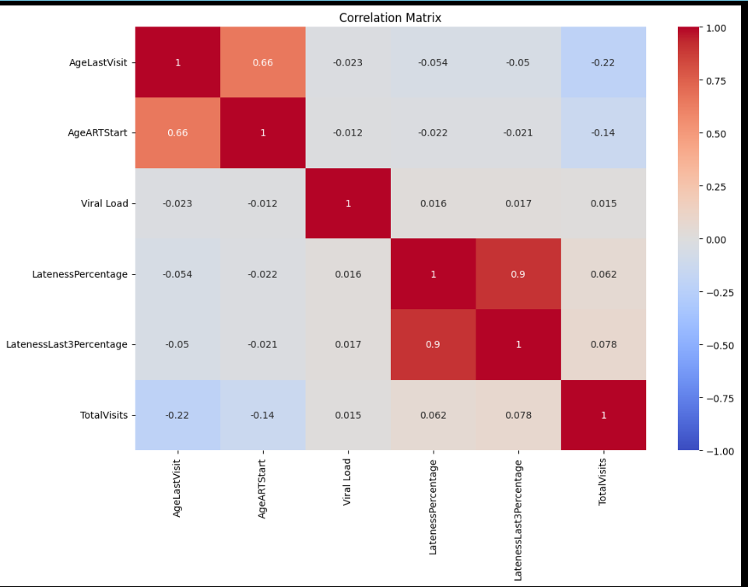

Slide 6
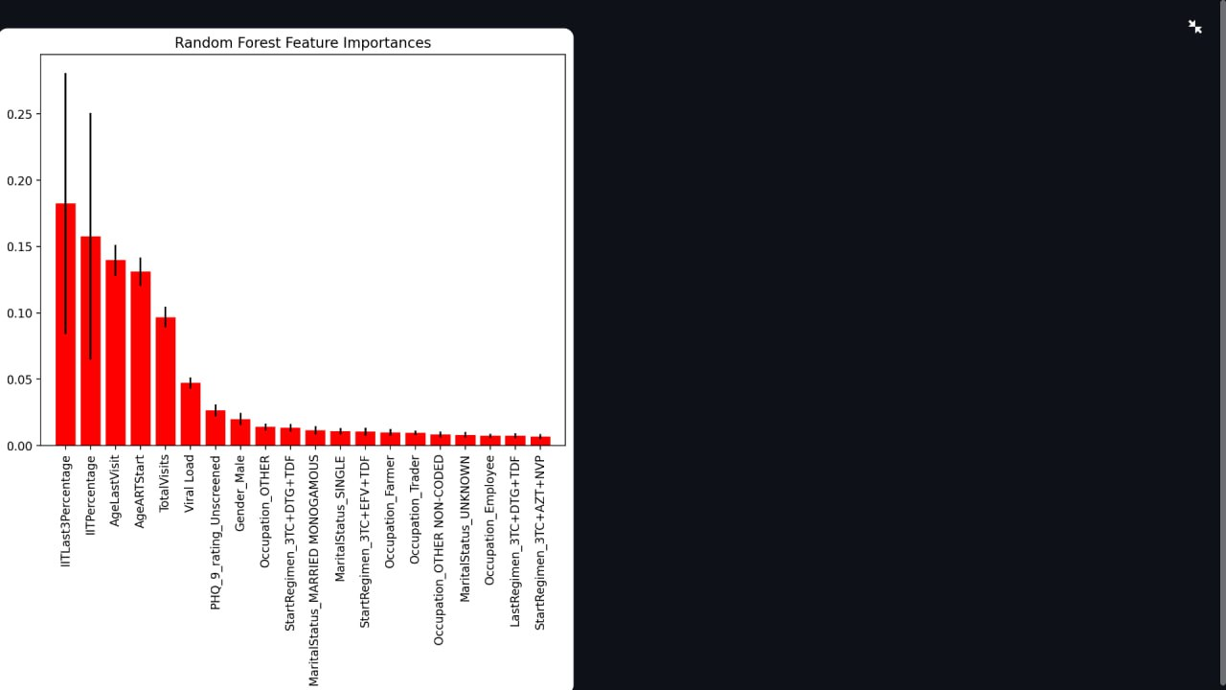
Feature importance

Slide 7
References:
Morillo-Verdugo, R., Martínez-Sesmero, J. M., Lázaro-López, A., Sánchez-Rubio, J., Navarro-Aznárez, H., & deMiguel-Cascón, M. (2017). Development of a risk stratification model for pharmaceutical care in HIV patients. Pharmaceutical Care, 11(2), 120-128. PubMed: https://pubmed.ncbi.nlm.nih.gov/28478749/
[1] Ramachandran, A., Kumar, A., Koenig, H., De Unanue, A., Sung, C., Walsh, J., Schneider, J., Ghani, R., & Ridgway, J. P. (2020). Predictive Analytics for Retention in Care in an Urban HIV Clinic. Scientific Reports, 10(1), 6421. https://www.nature.com/articles/s41598-020-62729-x
Morillo-Verdugo, R., Martínez-Sesmero, J. M., Lázaro-López, A., Sánchez-Rubio, J., Navarro-Aznárez, H., & deMiguel-Cascón, M. (2017). Development of a risk stratification model for pharmaceutical care in HIV patients. Pharmaceutical Care, 11(2), 120-128. https://pubmed.ncbi.nlm.nih.gov/28478749/
[1] Gesesew HA, Ward P, Hajito KW, Feyissa GT, Mohammadi L, Mwanri L. Discontinuation from Antiretroviral Therapy: A Continuing Challenge among Adults in HIV Care in Ethiopia: A Systematic Review and Meta-Analysis. PLoS One. 2017;12(1):e0169651. https://journals.plos.org/plosone/article?id=10.1371/journal.pone.0169651

Slide 8
Bootcamp Experience
It was a wonderful learning experience. We gained so many insights from all the work we got to do as a team, as well as from our mentors.
It was also a great opportunity to tap into our creativity and innovation and come up with ideas on how we could best package our solution.
Having to work alongside other students with diverse and equally brilliant ideas was very enlightening.
We learnt how to efficiently work together as a team, and maximize on individual strengths and skills.
However, one major setback that we encountered, was the communication inconsistencies with the coordinators.

