Slide 1

Comparative Evaluation of Unsupervised Anomaly Detection Algorithms for Structural Health Monitoring Using Real-World Bridge Sensor Data
Amelia Knapik & Marcello Balduccini
Saint Joseph’s University
HAROS 2026

Slide 2
AGENDA
01
Research motivation and question
01 | Add a topic for the presentation
02 | Add a topic for the presentation
03 | Add a topic for the presentation
04 | Add a topic for the presentation
05 | Add a topic for the presentation
02
Bridge data and analysis pipeline
03
Six unsupervised algorithms
04
Results: alignment, runtime and model agreement
05
Video context, conclusions and next steps
Amelia Knapik | Saint Joseph’s University

Slide 3
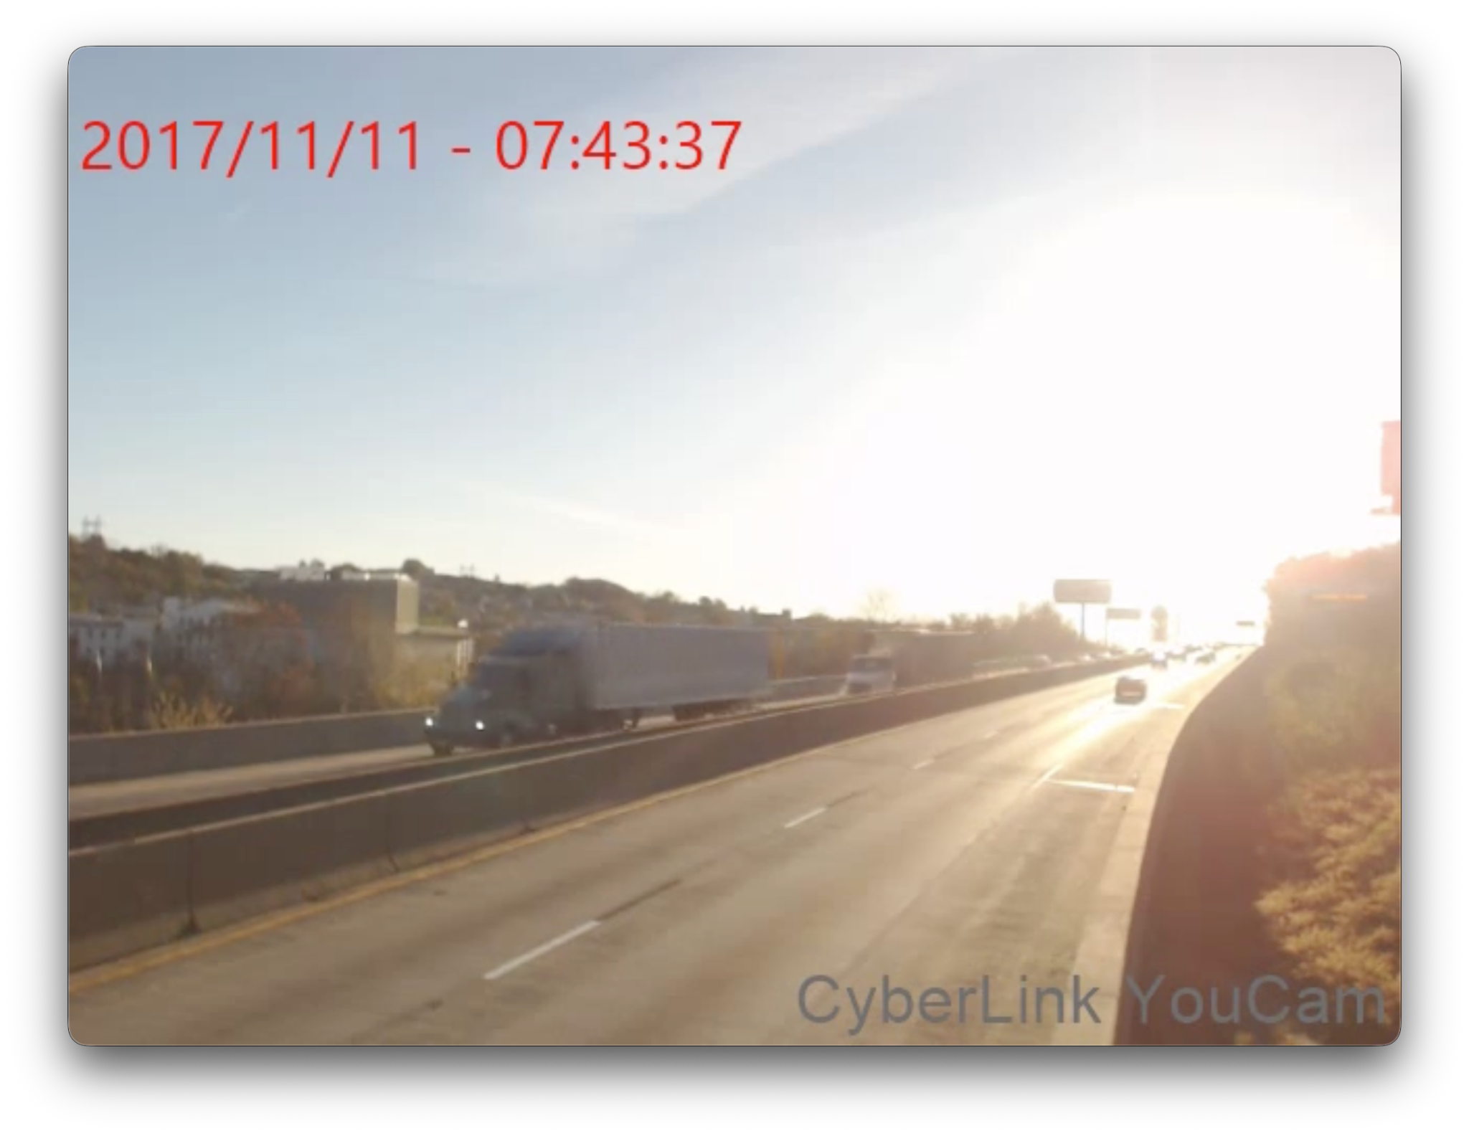
WHY UNSUPERVISED SCREENING FOR BRIDGE MONITORING?
One hour of monitoring produced approximately 1.84 million raw sensor measurements.
Inspection is intermittent
Traditional inspection captures only snapshots of structural behavior.
Screening must be practical
Useful methods should surface unusual responses without excessive computation.
Ground truth is limited
Confirmed examples of damage are rare and require expert validation.
Extreme conditions may be missing from training data
Research question: Which method best balances alignment with sensor-derived events, runtime and screening utility?
Supervised models can become less reliable when weather or operating conditions differ from past labeled examples.
Anomaly flags prioritize engineering review. They do not diagnose structural damage.
Amelia Knapik | Saint Joseph’s University

Slide 4
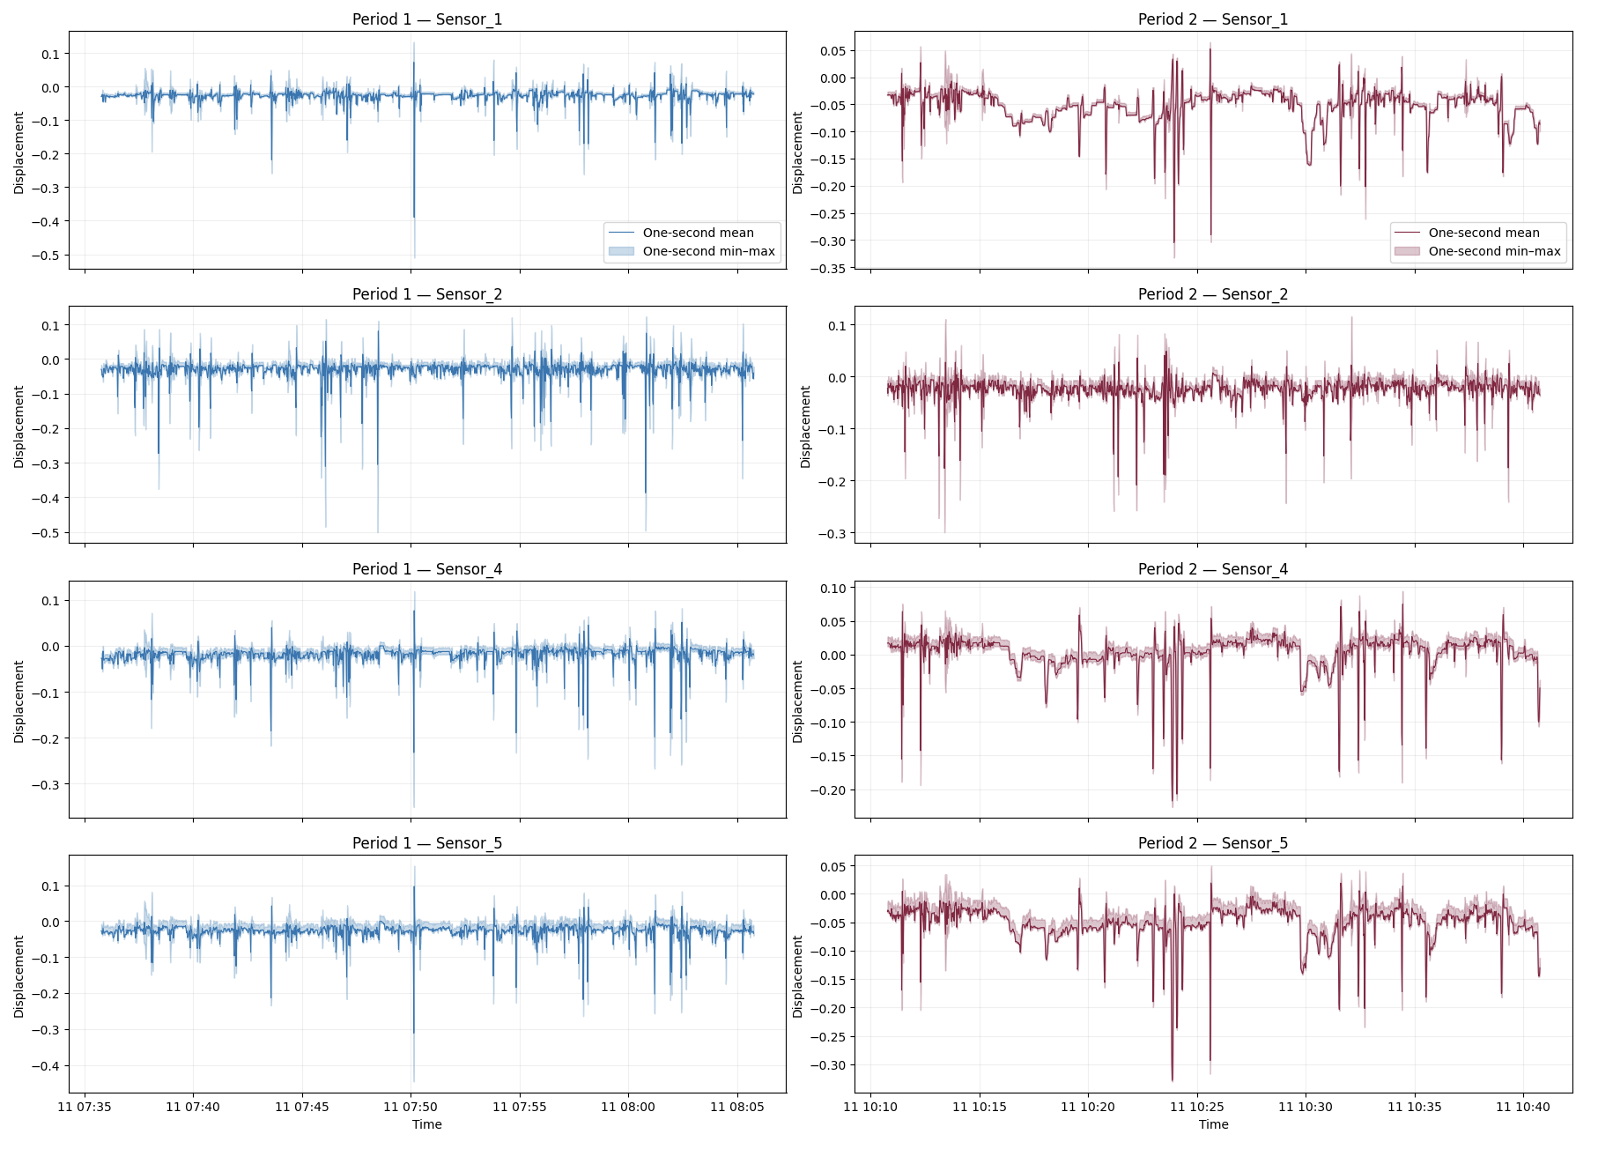
SYNCHRONIZED SENSOR AND VIDEO WINDOWS
4
128 Hz
2 × 30 min
3,600
sensors analyzed: 1, 2, 4 and 5
raw sampling rate
analysis windows
one-second observations
Period 1
07:35:47–08:05:46
Period 2
10:10:47–10:40:46
Video coverage: 07:35:47–12:20:48
One-day proof of concept
Amelia Knapik | Saint Joseph’s University

Slide 5
COMMON ANALYSIS PIPELINE
1
2
3
4
5
Clean
Aggregate
Create features
Scale features
Compare models
Remove the metadata row when present
Convert 128 readings per second into one observation
Calculate five summary statistics for each sensor
Use RobustScaler within each period
Use the same 3,600 × 20 data matrix and 1% anomaly proportion
Controlled comparison: identical input features and anomaly proportion for every model
Amelia Knapik | Saint Joseph’s University

Slide 6
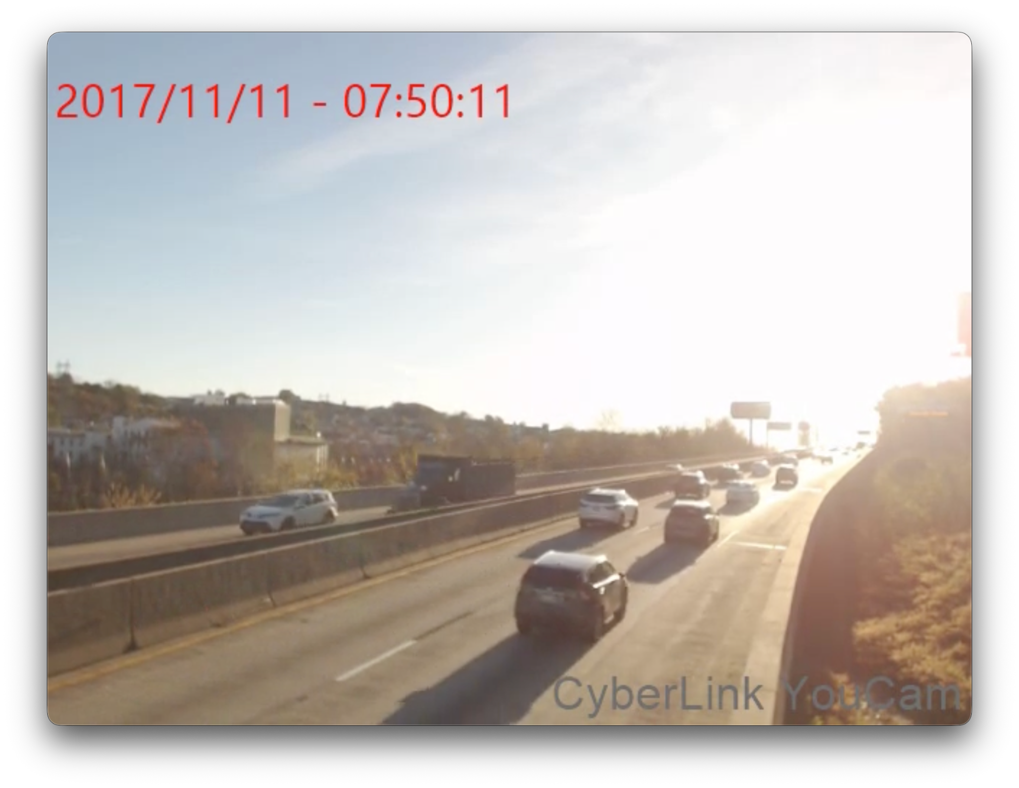
EVALUATION FRAMEWORK WITHOUT DAMAGE LABELS
20
candidate timestamps reviewed
Create reference events
Select the 10 strongest multi-sensor activity peaks per period, separated by at least 10 seconds.
Review physical context
Inspect ±10 seconds of video and annotate vehicle type, count and direction.
Measure model alignment
Count a model match when a flagged second occurs within ±5 seconds of a reference event.
Reference events come from sensor activity. Alignment is descriptive and does not measure accuracy or damage detection.
Amelia Knapik | Saint Joseph’s University

Slide 7
SIX UNSUPERVISED ALGORITHMS COMPARED
Ensemble
Clustering
Distance
Isolation Forest
CBLOF
Sampling
Random partitioning isolates unusual observations
Cluster size and distance define outlier scores
Subsample-based proximity identifies sparse observations
Rotation-based
Neural network
Generative
ROD
Autoencoder
AnoGAN
Robust geometric scoring across rotated views
Reconstruction error measures deviation
Adversarial reconstruction produces anomaly scores
Amelia Knapik | Saint Joseph’s University

Slide 8
AUTOENCODER AND ANOGAN SHOWED THE HIGHEST OBSERVED ALIGNMENT
16/20
combined across both periods
Alignment with sensor-derived events. Independent accuracy and damage detection remain unmeasured.
Autoencoder 80%, AnoGAN 80%, Isolation Forest 70%, CBLOF 70%, Sampling 65%, ROD 55%
Amelia Knapik | Saint Joseph’s University

Slide 9
RUNTIME VARIED BY NEARLY FIVE ORDERS OF MAGNITUDE
Different units: milliseconds at left, seconds at right
Sampling: 9.8 ms
AnoGAN: 6.42 min
Google Colab CPU-only, Intel Xeon 2.20 GHz, 1 physical and 2 logical cores, 12.67 GB RAM
Amelia Knapik | Saint Joseph’s University

Slide 10
MOST FLAGGED SECONDS WERE MODEL-SPECIFIC
94
unique seconds flagged by ≥1 model
2
seconds flagged by all six models
All-six timestamps
07:50:10
10:13:26
Each model flagged 36 seconds. ROD showed the lowest overlap with the other methods.
Amelia Knapik | Saint Joseph’s University

Slide 11
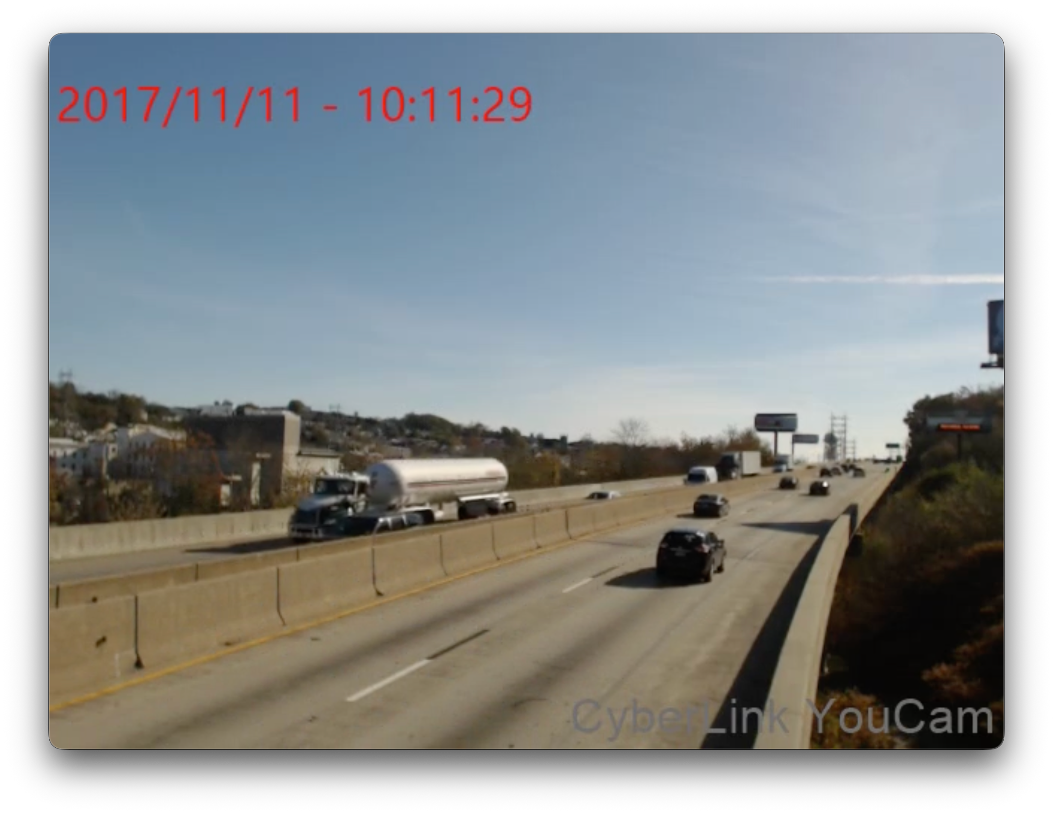
VIDEO CONTEXT FOR REPRESENTATIVE SENSOR EVENTS
Candidate 07:43:36 (frame +1 s)
Candidate 10:11:27 (frame +2 s)
Two heavy trucks visible within the ±10-second review window
Tanker truck visible within the ±10-second review window
Across all 20 video reviews: 19 were annotated as strong heavy-vehicle associations and 1 as a possible association.
Amelia Knapik | Saint Joseph’s University

Slide 12
CONCLUSIONS, LIMITATIONS AND NEXT STEPS
What the current experiment supports
Validation required next
No definitive winner
1
Repeat runtime tests and report median ± spread
Autoencoder had the highest observed alignment at moderate runtime. Isolation Forest was much faster with slightly lower alignment.
2
Review model-selected events beyond the initial 20 candidates
Speed and alignment must be considered together
Sampling was fastest. AnoGAN matched the top alignment but required the longest runtime.
3
Test additional days and quantify weather-related variability
Algorithms prioritize different seconds
4
Separate traffic-induced events from possible sensor artifacts
Low complete agreement shows the value of comparing rankings, not only fixed flag counts.
5
Use independent labels for damage claims and accuracy metrics such as AUC
Results support unsupervised event prioritization for engineering review. Damage diagnosis and a final model ranking require independent labels and broader testing.
Amelia Knapik | Saint Joseph’s University

Slide 13

Thank you!
Are there any questions?

