Slide 1
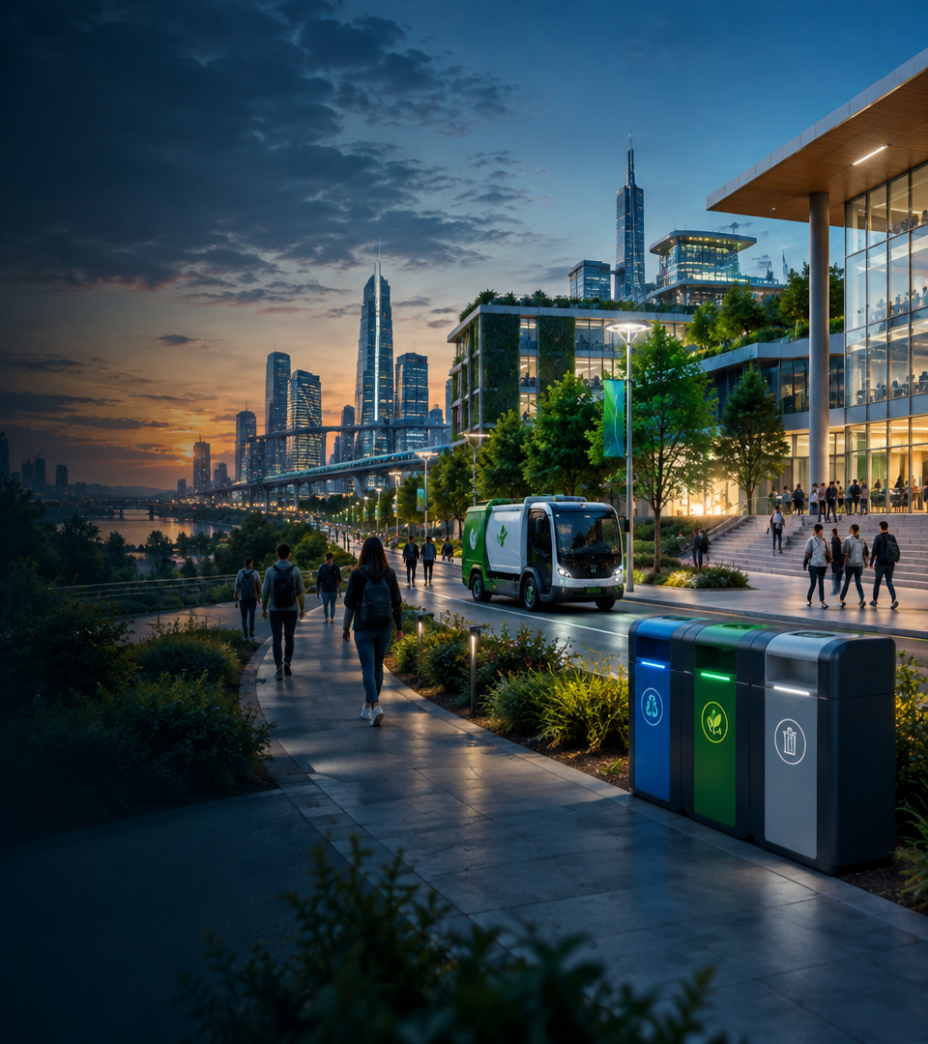
SmartWaste
Smart City Waste &
Recycling Manager
Yasmine mahfoudh Amen bahri Youssef zaiem Med abdallah

Slide 2


THE PROJECT
The problem: cities collect on a schedule, waste happens in real time
Overflowing bins, wrong routes
01
Trucks follow fixed schedules, not real needs. Full bins wait while half-empty bins are visited.
Slow, scattered reporting
02
Citizens have no simple way to report a broken or full bin. Problems stay for days.
No live feedback loop
03
Nobody is warned in time, and good recycling is rewarded too late. People stop taking part.
Our goal: close the gap between what happens in the street, what citizens do, and what the collection teams know.

Slide 3
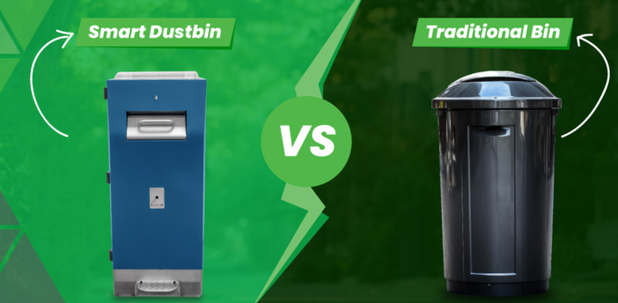
THE PROJECT
Our solution: one platform, five independent services
SmartWaste is a centralized platform that connects citizens, garbage trucks, smart recycling bins and city administrators.
MONITOR
PLAN
Smart bins send their fill level, so we always know which bins are full.
Pickup routes are built from real data, not from a fixed calendar.
Expected benefits
  Cleaner public spaces
  Fewer unnecessary collection trips
  Better recycling participation
  Faster incident resolution
  Better use of city resources
ENGAGE
NOTIFY
Citizens report incidents with a photo and earn eco-points.
Real-time alerts reach the right person at the right time.

Slide 4
MAIN FEATURES
Main features for each actor
Each feature is provided by one microservice (MS1 to MS5).
CITIZEN
DRIVER
ADMINISTRATOR
Register and log in MS1
Manage profile MS1
Find smart bins MS2
Report an incident with a photo MS4
Earn and view eco-points MS1
Receive notifications MS5
View assigned pickup routes MS3
Update route status MS3
See smart bins and fill level MS2
Receive alerts MS5
Manage users, award points MS1
Manage smart bins and types MS2
Monitor bin fill levels MS2
Manage trucks and routes MS3
Review incident reports MS4
Monitor system alerts MS5
For everyone: secure login (Keycloak + JWT), one entry point (API Gateway) and real-time notifications.

Slide 5
ACTORS AND GENERAL USE CASE
General use case diagram: who does what
Three actors. The colour of each use case shows which microservice provides it.
SmartWaste system
Manage profile
Every actor logs in first (Keycloak).
Manage users
View points and rewards
Award eco-points
View smart bins
«include»
Manage smart bins and types
Submit incident report
Upload photo
Citizen
Receive notifications
Monitor bin fill levels
Manage routes and trucks
Administrator
View assigned routes
Colour = microservice
MS1 Identity
MS2 Bin Asset
Manage incident reports
Update route status
MS3 Fleet
View smart bins
MS4 Incidents
Monitor system alerts
Driver
MS5 Alerts
All users have to be authenticated
Receive notifications

Slide 6
MICROSERVICES
Five services, one responsibility each
Split by business capability, not by database table or by screen.
MS1
MS2
MS3
MS4
MS5
Identity & Rewards
Smart Bin Asset
Fleet & Routing
Incident Reporting
Real-Time Alerts
RESPONSIBILITIES
RESPONSIBILITIES
RESPONSIBILITIES
RESPONSIBILITIES
RESPONSIBILITIES
  Register, log in, profile
  User roles
  Eco-points and rewards
  Bin location and capacity
  Fill level
  Bin types
  Garbage trucks
  Pickup routes
  Route status
  Citizen reports + photo
  Report status
  Announces new reports
  Listens to events
  Creates alerts
  Notifies users by role
OWNS
OWNS
OWNS
OWNS
OWNS
User, RewardHistory
SmartBin, BinType
GarbageTruck, PickupRoute
IncidentReport
Alert
DATABASE
DATABASE
DATABASE
DATABASE
DATABASE
PostgreSQL
MongoDB
PostgreSQL
MongoDB
H2
Publishes BinFullEvent
Consumes BinFullEvent
Publishes IncidentReportedEvent
Consumes IncidentReportedEvent
MS5 is our advanced-technology service: event-driven and real-time, built on RabbitMQ.

Slide 7
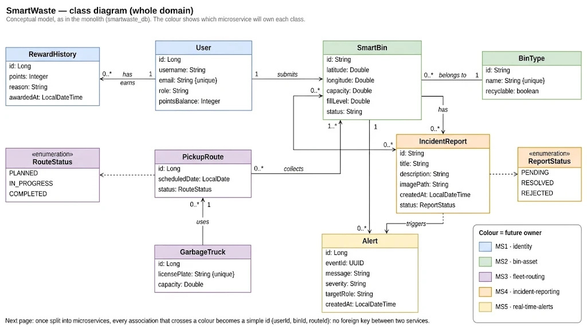

Slide 8
TECHNOLOGIES
The chosen technologies
Each choice matches the required microservices stack.
BACKEND
SPRING CLOUD
SECURITY
Java · Spring Boot
Gateway · Eureka · Config · OpenFeign
Keycloak · OAuth2 · JWT
REST APIs, one Spring Boot project per microservice.
Entry point, discovery, central config and service-to-service calls.
Login, roles and signed tokens checked by the gateway.
MESSAGING
DATABASES
FRONT AND DEVOPS
RabbitMQ
PostgreSQL · MongoDB · H2
Angular / React · Flutter · Docker · Git
Asynchronous events through the exchange smartwaste.events.
One database per service, chosen for the data.
Web and mobile apps, containers, version control.

Slide 9
ARCHITECTURE
The building blocks, explained simply
Each block solves one problem of a microservices system.
API Gateway
Keycloak
Eureka Server
The single front door.
The identity provider.
The phone book.
Routes each request to the right service and checks the JWT. Services are never exposed directly.
Handles login and gives a signed JWT with the user’s role (citizen, driver, admin).
Services register with their name. Others find them by name, not by fixed address.
Config Server
RabbitMQ
Docker Compose
The settings office.
The post office.
The container manager.
Gives each service its configuration at start-up from one Git repository (config-repo).
Carries asynchronous events (BinFullEvent, IncidentReportedEvent) from a publisher to its consumers.
Starts every service in its own container, on one private network (smartwaste-net).

Slide 10
DATA
One database per service, chosen for the job
No shared database: a service can only read another service’s data through its API or an event.
Service | Database | Why this choice | Data it owns
MS1 Identity | PostgreSQL | Structured, linked data (users, points). Points must always be exact: relational tables and transactions. | User, RewardHistory
MS2 Bin Asset | MongoDB | Bins have flexible data (location, sensors) and frequent fill-level updates: a document store fits. | SmartBin, BinType
MS3 Fleet | PostgreSQL | Trucks, routes and statuses are clearly related: relational tables keep them consistent. | GarbageTruck, PickupRoute
MS4 Incidents | MongoDB | A report is one self-contained document (text, photo path, status). Easy to add fields later. | IncidentReport
MS5 Alerts | H2 | Alerts are simple and short-lived: a light database is enough and starts fast. | Alert
One database per microservice
No shared tables, no foreign key between services
Other services get data by API call or by event
1
2
3

Slide 11
ARCHITECTURE
Communication: five flows, two modes
Numbers match the arrows on the architecture diagram.
# | From → To | Mode | What is exchanged | Why this mode
1 | MS4 → MS1 | Sync · OpenFeign | GET /api/users/{id}: does the reporter exist? | The answer is needed before saving the report
2 | MS4 → MS2 | Sync · OpenFeign | GET /api/bins/{id}: does the bin exist? | Same: do not save a report about a missing bin
3 | MS3 → MS2 | Sync · OpenFeign | GET /api/bins/{id}: bin location and capacity | Route planning needs the data right now
4 | MS2 → MS3 | Async · RabbitMQ | BinFullEvent: bin id, location, fill level | MS2 must not wait for MS3
5 | MS4 → MS5 | Async · RabbitMQ | IncidentReportedEvent: report id, bin, title, date | Alerts must not slow down the citizen
Synchronous = a phone call
The caller waits for the answer. If the other service is down: timeout, then a fallback (the report is saved as PENDING).
Asynchronous = a letter
The sender drops the message and continues. If the consumer is down: the message waits in the queue and nothing is lost.

Slide 12
ARCHITECTURE
Security: login once, check every request
Keycloak issues the pass (JWT). The gateway checks it.
1
Log in
2
Get a token
3
Call the API
4
Check the token
5
Forward
The user signs in on Keycloak from the web or mobile app.
Keycloak returns a JWT: a signed digital pass that contains the user’s role.
The app sends every request to the gateway with the JWT.
The gateway verifies the signature with Keycloak’s public keys. Invalid: 401.
If valid, the gateway routes the request to the right service.
CITIZEN
DRIVER
ADMINISTRATOR
Key rules
Report incidents, see own points and notifications
See assigned routes, update route status
Manage users, bins, routes, reports and alerts
  Only the gateway is public
  Services stay in a private network
  No token: 401. Wrong role: 403

Slide 13
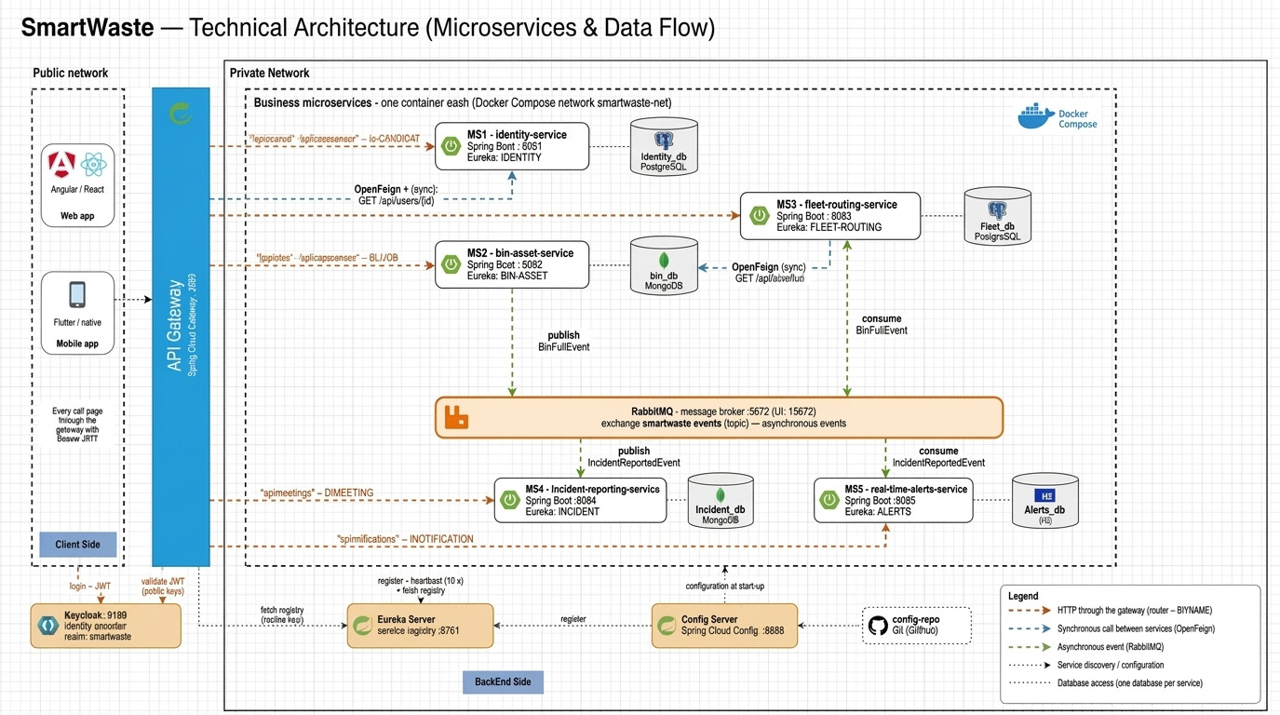

Slide 14
NEXT
Now: each member presents a microservice
Design (class diagram), interactions and API contract for each service.
MS1
MS2
MS3
MS4
MS5
Identity & Rewards
Smart Bin Asset
Fleet & Routing
Incident Reporting
Real-Time Alerts

Slide 15
MS1: Identity & Rewards

Slide 16
MS1 · IDENTITY & REWARDS
MS1: scope and work plan
RESPONSIBILITIES
OWNS
DATABASE
  Register, log in, profile
  User roles
  Eco-points and rewards
User, RewardHistory
MYSQL
WORK PLAN
1
2
3
4
5
Data model
Auth
Profile and rewards
Events
Tests and docs
User and RewardHistory tables
Register, login, roles
User and reward-history endpoints
Consume IncidentResolvedEvent, award points
Unit tests, API contract

Slide 17
MS1 · IDENTITY & REWARDS
Class diagram
User
RewardHistory
id: Long
username: String
email: String {unique}
role: String
pointsBalance: Integer
id: Long
points: Integer
reason: String
awardedAt: LocalDateTime
1
0..*
has / earns
Interactions with other services
User.id is stored as a plain userId in MS4 (IncidentReport): no foreign key crosses services. Sync: MS4 calls MS1 over REST to validate a userId. Async: MS1 listens for an incident-resolved event from MS4 and awards eco-points.

Slide 18
MS1 · IDENTITY & REWARDS
API contracts
Method | Endpoint | Response codes | Purpose
POST | /api/auth/register | 201, 400, 409 | Create an account
POST | /api/auth/login | 200, 401 | Authenticate, return token
GET | /api/users/{id} | 200, 404 | Read profile and balance
PUT | /api/users/{id} | 200, 400, 404 | Update profile
GET | /api/users/{id}/rewards | 200, 404 | List RewardHistory
POST | /api/users/{id}/points | 200, 400, 404 | Award points (internal)
Events
Consumes IncidentResolvedEvent (from MS4): creates a RewardHistory entry and increments pointsBalance in one transaction. Duplicate events are ignored by eventId.

Slide 19
MS2: Smart Bin Asset

Slide 20
MS2 · SMART BIN ASSET
MS2: scope and work plan
RESPONSIBILITIES
OWNS
DATABASE
  Bin location and capacity
  Fill level
  Bin types
SmartBin, BinType
MongoDB
WORK PLAN
1
2
3
4
5
Data model
Bin CRUD
Fill level
Events
Tests and docs
SmartBin and BinType collections
Bins and bin types endpoints
PATCH fill-level with validation
Publish BinFullEvent at threshold
Unit tests, API contract

Slide 21
MS2 · SMART BIN ASSET
Class diagram
BinType
SmartBin
id: String
name: String {unique}
recyclable: boolean
1
0..*
id: String
latitude: Double
longitude: Double
capacity: Double
fillLevel: Double
status: String
belongs to
Interactions with other services
SmartBin.id is stored as binId in MS3 (PickupRoute) and MS4 (IncidentReport). Sync: MS3 and MS4 call MS2 over REST to check a bin. Async: MS2 publishes BinFullEvent when fillLevel crosses the threshold.

Slide 22
MS2 · SMART BIN ASSET
API contracts
Method | Endpoint | Response codes | Purpose
POST | /api/bins | 201, 400, 404 | Register a bin
GET | /api/bins | 200 | List bins (filter by type, status)
GET | /api/bins/{id} | 200, 404 | Read one bin
PATCH | /api/bins/{id}/fill-level | 200, 400, 404 | Update fill level, may emit event
GET | /api/bin-types | 200 | List bin types
POST | /api/bin-types | 201, 400, 409 | Create a bin type
Events
Publishes BinFullEvent {eventId, binId, fillLevel, occurredAt} when fillLevel reaches the threshold. Consumed by MS5 (alerts) and MS3 (routing).

Slide 23
COMMUNICATION
Synchronous vs asynchronous
MS1 Identity
MS4 Incidents
MS2 Smart Bin
MS3 Fleet
MS5 Alerts
Solid line: REST (sync). Dashed line: event (async).
Sync: MS4 validates userId (MS1) and binId (MS2) over REST.
Async: MS2 publishes BinFullEvent to MS3 and MS5. MS4 emits IncidentResolvedEvent, MS1 awards points.

Slide 24
MS3: Fleet & Routing

Slide 25
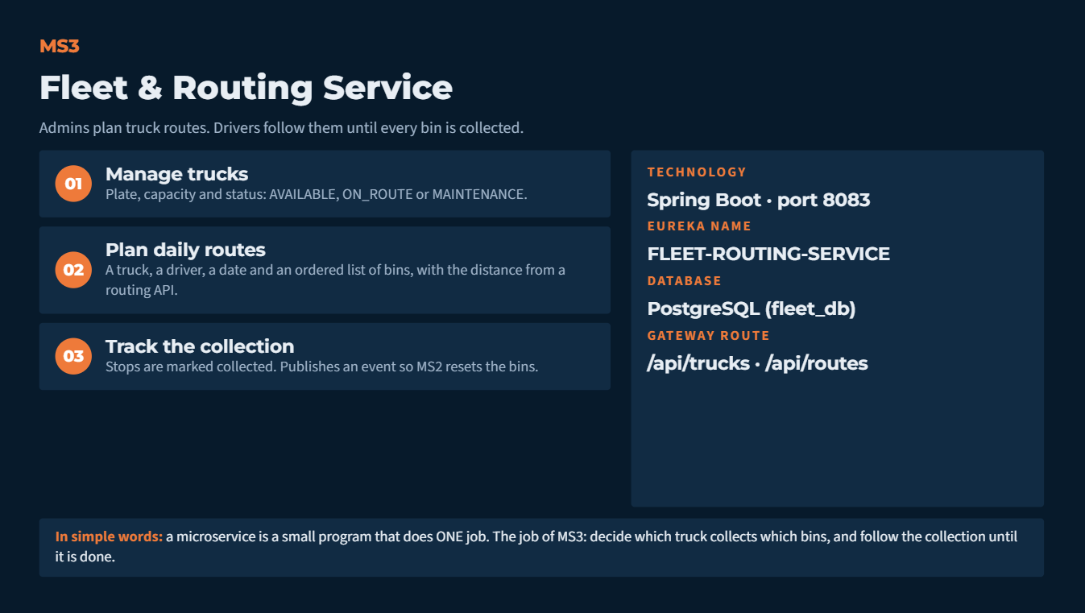

Slide 26
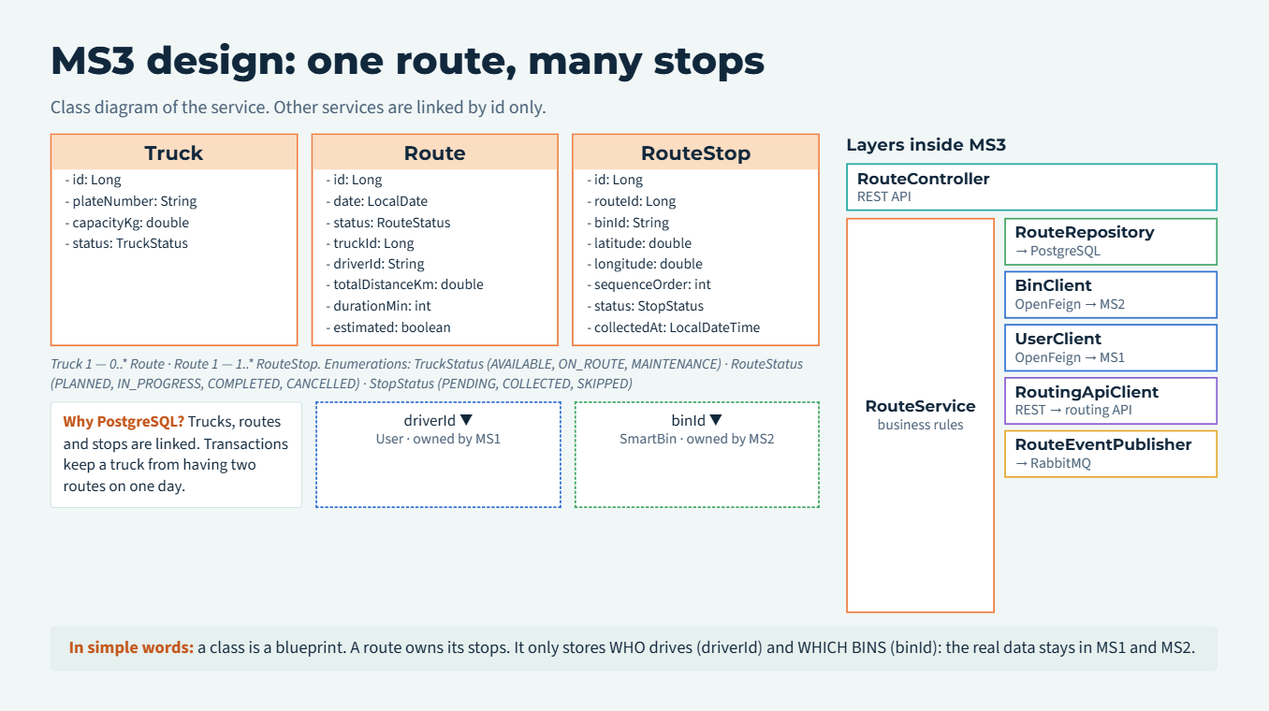

Slide 27
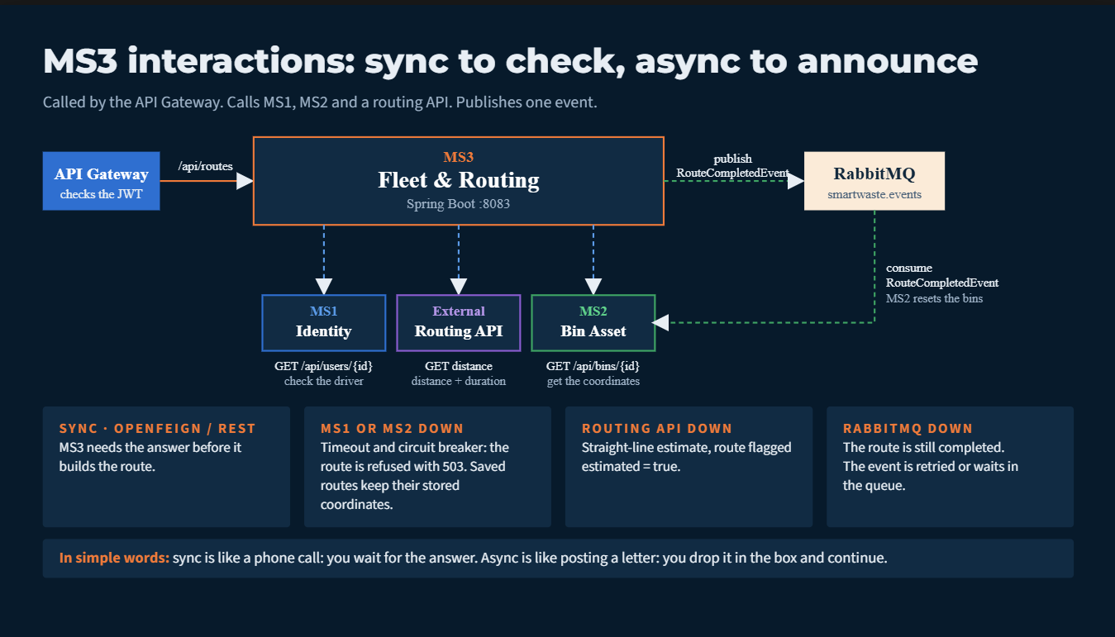

Slide 28
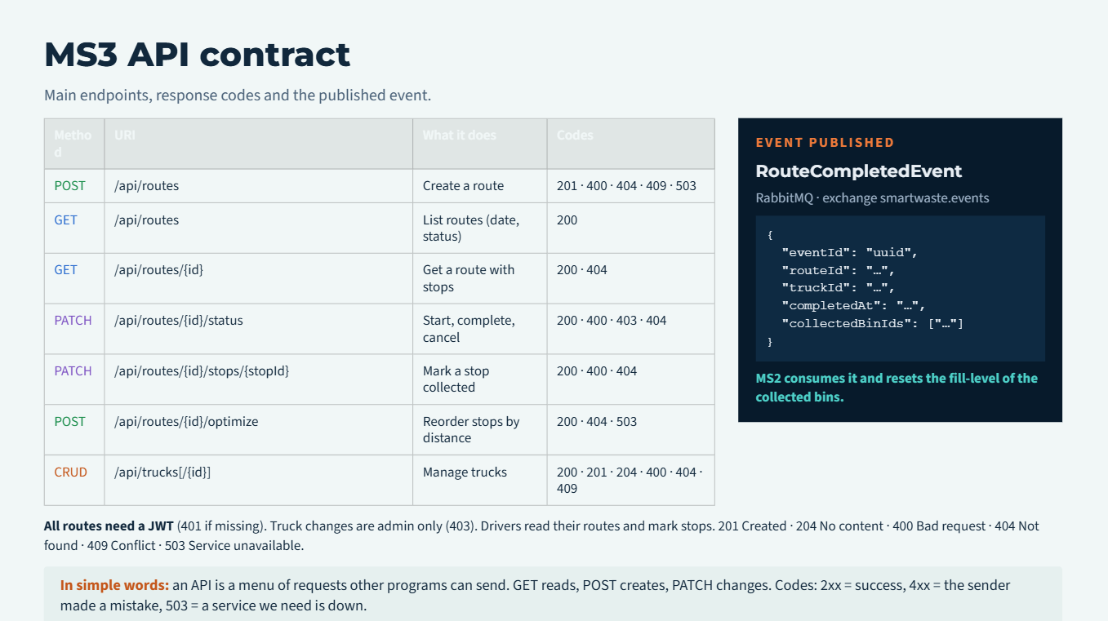

Slide 29
MS4: Incident Reporting

Slide 30
MS4
Incident Reporting Service
Citizens report a problem. Admins follow it until it is solved.
01
Receive reports
TECHNOLOGY
Spring Boot · port 8084
Title, description, photo and the bin concerned.
EUREKA NAME
Follow the status
INCIDENT
02
PENDING, then RESOLVED or REJECTED.
DATABASE
MongoDB (incident_db)
03
Announce new reports
GATEWAY ROUTE
Publishes an event so MS5 can alert the admins.
/api/incidents
In simple words: a microservice is a small program that does ONE job. The job of MS4: handle problems that citizens report, for example a full bin, a broken bin or rubbish on the ground.

Slide 31
MS4 design: one report, one document
Class diagram of the service. Other services are linked by id only.
IncidentReport
«enumeration»
ReportStatus
Layers inside MS4
IncidentController
REST API
- id: String
- title: String
- description: String
- imagePath: String
- createdAt: LocalDateTime
- status: ReportStatus
- userId: Long
- binId: String
PENDING
RESOLVED
REJECTED
status
IncidentService
business rules
IncidentRepository
→ MongoDB
Why MongoDB?
One report = one document. Photo path and status stay together. No joins with other services.
BinClient
OpenFeign → MS2
IncidentEventPublisher
→ RabbitMQ
userId (0..* → 1)
binId (0..* → 1)
Rule: services never share a database. A link to another service is a plain id (userId, binId), not a foreign key.
User
owned by MS1
SmartBin
owned by MS2
In simple words: a class is a blueprint. Each report is built from IncidentReport and has these fields. The report only stores WHO (userId) and WHICH BIN (binId). The real user and bin data stay in MS1 and MS2.

Slide 32
MS4 interactions: sync to check, async to announce
Called by the API Gateway. Calls MS2 and MS1. Publishes one event.
API Gateway
checks the JWT
MS4
Incident Reporting
Spring Boot :8084
publish
IncidentReportedEvent
RabbitMQ
smartwaste.events
consume
IncidentReportedEvent
MS5
Real-Time Alerts
/api/incidents
GET /api/bins/{id}
check the bin exists
GET /api/users/{id}
check the user exists
If a called service is down
MS2
Bin Asset
MS1
Identity
MS2 or MS1 down: timeout + circuit breaker. The report is saved as PENDING and the check is retried later.
RabbitMQ down: the report is still saved. The event is retried.
MS5 down: the event waits in the queue until MS5 restarts.
Sync (OpenFeign): MS4 needs the answer before it saves the report.
Async (RabbitMQ): MS4 does not wait for MS5, so reporting stays fast.
In simple words: sync is like a phone call: you wait for the answer. Async is like posting a letter: you drop it in the box and continue with your work.

Slide 33
MS4 API contract
Main endpoints, response codes and the published event.
Method | URI | What it does | Codes
POST | /api/incidents | Create a report (with photo) | 201 · 400 · 404
GET | /api/incidents | List reports (by status) | 200
GET | /api/incidents/{id} | Get one report | 200 · 404
PATCH | /api/incidents/{id}/status | Admin changes the status | 200 · 400 · 403 · 404
DELETE | /api/incidents/{id} | Delete a report | 204 · 404
EVENT PUBLISHED
IncidentReportedEvent
RabbitMQ · exchange smartwaste.events
{
"eventId": "uuid",
"incidentId": "…",
"binId": "…",
"title": "…",
"createdAt": "…"
}
MS5 consumes it and creates an Alert.
All routes need a JWT (401 if missing). PATCH and DELETE are admin only (403).
201 Created · 204 No content · 400 Bad request · 404 Not found
In simple words: an API is a menu of requests that other programs can send. GET reads, POST creates, PATCH changes, DELETE removes. Codes: 2xx = success, 4xx = the sender made a mistake.

Slide 34
MS5: Real-Time Alerts

Slide 35
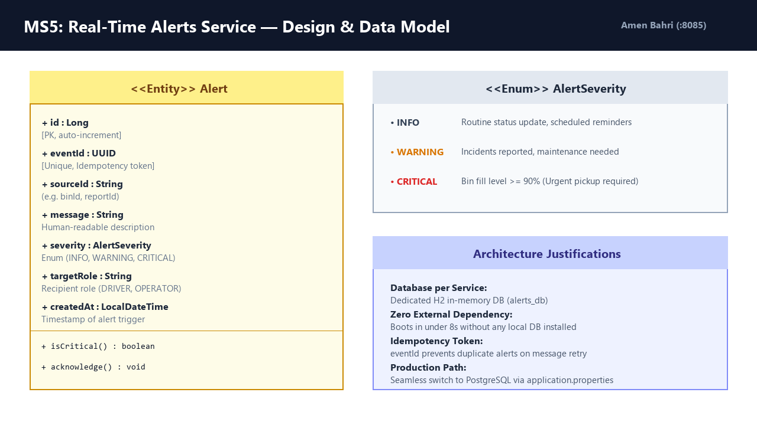

Slide 36


