Slide 1
Customer Feedback Analysis: Air Conditioning Products & Company Services
Key Insights and Recommendations
Date:05.01.25
Presented By
Amena Akhter

Slide 2
Overview of Feedback Responses
Total number of responses: 4
Breakdown of questions asked:
Air conditioning product quality
Areas of company improvement
Suggestions for product/service improvements
Preferred communication channels
Workplace environment satisfaction

Slide 3
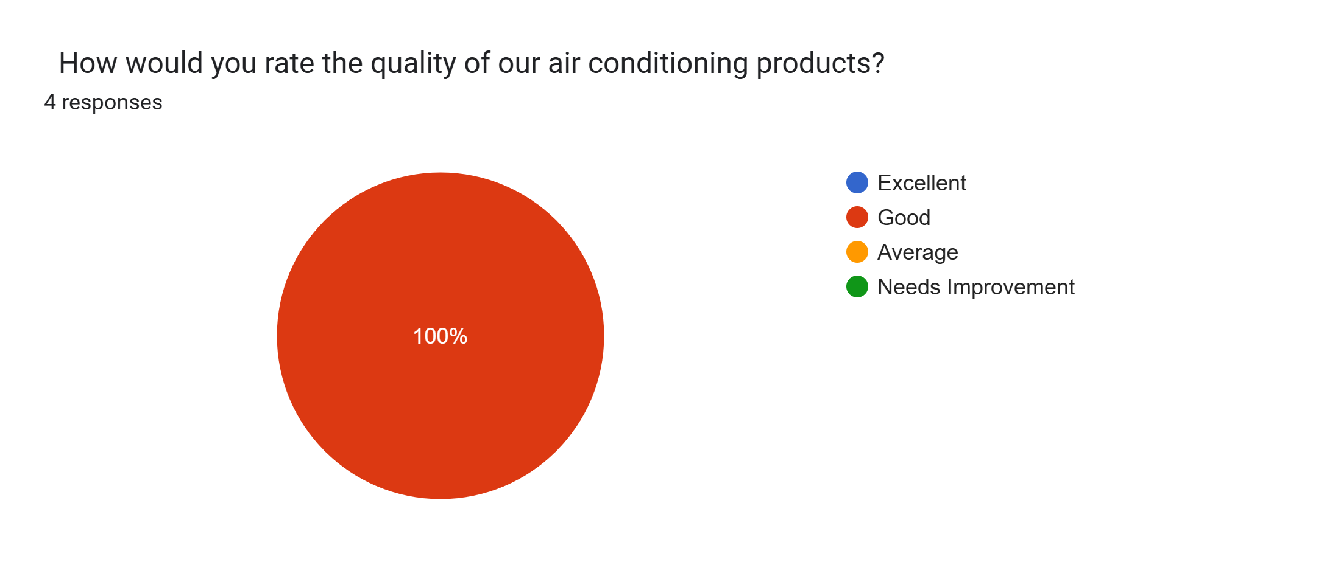
Air Conditioning Product Quality
All responses rated the air conditioning products as “Good”
No negative or neutral feedback

Slide 4
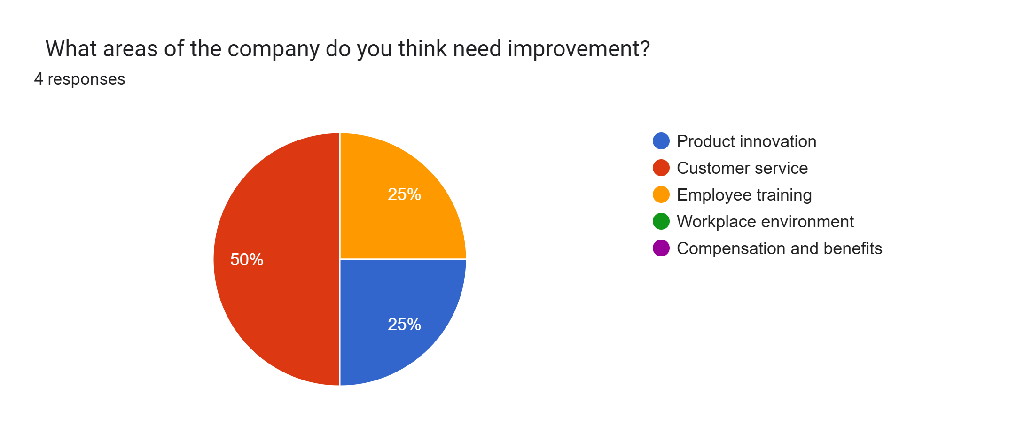
Areas for Improvement
Customer service is the top area needing improvement (50%)
Product innovation and employee training are secondary priorities

Slide 5
Suggestions for Improvement
Price is high (1 response)
Improve customer service (1 response)
Improve employee engagement (1 response)
No suggestions (1 response)
Customers are concerned about the pricing of products
Improving customer service was a recurring theme

Slide 6
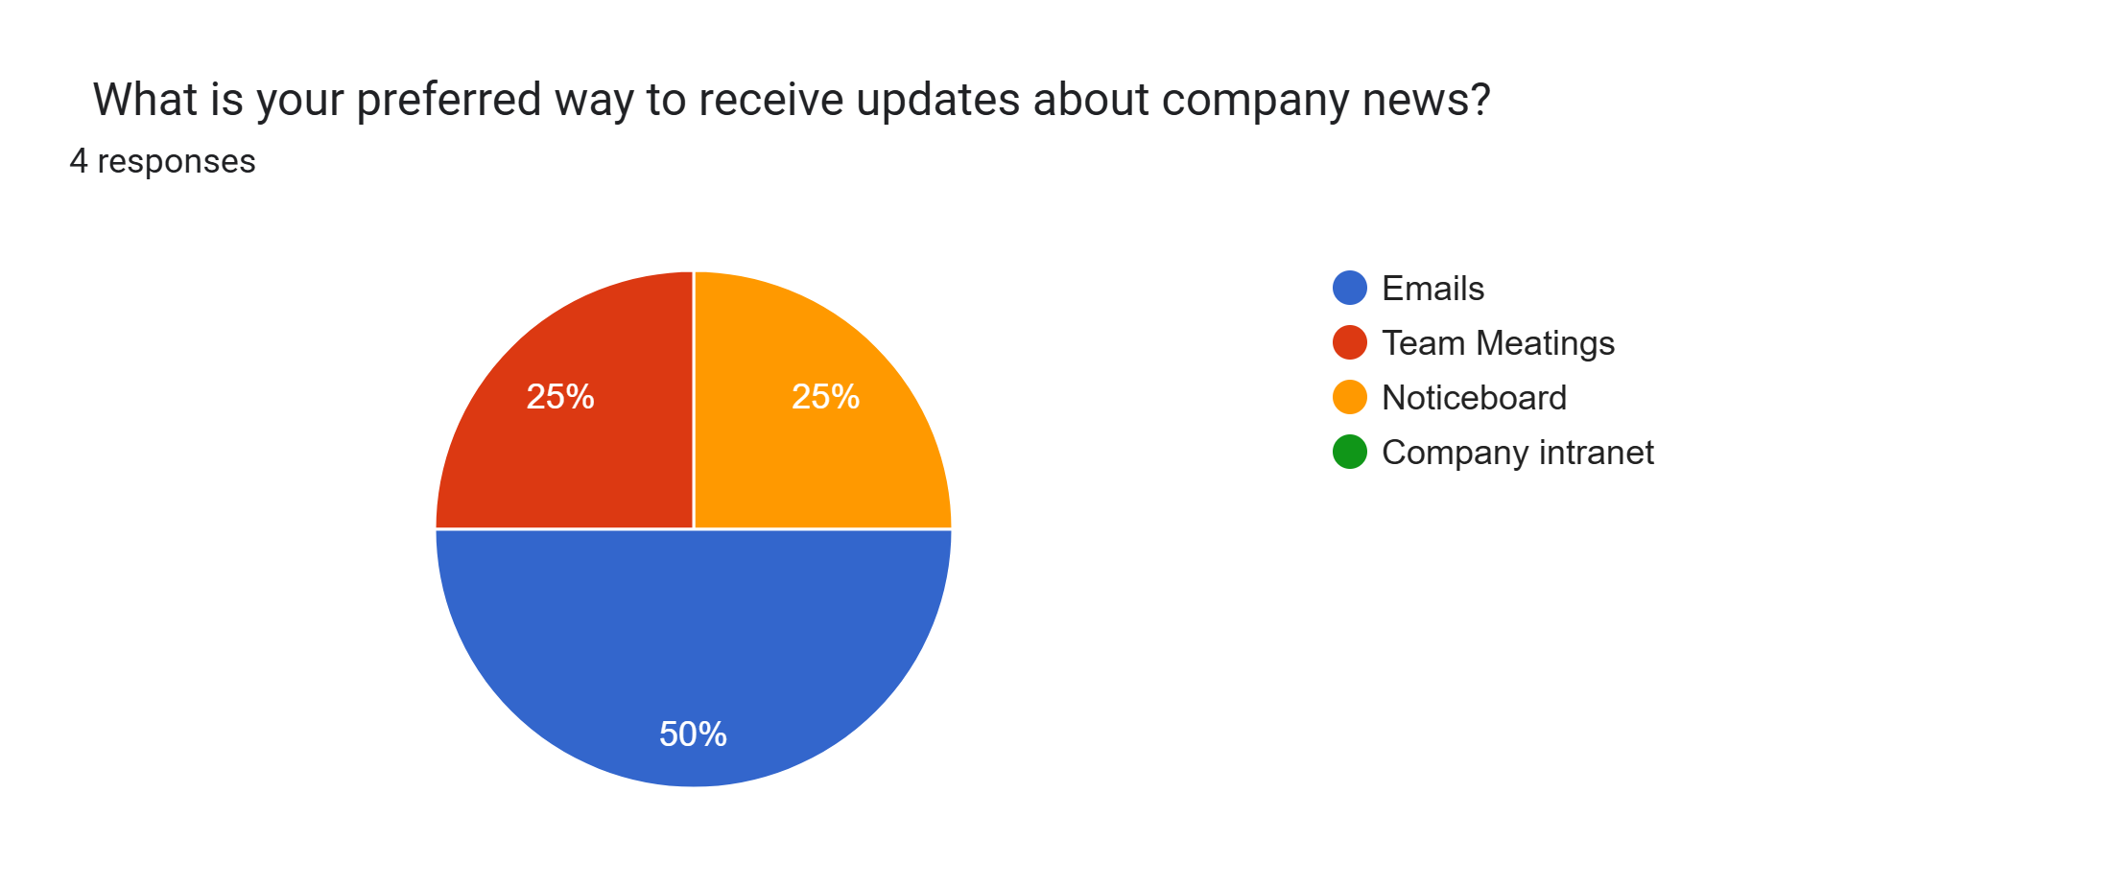
Preferred Way to Receive Updates
Majority of responses (50%) prefer receiving updates via emails
Team meetings and noticeboards are secondary preferences

Slide 7
Workplace Environment Satisfaction
Responses:
0 responses: Not satisfied
2 responses: Satisfied
2 responses: Very satisfied
Overall, satisfaction with the workplace environment is positive, with a majority satisfied or very satisfied.

Slide 8
Actionable Insights and Recommendations
Air Conditioning Products:
Continue maintaining the high standard as feedback was unanimously positive.
Customer Service:
Focus on improving customer service based on feedback.
Product Innovation & Employee Training:
Invest in improving these areas as they were mentioned by customers.
Pricing:
Review product pricing to ensure it is competitive.
Workplace Environment:
Focus on maintaining the positive workplace satisfaction, potentially addressing minor concerns in the future.

Slide 9
Next Steps and Timeline
Address customer service concerns immediately (e.g., training programs)
Review product pricing strategies in the next quarter
Gather more detailed feedback on workplace environment for ongoing improvements

Slide 10
Q&A
"We’d love to hear your questions and thoughts. Feel free to share any feedback!"

