Slide 1

Farmer – Crop Management
Mobile Application

Slide 2
Problem & Opportunity
The Challenge in Modern Agriculture:
Fragmented Data: Farmers lack a unified tool to track diverse crop health, schedules, and historical yield data.
Information Gap: Difficulty getting immediate, reliable advice on pests, diseases, or best practices.
Logistics Bottleneck: Inefficient manual communication for scheduling and coordinating harvest pickup, leading to delays and waste.
Our Opportunity: To create a seamless, real-time digital ecosystem that empowers farmers and streamlines administrative oversight.

Slide 3
Key Features & Technology Stack
Functionality | Key Technologies Used
Farmer App | Central hub for crop upload, real-time order tracking, and instant farmer-buyer chat. | React Native (cross-platform mobile) , Expo (camera/image tools) , Axios (API integration).
Admin Dashboard | Web-based central control panel for managing users, products, categories, and order statuses (Pending/Completed). | React, CSS (Frontend).
Backend/API | Bridges the mobile app and admin dashboard , handling core functionalities like crop and order processing. | Node.js, Express.js, MySQL (Database) , Sequelize ORM.
Security & Architecture
The system is built on an MVC Architecture with RESTful APIs and secured via JWT-Based Authentication, Role-Based Access Control (RBAC), and Data Sanitization.

Slide 4
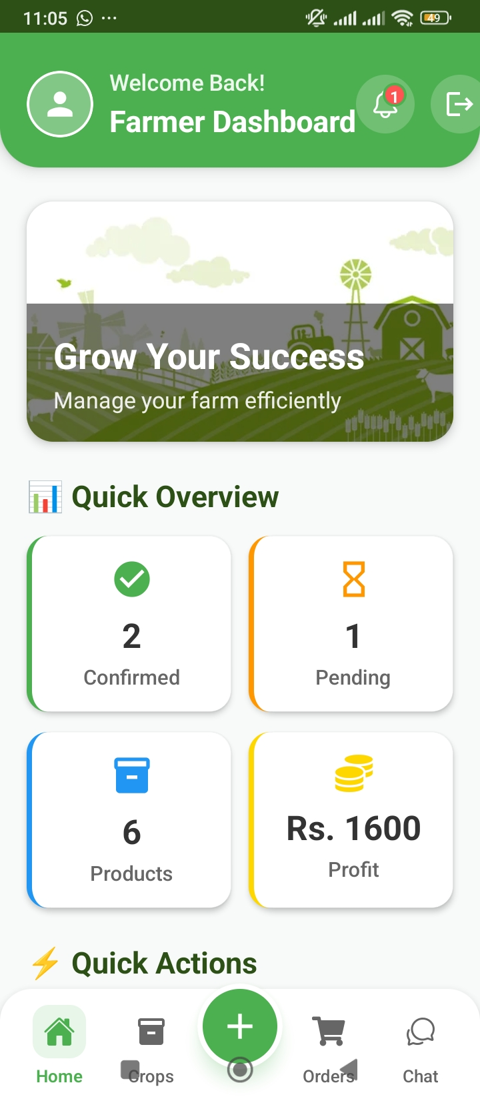
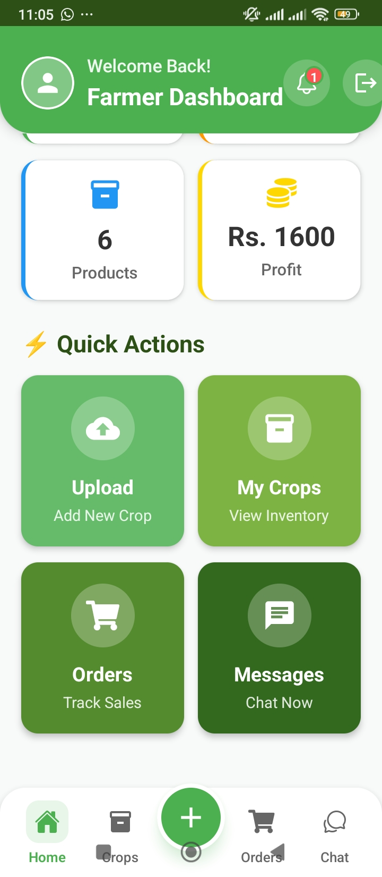
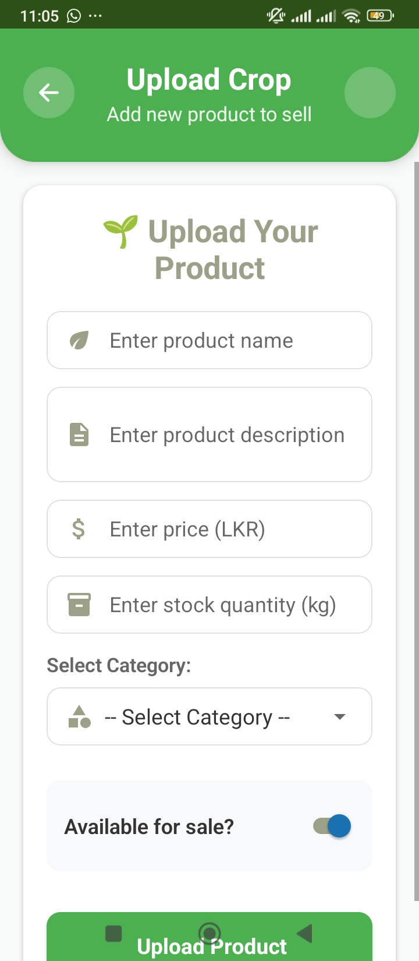
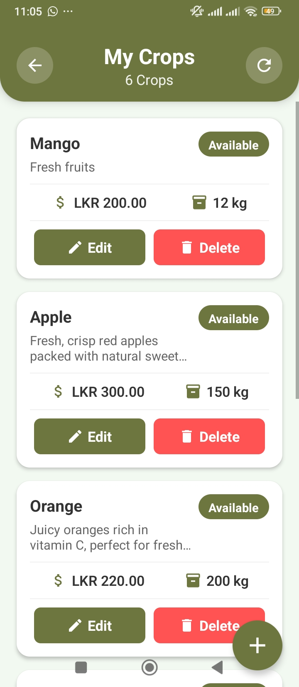
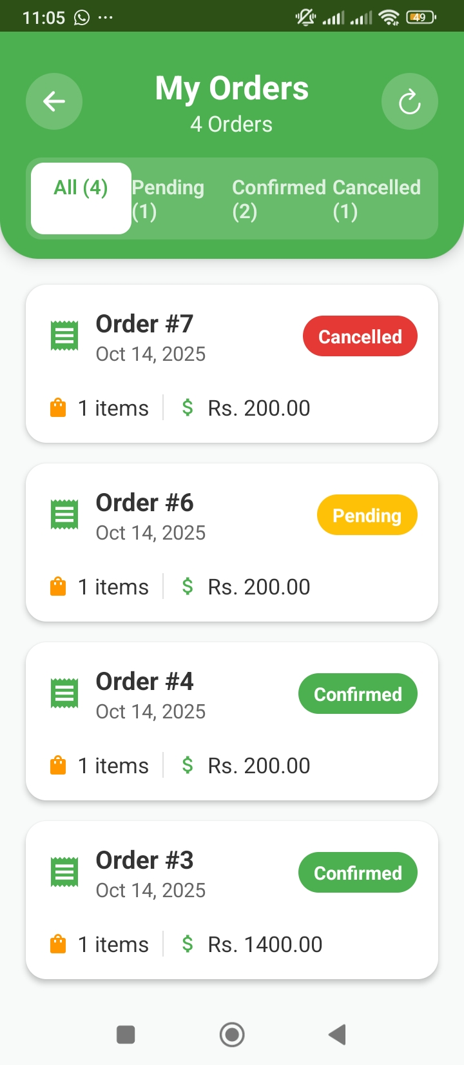
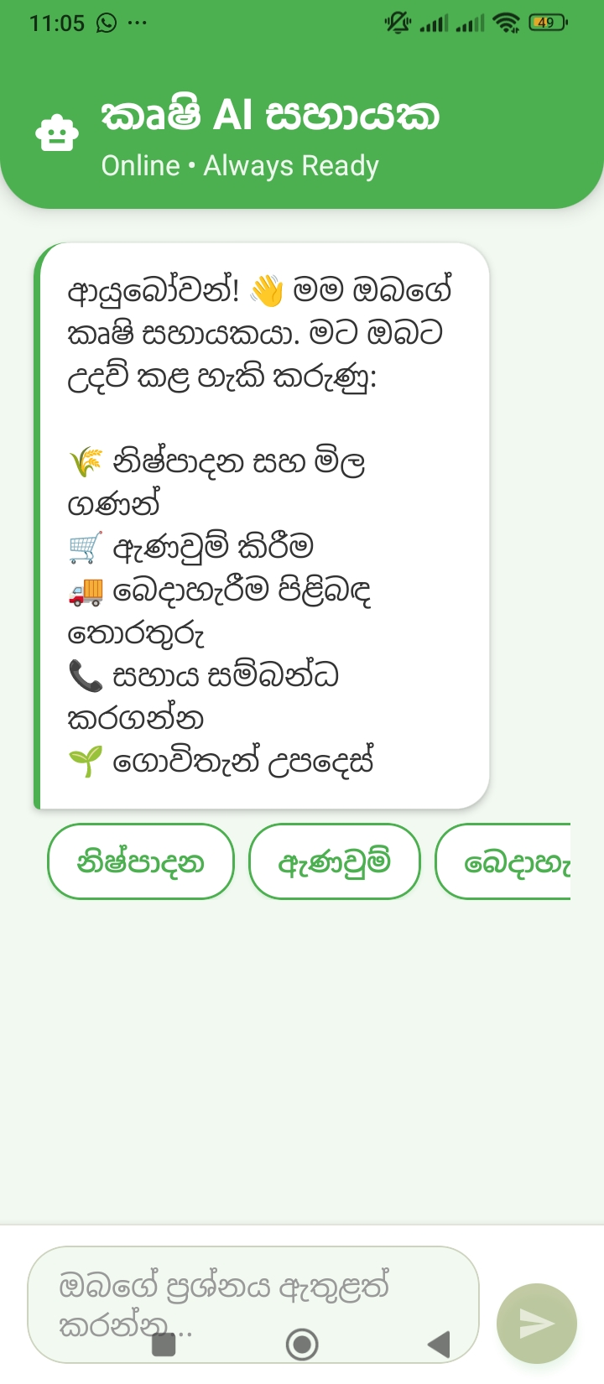
Farmer App – Frontend Overview
App Interface Highlights
Farmer Dashboard: Central hub to upload crops, track orders & chat with buyers.
Crop Upload: Simple form to add crop name, quantity, price & image using camera or gallery.
Orders Screen: Displays incoming buyer requests & order statuses in real time.
Chat Screen: Instant messaging feature for smooth farmer–buyer communication.
Technologies
React Native: Builds cross-platform mobile apps with native performance.
Expo: Simplifies testing & includes camera/image picker modules.
Axios: Handles API integration for secure data exchange with the backend.
Key Features
Effortless crop uploads with image.
Real-time order viewing.
Integrated chat for quick communication.
Clean, responsive & user-friendly design.

Slide 5
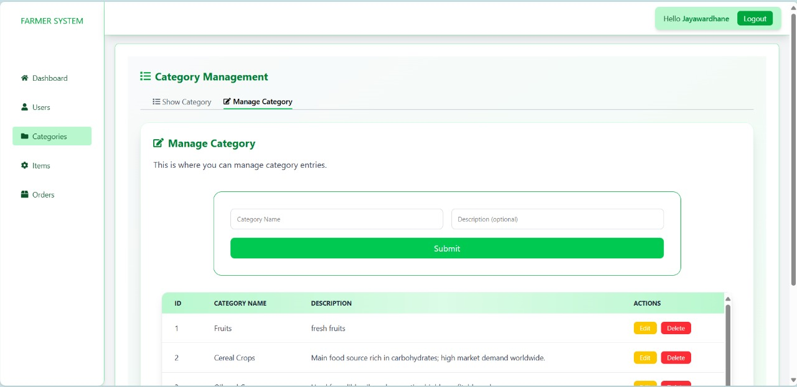
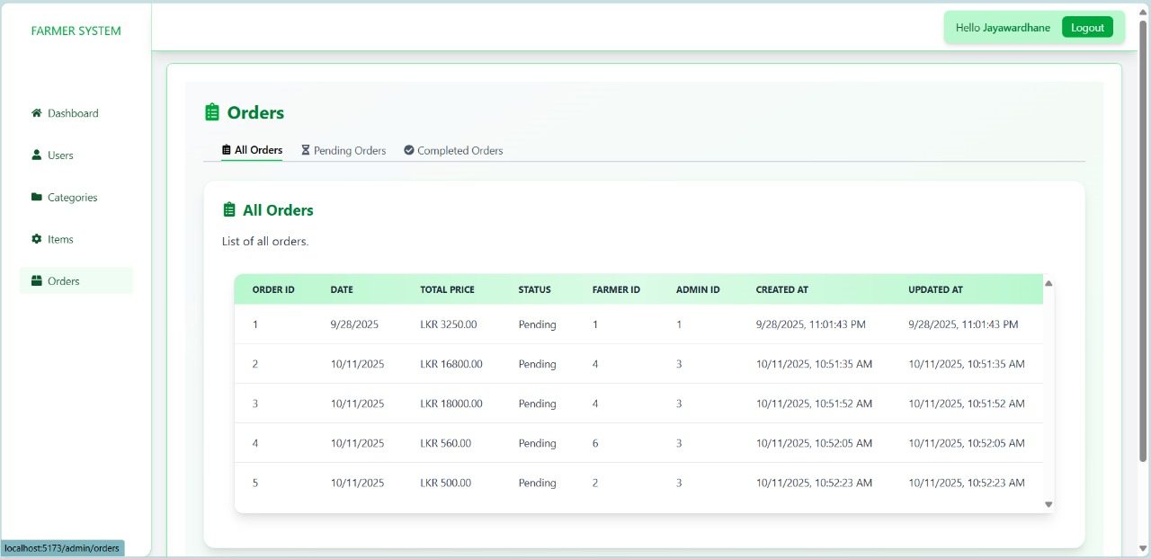
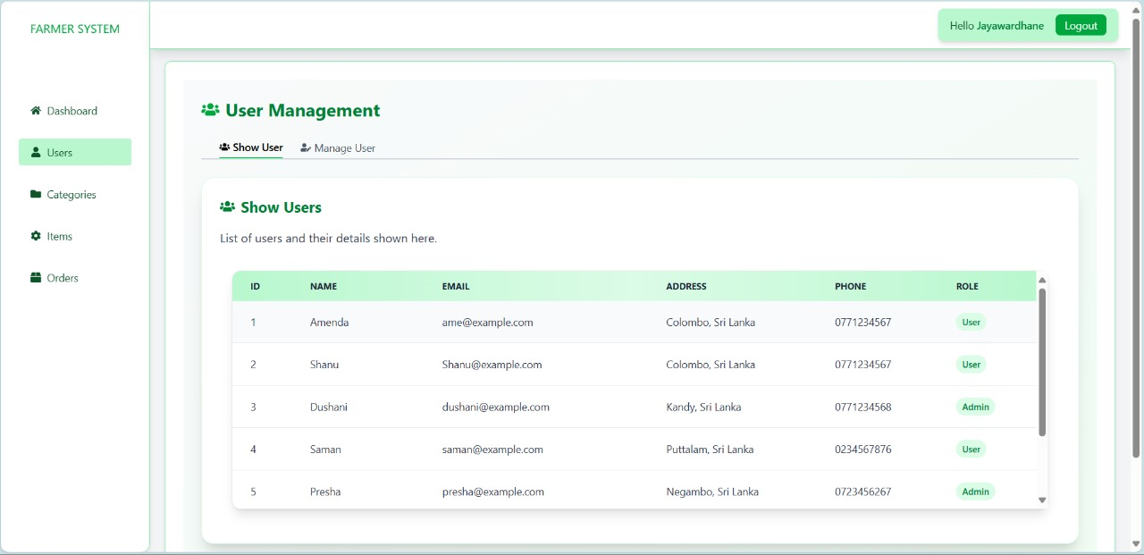
Admin Dashboard – Frontend
A web-based system for managing farmers, users, products, and orders. Centralized admin dashboard for monitoring and control. Streamlines agricultural e-commerce and user interactions.
Technologies Used → React,CSS
Main Functionalities:
Admin Dashboard
Displays total users, products, orders, and categories
Shows order statuses (Pending, Completed, Cancelled)
Recent Orders and Recent Users section for quick insights
User Management
View all registered users with details (Name, Email, Address, Role)
Manage user roles (Admin/User)
Add, Edit, or Delete users
Category Management
Add and maintain product categories and items

Slide 6
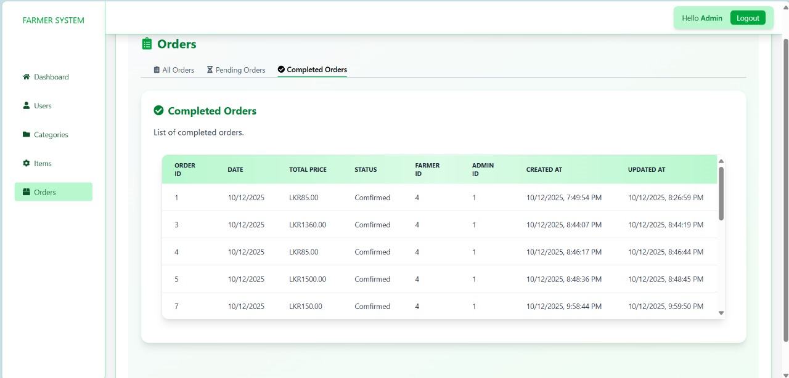
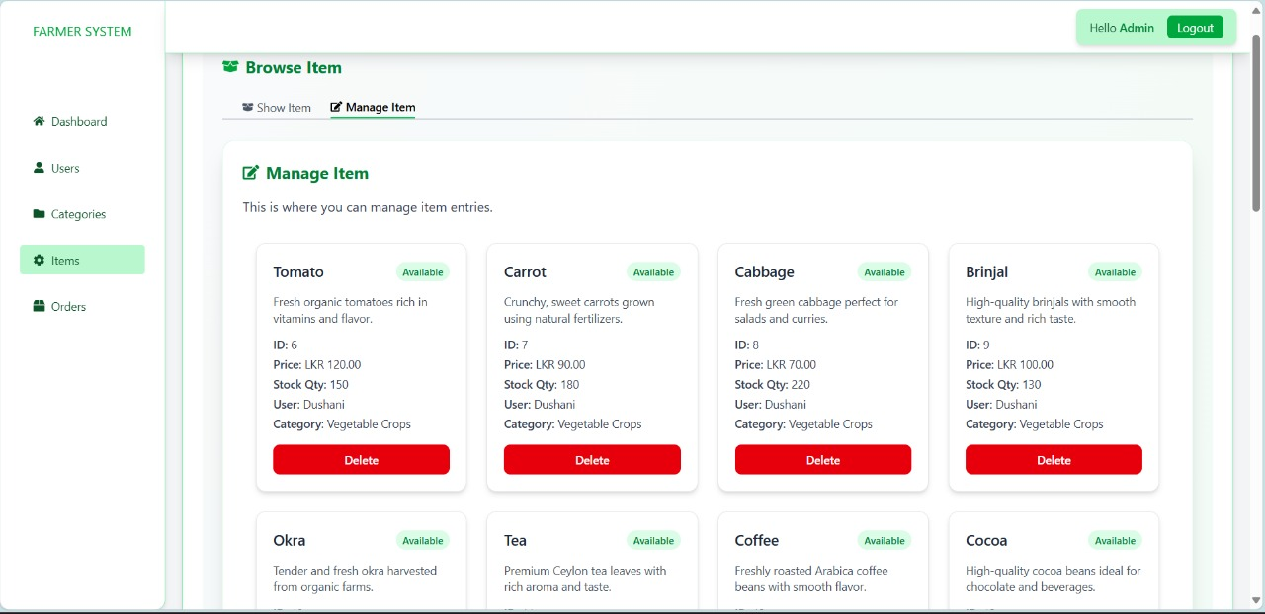
Admin Dashboard – Frontend
Centralize the management of farmers, users, products, and orders streamlining agricultural e-commerce operations.
Key Functionalities
Product Management: Add, edit, and delete items such as Tomato, Carrot, Tea, and Coffee. View product price, stock quantity, and availability.
Order Management: Track all orders with statuses like Pending, Completed, and Cancelled. Each order displays total price, date, farmer ID, and admin timestamps.
Admin Dashboard: Central control panel showing total users, products, orders, and categories with real-time system insights.
User & Category Management: Manage user details, roles, and product categories efficiently for better organization.

Slide 7
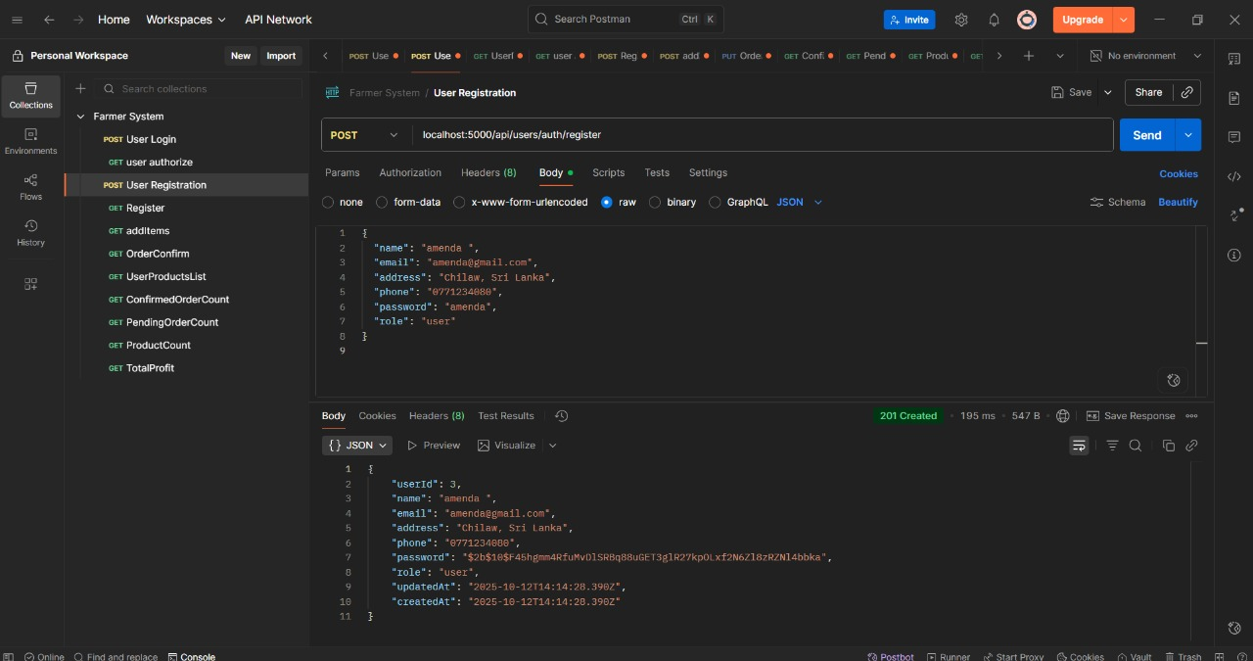
Admin Dashboard – Backend
Technology Stack → Optimized with async/await patterns and middleware layering
Node.js
Express.js
MySQL
Sequelize ORM
Architecture→ Ensures maintainability, scalability & clean separation of concerns
MVC (Model–View–Controller) + Modular Routing
API Design→ Implements pagination, filtering & error-handling middleware
RESTful APIs with standardized response structure (status, message, data)
Core Functionalities
User & Farmer Management
Crop & Order Processing
Bridges mobile app and admin dashboard seamlessly
Integrated middleware for logging, validation & performance monitoring

Slide 8
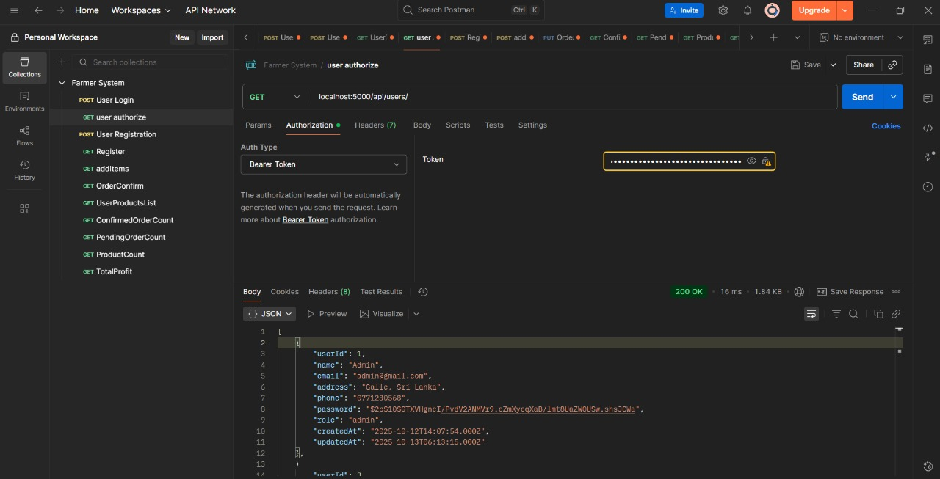
Admin Dashboard – Backend
API Workflow, Security & Testing
API Workflow
User action → API request
Backend validates → Updates database
Sends JSON response to frontend
Security
JWT-Based Authentication: Token verification middleware for secure sessions
Role-Based Access Control (RBAC): Restricted endpoints for Admin & Farmer roles
Data Sanitization: Prevents SQL injection & XSS attacks
HTTPS & CORS Policies: Ensures secure and controlled communication
API Testing
Tool Used: Postman (Collection-based testing)
Endpoints Verified: Login, Register, Crop, and Orders APIs
Test Focus:
Status code validation (200, 400, 401, 500)
Schema & data integrity checks
Error handling & response time tracking

Slide 9

THANK YOU!!

