Slide 1
The purpose of project
The purpose of this project is to create a database for online banking that enables banks to effectively manage data regarding their customers, various accounts and transactions in an organized manner. This database shall help banks to maintain their information at one place and provide an overview of the bank operations.

Slide 2
ER Diagram
The first stage of database design was to develop an Entity-Relationship diagram to describe information to be stored in a database. An ER diagram is used as a blueprint to build a database. It is a graphical representation of the information system, its entities and various relationships that can exist between them. An entity represents a table in the relational database. During this project, ER diagram helped in identifying the important tables and mapping the requirements in a more concise manner.

Slide 3
Tables
For the initial ERD, the basic requirements of the online banking system were captured and below tables were identified:
Branches
Customers
Accounts
Credit_Cards
Banking_Transactions
CC_Transactions
Loan_Details

Slide 4
Relationships
After identifying the tables, the attributes for each table were specified. Primary keys were also established to ensure every table has a unique identifier column for their records. Relationships between the tables were also idefined.
One to many relationship - This type of relation was established between Branches and Accounts, customer and banking transaction, customer and credit cards, credit cards and cc_transactions.
There is also one to many relation between customers and loans with zero or 1 cardinality as it wasn’t necessary that all customers had taken loans.

Slide 5
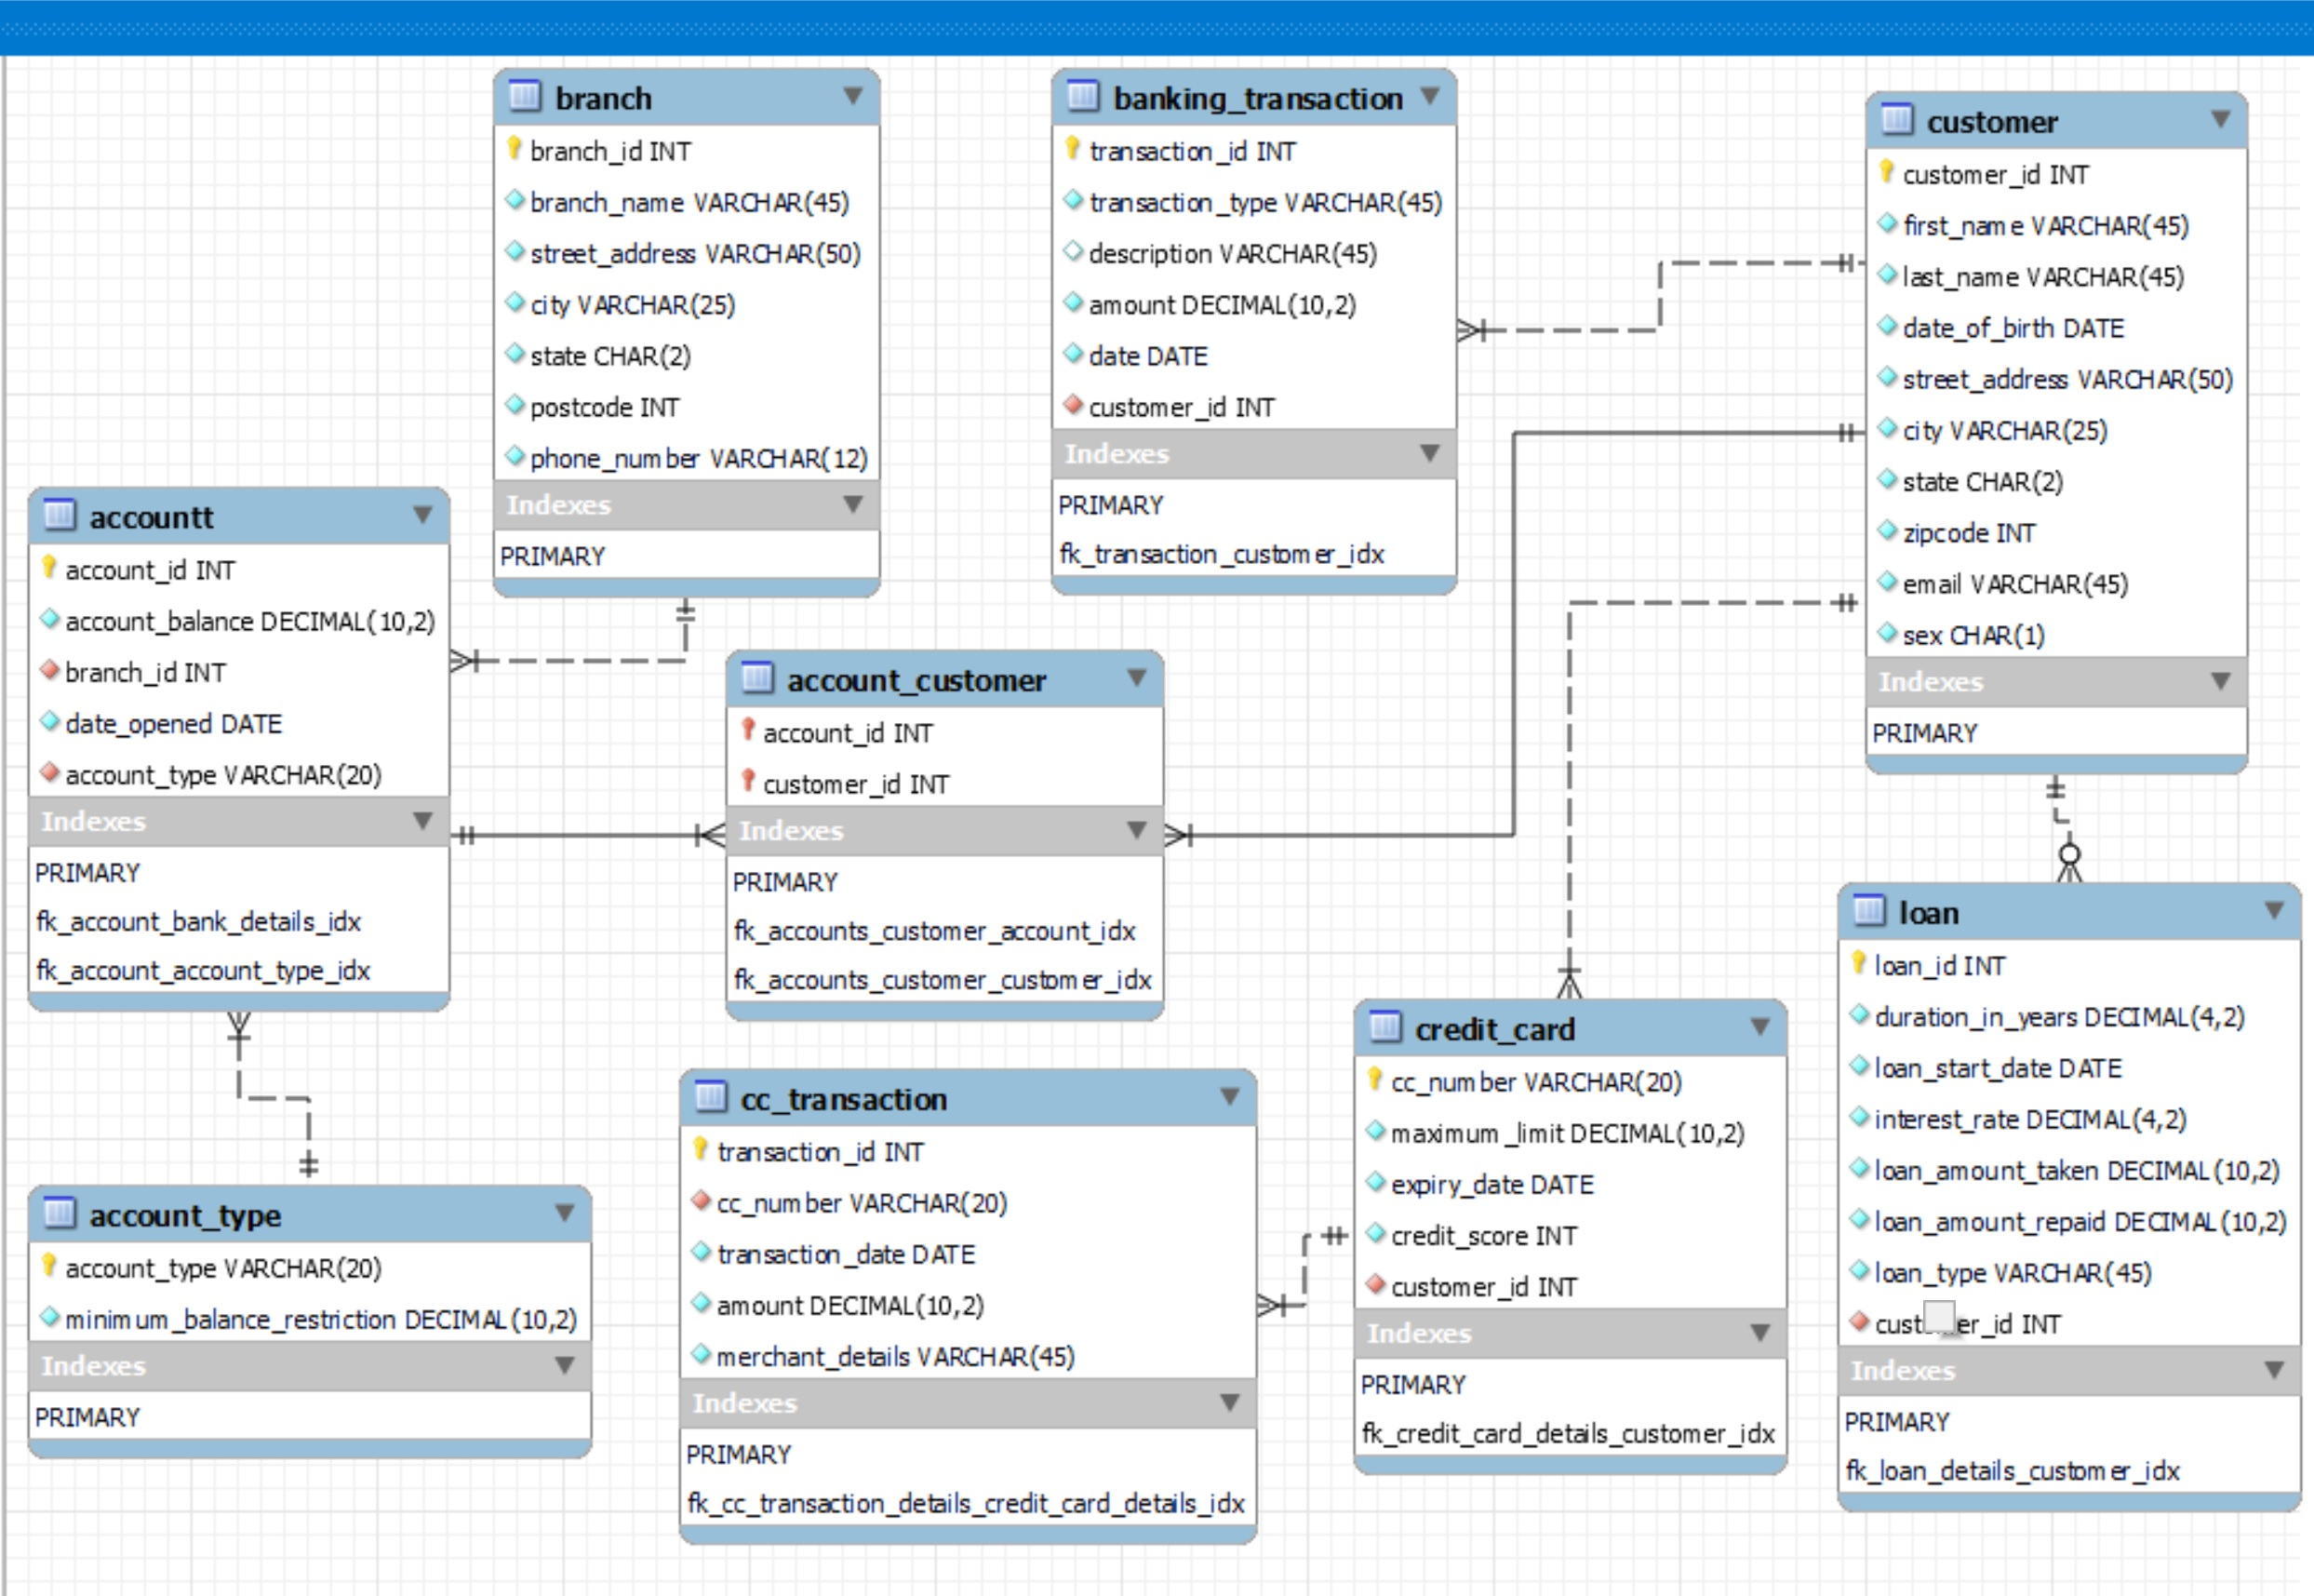
ER Diagram

Slide 6
Query 1: Gaining the total amount of transactions for each branch
To achieve this banking transactions for each customer at the same branch are identified.
Join on banking_transactions, customer, account_customers, accounts and branches are performed.
Then if the transaction type is credit the amount is added and if it is debit the amount is subtracted from the total amount.
The ‘amount’ is calculated by 'tr_amount' funtion.

Slide 7
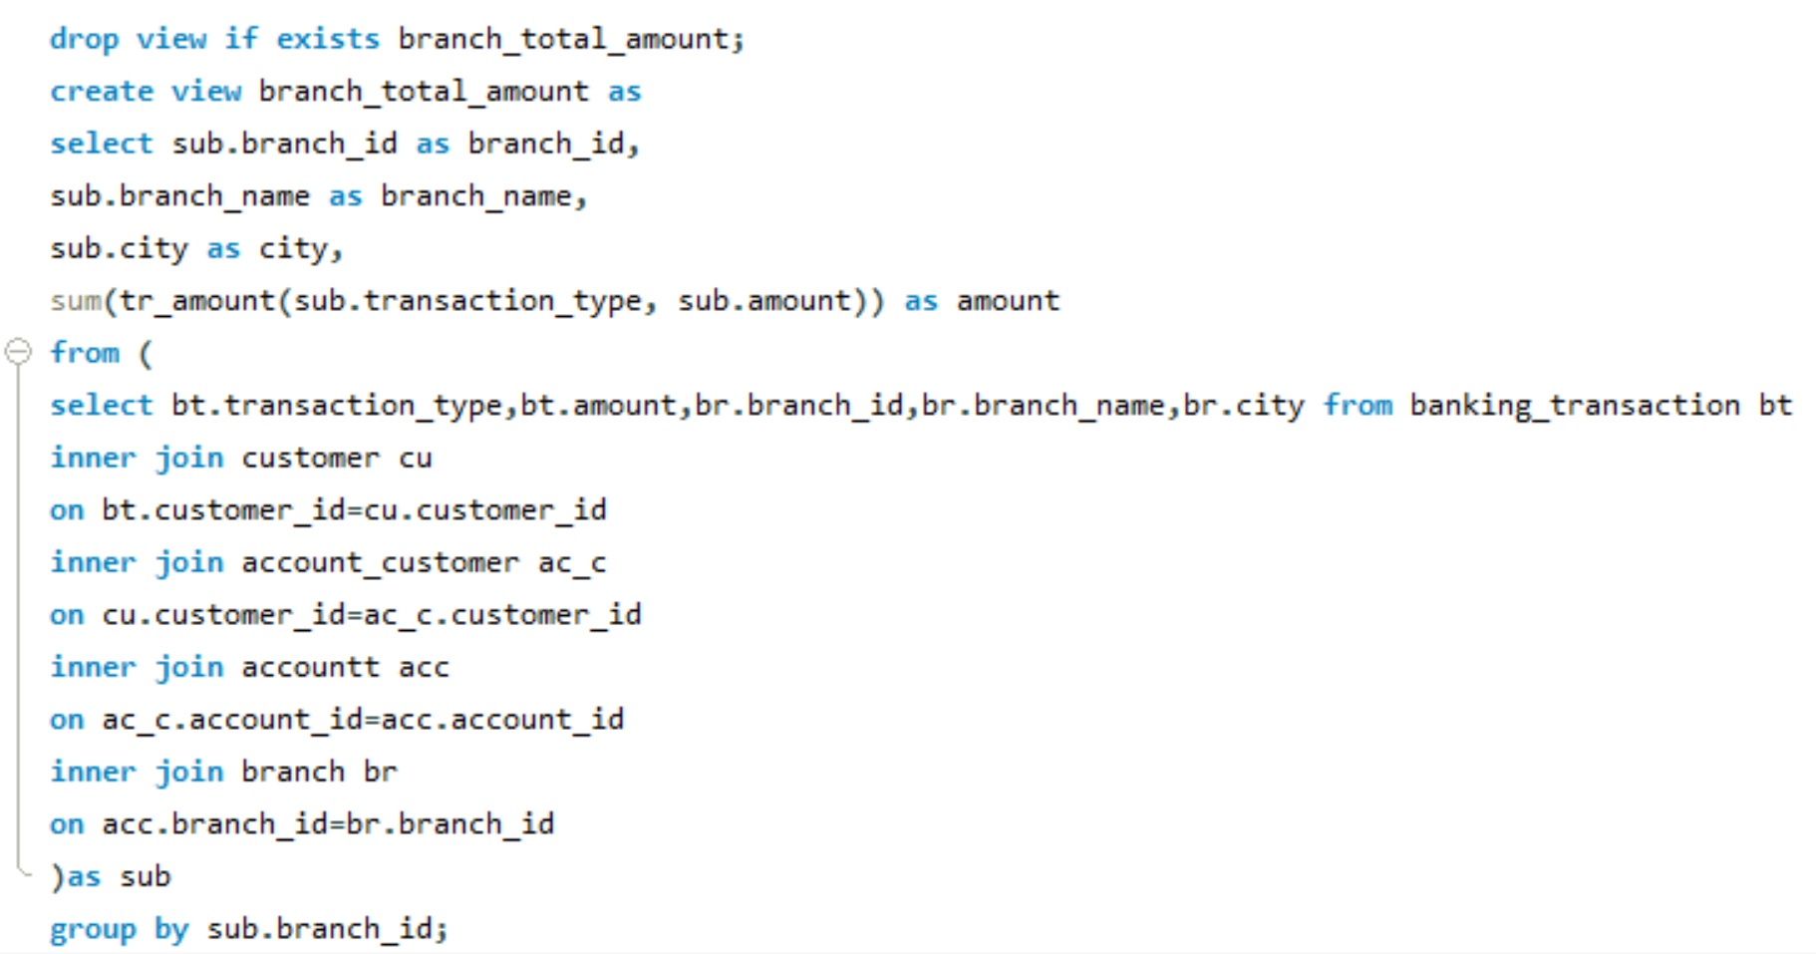
Query 1: Gaining the total amount of transactions for each branch

Slide 8
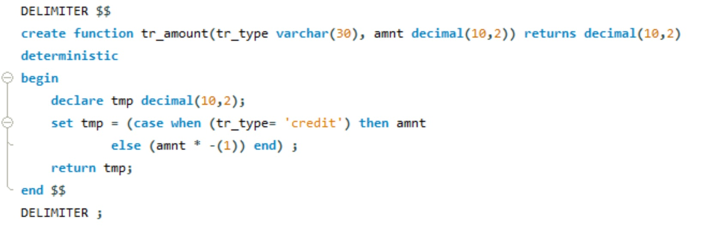
Query 1: Gaining the total amount of transactions for each branch

Slide 9
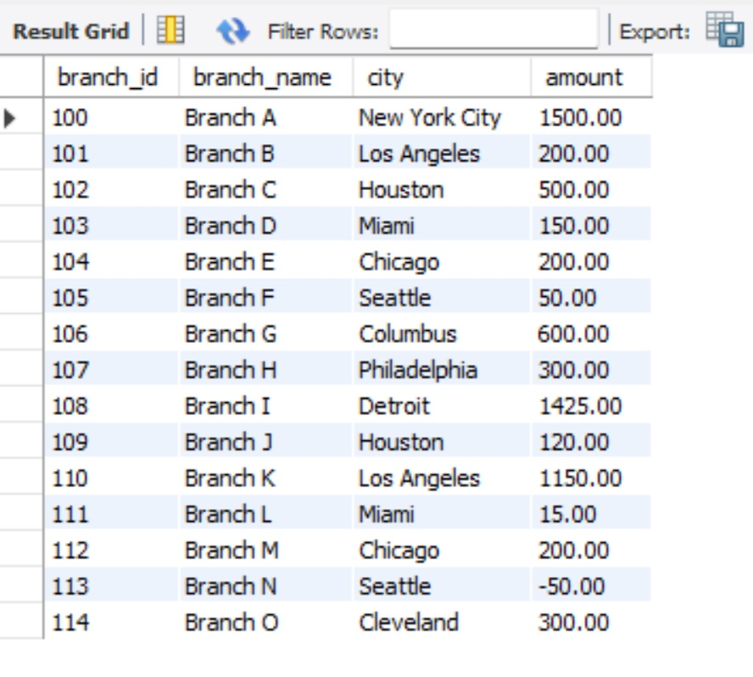
Query 1

Slide 10
Query 2: Gaining average interest rate for each loan type.
Inner join on customers and loan is performed.
avg function to calculate average interest_rate and group by to group the loan_types are used.

Slide 11
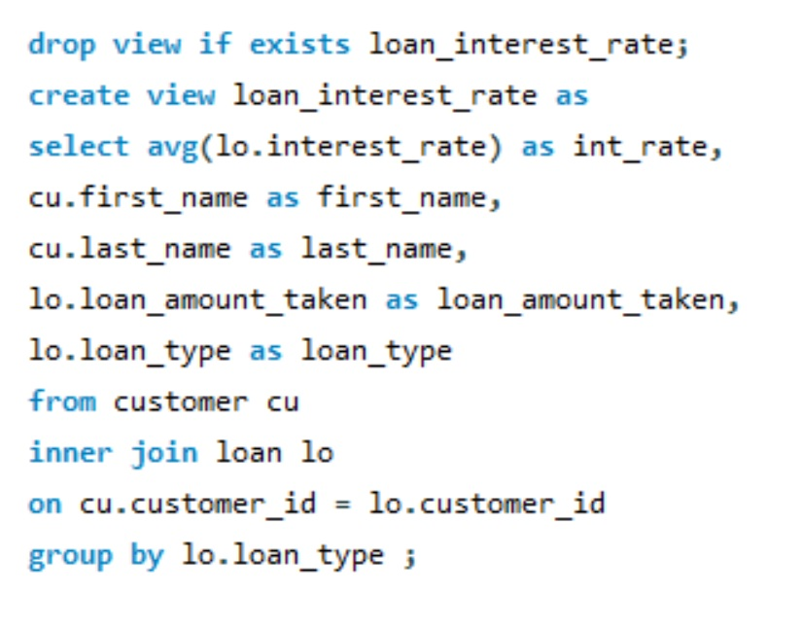
Query 2: Gaining average interest rate for each loan type.

Slide 12
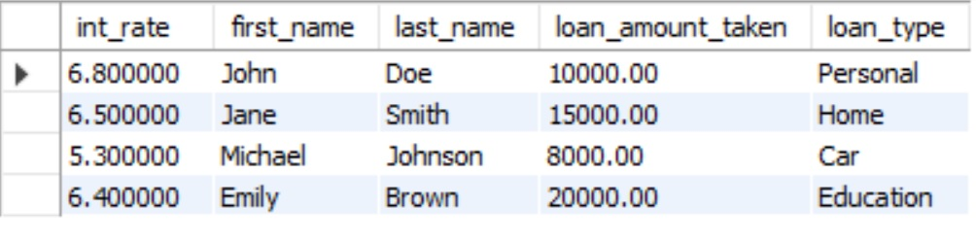
Query 2: Gaining average interest rate for each loan type.

Slide 13
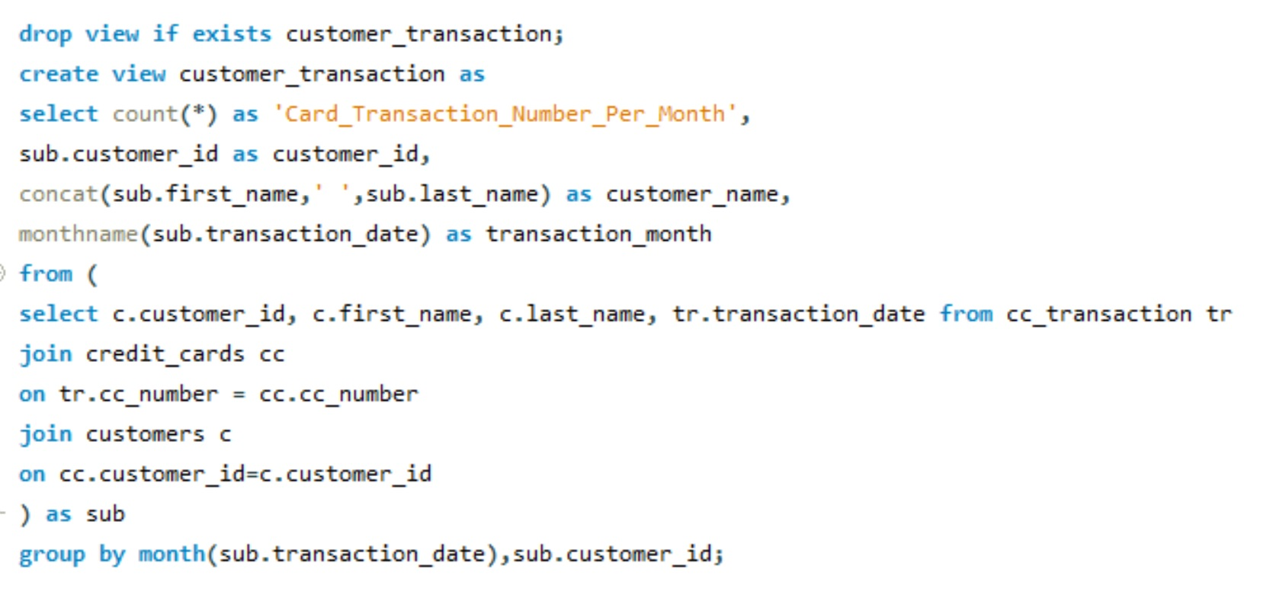
Query 3:Gaining the count of credit card transactions per month for each customer.

Slide 14
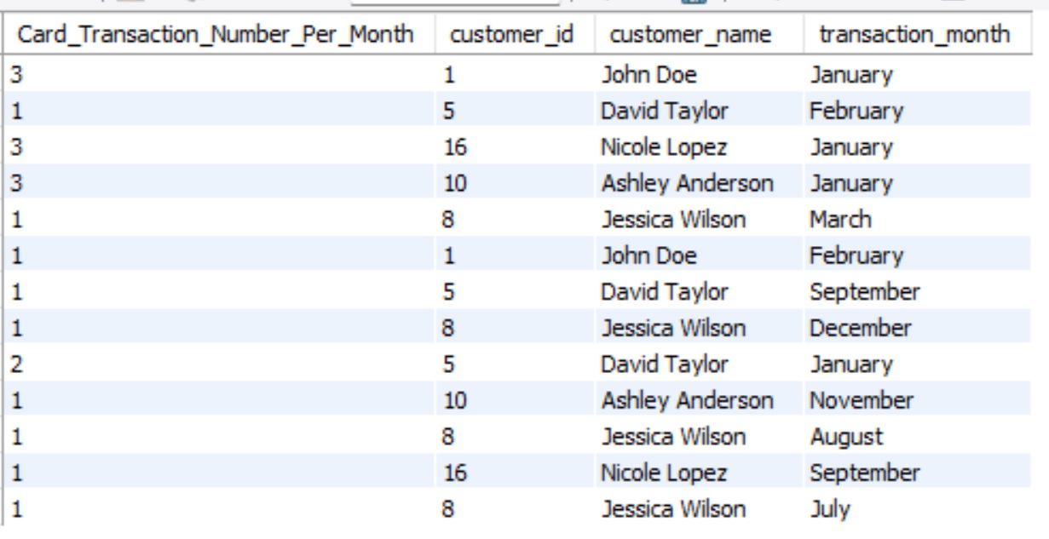
Query 3:Gaining the count of credit card transactions per month for each customer.

Slide 15
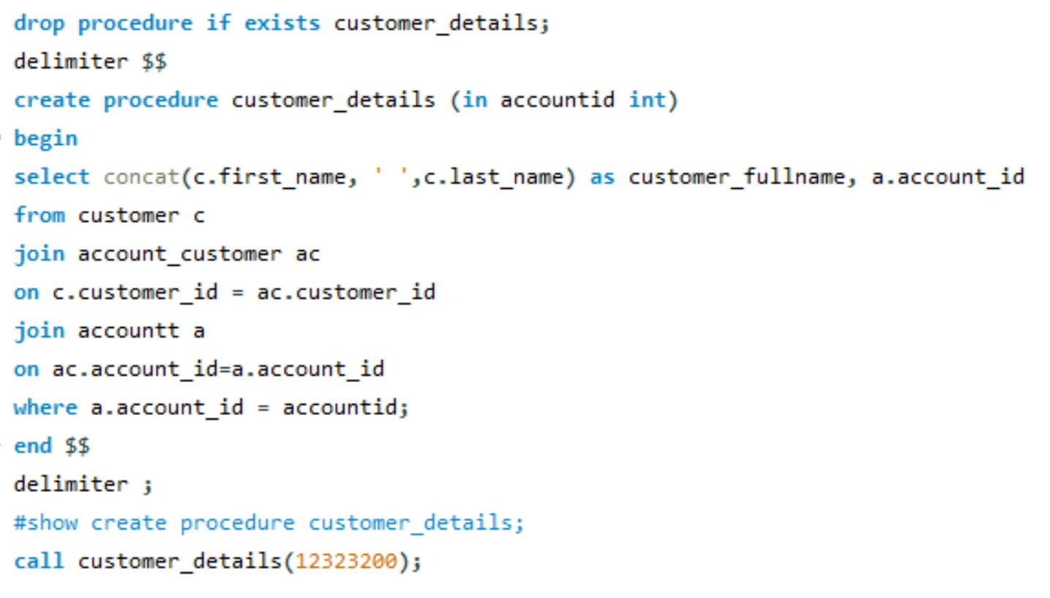
Query 4: Creating a SP that accepts accountid as a parameter and returns customer's full name.

Slide 16
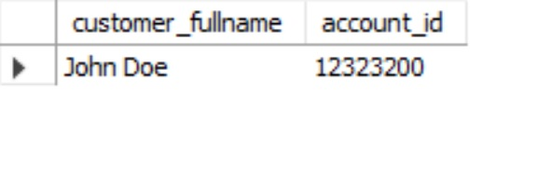
Query 4: Creating a SP that accepts accountid as a parameter and returns customer's full name.

Slide 17
Future Work
Some tables such as ‘employee’ and ‘branch_employee’, ‘transaction_error’ were not taken into consideration.
Banking operations such as withdrawal, deposit, atm transactions were not explicitly addressed and were included as a part of banking_transactions table.

Slide 18
Thank you

