Slide 1

How does Selenium Find Elements?
Maciej Wyrodek

Slide 2



About Me
Community leader and test automation expert at Objectivity
Blog: https://thebrokentest.com
TableElemnet: https://www.nuget.org/packages/TableElement

Slide 3
How does Selenium Find Elements?
Maciej Wyrodek

Slide 4

You don’t have to be an engineer to be a racing driver, but you do have to have Mechanical Sympathy.
- Jackie Stewart

Slide 5
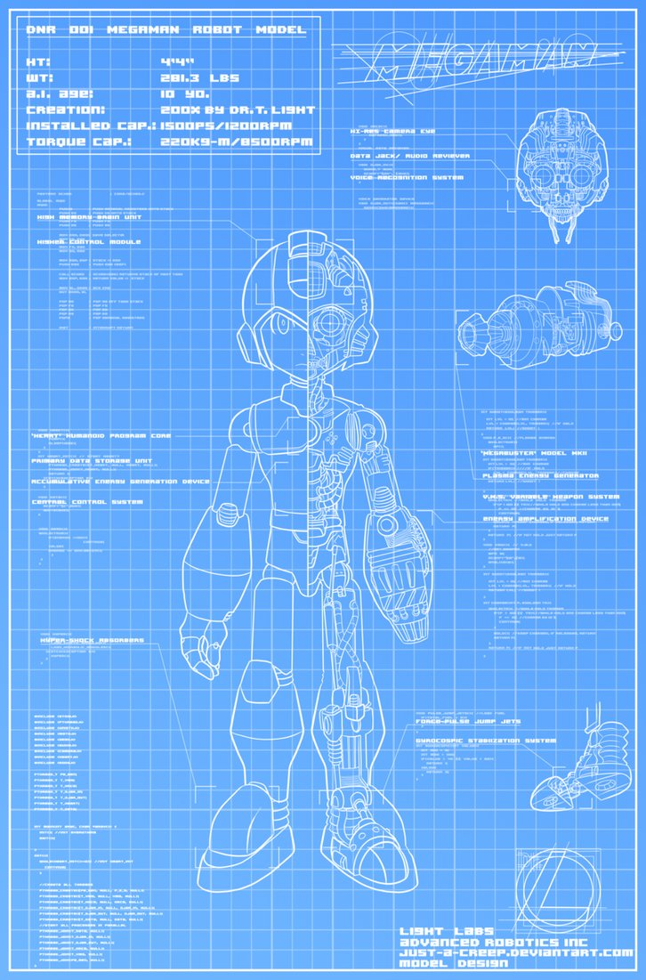

A Long Time Ago…
Let's keep locators as Xpath!
I see a lot of issues with this approach:
Xpath is the simplest and allows for most of the things. Besides, it all treated the same by the browser!
This Photo by Unknown Author is licensed under CC BY-NC-ND

Slide 6
How I was taught
ID
Name
Css
Xpath
Link text

Slide 7

Let’s code

Slide 8
A Long Time Ago… But not as long as previously.
This experiment is not valid, it doesn’t reflect real-world scenario, and there is to many variables that could affect result!
This Photo by Unknown Author is licensed under CC BY-NC-ND

Slide 9


Slide 10

Postman

Slide 11
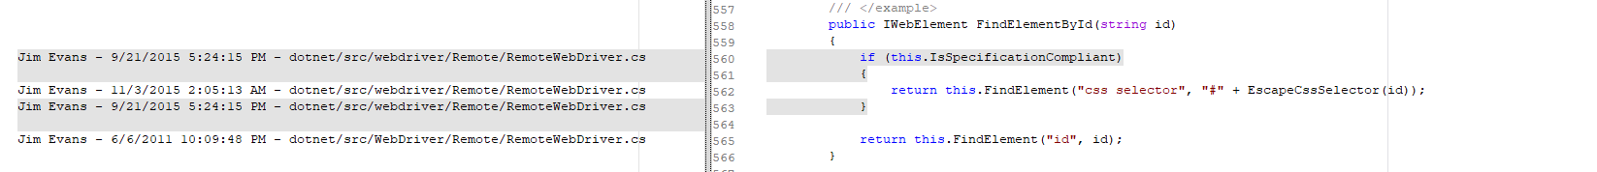

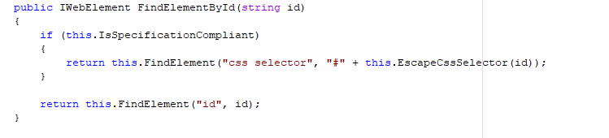
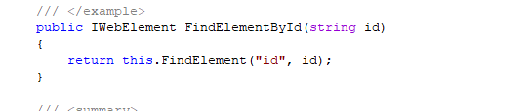
Let’s Go To code
2011-2015
2015-NOW

Slide 12
A Long Time Ago…
Ok I give up you are right!
This Photo by Unknown Author is licensed under CC BY-NC-ND

Slide 13

Lets look how ChromeDriver Does It

Slide 14

Time For Theory

Slide 15
2004 – Jason Huggins Creates Selenium
Later known as Selenium Core

Slide 16
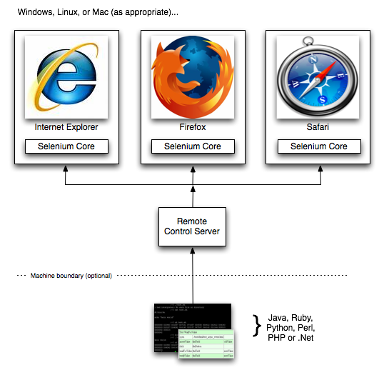
Old Times Selenium RC
Notes:
Source: https://www.seleniumhq.org/projects/remote-control/

Slide 17

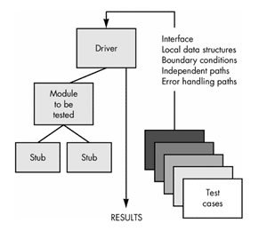
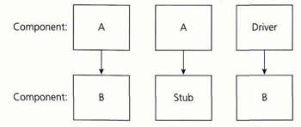

2006 – Semon StewaRT Start Work on Web Driver

Slide 18
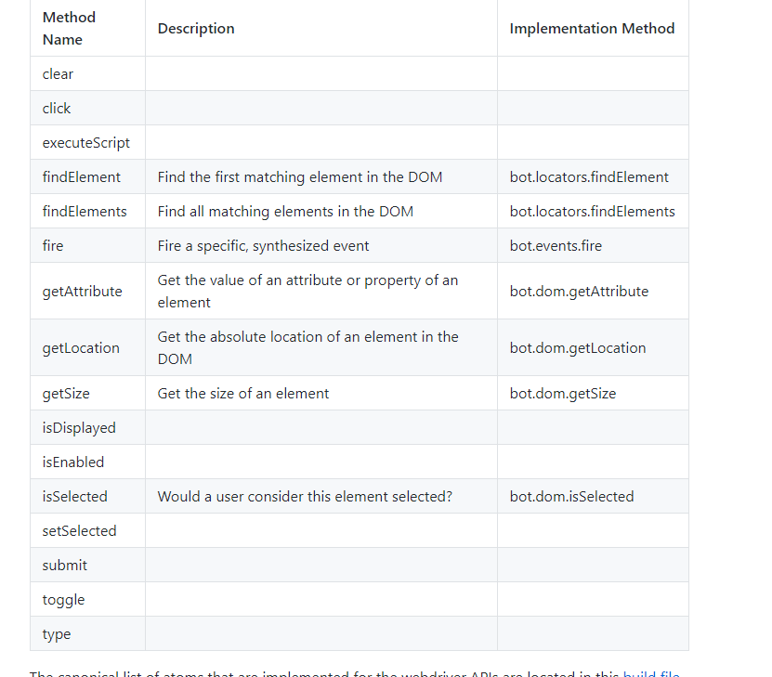
Automation Atoms

Slide 19
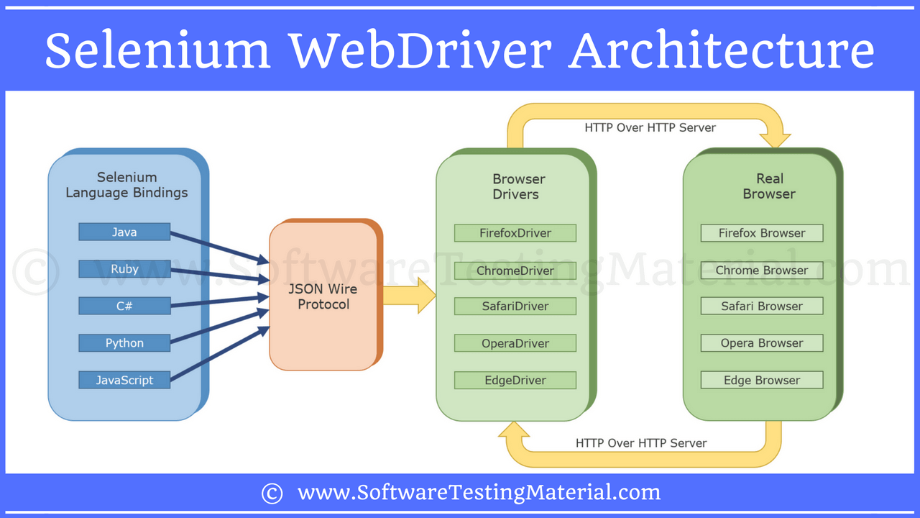
Selenium 2.0

Slide 20
Selenium doesn't find elements
It asks the browser to fetch element with the given locator.

Slide 21

But how does it happens?

Slide 22

Let’s look at some documentation
Notes:
Wrzucic jakiegoś znudzonego gościa w tło

Slide 23
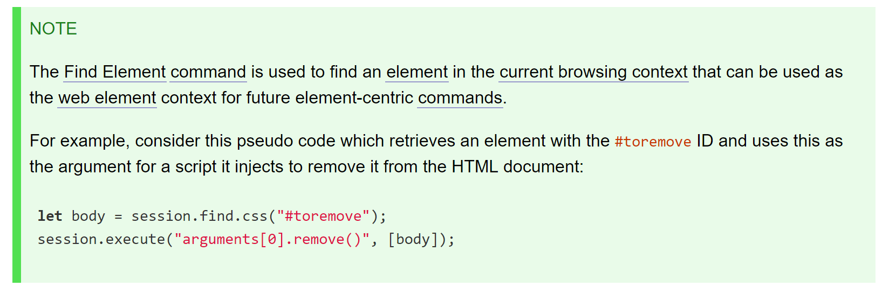

Slide 24
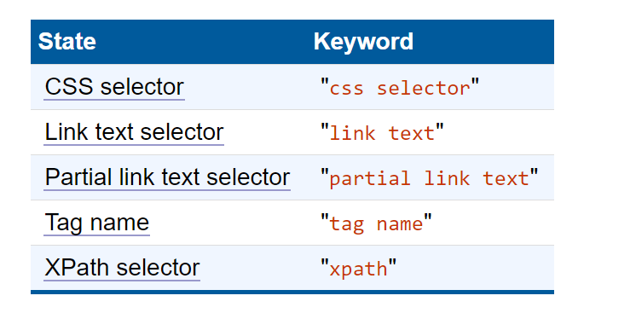
Locator Srtategies

Slide 25
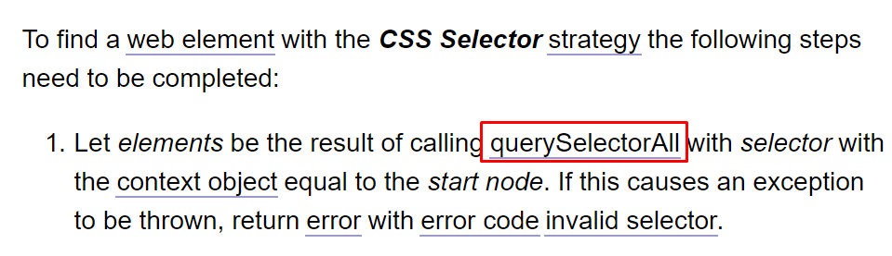
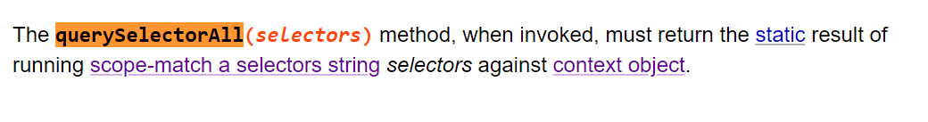
CSS Selector

Slide 26
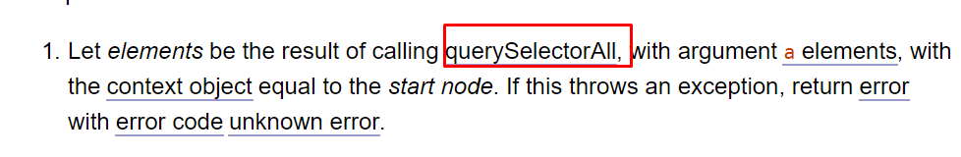
Link Text & Partial link tex

Slide 27
Locator Srtategies
STATE | KEYWORD | DOM call | DOM LEVEL
CSS selector | css selector | querySelectorAll | 2
Link text selector | link text | querySelectorAll | 2
Partial link text selector | partial link text | querySelectorAll | 2
Tag name | tag name | getElementByTagName | 2
XPath selector | xpath | Evaluate ORDERED_NODE_SNAPSHOT_TYPE | 3

Slide 28
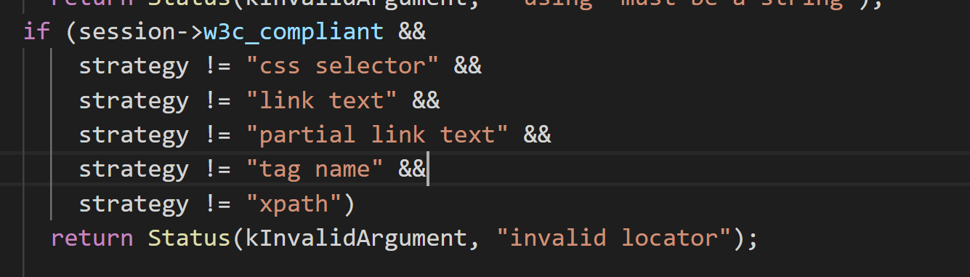
Notes:
https://github.com/bayandin/chromedriver
Element_utill.cc 300

Slide 29
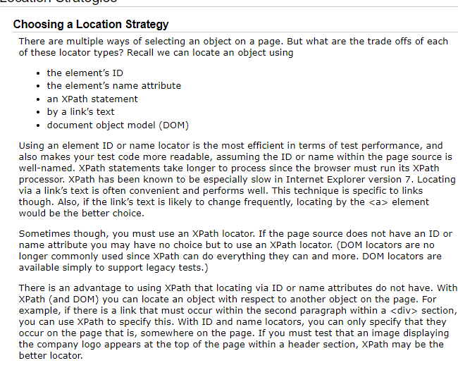
How I was taught
ID
Name
Css
Xpath
Link text
Notes:
https://www.seleniumhq.org/docs/06_test_design_considerations.jsp#location-strategies

Slide 30
Selenium 2.0

Slide 31
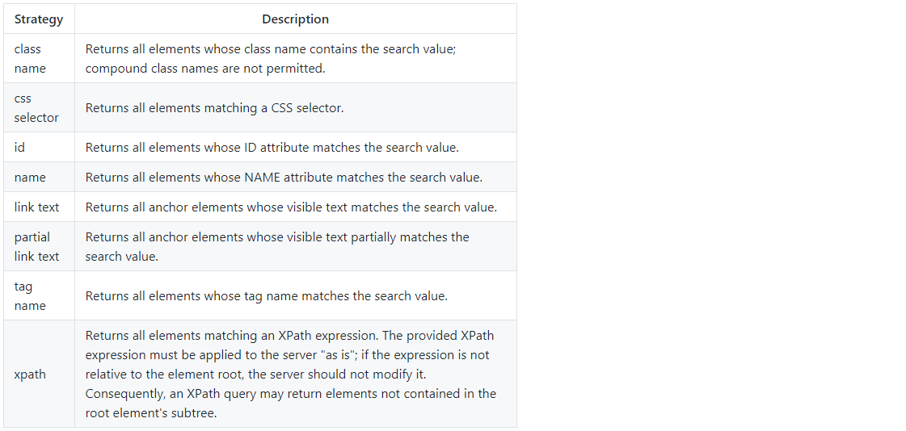
Notes:
https://stackoverflow.com/questions/48369043/official-locator-strategies-for-the-webdriver
https://github.com/w3c/webdriver/issues/1042

Slide 32
Selenium 2.0
WEBDRVIVER
WIRE
PROTOCOL

Slide 33


Okay How does it work?
Chrome DevTools Protocol
Marionette

Slide 34
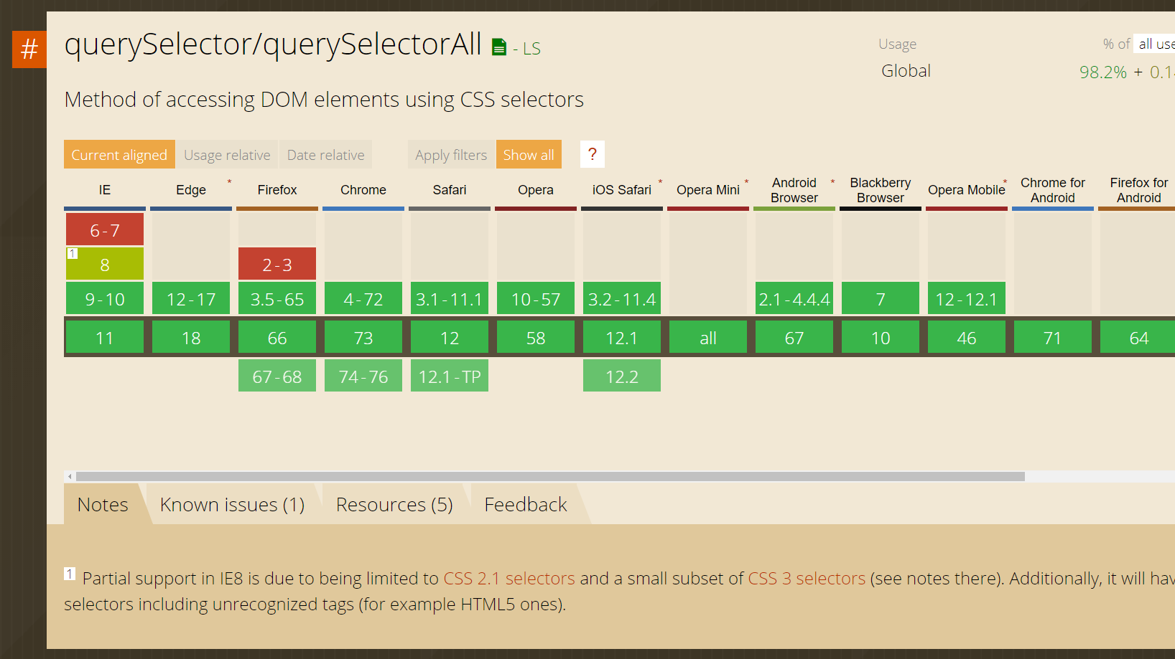
Notes:
https://caniuse.com/#search=qu

Slide 35
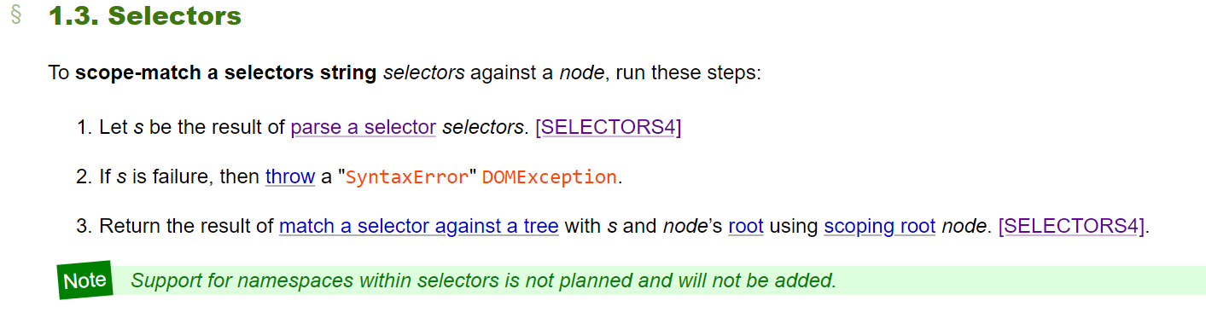
QuerySelectorAll
Notes:
https://dom.spec.whatwg.org/#selectors

Slide 36
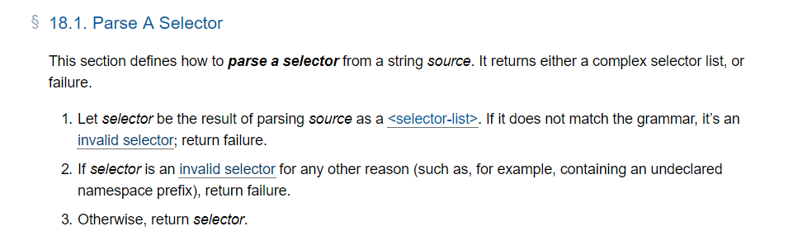
Notes:
https://drafts.csswg.org/selectors-4/#match-a-selector-against-a-tree

Slide 37
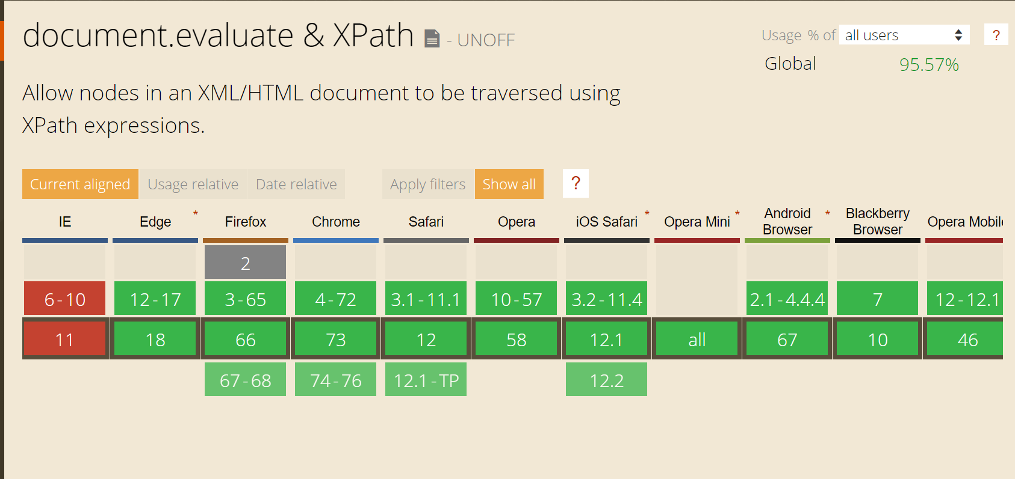
Xpath

Slide 38
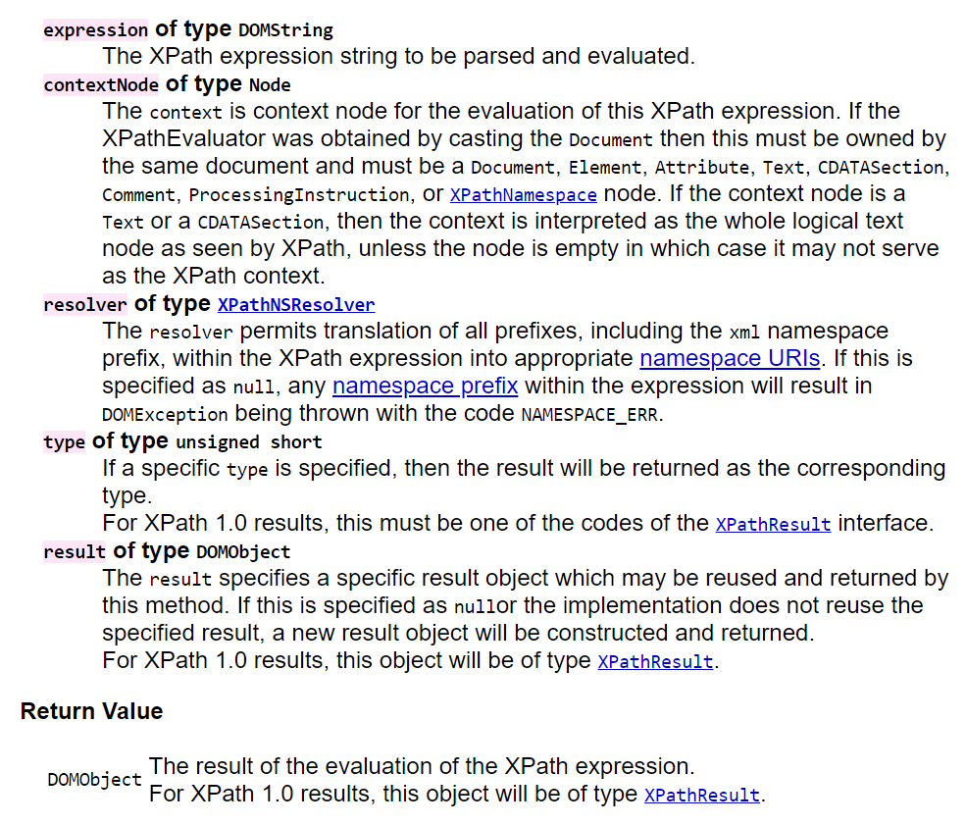
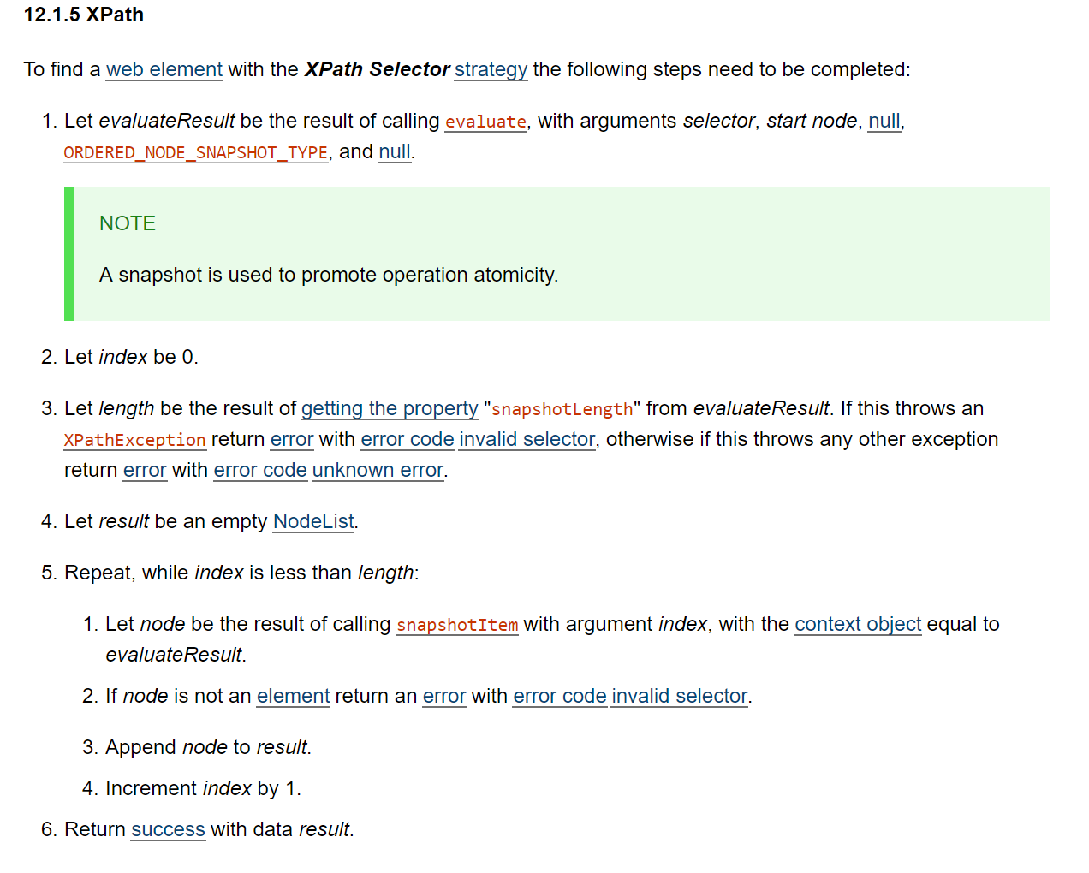
XPATH

Slide 39
To Sum it up
He Was wrong but know he is Right (sort of)
Selenium doesn't find elements it asks for it!
After all the men in the middle it is basicly served by Dom

Slide 40

Thank YOU
We are Hiring!

Slide 41
Sources
Test Doubles:
https://www.martinfowler.com/bliki/TestDouble.html
http://www.differencebetween.info/difference-between-stub-and-driver
Documentations & Standartds
https://dom.spec.whatwg.org/
https://www.w3.org/TR/DOM-Level-3-XPath/
https://www.w3.org/TR/selectors-api/

Slide 42
Sources pt 2
Codes Repostiories
https://github.com/SeleniumHQ/selenium
https://chromium.googlesource.com/chromium/src/+/master/chrome/test/chromedriver/
https://github.com/bayandin/chromedriver
https://github.com/ChromeDevTools/awesome-chrome-devtools
Other
http://scraping.pro/what-is-selenium-webdriver/
https://github.com/SeleniumHQ/selenium/wiki/Automation-Atoms
https://caniuse.com
https://firefox-source-docs.mozilla.org/testing/marionette/Intro.html
https://chromedevtools.github.io/devtools-protocol/
https://stackoverflow.com/questions/48369043/official-locator-strategies-for-the-webdriver

