Slide 1

How does Selenium Find Elements?
Maciej Wyrodek

Slide 2


About Me
Community leader and test automation expert at Objectivity
Blog: https://thebrokentest.com
ChainAnallyzer: https://www.nuget.org/packages/ChainAnalyzer

Slide 3
How does Selenium Find Elements?
Maciej Wyrodek

Slide 4

You don’t have to be an engineer to be a racing driver, but you do have to have Mechanical Sympathy.
- Jackie Stewart

Slide 5


A Long Time Ago…
Let's keep locators as Xpath!
I see a lot of issues with this approach:
Xpath is the simplest and allows for most of the things. Besides, it all treated the same by the browser!
This Photo by Unknown Author is licensed under CC BY-NC-ND

Slide 6
How I was taught
ID
Name
Css
Xpath
Link text

Slide 7

Let’s code

Slide 8
A Long Time Ago… But not as long as previously.
This experiment is not valid, it doesn’t reflect real-world scenario, and there are too many variables that could affect the result!
This Photo by Unknown Author is licensed under CC BY-NC-ND

Slide 9


Slide 10

Postman

Slide 11
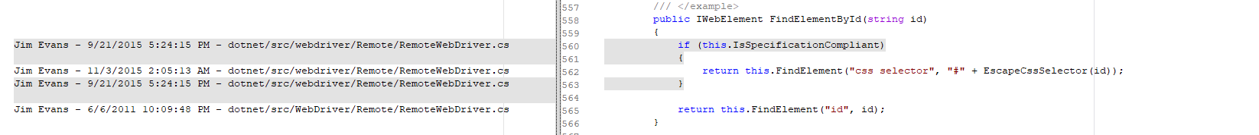

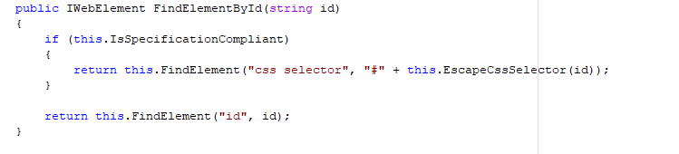
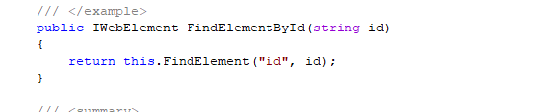
Let’s Go To code
2011-2015
2015-NOW

Slide 12
A Long Time Ago…
Ok! I give up you are right!
This Photo by Unknown Author is licensed under CC BY-NC-ND

Slide 13

Let’s look INTO ChromeDriver COde

Slide 14

Time For Theory

Slide 15
2004 – Jason Huggins Creates Selenium
Later known as Selenium Core

Slide 16
„Selenium tool started as a developers tool, for developers by developers.”
Jason Huggins

Slide 17



Selenium is used To Cure Mercury Poisoning

Slide 18

Selenium is used To Cure Mercury Poisoning

Slide 19
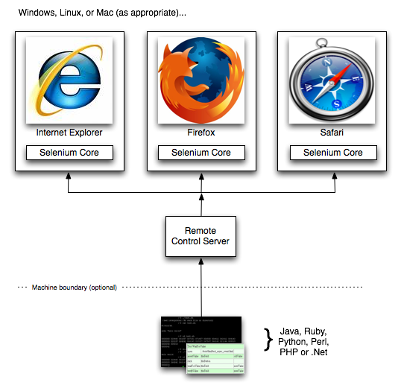
Old Times Selenium RC
Notes:
Source: https://www.seleniumhq.org/projects/remote-control/

Slide 20
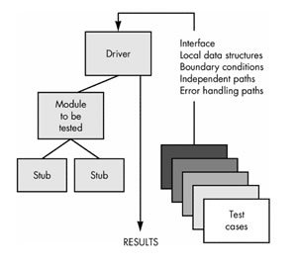
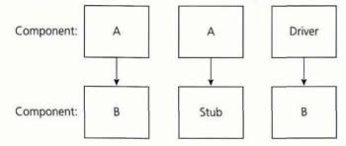
2006 – SImon StewaRT Start Work on Web Driver

Slide 21
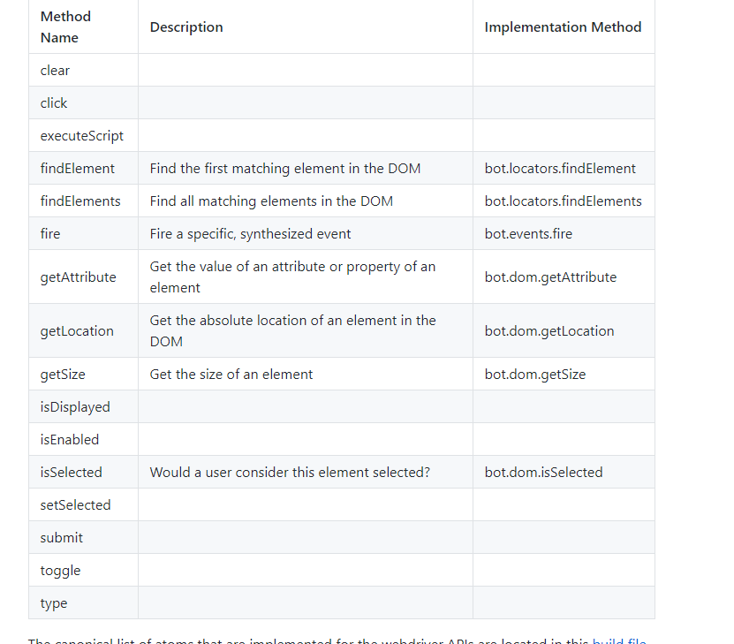
Automation Atoms

Slide 22
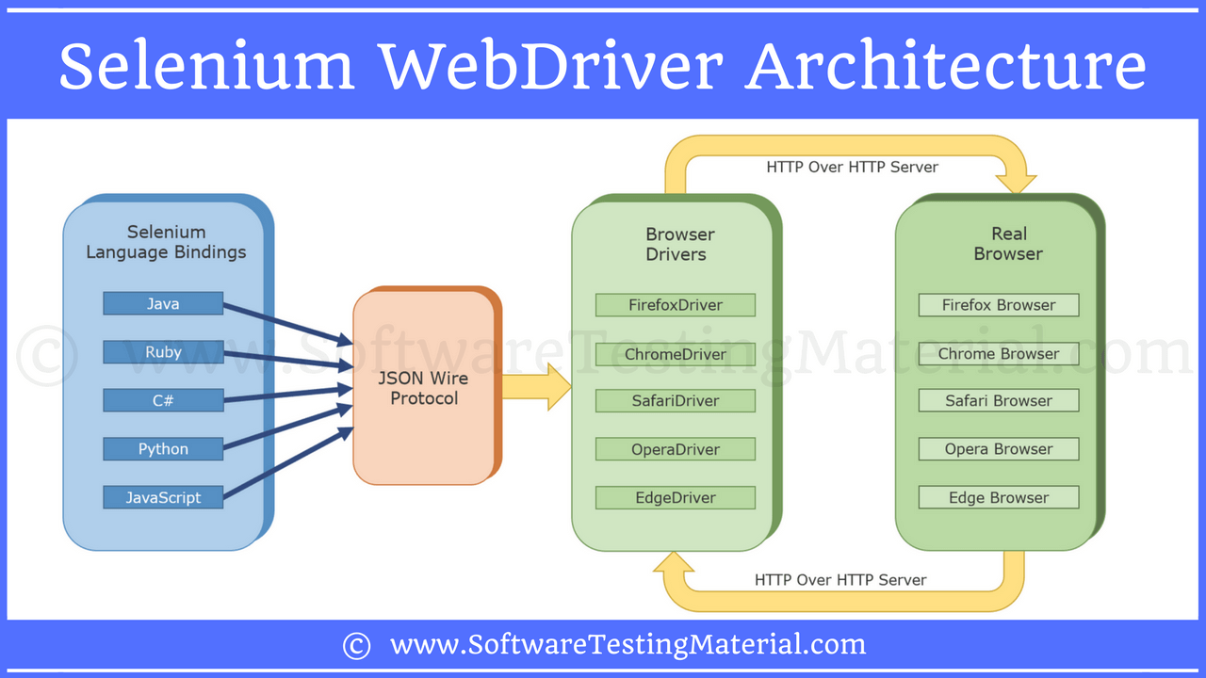
Selenium 2.0

Slide 23
Selenium doesn't find elements
It asks the browser to fetch element with the given locator.

Slide 24

But how does it happens?

Slide 25

Let’s look at some documentation
Notes:
Wrzucic jakiegoś znudzonego gościa w tło

Slide 26
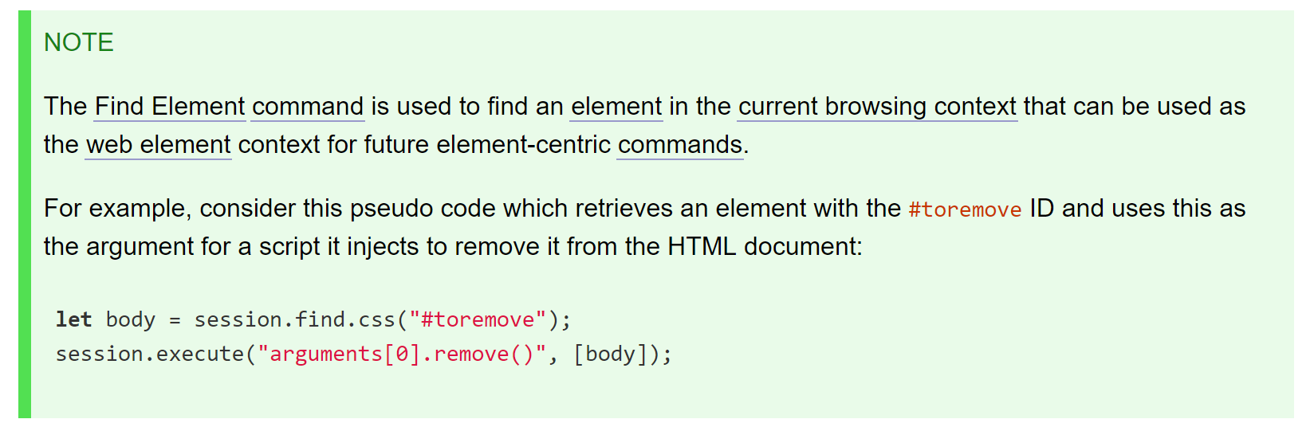

Slide 27
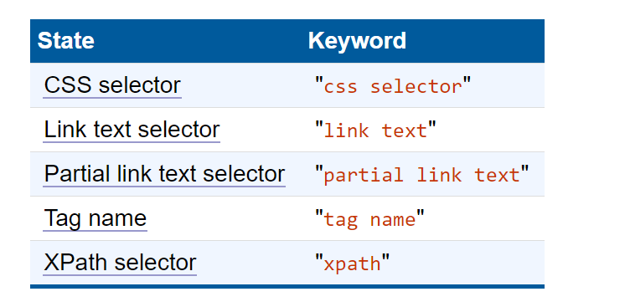
Locator StRategies

Slide 28
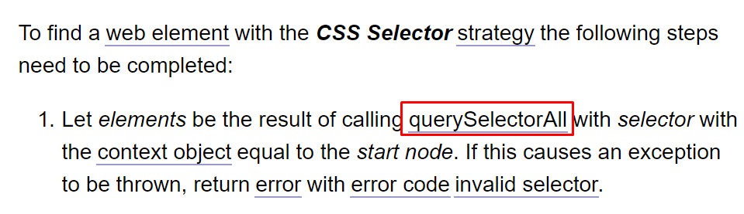
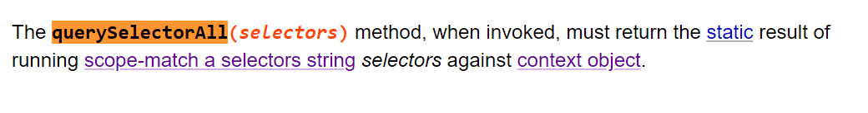
CSS Selector

Slide 29
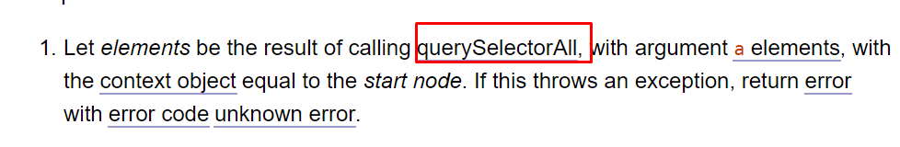
Link Text & Partial link tex

Slide 30
Locator Strategies
STATE | KEYWORD | DOM call | DOM LEVEL
CSS selector | css selector | querySelectorAll | 2
Link text selector | link text | querySelectorAll | 2
Partial link text selector | partial link text | querySelectorAll | 2
Tag name | tag name | getElementByTagName | 2
XPath selector | xpath | Evaluate ORDERED_NODE_SNAPSHOT_TYPE | 3

Slide 31
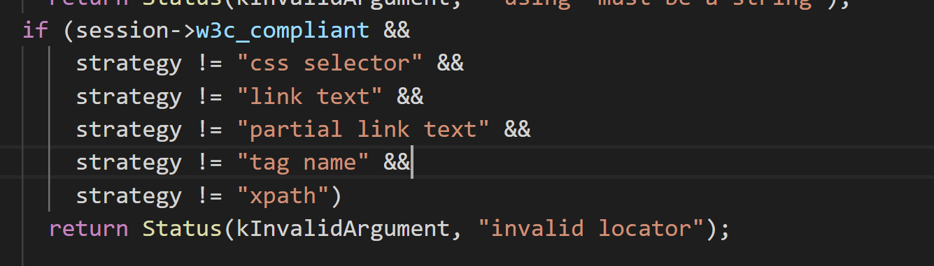
Notes:
https://github.com/bayandin/chromedriver
Element_utill.cc 300

Slide 32
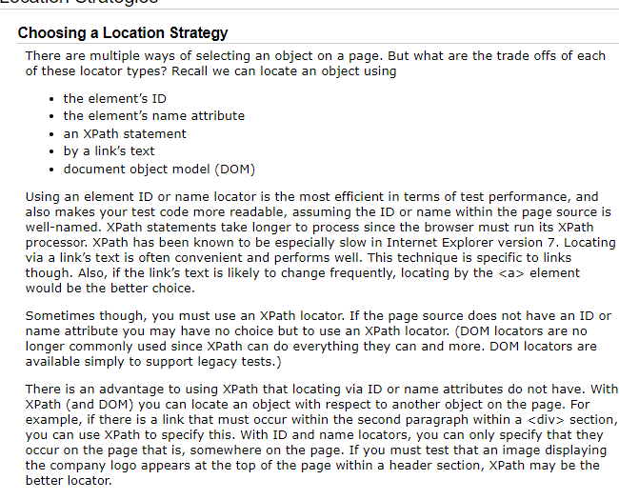
How I was taught
ID
Name
Css
Xpath
Link text
Notes:
https://www.seleniumhq.org/docs/06_test_design_considerations.jsp#location-strategies

Slide 33
Selenium 2.0

Slide 34
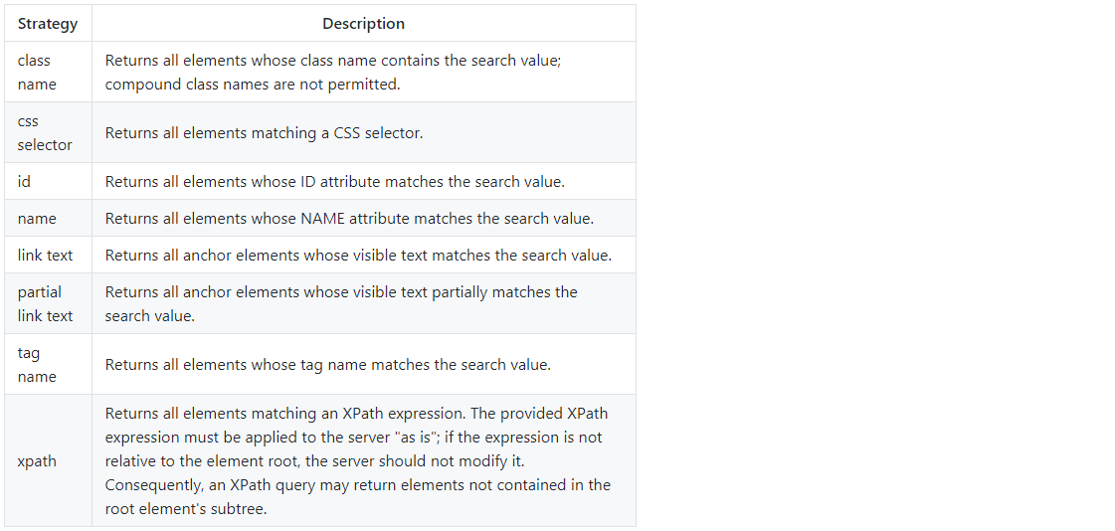
Notes:
https://stackoverflow.com/questions/48369043/official-locator-strategies-for-the-webdriver
https://github.com/w3c/webdriver/issues/1042

Slide 35
Selenium 2.0
WEBDRVIVER
WIRE
PROTOCOL

Slide 36


Okay How does it work?
Chrome DevTools Protocol
Marionette

Slide 37


Slide 38
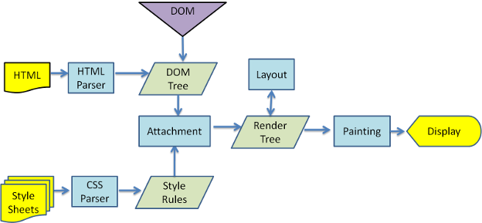
wEBKIT MAIN FLOW

Slide 39
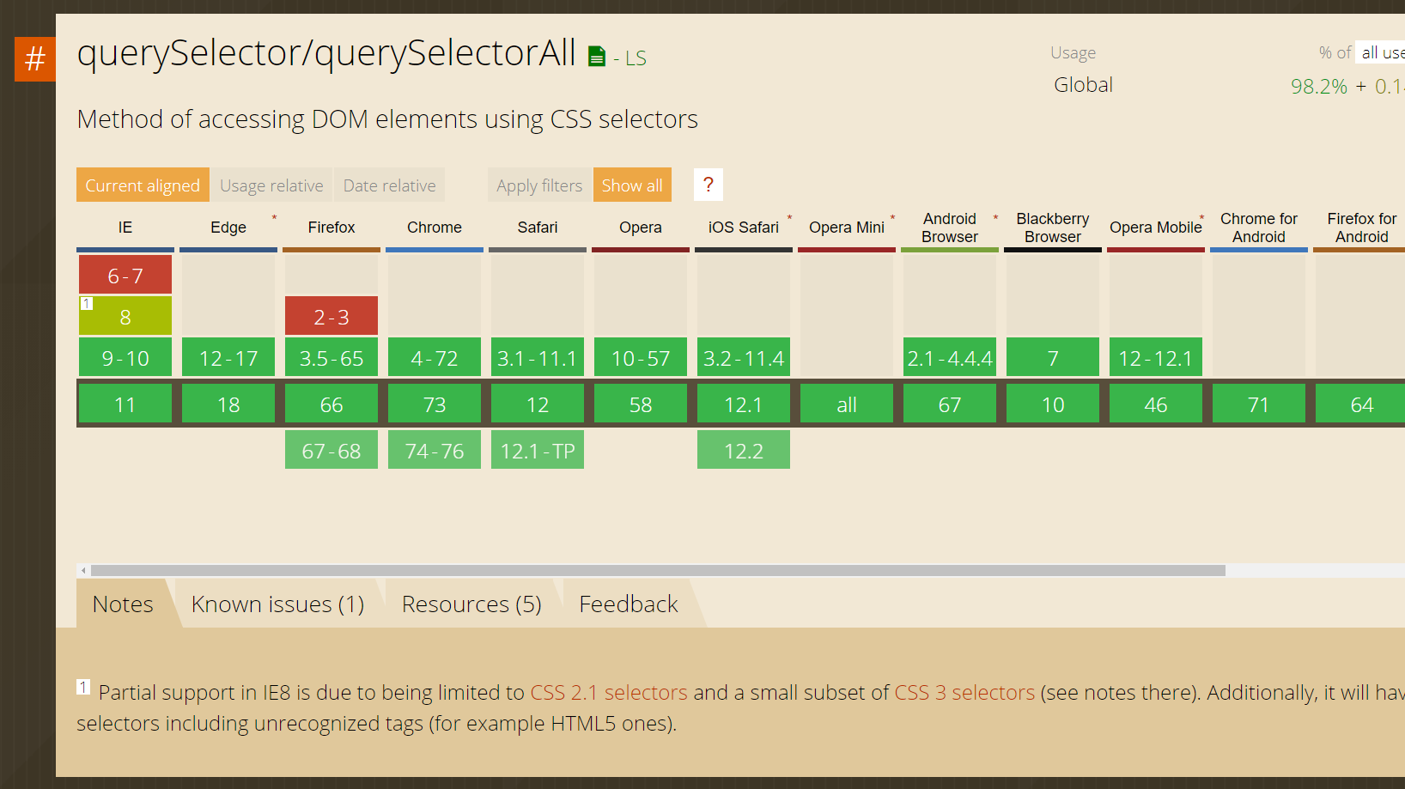
Notes:
https://caniuse.com/#search=qu

Slide 40
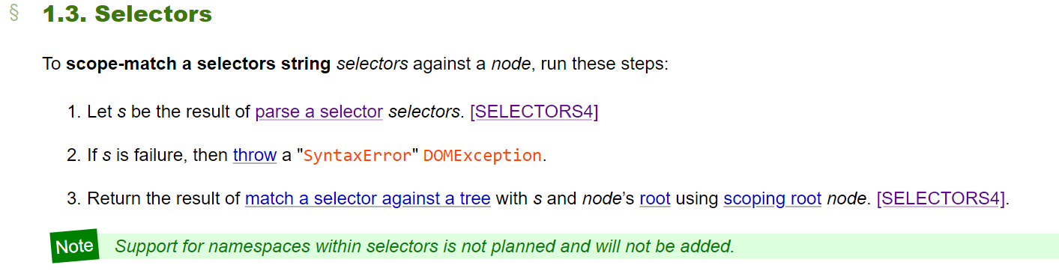
QuerySelectorAll
Notes:
https://dom.spec.whatwg.org/#selectors

Slide 41
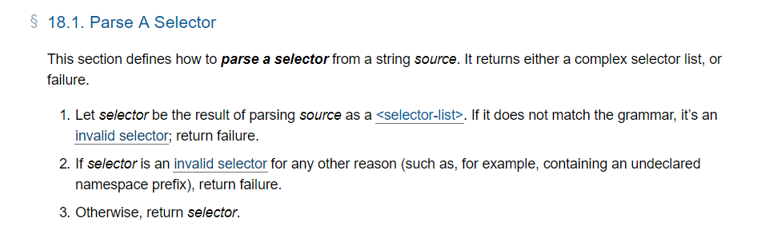
Notes:
https://drafts.csswg.org/selectors-4/#match-a-selector-against-a-tree

Slide 42
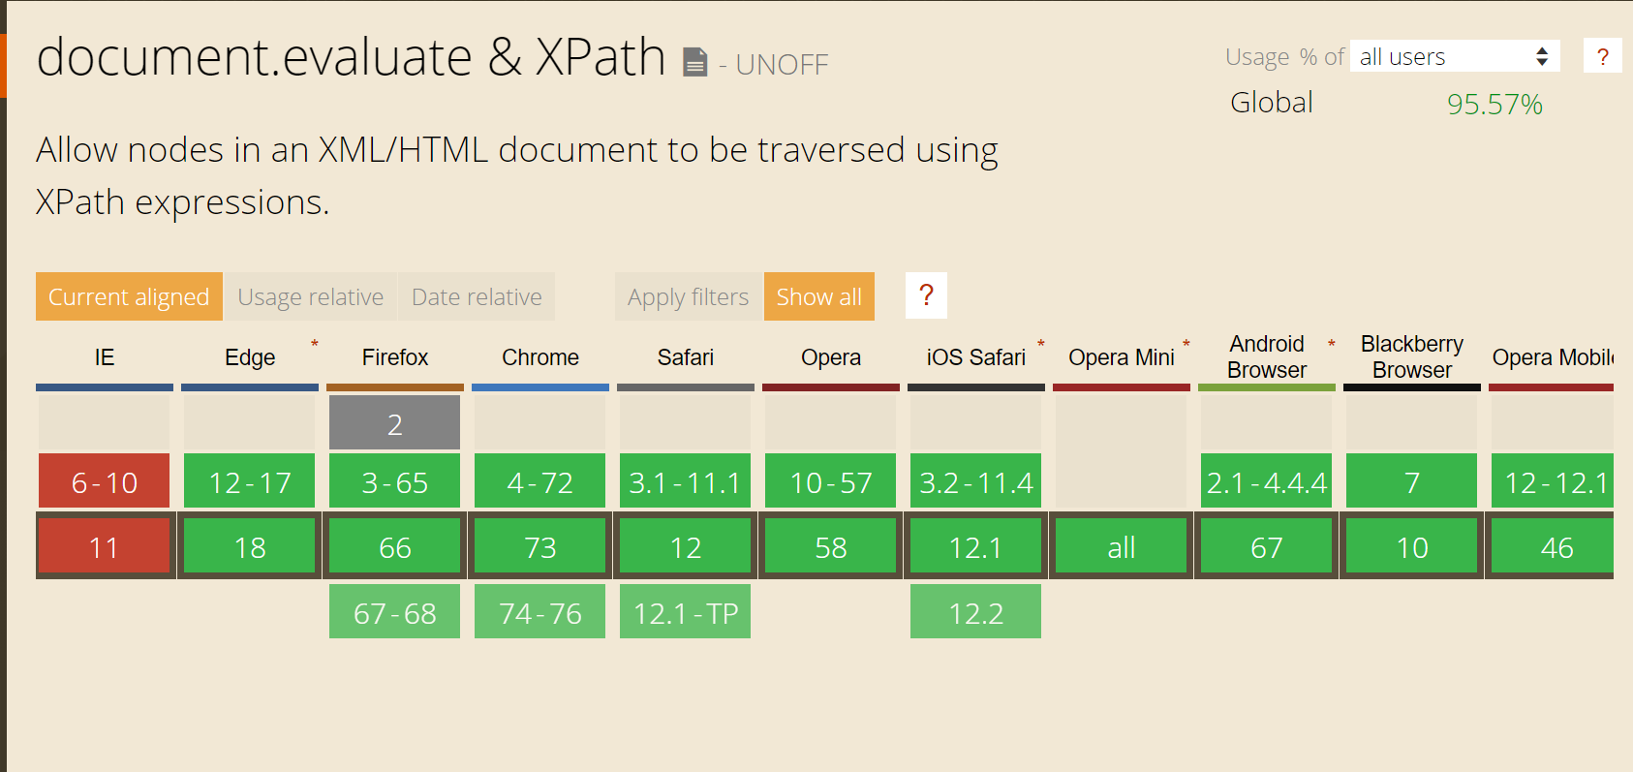
Xpath

Slide 43
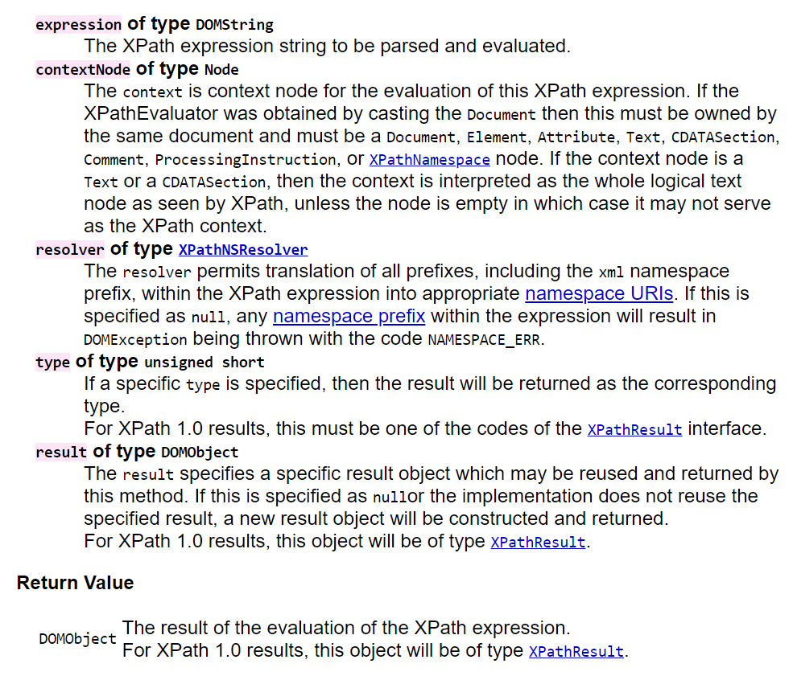
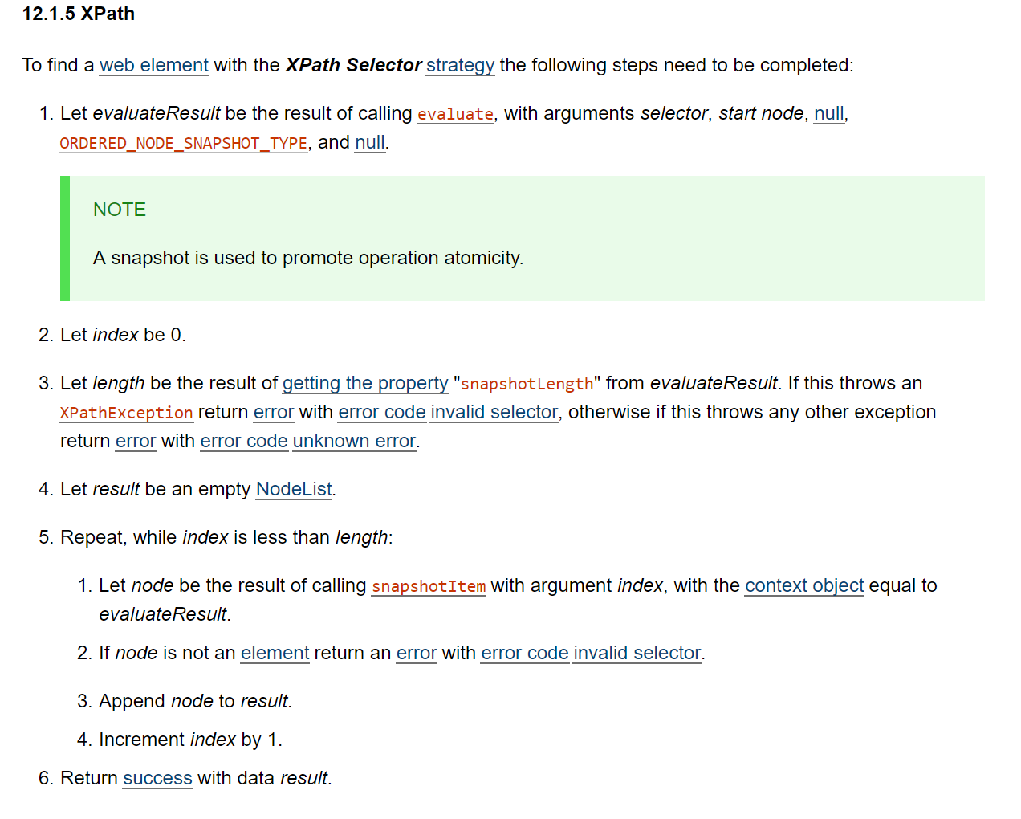
XPATH

Slide 44

Let's measure performance one more time!
(but in a less awkward way)

Slide 45
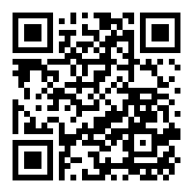
To Sum it up
He Was wrong but know he is Right (sort of)
Selenium doesn't find elements it asks for it!
After all the men in the middle it is basicly served by Dom

Slide 46
Sources
Test Doubles:
https://www.martinfowler.com/bliki/TestDouble.html
http://www.differencebetween.info/difference-between-stub-and-driver
Documentations & Standards
https://dom.spec.whatwg.org/
https://www.w3.org/TR/DOM-Level-3-XPath/
https://www.w3.org/TR/selectors-api/
https://www.w3.org/TR/webdriver1/

Slide 47
Sources pt 2
Code Repositories
https://github.com/SeleniumHQ/selenium
https://chromium.googlesource.com/chromium/src/+/master/chrome/test/chromedriver/
https://github.com/bayandin/chromedriver
https://github.com/ChromeDevTools/awesome-chrome-devtools
Other
http://scraping.pro/what-is-selenium-webdriver/
https://github.com/SeleniumHQ/selenium/wiki/Automation-Atoms
https://caniuse.com
https://firefox-source-docs.mozilla.org/testing/marionette/Intro.html
https://chromedevtools.github.io/devtools-protocol/

Slide 48
Sources pt 3
Podcasts & Videos:
https://www.youtube.com/watch?v=Vlz-WmcrBL8
https://www.angryweasel.com/ABTesting/ab-testing-episode-103-the-croissants-are-selenium-with-jason-huggins/
https://www.ministryoftesting.com/dojo/lessons/the-use-and-abuse-of-selenium-simon-stewart
https://www.youtube.com/watch?v=NtEZ2aBszrc
Other & Videos
https://stackoverflow.com/questions/48369043/official-locator-strategies-for-the-webdriver
https://www.youtube.com/watch?v=NtEZ2aBszrc
https://seleniumhq.github.io/docs/site/en/
https://www.youtube.com/watch?v=IcCnzXTxFt0

Slide 49
Sources pt 4
Other:
https://cs.chromium.org/chromium/src/chrome/test/chromedriver/README.txt
https://www.html5rocks.com/en/tutorials/internals/howbrowserswork/
https://wiki.mozilla.org/Gecko:Overview
https://html.spec.whatwg.org/multipage/parsing.html
Other:
https://docs.google.com/spreadsheets/d/1r0hCQ_PGyS0upupU5cOqTnRpHSGKq-I_zHdjCrN446Y/edit?usp=sharing
https://jsperf.com/queryselectorall-vs-getelementsbytagname/179

