Slide 1
Zachery K.N. Annancy
Web Tech Fall 2021 Final Exams

Slide 2
Zachery Annancy is developing a data powered website to help a company called Cat-world solve their problem of finding it difficult to capture and display altogether the records of all the wild cats they capture, keep and sell from the jungle to interested individuals, and return them back to the jungle after they have been made ready and fit enough for the jungle.

Slide 3
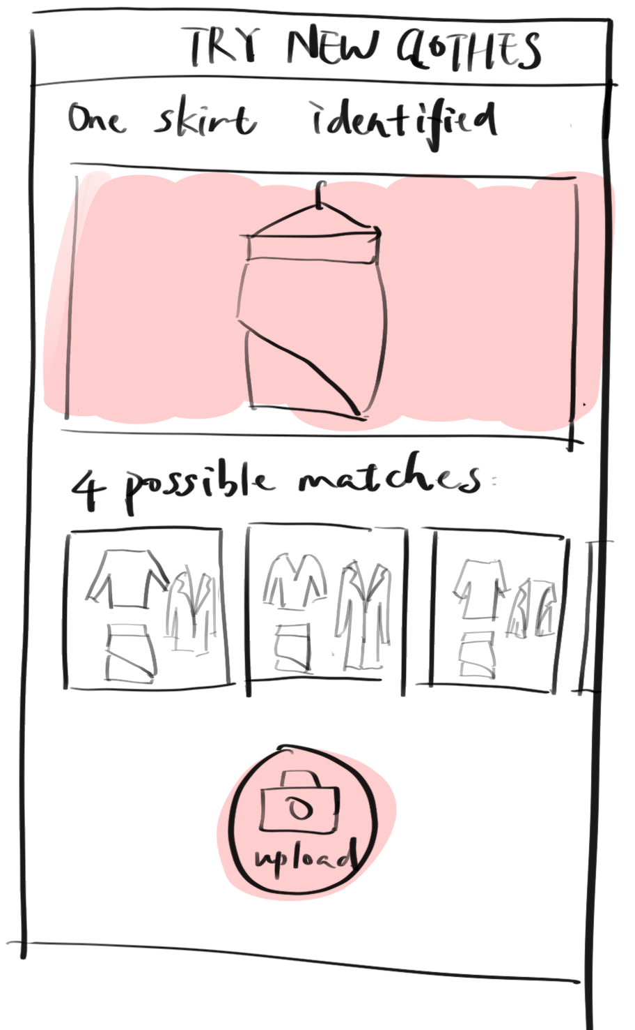



Cat-World
ddd
PROBLEM:
The problem of finding it difficult to capture and display altogether the records of all the wild cats they capture, keep and sell from the jungle to interested individuals, and return them back to the jungle after they have been made ready and fit enough for the jungle
PAYOFF:
Shows users the pictorial details of available wild cats which can be adopted or sponsored by investors
Allows the users have immediate responses to their asked questions concerning the company, as if it were a live chat.
PERSONA(s)
Investors, Members, Visitors
are the people involved in using the website. Most of them are novice users.
FINISH: The users are better off with the website than before because the website allows easier communication.
It also allows users to have a more visual analysis of the wild cats available.

Slide 4
User / Customer
“Cat-world” is a company that capture, keep and sell wild cats from the jungle to interested individuals, and return them back into the jungle after they have been made ready and fit enough for the jungle. The reason for their operation is to prevent the extinction of the wild cats since some of them are now endangered species. Cat-world ensures they are taken care of by the employees as well as buyers. The company also makes sure that the cats mate with one another to continue the lineage of various breeds of wild cats.
Roles of the users:
Investors: Their roles are to assess or evaluate the information provided on the website.
Members: Their roles are to monitor the information uploads on the website
Visitors: Their roles are to interact with the information provided on the website.

Slide 5
Main Functions of the Website
The website will allow users be able to visually analyze the available wild cats in the company’s possession.
The website will allow users sign up virtually to be apart of the team and allow these members (such as hunters, explorers, and adventurists) provide the company with information to help the endangered wild cats.
The website will provide all users with all available information about the company feature to allow users have live interactions for making enquiries through some of the workers at the company.

Slide 6
Architecture
Presentation Layer: HTML, CSS
Application Layer: PHP, JavaScript
Data Layer: MySQL
Presentation Layer
HTML, CSS
Data Layer
MySQL
Application Layer
PHP, JavaScript

