Slide 1
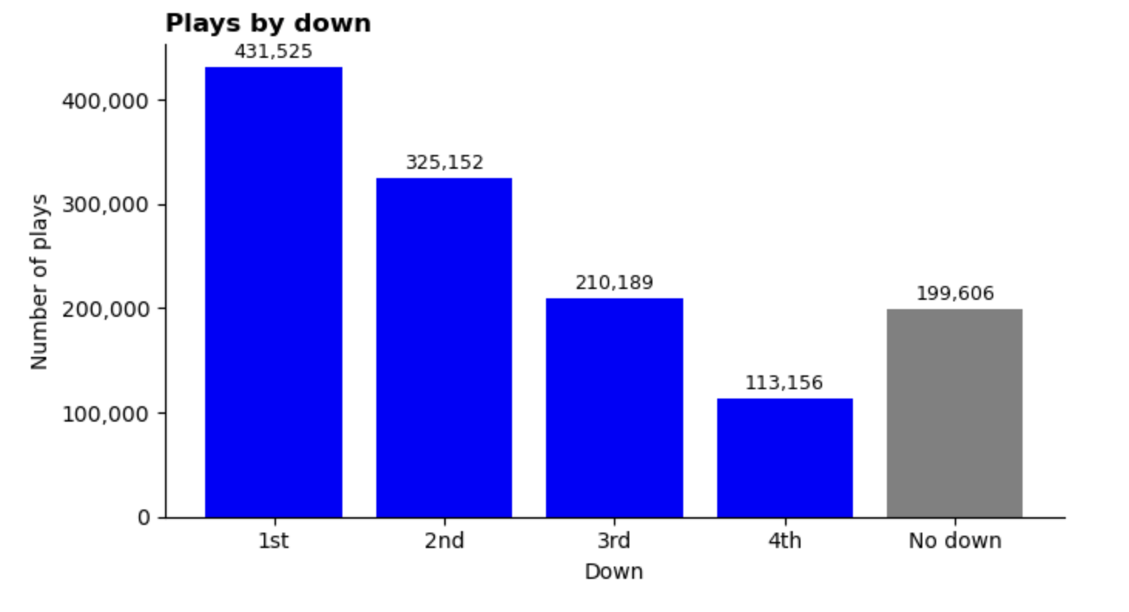

Slide 2
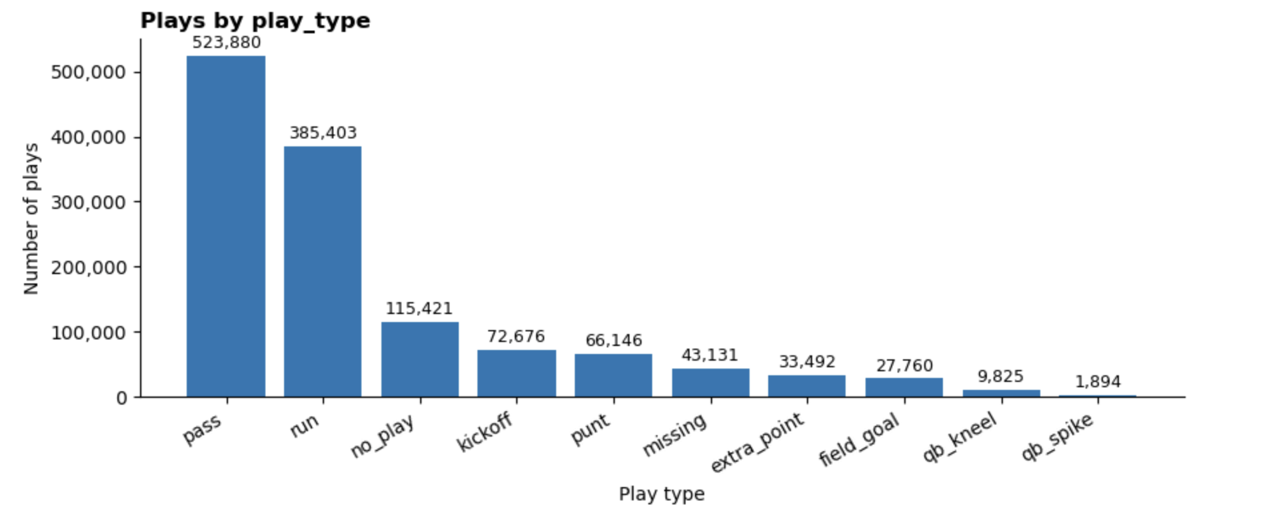

Slide 3
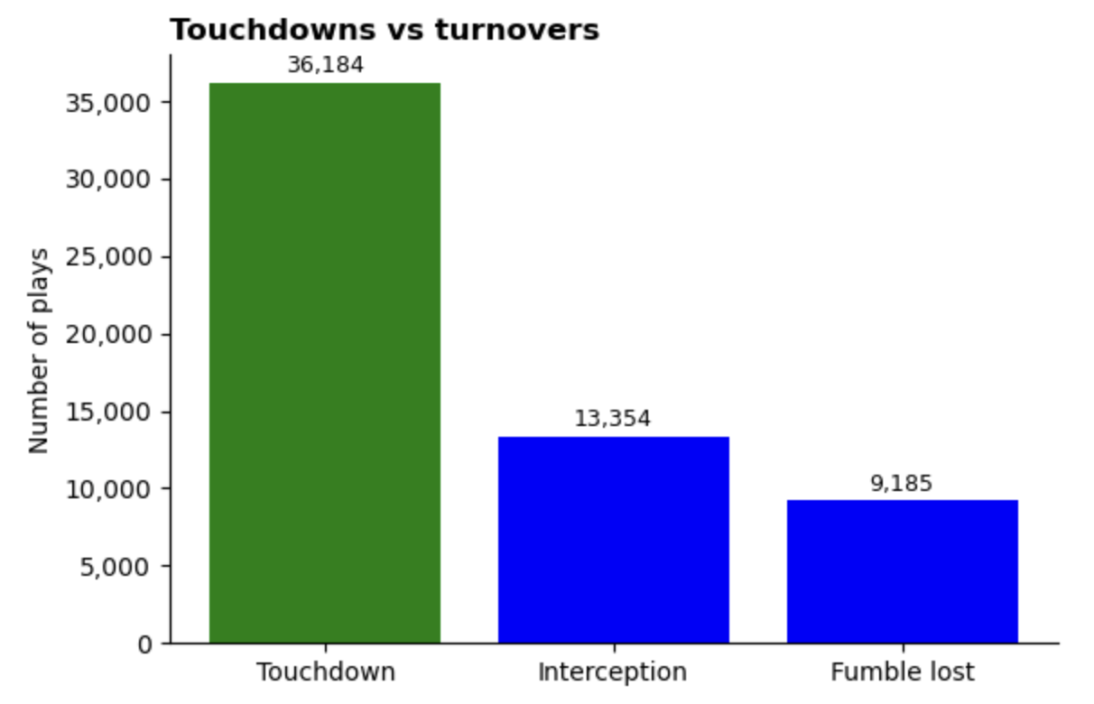

Slide 4
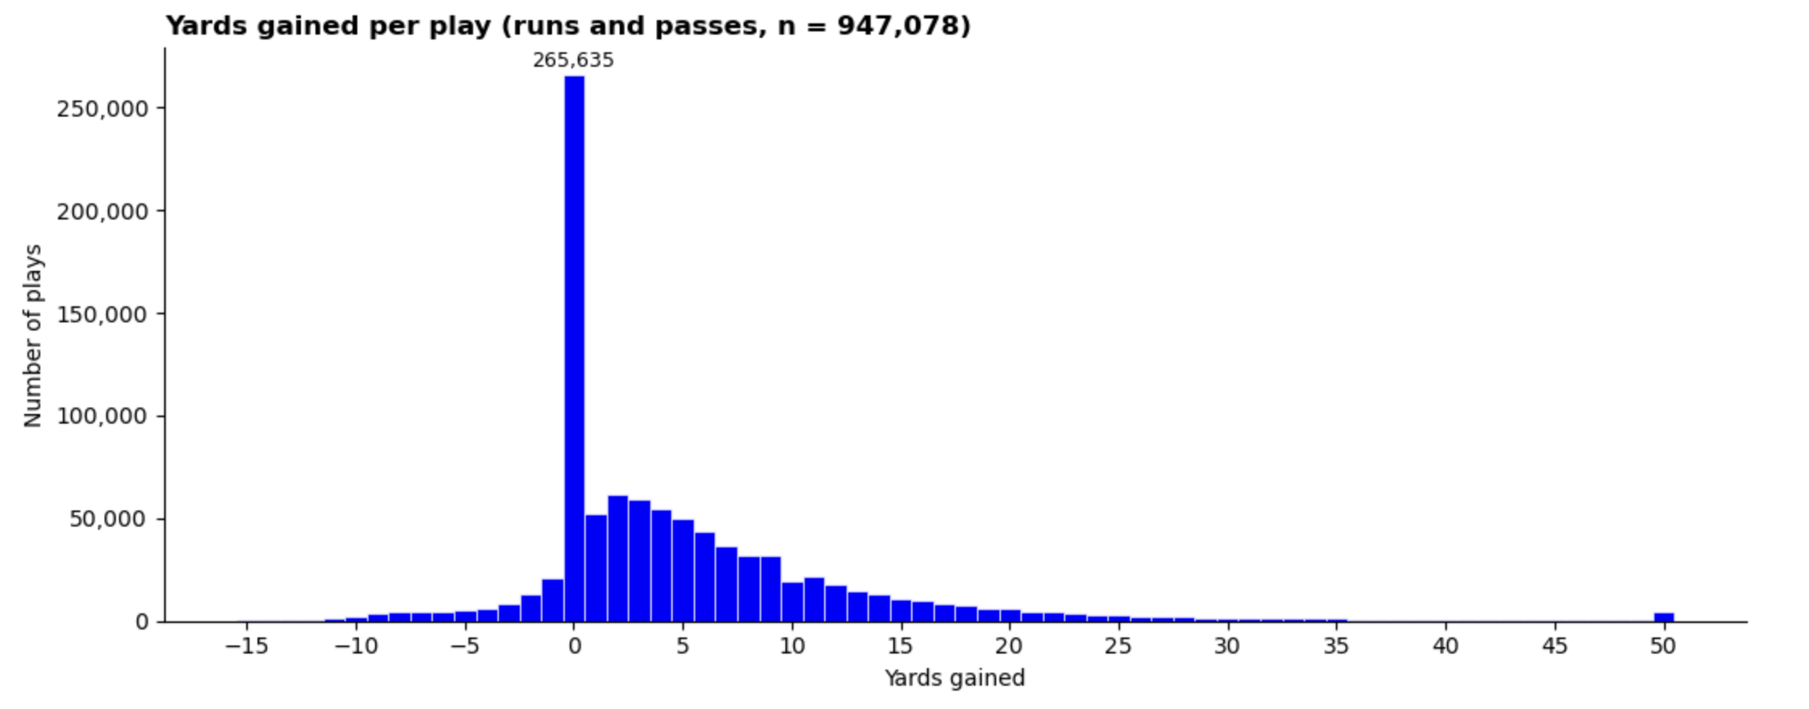

Slide 5
Run vs. Pass: Predicting Play Outcomes with Uncertainty
Two separate models: one fitted on run plays, one on pass plays. The models are estimated using a multinomial logistic regression.
Each play is one row: the outcome is its yardage category (≤0, 1–10, 11–14, 15–19, 20–29, 30+, TD or turnover). The predictors are field position, down, yards to go, if the previous play gained yards, as well as offense and defense scores.
Training data: downs 1–3 from 1999–2022, with 2023–2025 held out to test accuracy. The models are then refit on all seasons for the dashboard.
Predictions: the model gives the probability of each outcome category, which is used to calculate expected yards, P(first down), P(TD) and P(turnover).
Uncertainty: the fitted coefficients and their covariance are used to draw 200 plausible coefficient sets. The spread of predictions across those draws gives the 90% confidence intervals and P(pass better).
Could use ML classifiers (random forest, XGBoost, etc.) but it would be harder to create the confidence intervals, ie. will need a bootstrapping procedure, and might be harder to implement in JS.

Slide 6
The target would be a categorical variable for the outcome of the play, based on yards gained/lost or TD/TO.

Slide 7
Predictors in the model
Field position: yards to the opponent's end zone (in 10-yard zones).
Down: 1st, 2nd or 3rd, as a category.
Yards to go: grouped as 1, 2, 3, 4–5, 6–7, 8–10, 11–15 (15+ capped at 15).
Previous play gained: 1 if the previous play in the same drive gained more than 0 yards; 0 otherwise, including the first play of a drive.
Offense score: the pre-game strength of the team with the ball.
Built from: yards per play, offensive points per game and EPA per play season-to-date numbers mixed with last season’s, weighted toward the current season as more games are played standardized within each season (0 = league average). Alternatively standardize to a score 0-100.
Defense score: the same construction using yards, points and EPA allowed. Higher means a better defense.

Slide 8
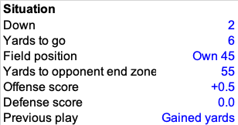
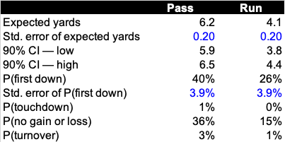

Slide 9
What's currently done.
NFL analytics mostly measures play value with single-number summaries, where expected points and EPA, win probability, and metrics such as success rate and pass rate are expressed just by a single number. Models of outcome distributions exists, but comprehensive tools like this are still rare - at least not public. (check NFL's 2020 Big Data Bowl)
This project's contribution.
It predicts the full yardage distribution for both runs and passes in the same situation, adjusted for the strength of the specific offense and defense, rather than one average number. It also measures how certain that run-versus-pass comparison is, and presents it in an interactive decision map. The dashboard shows where each play type is predicted to do better, by how much, and whether the call is clear-cut or a toss-up.

