Slide 1

Academic Performance Analysis and Early Prediction of Student Dropout
AMER ZAKARIA (amer_154532)
Coordinator: doaa Akram kordab

Slide 2
This project aims to understand and analyze students’ personal data that has been collected about them at the time of their enrollment in various courses in a Portuguese University, as well as their first and second semester information, which is present in the dataset. Additionally, since the dataset also contains a student status (graduate, enrolled, and dropout) at the end of the normal duration of the course, enrolled means still studying at that time, so we could make a predictive model that predicts whether a student is going to drop out or not while he/she is still an undergraduate.

Slide 3
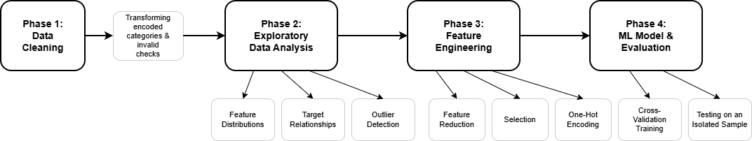
Project Phases

Slide 4
Data Cleaning: Preparing the Dataset
While the data is already cleaned from its source, I’ve done a couple of quick checks:
Checked null & empty values
Checked for duplicates
Checked for inconsistency (Portuguese student and international at the same time)

Slide 5
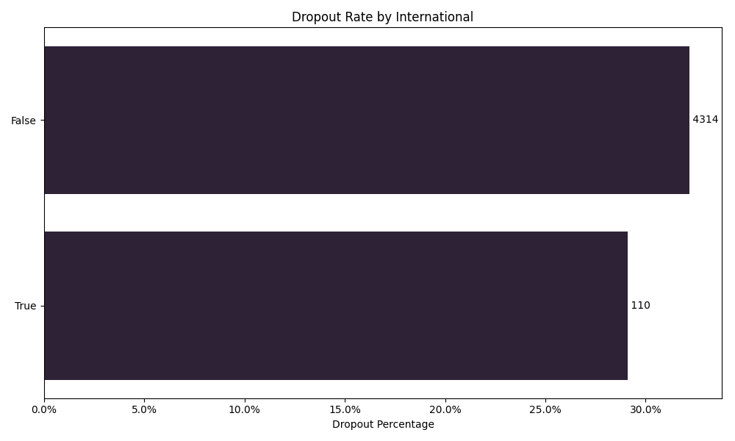
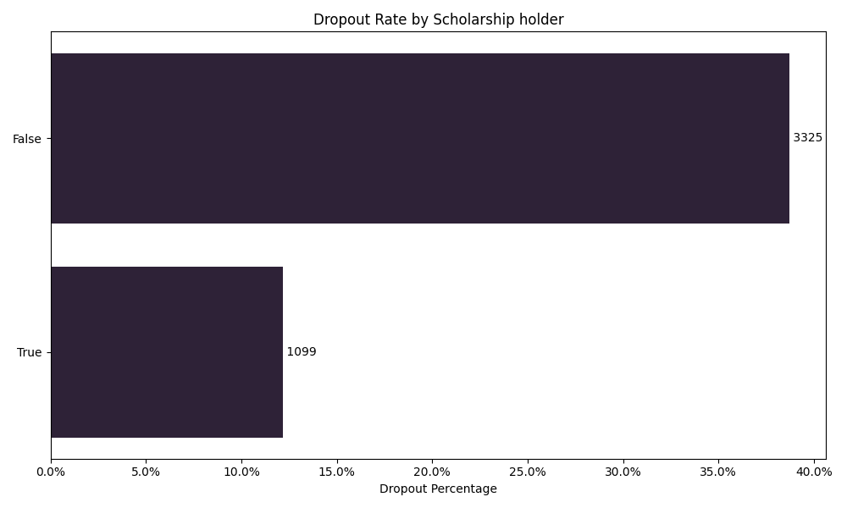
Feature Engineering - Feature Selection – Categorical
The dropout rates for international students don’t differ that much from those of local students, which makes me able to remove this feature.
In contrast, scholarships have a significant impact on the dropout rate. Those who had a scholarship are 25% more likely to either graduate or stay enrolled.

Slide 6
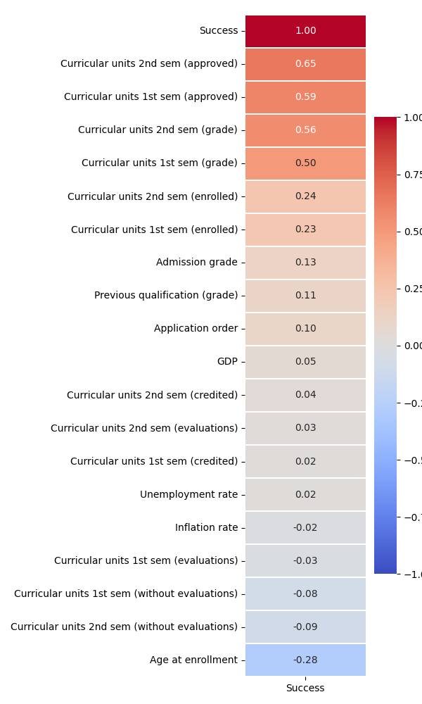
Feature Engineering - Feature Selection – Numerical
I’ve done ordinal encoding on the Target feature to become named “success”: 0 -> Dropped out
1-> Still enrolled
2 -> Graduated
And then correlated the “success” feature with the numerical features in my dataset, and found that only 7 features had a noticeable relationship with (Approximately 25% or more, negative or positive relationships), which I would keep for the training phase

Slide 7
Feature Engineering - Feature Reduction
Feature | Spearman Correlation (1st vs 2nd)
(credited) | 0.91
(enrolled) | 0.96
(evaluations) | 0.69
(approved) | 0.89
(grade) | 0.76
(without evaluations) | 0.38
I kept only the Average of the semesters 1 & 2 corresponding features as they are highly correlated.

Slide 8
Feature Engineering - One_hot Encoding
I performed one-hot encoding for non-ordinal categorical features to avoid false ordinal relationships with the target. But for each feature, I am ignoring categories with less than 15 occurrences, the values of which are all 0s for all of the one-hot encoded columns for the same original feature) The result of which can be found at `data/processed/3_preprocessed.csv` from the root directory

Slide 9
ML Training & Evaluation
I’ve used the Decision Tree and Logistic Regression models to predict the dropout binary (0 didn’t drop out, and 1 dropped out) Kept aside a testing set which consists of 15% of the dataset without training anything on it, so that I can ultimately evaluate the model's accuracy based on it On the remaining 85% of data, I used 5-fold crossover, which trained and validated the dataset across 5 different splits.
The output result of the modelling is as follows:
Decision Tree Cross-Validation Scores (5 folds): ['0.77', '0.79', '0.79', '0.79', '0.80'] Mean CV Score: 0.79 Decision Tree accuracy score: 0.77 Logistic Regression Cross-Validation Scores (5 folds): ['0.85', '0.85', '0.86', '0.85', '0.85'] Mean CV Score: 0.85 Logistic Regression accuracy score: 0.84
Interpretation of the output: Both models had consistent cross-validation results across all of the splits. As for the testing set evaluation, Logistic Regression has been more effective at predicting the dropout potential of the students using the accuracy score evaluation method (which takes the correct predictions and divides them by the total predictions made). We can say that 84% of the time, the Logistic Regression model could predict whether a student would drop out or not at the end of the normal duration of the course he/she has enrolled in.

