Slide 1
Group 2:
Ali , Ameer, Nav

Slide 2
DOES MARITAL STATUS INFLUENCE MONTHLY INCOME LEVELS?
hrssample.csv
Notes:
Introduction i was given the hard task : too…..

Slide 3
Is it worth it?
Notes:
Ladies and gentlemen The biggest question is :
To get married yes or is it a no?
If this is your question fear not i am here to help you analyze the data to make you that sound decision .

Slide 4
How did we analyze?
Married vs single : Age
Married vs single: Income
Married vs single: Education
Married vs single: Current Manager

Slide 5
AGE

Slide 6
Average age?
FOR MARRIED : 38
FOR SINGLE : 35
Notes:
What was the average age we got using out mean method?

Slide 7
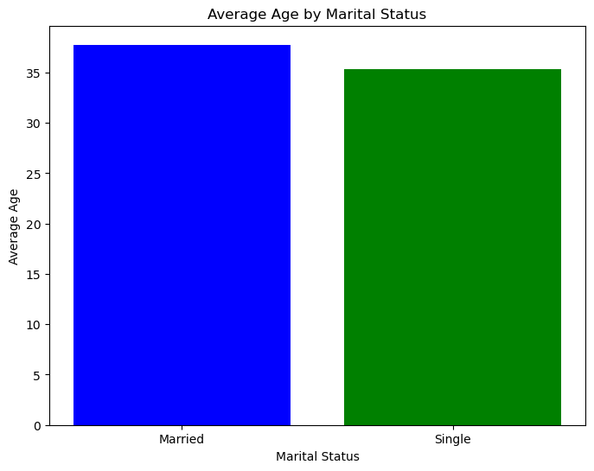

Slide 8
MONTHLY INCOME

Slide 9
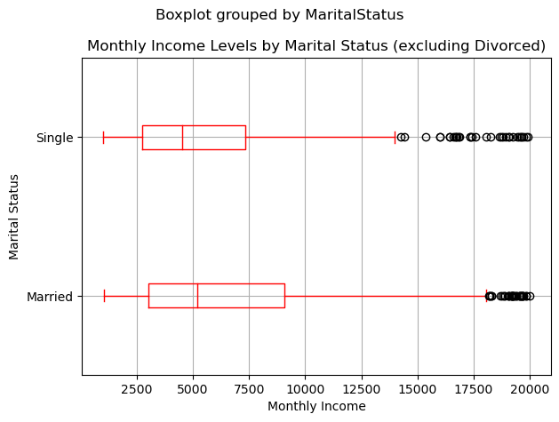
Median salaries
Notes:
Monthly Income for married individuals (5204.00) is higher than that for single individuals (4536.00)

Slide 10
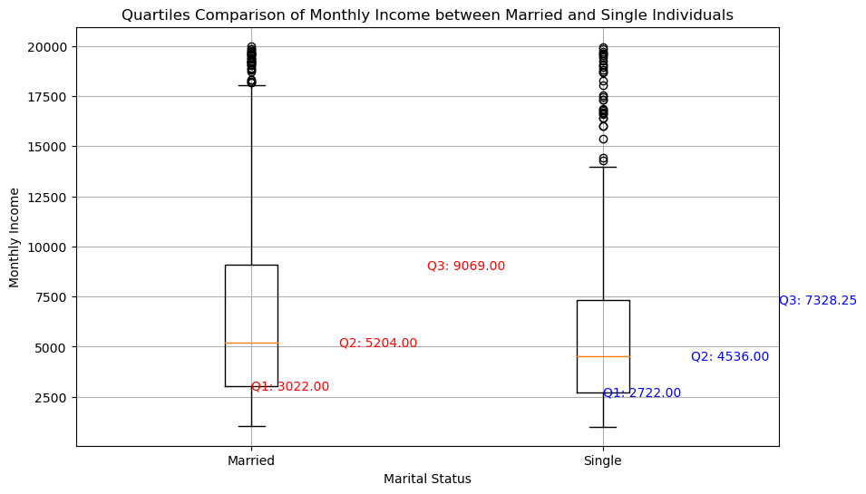
Notes:
Monthly Income for married individuals (5204.00) is higher than that for single individuals (4536.00)
2)Income Spread: The interquartile range (IQR), which is the difference between the 75th and 25th percentiles provides a measure of the spread of the data.
The IQR for married individuals (9069.00 - 3022.00 = 6047.00) is wider than that for single individuals (7328.25 - 2722.00 = 4606.25).

Slide 11
INCOME SPREAD
INCOME SPREAD FOR THE IQR IS
MARRIED = (9069.00 - 3022.00 = 6047.00)
SINGLE = (7328.25 - 2722.00 = 4606.25)
This indicates that the Monthly Income distribution for married individuals is more spread out than for single individuals.
Notes:
2)Income Spread: The interquartile range (IQR), which is the difference between the 75th and 25th percentiles provides a measure of the spread of the data.
The IQR for married individuals (9069.00 - 3022.00 = 6047.00) is wider than that for single individuals (7328.25 - 2722.00 = 4606.25).

Slide 12
QUARTILE CONCLUSION:
Quartile values allow us to compare the income distribution and identify differences between married and single individuals.
Married were higher in pay than the singles.

Slide 13
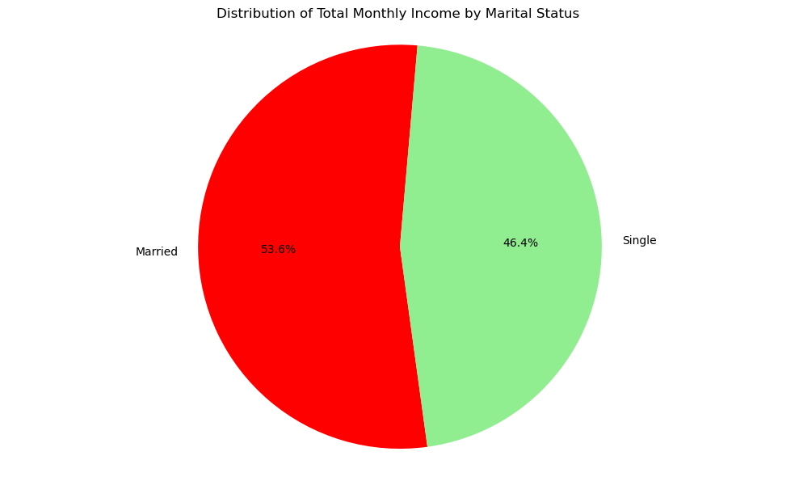
Notes:
Conclude Martal status vs single

Slide 14
EDUCATION:
Notes:
NOW WE ARE ENTERING EDUCATION:

Slide 15
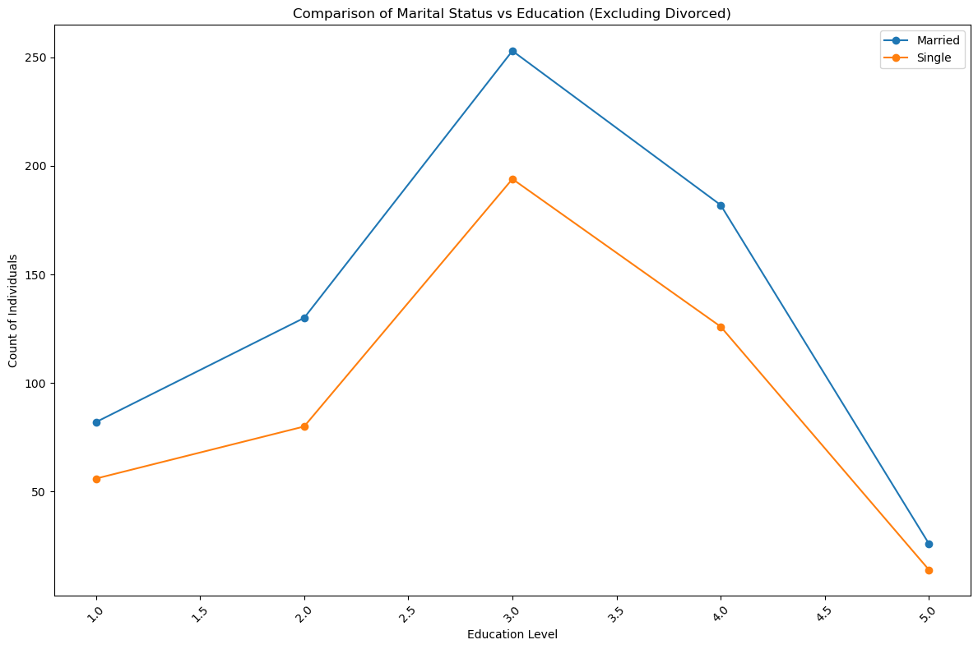
Notes:
I can delete this if time is an issue

Slide 16
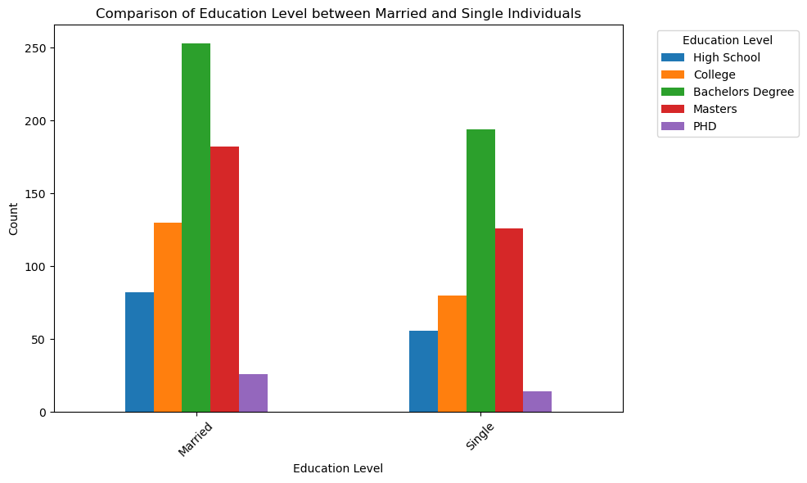

Slide 17
Compare Marital status with Current Manager

Slide 18
