Slide 1
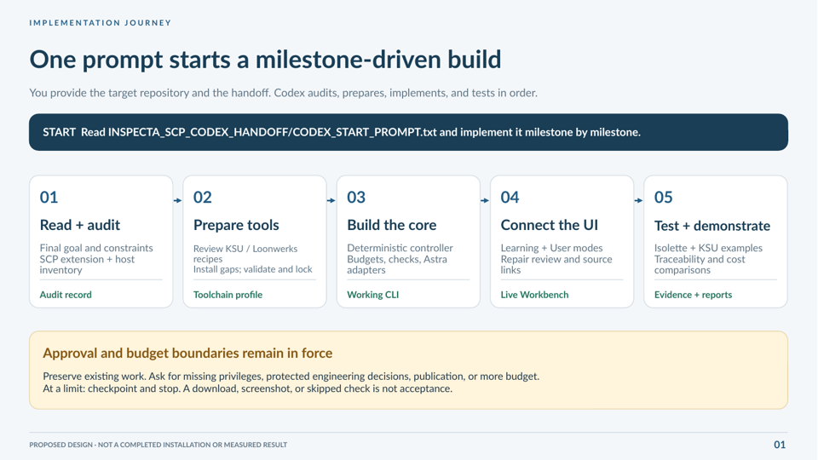
Notes:
Proposed implementation, not a completed toolchain or measured experiment. The supplied HTML is an offline synthetic prototype. The PNG is static. Repository browsing, live generation, checks and evidence are Codex implementation requirements. Use CODEX_START_PROMPT.txt and the consolidated goal; consult PACKAGE_GUIDE.md for exact script capabilities. This visual slide is a raster illustration, not an editable application or source-code diagram.

Slide 2
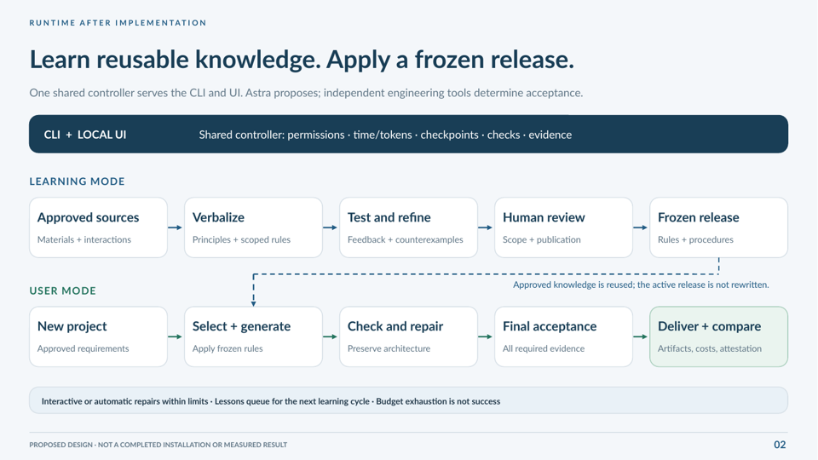
Notes:
Proposed implementation, not a completed toolchain or measured experiment. The supplied HTML is an offline synthetic prototype. The PNG is static. Repository browsing, live generation, checks and evidence are Codex implementation requirements. Use CODEX_START_PROMPT.txt and the consolidated goal; consult PACKAGE_GUIDE.md for exact script capabilities. This visual slide is a raster illustration, not an editable application or source-code diagram.

Slide 3
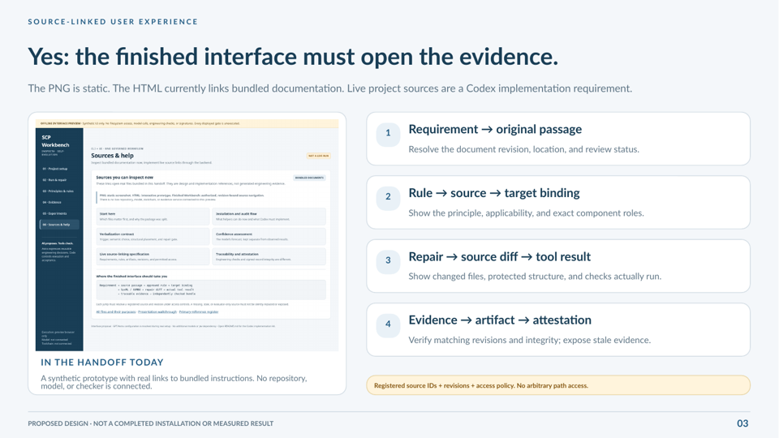
Notes:
Proposed implementation, not a completed toolchain or measured experiment. The supplied HTML is an offline synthetic prototype. The PNG is static. Repository browsing, live generation, checks and evidence are Codex implementation requirements. Use CODEX_START_PROMPT.txt and the consolidated goal; consult PACKAGE_GUIDE.md for exact script capabilities. This visual slide is a raster illustration, not an editable application or source-code diagram.

