Slide 1
Overview of NCES Large-Scale Assessments With a Closer Look at NAEP and TIMSS
EdSurvey Large-Scale Data Analysis Training Series| October 2021
Martin Hooper, PhD
American Institutes for Research

Slide 2
What are large-scale assessments?
Tests that focus on measuring and monitoring what populations know and can do in academic subject areas
Populations are usually certain ages/grade in cities, states, countries
Subpopulation measurement (gender, SES, race/ethnicity) is also prioritized
Academic subject areas include mathematics, science, reading, civics, computer literacy, etc.
National assessments like NAEP for the United States allow for trend monitoring and comparisons between states and large cities
International assessment like TIMSS, PIRLS, and PISA allow for country-level trend monitoring and between-country comparisons

Slide 3
Closer look at National Assessment for Educational Progress (NAEP)

Slide 4
National Assessment of Educational Progress (NAEP)
Congressionally mandated in the United States - began in 1969
A comprehensive nationally representative assessment of what U.S. students know and can do in a broad range of academic subjects
Designed to produce national, state, and large urban school district results, not a testing program for individual students or schools
Administered by the National Center for Education Statistics (NCES)
State assessments since 1990
Urban district results (on trial basis) since 2002
Policy oversight and guidance by the National Assessment Governing Board (NAGB)

Slide 5
NAEP Components
The National Assessment of Educational Progress (NAEP)
MAIN
LONG-TERM TREND
National
Public & Non-public
Grades 4, 8 & 12
State
Public
Grades 4 & 8
National
Public & Non-public
9, 13 & 17 yr olds
Trial Urban District
Public
Grades 4 & 8

Slide 6
Main: National Assessments
Reports statistical summaries of student achievement and factors related to educational performance for the nation and specific subgroups of the population
Includes students drawn from both public and nonpublic schools and reports results for student achievement at grades 4, 8, and 12
Follows subject-area frameworks developed by NAGB

Slide 7
Main: State Assessments
First reported performance at the state level in 1990
Assesses public school students only at grades 4 and 8, in selected subjects, reading, mathematics, science, and writing
Allows states to monitor progress over time in the selected subject areas and allows comparisons with other states and with the nation
Follows subject-area frameworks developed by NAGB that are identical, by grade and subject, to those for the national assessment

Slide 8
Frequency of Assessments
NAEP conducts national and state assessments at least once every two years in reading and mathematics in grades 4 and 8 (beginning in 2003).
Due to COVID, NAEP was not administered in 2021 but instead will be administered in 2022.
Other NAEP subjects (writing, science, history, geography, civics, economics, and arts) in 4th, 8th and 12th grades will continue to be assessed on a voluntary basis at regularly scheduled intervals.
TEL assessment was administered in 2014 first for grade 8 only.

Slide 9
NAEP Reporting
Achievement levels
Scale scores
Disaggregated data by:
Subgroups (e.g., race/ethnicity, gender, SD, ELL)
SES: National School Lunch Program eligibility, parental education level (for grade 8 only)
Geography (national, state and regional comparisons; school location)
Background information (i.e., school, teacher and student questionnaires)

Slide 10
NAEP Achievement Levels
NAEP reports by scale scores and achievement levels
Levels set by NAGB and designed to describe what students should know and be able to do
NAEP reports three achievement levels at each grade:
NAEP Basic denotes partial mastery of prerequisite knowledge and skills that are fundamental for proficient work at each grade
NAEP Proficient represents solid academic performance for each grade assessed
NAEP Advanced represents superior performance

Slide 11
How NAEP Data are Used
NAEP provides a credible independent standard that educators, legislators and the general public can use to gauge the effectiveness of education policies.
NAEP data enable policymakers to examine the relative emphasis of state standards.
NAEP data are used by research scientists who study education policy issues and the development of student skills and abilities.
Although numerous data tools are available, NAEP student-level data is restricted-use and use must be licensed.
The NAEP primer data used for the examples in this training is publicly-available.

Slide 12
International Large-Scale Assessments (ILSAs)

Slide 13







NCES International Activities Program
Study |  | What’s Surveyed? | Who’s Surveyed? | When?
International Early Learning Study (IELS) |  | Emerging literacy skills Emerging numeracy skills Empathy & trust Self-regulation | 5-year-olds | 2018
Progress in International Reading Literacy Study (PIRLS) |  | Informational and reading literacy Online reading literacy | 4th-graders | 2001, 2006, 2011, 2016, 2021
Trends in International Mathematics and Science Study (TIMSS) |  | Mathematics Science | 4th-graders 8th-graders | 1995, 1999, 2003, 2007, 2011, 2015, 2019
 |  | Advanced mathematics Physics | Advanced 12th-graders | 1995, 2008, 2015
International Computer and Information Literacy Study (ICILS) |  | Computer and information literacy | 8th-graders | 2013, 2018
Program for International Student Assessment (PISA) |  | Reading literacy Mathematics literacy Science literacy Problem solving Financial literacy | 15-year-olds | 2000, 2003, 2006, 2009, 2012, 2015, 2018
Teaching and Learning International Survey (TALIS) |  | Teachers’ teaching practices, and learning environments | Teachers in grades 7, 8, and 9 | 2008, 2013, 2018
Program for the International Assessment of Adult Competencies (PIAAC) |  | Literacy skills Numeracy skills Problem solving in a technology-rich environment | Adults ages 16-65 (16-74 in the U.S.) | 2012, 2022

Slide 14
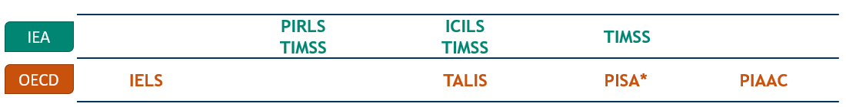
NCES International Studies Across the Lifespan
High School
Adults
Middle School
Literacy
Numeracy
Problem Solving
Outcomes in employment, income, education, health
Early Childhood
Elementary
Reading
Mathematics
Science
Financial literacy
Collaborative problem solving
Advanced mathematics and physics
Mathematics
Science
Teachers and teaching
Computer and information literacy
Reading
Mathematics
Science
Online Reading
Literacy
Numeracy
Social Skills
Executive Function
PIRLS
TIMSS
TIMSS
*PISA Young Adult Follow-Up Study (PISA YAFS), a longitudinal extension of PISA 2012, was released in June 2021. EdSurvey 2.7 can be used to analyze PISA YAFS.

Slide 15
Uses of International Assessments
Provide information for international achievement comparisons
How does the performance in one country compare with that of other countries?
Examine trends in achievement
How does one country’s achievement increase or decrease over time?
Improve education by informing policy, research, and practices
What factors are associated with educational achievement? What can we learn from others about what works (and what doesn't)? What could be adopted by or adapted?

Slide 16
Closer look at Trends in International Mathematics and Science Study (TIMSS)

Slide 17
TIMSS and TIMSS Advanced Administration Cycle
1995
2003
2007
2011
2015
1999¹
2019
TIMSS
TIMSS Advanced
- - - - - - - - - - -
- - - -
1995
2015
2008
TIMSS
: Mathematics and science assessment at grades 4 and 8
TIMSS Advanced
: Advanced mathematics and physics assessment in the final year of secondary school
¹ Grade 8 only

Slide 18
Sponsorship and Management
 | TIMSS (and PIRLS)
Sponsor | IEA
International contractor | TIMSS & PIRLS International Study Center at Boston College
National research center | US: NCES

Slide 19
Complex Sampling :Why Do We Use Samples?
Impossible to test everyone on everything
Too many people
Too many items
Too expensive
Not necessary to test everyone on everything, e.g.,
Blood sample
Soup sample
ILSA context:
Some students are tested on some items
Results should be seen in the context of the student and item sample design
Source: Sabine Meinck, Ph.D., IEA, Design of International Large-Scale Assessments and Implications for Multilevel Modeling

Slide 20
Complex Sample Designs
Why “complex”?
Multiple stages of sampling
Homogenous clusters are sampled
Stratification is used
Selection probabilities differ for different sampling units
Source: Sabine Meinck, Ph.D., IEA, Design of International Large-Scale Assessments and Implications for Multilevel Modeling

Slide 21



Multiple Sampling Stages
IDSCHOOL
150-200 schools sampled
Schools (1st stage)
IDCLASS
Classroom (2nd stage)
IDSTUD
4000-5000
students sampled
All students in classroom
Notes:
https://timssandpirls.bc.edu/publications/timss/2015-methods/T15-Methods-and-Procedures-TIMSS-2015.pdf page 49

Slide 22
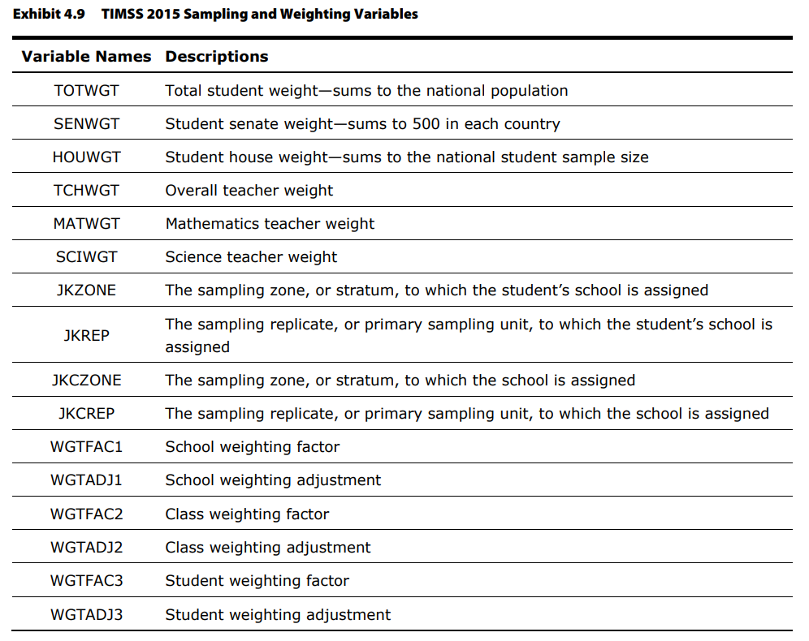
Sampling Weights
Single-level analysis
Student background and achievement data
TOTWGT, SENWGT, HOUWGT (student-level)
Teacher background data
MATWGT, SCIWGT (student-level)
Multilevel analysis
Need to construct weighting variables at different levels using weight factor and adjustment

Slide 23
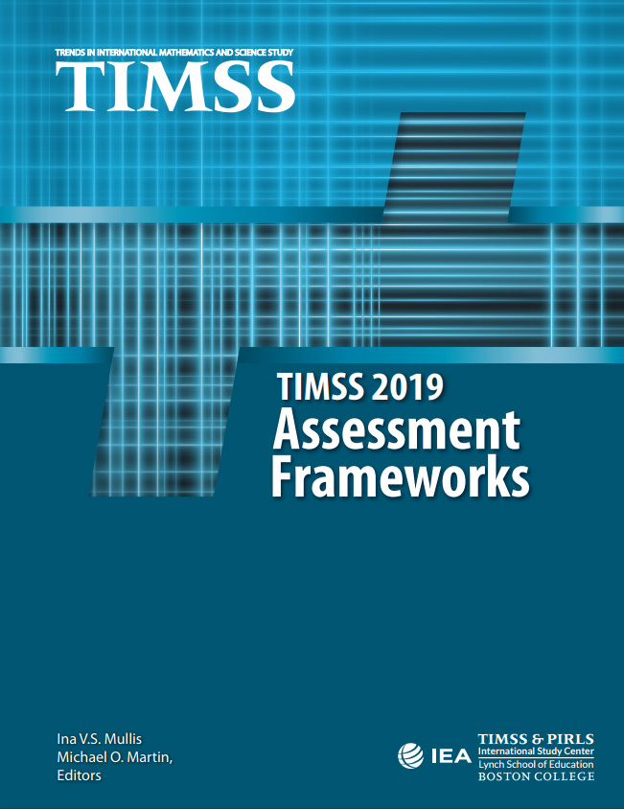
TIMSS Frameworks
Content dimension that specifies the mathematics/science content to be assessed
Cognitive dimension that specifies the thinking processes to be assessed

Slide 24
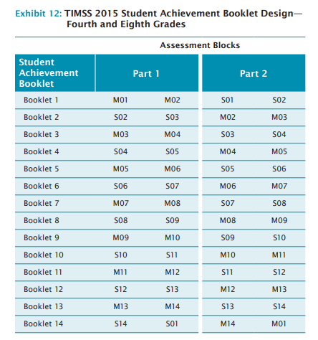
Complex Assessment Design
TIMSS uses a matrix-sampling approach
Combine responses across all students
Item response theory scaling methods
Comprehensive picture of the achievement of the entire student population of a country

Slide 25
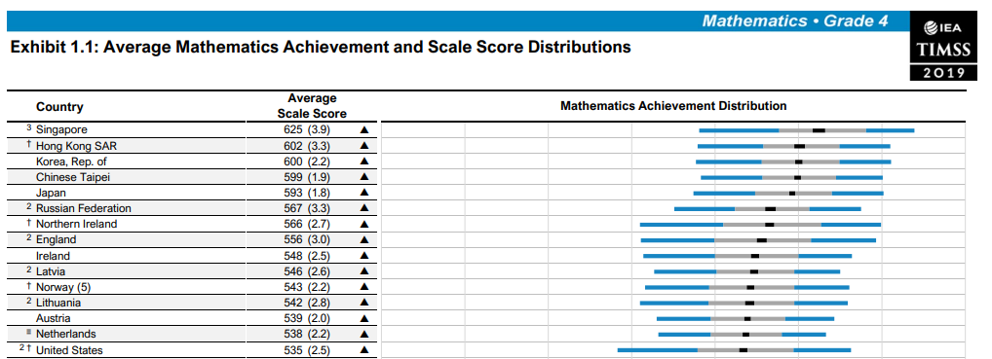
TIMSS Achievement Scales
Range
0 – 1000
Standard deviation
100
Centerpoint
500
(set to correspond to the mean of overall achievement in 1995)
Notes:
The TIMSS achievement scales were established in TIMSS 1995 based on the achievement across all participating countries, treating each country equally.
At each grade, the scale has a range of 0–1,000 (although student performance typically ranges between 300 and 700). A centerpoint of 500 was set to correspond to the mean of overall achievement in 1995, with 100 points set to correspond to the standard deviation.
Achievement data from subsequent TIMSS assessments have been reported on these scales so that increases or decreases in average achievement may be monitored across assessments. TIMSS uses the scale centerpoint as a point of reference that remains constant from assessment to assessment.

Slide 26
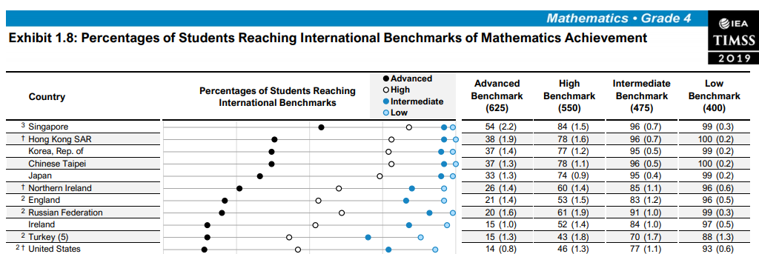
International Benchmarks

Slide 27
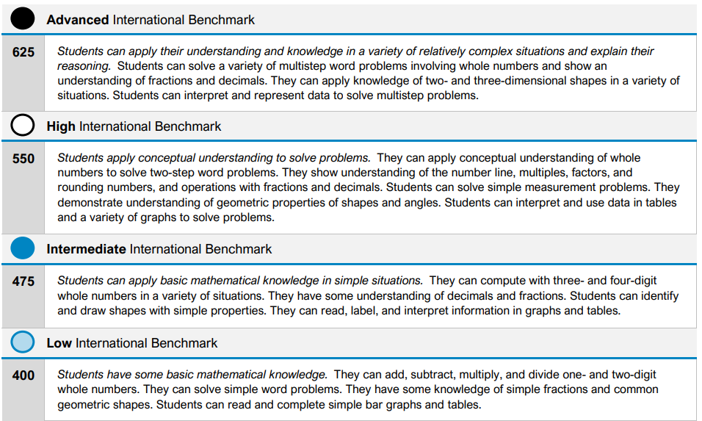
International Benchmarks

Slide 28
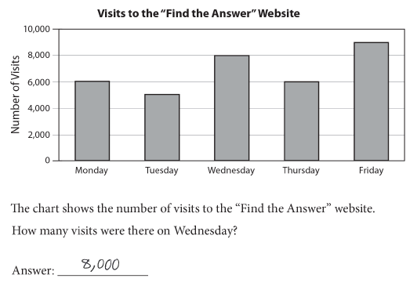
Example TIMSS Grade 4 Math Assessment Item
Content Domain: Data Display
Cognitive Domain: Knowing
Proficiency Level: Low
Percentage of students answering correctly:
U.S. average: 90%
International average: 84%
SOURCE: NCES. The Commissioner's presentation of the TIMSS and TIMSS Advanced 2015 results

Slide 29
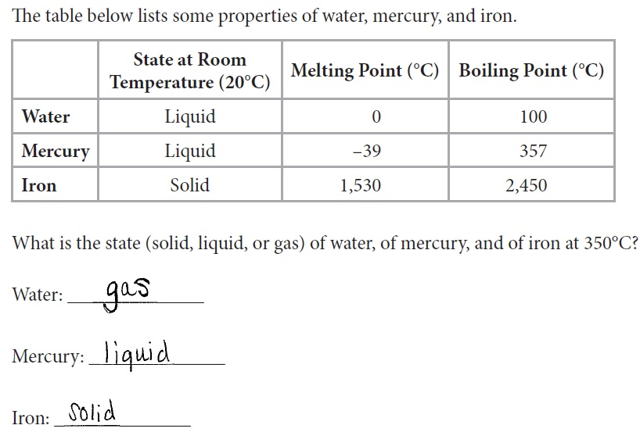
Example TIMSS Grade 8 Science Assessment Item
Content Domain: Chemistry
Cognitive Domain: Reasoning
Proficiency Level: High
Percentage of students answering correctly:
U.S. average: 40%
International average: 39%

Slide 30
Questionnaires (and Example Components)
Student
Home educational resources (socioeconomic status)
Self-perceptions, beliefs, and attitudes about learning
Teacher
Teacher’s years of experience
Teacher’s job satisfaction
School (Principal)
School climate and safety
School resources and technology
Curriculum (Country Representatives)
National Policies

Slide 31
Resources
IEA TIMSS International Database
IEA International Database Analyzer (IDB Analyzer) and its tutorials
NCES International Data Explorer (IDE)
NCES EdSurvey R statistical package
NCES Dire R statistical package
NCES Distance Learning Dataset Training Modules (DLDT)
NCES International Activities Program website
TIMSS and PIRLS International Study Center website
IEA website
ILSA Gateway
OECD PISA website

Slide 32
EdSurvey Large-Scale Data Analysis Training Series | October 2021
Martin Hooper, PhD
American Institutes for Research mhooper@air.org

