Slide 1
Large-Scale Assessment Methodology: Sampling
Paul Bailey, Ph.D.
Senior Economist
EdSurvey Large-Scale Data Analysis Training Series| Oct 2021

Slide 2
Overview
Why are sample surveys weighted?
How to use weights
Design considerations for variance estimation
Using replicate weights for variance estimation

Slide 3
Why Weight
A cautionary tale

Slide 4
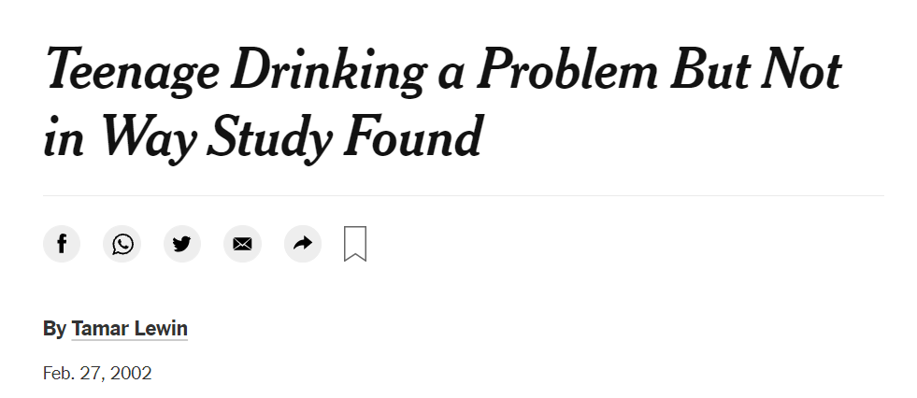
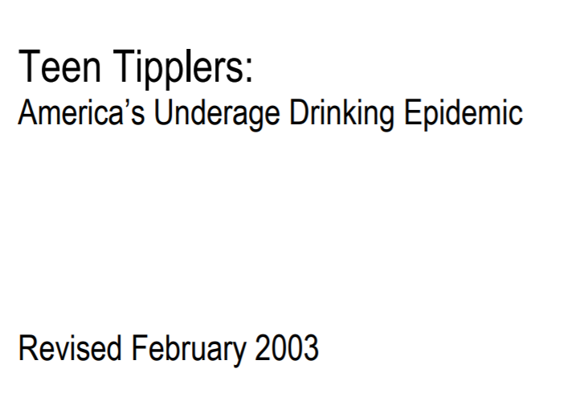
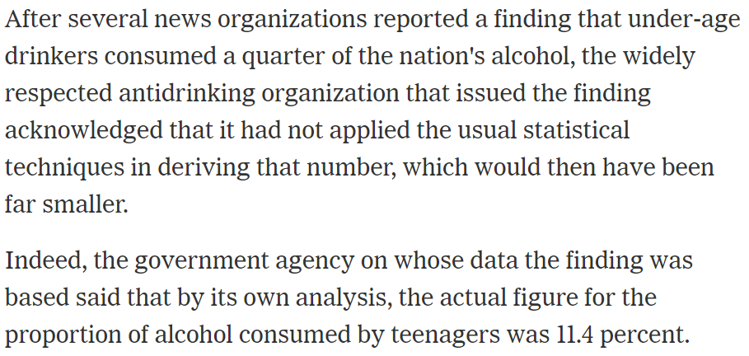
What could possibly go wrong?

Slide 5
How we Sample
A cautionary tale

Slide 6
Multi-stage Samples
Samples are drawn in a multi-stage process, not independently
Individuals are not drawn with equal probabilities
Multi-stage sampling saves on costs for respondents and collectors

Slide 7



Stratify
A list of all schools in the country is used
Schools are grouped into strata

Slide 8
Stratify
A list of all schools in the country is used
Schools are grouped into strata
Primary sampling units are selected

Slide 9

Stratify
A list of all schools in the country is used
Schools are grouped into strata
Primary sampling units (PSUs) are selected
Students are selected within each PSU

Slide 10
Centrality

Slide 11
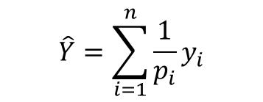
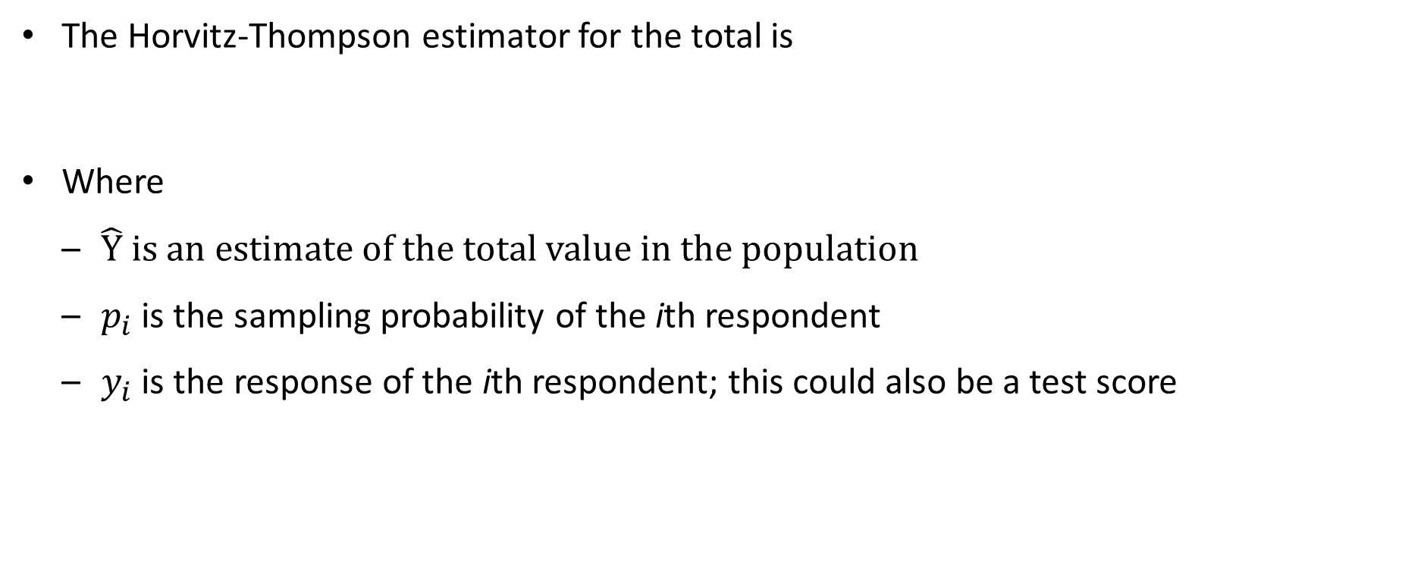
Estimating a Sum
The Horvitz-Thompson estimator for the total is
Where
$\hat{Y}$ is an estimate of the total value in the population
$p_{i}$ is the sampling probability of the ith respondent
$y_{i}$ is the response of the ith respondent; this could also be a test score
$$\hat{Y}=\sum_{i=1}^{n}{\frac{1}{p_{i}}y_{i}}$$

Slide 12


Why Horvitz-Thompson
The Horvitz-Thompson estimator is unbiased
$$E\left(\hat{Y}\right)=E\left[\sum_{i=1}^{N}{\frac{1}{p_{i}}y_{i}}\right]$$
$$=\sum_{i=1}^{N}{E\left[\frac{1}{p_{i}}y_{i}\right]}$$
$$=\sum_{i=1}^{N}{p_{i}\frac{1}{p_{i}}y_{i}}$$
$$=\sum_{i=1}^{N}{y_{i}}$$
Assumes $p_{i}$ greater than zero for every person
Notes:
In large scale assessments such as NAEP or TIMSS, when you try to study students’ achievement, you would notice that for each subject, instead of one achievement score for each sample student, the data file has multiple scores called plausible values assigned to each student. Have you wonder why having the plausible values, and how to use them in data analysis

Slide 13


HT Notes
One notation change :
Where $w_{i}$ is called the weight
Nowhere did we specify this sampling scheme!
$$\hat{Y}=\sum_{i=1}^{n}{\frac{1}{p_{i}}y_{i}}=\sum_{i=1}^{n}{w_{i}y_{i}}$$

Slide 14

Sum Uses
If you can estimate a sum, you can divide by the sample size to get a mean
Define $y_{i}$ as “is in this group” then you can estimate the proportion in a group
Speaks Spanish at home
Is proficient in Reading

Slide 15
Quiz
Which factors make the unweighted mean in a state a potentially biased estimator:
NCES select schools as group to sample
The sampled population may include more students in a particular group (e.g. attends private schools) than the population
Some students do not take the assessment or fill in the survey
Some school close after the sampling frame is made but before the survey can be administered
Notes:
In large scale assessments such as NAEP or TIMSS, when you try to study students’ achievement, you would notice that for each subject, instead of one achievement score for each sample student, the data file has multiple scores called plausible values assigned to each student. Have you wonder why having the plausible values, and how to use them in data analysis

Slide 16
Variance Estimation

Slide 17

Accounting for sampling procedure
The variance estimate is the sum of measurement variance and sampling variance
The sampling variance arises from the sampling process
The sampling process is based on sampling groups of schools (PSU’s), schools, and then students
A variance estimator should account for the clustered nature of the sample!
But, it can use that groups of schools were sample independently
$$V=\left(1+\frac{1}{M}\right)B_{M}+U^{∗}$$
measure variance + sampling variance
Notes:
In large scale assessments such as NAEP or TIMSS, when you try to study students’ achievement, you would notice that for each subject, instead of one achievement score for each sample student, the data file has multiple scores called plausible values assigned to each student. Have you wonder why having the plausible values, and how to use them in data analysis

Slide 18
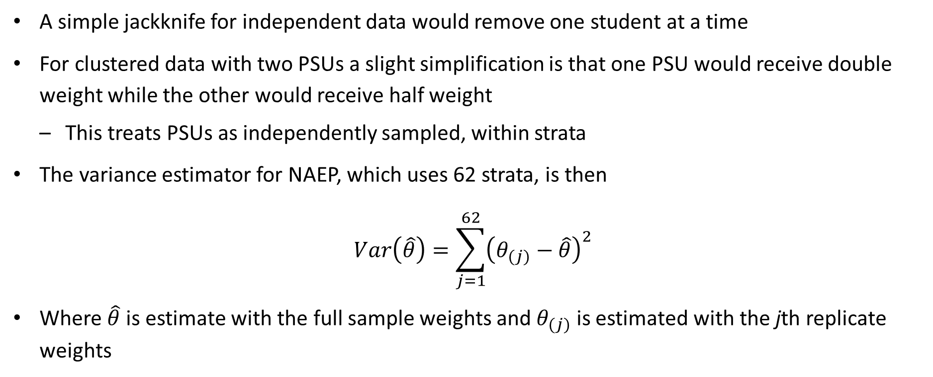
Sample variance, independent case
A simple jackknife for independent data would remove one student at a time
For clustered data with two PSUs a slight simplification is that one PSU would receive double weight while the other would receive half weight
This treats PSUs as independently sampled, within strata
The variance estimator for NAEP, which uses 62 strata, is then
$$Var\left(\hat{θ}\right)=\sum_{j=1}^{62}{{\left(θ_{(j)}−\hat{θ}\right)}^{2}}$$
Where $\hat{θ}$ is estimate with the full sample weights and $θ_{(j)}$ is estimated with the jth replicate weights
Notes:
In large scale assessments such as NAEP or TIMSS, when you try to study students’ achievement, you would notice that for each subject, instead of one achievement score for each sample student, the data file has multiple scores called plausible values assigned to each student. Have you wonder why having the plausible values, and how to use them in data analysis

Slide 19
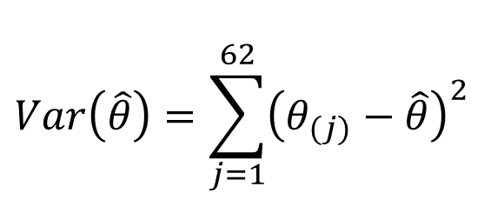
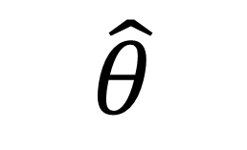
Sampling Variance Example
$$Var\left(\hat{θ}\right)=\sum_{j=1}^{62}{{\left(θ_{(j)}−\hat{θ}\right)}^{2}}$$
$$\hat{θ}$$
School | Stratum | PSU | Full Sample Weight | Replicate weight 1 | Replicate weight 2
A | 1 | 1 | 80 | 0 | 80
B | 1 | 2 | 120 | 200 | 120
C | 2 | 1 | 60 | 60 | 140
D | 2 | 2 | 80 | 80 | 0
E | 3 | 1 | 45 | 45 | 45
F | 3 | 2 | 55 | 55 | 55
Notes:
In large scale assessments such as NAEP or TIMSS, when you try to study students’ achievement, you would notice that for each subject, instead of one achievement score for each sample student, the data file has multiple scores called plausible values assigned to each student. Have you wonder why having the plausible values, and how to use them in data analysis

Slide 20
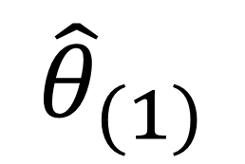
Sampling Variance Example (Cont.)
$$Var\left(\hat{θ}\right)=\sum_{j=1}^{62}{{\left(θ_{(j)}−\hat{θ}\right)}^{2}}$$
$${\hat{θ}}_{(1)}$$
School | Stratum | PSU | Full Sample Weight | Replicate weight 1 | Replicate weight 2
A | 1 | 1 | 80 | 0 | 80
B | 1 | 2 | 120 | 200 | 120
C | 2 | 1 | 60 | 60 | 140
D | 2 | 2 | 80 | 80 | 0
E | 3 | 1 | 45 | 45 | 45
F | 3 | 2 | 55 | 55 | 55
Notes:
In large scale assessments such as NAEP or TIMSS, when you try to study students’ achievement, you would notice that for each subject, instead of one achievement score for each sample student, the data file has multiple scores called plausible values assigned to each student. Have you wonder why having the plausible values, and how to use them in data analysis

Slide 21
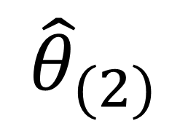
Sampling Variance Example (Cont. 2)
$$Var\left(\hat{θ}\right)=\sum_{j=1}^{62}{{\left(θ_{(j)}−\hat{θ}\right)}^{2}}$$
$${\hat{θ}}_{(2)}$$
School | Stratum | PSU | Full Sample Weight | Replicate weight 1 | Replicate weight 2
A | 1 | 1 | 80 | 0 | 80
B | 1 | 2 | 120 | 200 | 120
C | 2 | 1 | 60 | 60 | 140
D | 2 | 2 | 80 | 80 | 0
E | 3 | 1 | 45 | 45 | 45
F | 3 | 2 | 55 | 55 | 55
Notes:
In large scale assessments such as NAEP or TIMSS, when you try to study students’ achievement, you would notice that for each subject, instead of one achievement score for each sample student, the data file has multiple scores called plausible values assigned to each student. Have you wonder why having the plausible values, and how to use them in data analysis

Slide 22
Quiz
NAEP accounts for clustering
NAEP uses a group jackknife variance estimator that accounts for the fact that two students in the same school have more similar scores than two randomly selected students (an ICC)
NAEP fails to account for clustering
NAEP results that can be obtained with a linear regression, such as a mean, do not use a hierarchal linear model and so the variance estimator does not account for the ICC between students in the same school

Slide 23
Quiz
Q1: T/F if an assessment selected students from a national sample and students were selected independently (one stage) then estimates must still account for correlation within schools

Slide 24
Oversampling

Slide 25
Good Reasons to Overdo it!
an oversample is when the probability of selection goes up for individuals/groups in the oversampled condition
This leads to a higher number of individuals/groups with the characteristic in the sample than in a simple random sample
In some studies, oversamples are collected of schools and/or students

Slide 26
Selection Probabilities
Selection probabilities depend on school sampling probabilities
To obtain a high quality estimator, enough students must be sampled in a subgroup or geography to obtain a high quality estimate, so school selection probabilities are not equal
Weights are adjusted to account for the school’s (student’s) probability of selection then adjusted for:
high weights are edited down to avoid high variance estimator
School non-response
Student non-response
Adjustment to known margins from e.g. the U.S. Census
Notes:
In large scale assessments such as NAEP or TIMSS, when you try to study students’ achievement, you would notice that for each subject, instead of one achievement score for each sample student, the data file has multiple scores called plausible values assigned to each student. Have you wonder why having the plausible values, and how to use them in data analysis

Slide 27
How can we analyze large scale assessment data?

Slide 28
Takeaways
NAEP uses a complicated sampling strategy
The sampling scheme uses strata and PSUs
The mean estimator assumes that the sample was collected according to the plan
The variance estimator accounts for within school (stratum/PSU) covariance
The variance has as many as two components
Measurement/imputation variance
Sampling variance

Slide 29
Quiz
When do you need to account for sampling variance
When not using a hierarchical linear model
Whenever using large scale assessment data
When estimating a total but not a mean
Notes:
In large scale assessments such as NAEP or TIMSS, when you try to study students’ achievement, you would notice that for each subject, instead of one achievement score for each sample student, the data file has multiple scores called plausible values assigned to each student. Have you wonder why having the plausible values, and how to use them in data analysis

Slide 30
Paul Bailey
Senior Economist
202.403.5694
pbailey@air.org

