Slide 1
Large-Scale Assessment Methodology: Sampling, Weighting, & Variance Estimation
Paul Bailey, Ph.D.
Senior Economist
EdSurvey Large-Scale Data Analysis Training Series| Oct 2021

Slide 2
Overview
Why weight?
Sampling procedures in NAEP and ILSA
Estimating a parameter in a probability sample
Variance estimation

Slide 3
Why Weight
A cautionary tale

Slide 4
Simple Random Sample (Introduction to Statistics)
If a country had a national roster of all students (the US does not have this) one could sample these students. This is called a simple random sample, or SRS
This would increase response burden at the school
This is not how samples are drawn
The actual sampling scheme is complicated
This presentation is an introduction to the actual scheme

Slide 5
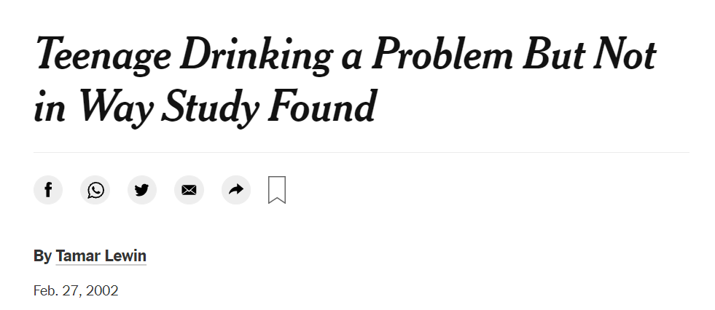
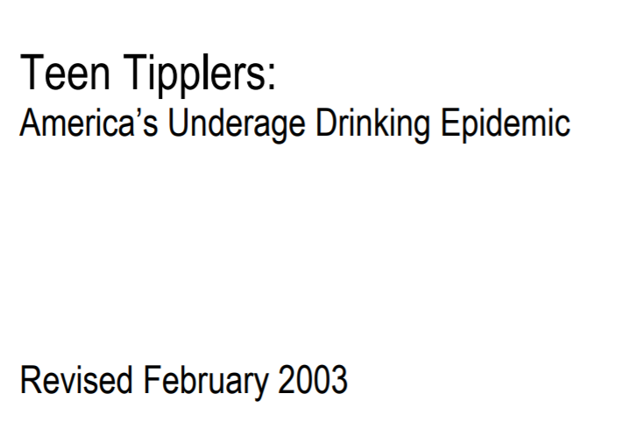
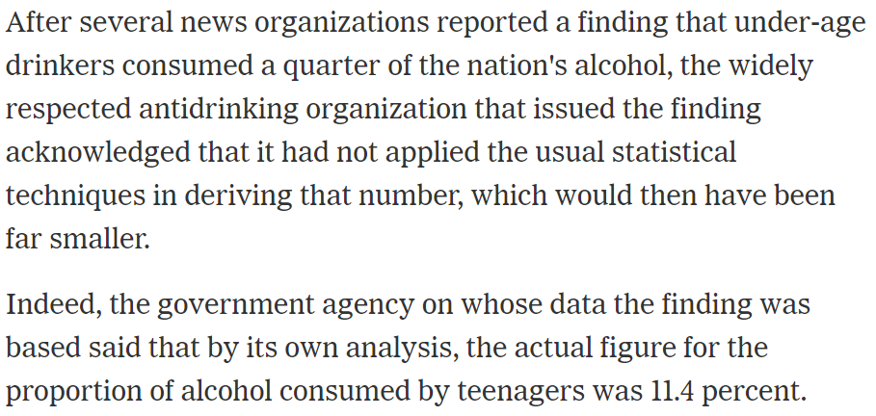
What could possibly go wrong?

Slide 6
Sampling procedures in NAEP and ILSA

Slide 7
How to Measure Student Performance of an Education System
Have every student in the country take an instrument
High response and administrative costs
Offer the instrument to students or schools that apply to participate
Volunteer schools or students may be different from non-volunteers
Choose schools that seem likely to be representative of the nation
Expert selector could be incorrect; variance difficult to estimate
Randomly sample schools and students
Requires survey methodology knowledge

Slide 8
Drawing a Multi-stage Random Sample
Samples are drawn in a multi-stage process, not independently
Individuals are not drawn with equal probabilities
Multi-stage sampling saves on costs for respondents and collectors

Slide 9



Stratify
A list of all schools in the country is used
Schools are grouped into strata

Slide 10
Stratify
A list of all schools in the country is used
Schools are grouped into strata
Primary sampling units (schools) are selected

Slide 11

Stratify
A list of all schools in the country is used
Schools are grouped into strata
Primary sampling units (schools) are selected
Students are selected within each PSU

Slide 12
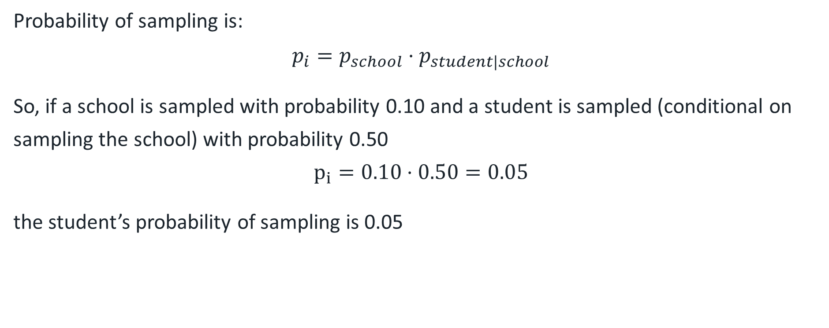
Probability of Sampling
Probability of sampling is:
$$p_{i}=p_{school}⋅p_{student|school}$$
So, if a school is sampled with probability 0.10 and a student is sampled (conditional on sampling the school) with probability 0.50
$$p_{i}=0.10⋅0.50=0.05$$
the student’s probability of sampling is 0.05

Slide 13
Selection Probabilities
Selection probabilities depend on school sampling probabilities
To obtain a high quality estimator, enough students must be sampled in a subgroup or geography, so school selection probabilities may not be equal
Weights can be adjusted to account for the school’s (student’s) probability of selection then adjusted for:
School non-response
Student non-response
Difference between expected and actual number of students in a school
Adjustment to known margins from e.g. the U.S. Census
high weights are edited down to avoid high variance estimator
Notes:
In large scale assessments such as NAEP or TIMSS, when you try to study students’ achievement, you would notice that for each subject, instead of one achievement score for each sample student, the data file has multiple scores called plausible values assigned to each student. Have you wonder why having the plausible values, and how to use them in data analysis

Slide 14
Estimating parameters in a probability sample
Centrality

Slide 15
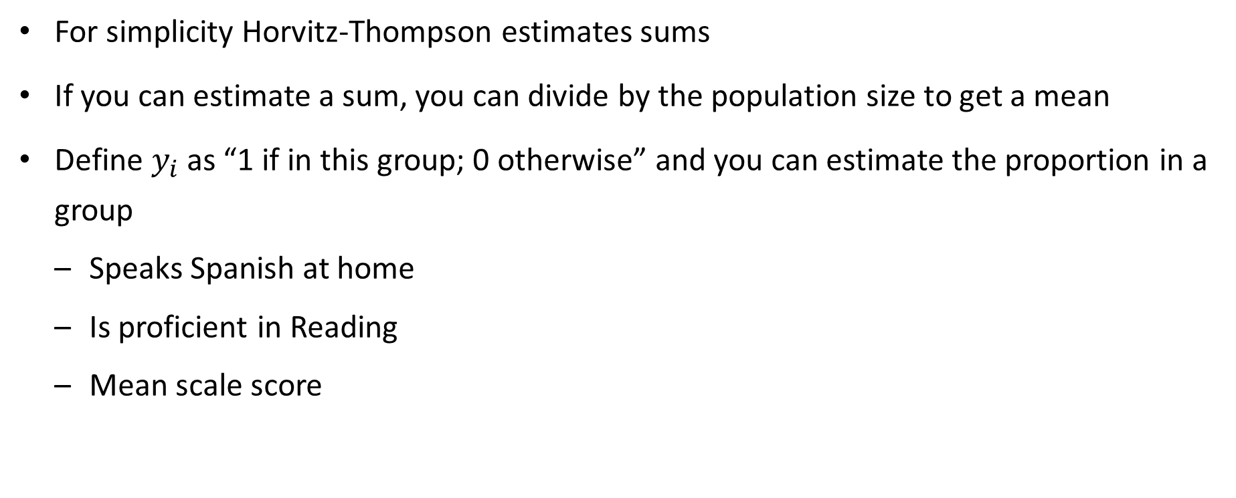
Sum Uses
For simplicity Horvitz-Thompson estimates sums
If you can estimate a sum, you can divide by the population size to get a mean
Define $y_{i}$ as “1 if in this group; 0 otherwise” and you can estimate the proportion in a group
Speaks Spanish at home
Is proficient in Reading
Mean scale score

Slide 16
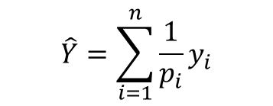
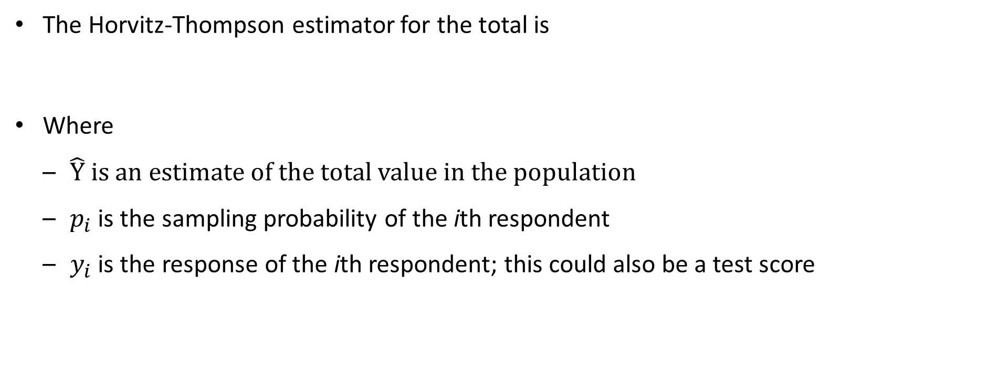
Estimating a Sum
The Horvitz-Thompson estimator for the total is
Where
$\hat{Y}$ is an estimate of the total value in the population
$p_{i}$ is the sampling probability of the ith respondent
$y_{i}$ is the response of the ith respondent; this could also be a test score
$$\hat{Y}=\sum_{i=1}^{n}{\frac{1}{p_{i}}y_{i}}$$

Slide 17


Why Horvitz-Thompson
The Horvitz-Thompson estimator is unbiased
$$E\left(\hat{Y}\right)=E\left[\sum_{i=1}^{N}{\frac{1}{p_{i}}y_{i}}\right]$$
$$=\sum_{i=1}^{N}{E\left[\frac{1}{p_{i}}y_{i}\right]}$$
$$=\sum_{i=1}^{N}{p_{i}\frac{1}{p_{i}}y_{i}}$$
$$=\sum_{i=1}^{N}{y_{i}}$$
Assumes $p_{i}$ greater than zero for every person
Notes:
In large scale assessments such as NAEP or TIMSS, when you try to study students’ achievement, you would notice that for each subject, instead of one achievement score for each sample student, the data file has multiple scores called plausible values assigned to each student. Have you wonder why having the plausible values, and how to use them in data analysis

Slide 18

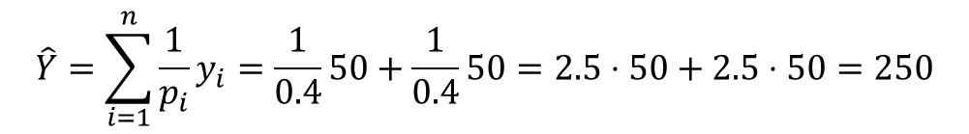
Example
Each blue school as a value of 50 students and a section probability of 0.20 (20%)
So, the total for blue schools is 50 students in a school times 5 schools = 250 students
Now, sample them, selecting one (n=1; p_{i} = 0.2)
Now, sample them, selecting two (n=2 ; p_{i} = 0.4)
$$\hat{Y}=\sum_{i=1}^{n}{\frac{1}{p_{i}}y_{i}}=\frac{1}{0.2}50=5⋅50=250$$
$$\hat{Y}=\sum_{i=1}^{n}{\frac{1}{p_{i}}y_{i}}=\frac{1}{0.4}50+\frac{1}{0.4}50=2.5⋅50+2.5⋅50=250$$

Slide 19

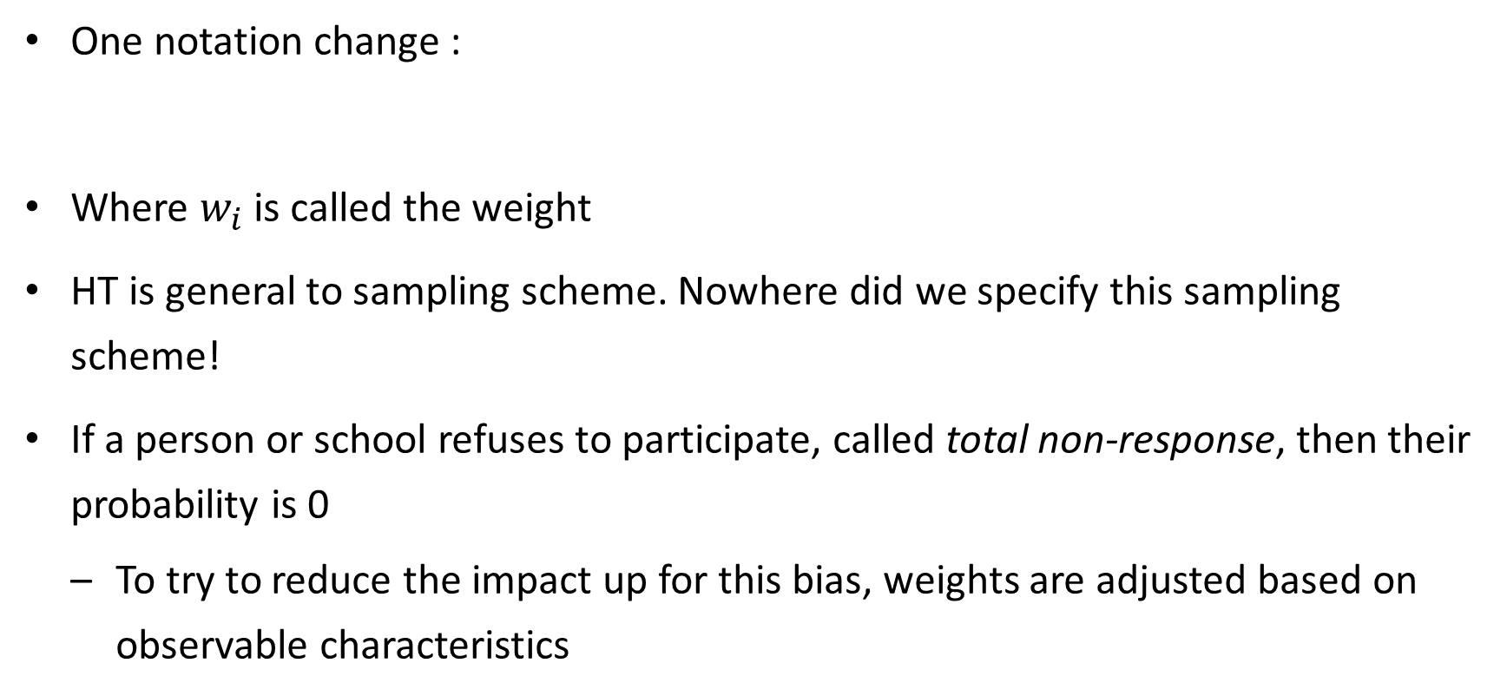
HT Notes
One notation change :
Where $w_{i}$ is called the weight
HT is general to sampling scheme. Nowhere did we specify this sampling scheme!
If a person or school refuses to participate, called total non-response, then their probability is 0
To try to reduce the impact up for this bias, weights are adjusted based on observable characteristics
$$\hat{Y}=\sum_{i=1}^{n}{\frac{1}{p_{i}}y_{i}}=\sum_{i=1}^{n}{w_{i}y_{i}}$$

Slide 20
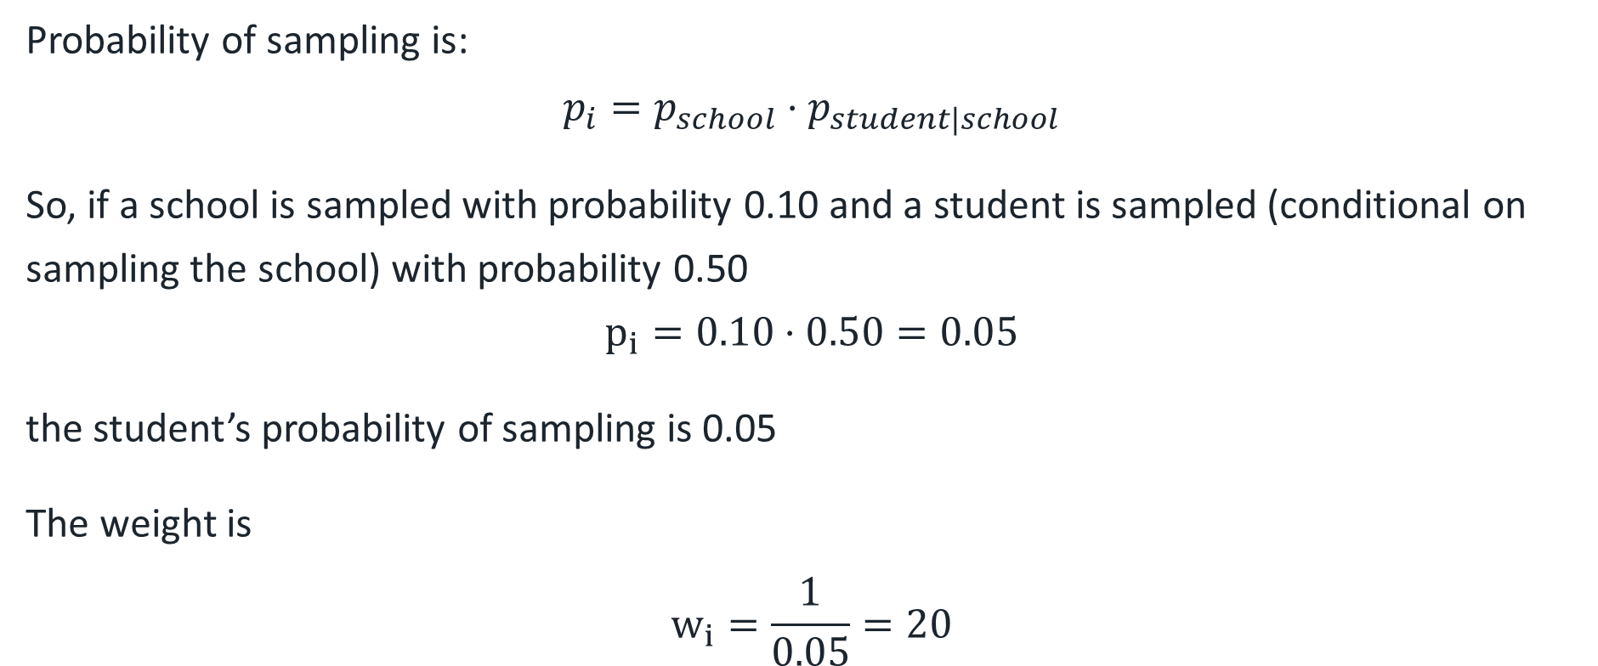
Probability of Sampling
Probability of sampling is:
$$p_{i}=p_{school}⋅p_{student|school}$$
So, if a school is sampled with probability 0.10 and a student is sampled (conditional on sampling the school) with probability 0.50
$$p_{i}=0.10⋅0.50=0.05$$
the student’s probability of sampling is 0.05
The weight is
$$w_{i}=\frac{1}{0.05}=20$$

Slide 21
Quiz
Which factors make the Horvitz-Thompson estimator desirable
The sample is multi-staged and involves strata
It says how to form weights to use to get an unbiased estimate of a total
It is robust to total non-response (when a person refuses to answer)
Notes:
In large scale assessments such as NAEP or TIMSS, when you try to study students’ achievement, you would notice that for each subject, instead of one achievement score for each sample student, the data file has multiple scores called plausible values assigned to each student. Have you wonder why having the plausible values, and how to use them in data analysis

Slide 22
Variance Estimation

Slide 23

Accounting for sampling procedure
The variance estimate is the sum of measurement variance and sampling variance
The sampling variance arises from the sampling process
The sampling process is based on sampling groups of schools (PSU’s), schools, and then students
A variance estimator should account for the clustered nature of the sample!
But, it can use that groups of schools were sample independently
$$V=\left(1+\frac{1}{M}\right)B_{M}+U^{∗}$$
measurement variance + sampling variance
Notes:
In large scale assessments such as NAEP or TIMSS, when you try to study students’ achievement, you would notice that for each subject, instead of one achievement score for each sample student, the data file has multiple scores called plausible values assigned to each student. Have you wonder why having the plausible values, and how to use them in data analysis

Slide 24
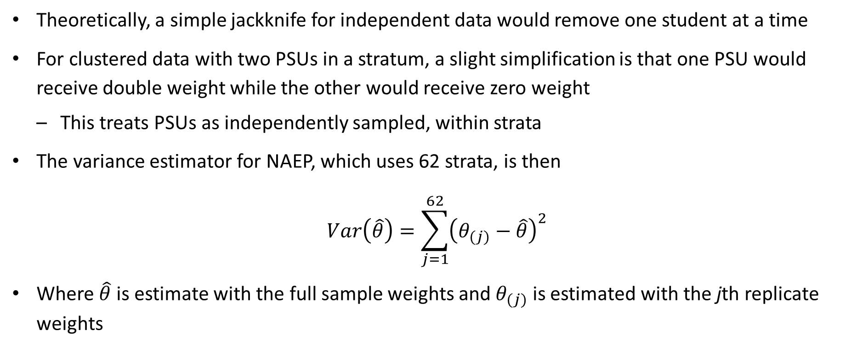
Sample variance, independent case
Theoretically, a simple jackknife for independent data would remove one student at a time
For clustered data with two PSUs in a stratum, a slight simplification is that one PSU would receive double weight while the other would receive zero weight
This treats PSUs as independently sampled, within strata
The variance estimator for NAEP, which uses 62 strata, is then
$$Var\left(\hat{θ}\right)=\sum_{j=1}^{62}{{\left(θ_{(j)}−\hat{θ}\right)}^{2}}$$
Where $\hat{θ}$ is estimate with the full sample weights and $θ_{(j)}$ is estimated with the jth replicate weights
Notes:
In large scale assessments such as NAEP or TIMSS, when you try to study students’ achievement, you would notice that for each subject, instead of one achievement score for each sample student, the data file has multiple scores called plausible values assigned to each student. Have you wonder why having the plausible values, and how to use them in data analysis

Slide 25
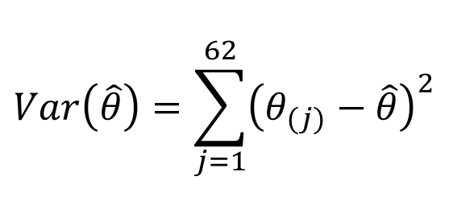
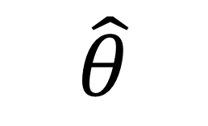
Sampling Variance Example
$$Var\left(\hat{θ}\right)=\sum_{j=1}^{62}{{\left(θ_{(j)}−\hat{θ}\right)}^{2}}$$
$$\hat{θ}$$
School | Stratum | PSU | Full Sample Weight | Replicate weight 1 | Replicate weight 2
A | 1 | 1 | 80 | 0 | 80
B | 1 | 2 | 120 | 240 | 120
C | 2 | 1 | 60 | 60 | 120
D | 2 | 2 | 80 | 80 | 0
E | 3 | 1 | 45 | 45 | 45
F | 3 | 2 | 55 | 55 | 55
Notes:
In large scale assessments such as NAEP or TIMSS, when you try to study students’ achievement, you would notice that for each subject, instead of one achievement score for each sample student, the data file has multiple scores called plausible values assigned to each student. Have you wonder why having the plausible values, and how to use them in data analysis

Slide 26
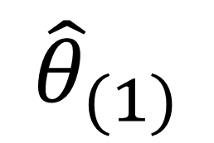
Sampling Variance Example (Cont.)
$$Var\left(\hat{θ}\right)=\sum_{j=1}^{62}{{\left(θ_{(j)}−\hat{θ}\right)}^{2}}$$
$${\hat{θ}}_{(1)}$$
School | Stratum | PSU | Full Sample Weight | Replicate weight 1 | Replicate weight 2
A | 1 | 1 | 80 | 0 | 80
B | 1 | 2 | 120 | 240 | 120
C | 2 | 1 | 60 | 60 | 120
D | 2 | 2 | 80 | 80 | 0
E | 3 | 1 | 45 | 45 | 45
F | 3 | 2 | 55 | 55 | 55
Notes:
In large scale assessments such as NAEP or TIMSS, when you try to study students’ achievement, you would notice that for each subject, instead of one achievement score for each sample student, the data file has multiple scores called plausible values assigned to each student. Have you wonder why having the plausible values, and how to use them in data analysis

Slide 27
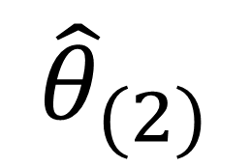
Sampling Variance Example (Cont. 2)
$$Var\left(\hat{θ}\right)=\sum_{j=1}^{62}{{\left(θ_{(j)}−\hat{θ}\right)}^{2}}$$
$${\hat{θ}}_{(2)}$$
School | Stratum | PSU | Full Sample Weight | Replicate weight 1 | Replicate weight 2
A | 1 | 1 | 80 | 0 | 80
B | 1 | 2 | 120 | 240 | 120
C | 2 | 1 | 60 | 60 | 120
D | 2 | 2 | 80 | 80 | 0
E | 3 | 1 | 45 | 45 | 45
F | 3 | 2 | 55 | 55 | 55
Notes:
In large scale assessments such as NAEP or TIMSS, when you try to study students’ achievement, you would notice that for each subject, instead of one achievement score for each sample student, the data file has multiple scores called plausible values assigned to each student. Have you wonder why having the plausible values, and how to use them in data analysis

Slide 28
Quiz Choose One
A NAEP accounts for clustering. NAEP uses a group jackknife variance estimator that accounts for the fact that students in the same school have more similar scores than randomly selected students (an ICC that is no zero)
B NAEP fails to account for clustering. NAEP results are means and do not use a hierarchal linear model and so the variance estimator does not account for the ICC between students in the same school

Slide 29
How can we analyze large scale assessment data?

Slide 30
Takeaways
NAEP, ILSA use a complicated sampling strategy
The sampling scheme uses strata and PSUs
The weighted mean estimator assumes that the sample was collected according to the plan
The jackknife variance estimator accounts for within school (stratum/PSU) covariance
The variance has as many as two components
Sampling variance
Measurement/imputation variance

Slide 31
Paul Bailey
Senior Economist
202.403.5694
pbailey@air.org

