Slide 1
DEVELOPING DATA STORIES
Building Assets| August 2021

Slide 2
Virtual Meeting/Conference Recording Notice
The American Institutes for Research® (AIR®) allows for the recording of audio, visuals, participants, and other information sent, verbalized, or utilized during business related meetings. By joining a meeting, you automatically consent to such recordings. Any participant who prefers to participate via audio only should disable their video camera so only their audio will be captured. Video and/or audio recordings of any AIR session shall not be transmitted to an external third party without the permission of AIR.
Notes:
Nicol - reviews
Shoshana – starts recording

Slide 3




Meet the Presenters
Christina Jones
Noah Song
Ali Pelczar
Khaya Klanot
Principal Data Scientist
cjones@air.org
Web Development Specialist
hsong@air.org
Data Science Associate
apelczar@air.org
Data Science Assistant
kklanot@air.org

Slide 4
Agenda
Data visualization best practices
Intro to GitHub
Visualizations
Bar charts
Pie charts
Maps
Intro to ggplot2
Wrap-up
Resources
Questions
Break

Slide 5
Data Visualization Best Practices

Slide 6
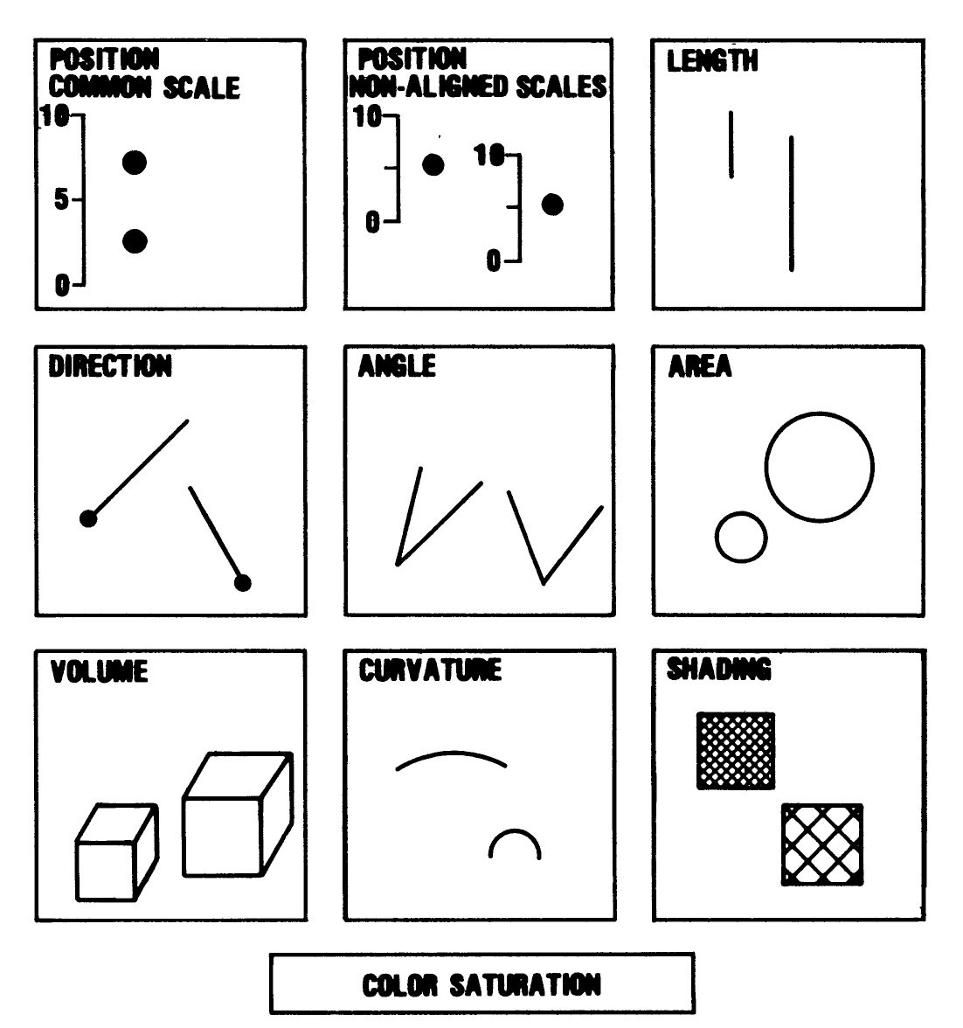
1. Visual cues are not created equal
More accurate
Less accurate
Source. Cleveland, W. & McGill, R. (1984). Graphical Perception: Theory, Experimentation, and the Application to the Development of Graphical Methods.

Slide 7
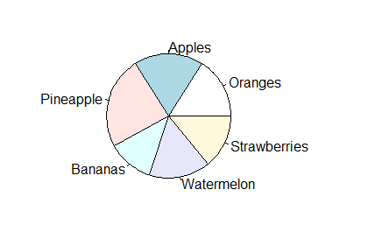
1. Visual cues are not created equal
Note. Placeholder for notes, sources, and permissions (if needed). “Note.” (including a period) is italicized.

Slide 8
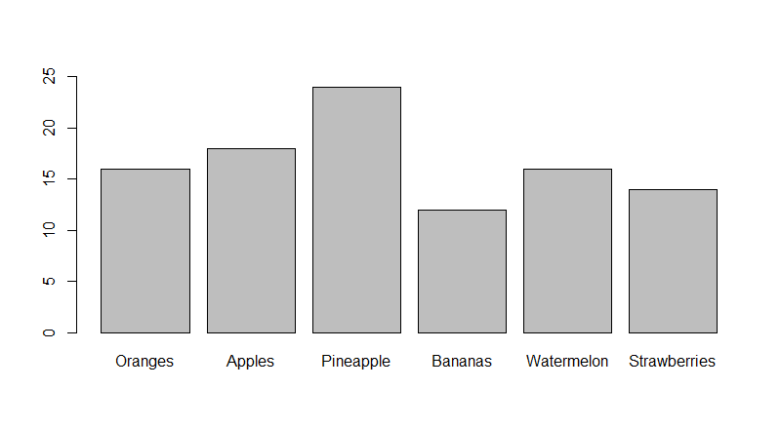
1. Visual cues are not created equal
Note. Placeholder for notes, sources, and permissions (if needed). “Note.” (including a period) is italicized.

Slide 9
2. Use colors to your advantage
Categorical
Sequential
Diverging
Source. https://github.com/d3/d3-scale-chromatic

Slide 10
3. Preattention
Subconscious gathering of information
Use when you want to draw attention to something important
Note. Placeholder for notes, sources, and permissions (if needed). “Note.” (including a period) is italicized.

Slide 11
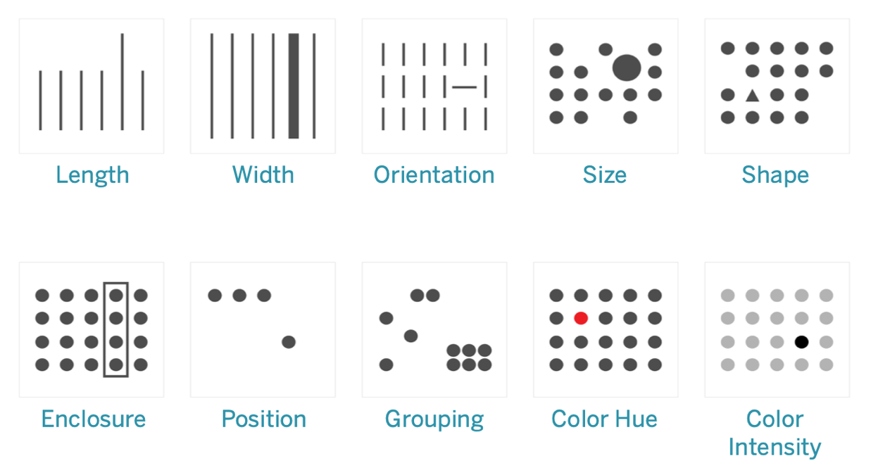
3. Preattention
Source. https://help.tableau.com/current/blueprint/en-us/bp_why_visual_analytics.htm.

Slide 12
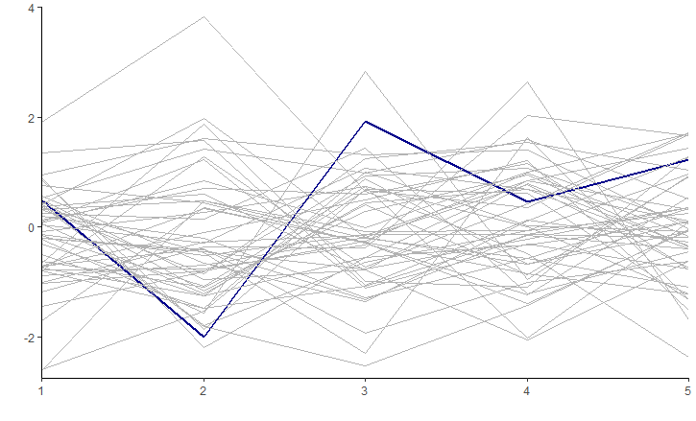
3. Preattention

Slide 13
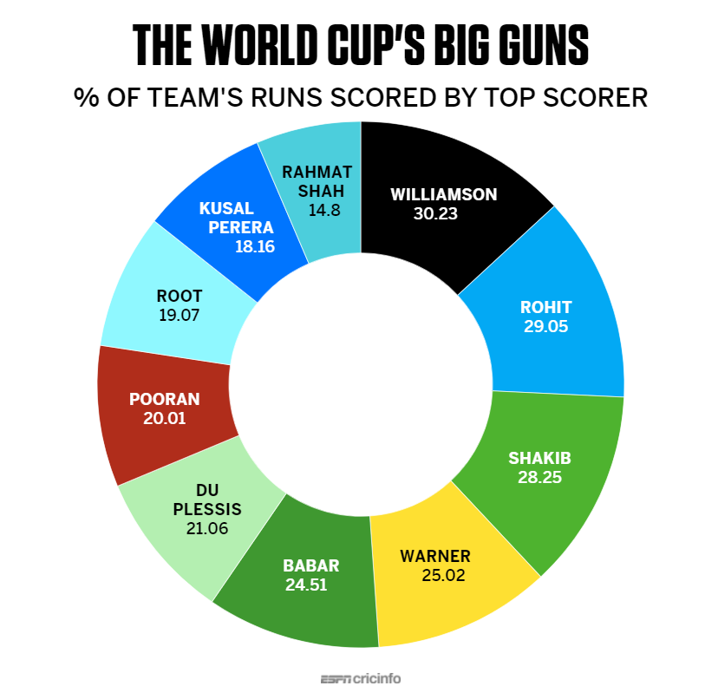
Warm-up activity
Source. https://www.espncricinfo.com/story/kane-williamson-s-is-the-hand-that-steadies-new-zealand-s-ship-1193354

Slide 14
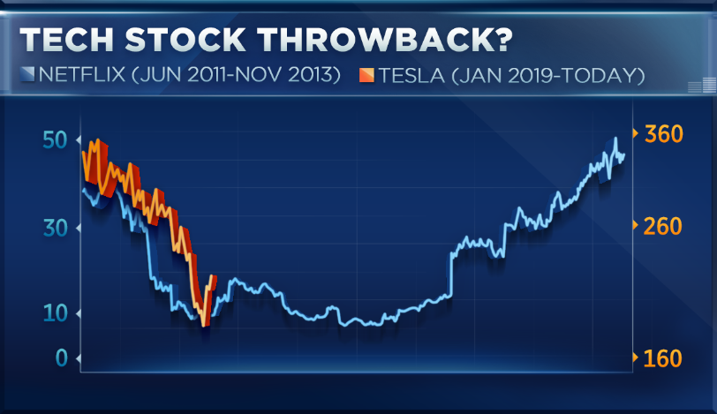
Warm-up activity
Source. https://www.cnbc.com/2019/06/12/tesla-looks-like-netflix-did-in-2011and-it-may-see-a-similar-recovery.html

Slide 15
Warm-up activity
https://projects.tampabay.com/projects/2015/investigations/pinellas-failure-factories/chart-failing-black-students/
Note. Placeholder for notes, sources, and permissions (if needed). “Note.” (including a period) is italicized.

Slide 16
GitHub Basics

Slide 17
Why use GitHub?
Version control when working collaboratively
More than cloud storage
Don’t lose earlier versions of files
Someone else can’t delete your work
Easier to keep track of projects with many files
Note. Placeholder for notes, sources, and permissions (if needed). “Note.” (including a period) is italicized.

Slide 18
GitHub Basics
Git works through commits that contain changes to files
Work on your files locally
Then bundle the changed files into a commit
Push the commit to the GitHub repository
After someone else works on the same files, you can pull their changes and it will update your own local files
Note. Placeholder for notes, sources, and permissions (if needed). “Note.” (including a period) is italicized.

Slide 19
GitHub Basics
What problems might arise?
Merge conflicts happen when two people edit the same line of code
Working on separate branches, and merging them later, will help you avoid this
Note. Placeholder for notes, sources, and permissions (if needed). “Note.” (including a period) is italicized.

Slide 20
GitHub on Windows: Git Bash
Similar to using Git on the command line
In file explorer, right-click a folder name and select “Git Bash here”
Basic command line:
cd: change directory (directory = folder)
cd folder1/subfolder to go into a folder
cd .. To go up a level
ls: list files in the current directory
Note. Placeholder for notes, sources, and permissions (if needed). “Note.” (including a period) is italicized.

Slide 21
GitHub on Windows: Git Bash
To clone an existing public repository:
Go to the webpage for the repository
Under the green “Code” button, copy the URL under the HTTPS option (e.g. https://github.com/orgname/reponame)
Navigate to the folder that you want to put the repository in
git clone <https://github.com/orgname/reponame>
Note. Placeholder for notes, sources, and permissions (if needed). “Note.” (including a period) is italicized.

Slide 22
GitHub on Windows: Git Bash
To clone an existing private repository:
Generate an SSH key as described here
The file will probably go to C://Users/yourusername/.ssh
Add it to your account as described here
Copy the link under the SSH tab on the green “Code” button
Then, in Git Bash:
git clone <url>
Enter your passphrase when prompted and press enter
Note. Placeholder for notes, sources, and permissions (if needed). “Note.” (including a period) is italicized.

Slide 23
GitHub on Windows: Git Bash
To pull:
Navigate to the folder where the repository is
git pull
To push your changes
Navigate to the folder where the repository is
git status
git add file1.R file2.html file3.js
git commit –m”Type a helpful message here!”
git push
Note. Placeholder for notes, sources, and permissions (if needed). “Note.” (including a period) is italicized.

Slide 24
Data Visualization in R

Slide 25
Two Options for Activities
Option A: Hands-On
Building visualizations in R
Previous programming experience
Option B: Conceptual
Data visualization development and critique
Little or no previous programming experience
Note. Placeholder for notes, sources, and permissions (if needed). “Note.” (including a period) is italicized.

Slide 26
Making a bar chart
Note. Placeholder for notes, sources, and permissions (if needed). “Note.” (including a period) is italicized.

Slide 27
Activity 1A
Creating a bar chart
Note. Placeholder for notes, sources, and permissions (if needed). “Note.” (including a period) is italicized.

Slide 28
Activity 1B: Create a color palette
Visit https://color.adobe.com/create/color-wheel
Create a custom, discrete 5-color palette that:
Option 1. Works against a black background and contains the color #E0222D
Option 2. Works against a white background and contains the color #2DE0BF
Note. Placeholder for notes, sources, and permissions (if needed). “Note.” (including a period) is italicized.

Slide 29
Creating a pie chart
Note. Placeholder for notes, sources, and permissions (if needed). “Note.” (including a period) is italicized.

Slide 30
Activity 2A
Creating a pie chart
Note. Placeholder for notes, sources, and permissions (if needed). “Note.” (including a period) is italicized.

Slide 31
Activity 2B
http://graphics.wsj.com/job-market-tracker/
Note. Placeholder for notes, sources, and permissions (if needed). “Note.” (including a period) is italicized.

Slide 32
Activity 2B: Visualization packages in R
graphics (included in base R)
ggplot2: static
plotly: static or interactive
lattice: multivariate data; multiple small plots simultaneously
R2D3: read D3 files
gganimate: animation
Helpers
RColorBrewer: select from many color palettes
viridisLite (included in R download): colorblind-accessible palettes
Note. Placeholder for notes, sources, and permissions (if needed). “Note.” (including a period) is italicized.

Slide 33
Creating a map
Maps require a spatial dataset that describes the shape of the areas (states, counties, etc.)
It isn’t possible to read these files without an R package such as rgdal
We also need a way to handle projections
Note. Placeholder for notes, sources, and permissions (if needed). “Note.” (including a period) is italicized.

Slide 34
Mapping packages
Reading in spatial data
rgdal
geojsonio
Use preexisting spatial data
usmap
maps
mapproj
Static maps
graphics/base R
ggplot2
Interactive maps
plotly + ggplot2
Leaflet
Note. Placeholder for notes, sources, and permissions (if needed). “Note.” (including a period) is italicized.

Slide 35
Ggplot2 Basics

Slide 36
Ggplot2 basics
Most popular and common R visualization package
Chart elements are added as layers:
Chart_data + chart_type + chart_colors + chart_title
Only need to specify data and type
Charts can be saved as objects
Note. Placeholder for notes, sources, and permissions (if needed). “Note.” (including a period) is italicized.

Slide 37
Ggplot2 basics: selecting data
Specify chart data with ggplot() and aes()
aes() refers to aesthetics
Typical format:
ggplot(df, aes(x=XX, y=YY, color=ZZ, fill=WW, …))
Note. Placeholder for notes, sources, and permissions (if needed). “Note.” (including a period) is italicized.

Slide 38
Ggplot2 basics: selecting chart type
Specify chart type with geometries: geom_ functions
geom_bar()
geom_point()
geom_boxplot()
geom_histogram()
Note. Placeholder for notes, sources, and permissions (if needed). “Note.” (including a period) is italicized.

Slide 39
Ggplot2 basics: adding interactivity
Add tooltips with plotly
plt <- ggplot(df, aes(x=x_var, y=y_var)) + geom_point()
ggplotly(plt)
Note. Placeholder for notes, sources, and permissions (if needed). “Note.” (including a period) is italicized.

Slide 40
General R Resources
R cheat sheets: https://www.rstudio.com/resources/cheatsheets/
Includes reading data, cleaning data, data visualization, and more
Visualizations: https://www.r-graph-gallery.com/index.html
Gallery of chart types and code to make them
Documentation of graphics in base R: https://www.rdocumentation.org/packages/graphics/versions/3.6.2
Ggplot2 documentation: https://ggplot2.tidyverse.org/index.html
Named colors in R: http://www.stat.columbia.edu/~tzheng/files/Rcolor.pdf
Note. Placeholder for notes, sources, and permissions (if needed). “Note.” (including a period) is italicized.

Slide 41
General Resources
An overview of studies on visual perception: https://medium.com/@kennelliott/39-studies-about-human-perception-in-30-minutes-4728f9e31a73
Color palette creator: https://color.adobe.com/create/color-wheel
Accessible color palette creators:
https://colorbrewer2.org/
https://color.adobe.com/create/color-accessibility
Note. Placeholder for notes, sources, and permissions (if needed). “Note.” (including a period) is italicized.

Slide 42
Questions?

Slide 43
Break

