Slide 1
Reducing Data Usage Barriers: Using Bookdown for Flexible, Open-Source Data Documentation
Process Data Center
Innovation Demonstration II
Karen Yi, Data Scientist Assistant | Grant Adams, Researcher | Juanita Hicks, Senior Researcher
kyi@air.org
NCME | April 2024
Copyright © 20XX American Institutes for Research®. All rights reserved.

Slide 2
Virtual Meeting/Conference Recording Notice
The American Institutes for Research® (AIR®) allows for the recording of audio, visuals, and other information shared during business-related meetings. By joining a meeting, you automatically consent to such recordings. If you prefer, you may participate via audio only and should disable your video camera. Video or audio recordings of any AIR session shall not be transmitted to any third party without AIR’s permission. Additionally, AIR does not permit external artificial intelligence bots to record or transcribe AIR meetings or webinars unless requested as a reasonable accommodation.

Slide 3

Meet the Presenters
Karen Yi (By Day)
Karen Yi (By Night)
Grant Adams
Juanita Hicks
American Institutes for Research
Data Scientist Assistant
kyi@air.org
University of Chicago
Master’s in Computational Analysis and Public Policy
American Institutes for Research
Researcher
American Institutes for Research
Senior Researcher

Slide 4
AIR Inclusive Meeting Guidelines

Slide 5
Agenda
Why bookdown?
Getting started
Adding interaction
Long-term planning
Crowd-sourced edits
Further reading

Slide 6
Have you or your loved ones been in this situation?
Screenshots of disorganized files for large dataset
Note. Placeholder for notes, sources, and permissions (if needed). “Note.” (including a period) is italicized.

Slide 7
Why bookdown?
What is bookdown?
Do I/my team need to code to use bookdown?
How is bookdown different from Word/Google Docs?
Features | Microsoft Word/Google Docs | R Markdown | bookdown
Multiple collaborators | Yes | Yes, via GitHub | Yes, via GitHub
Formats and runs code snippets | No | Yes, R code | Yes, R code
Formats math | Yes | Yes, with LaTeX | Yes, with LaTeX
Consistent appearance and formatting | Haha | Yes | Yes
PDF accessibility | Yes, via tagged PDF export | No, requires customization | No, requires customization
Web accessibility | Yes, with some exceptions | Yes, via HTML output | Yes, via HTML output
Note. Placeholder for notes, sources, and permissions (if needed). “Note.” (including a period) is italicized.
Notes:
Bookdown is a file format extended from R Markdown
No code is technically needed for simple use cases (eg, text only) but it is very helpful in order to take full advantage
To deploy on a website, you need some code and at least Github
When not to use bookdown?

Slide 8
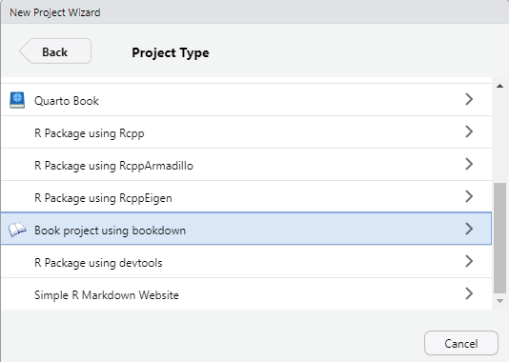
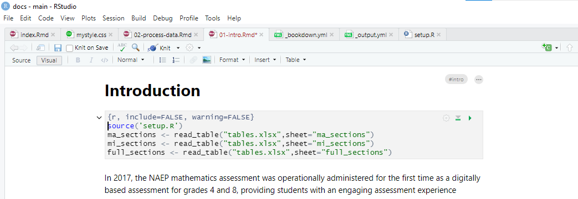
Getting started
All you need is:
Rstudio
Editing options:
R code
graphic interface
Note. Placeholder for notes, sources, and permissions (if needed). “Note.” (including a period) is italicized.

Slide 9
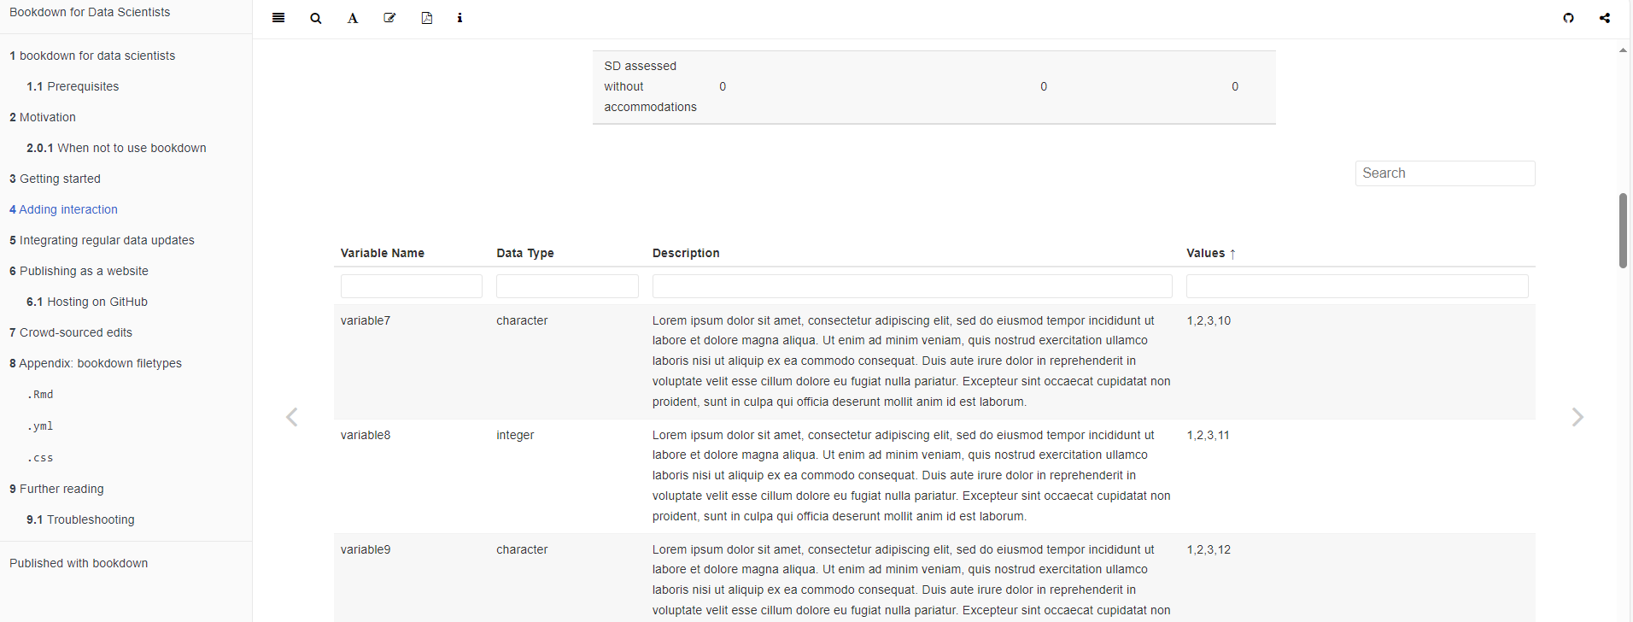
Adding interaction
reactable enables Excel-like filtering functionality
Note. Placeholder for notes, sources, and permissions (if needed). “Note.” (including a period) is italicized.

Slide 10
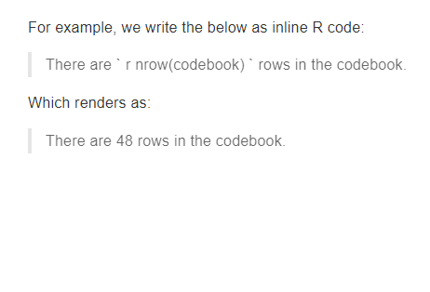
Long-term planning
Regular data releases
Have to update numbers
R can do it for you!
Upload a new data file
Variables change automatically
Note. Placeholder for notes, sources, and permissions (if needed). “Note.” (including a period) is italicized.

Slide 11
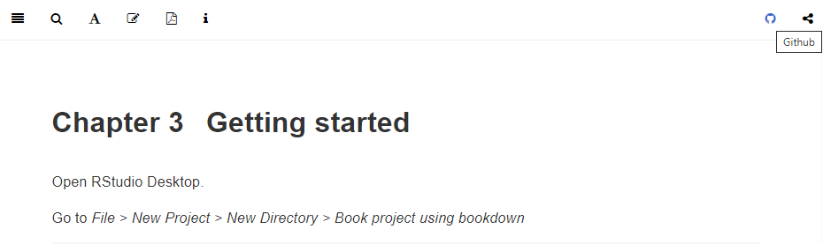
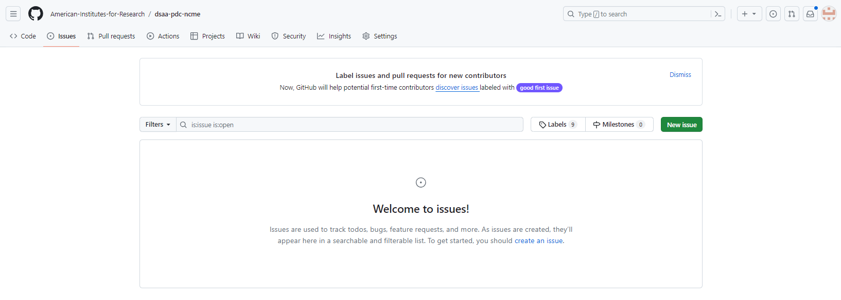
Publishing online
Accessibility
Can output in both PDF and website formats
Crowd-sourced edits
Any Github user can add issues to the repository
Note. Placeholder for notes, sources, and permissions (if needed). “Note.” (including a period) is italicized.
Notes:
Host website on Github Pages so everyone can view it
Github Pages is public to everyone, so you can also output as PDF

Slide 12
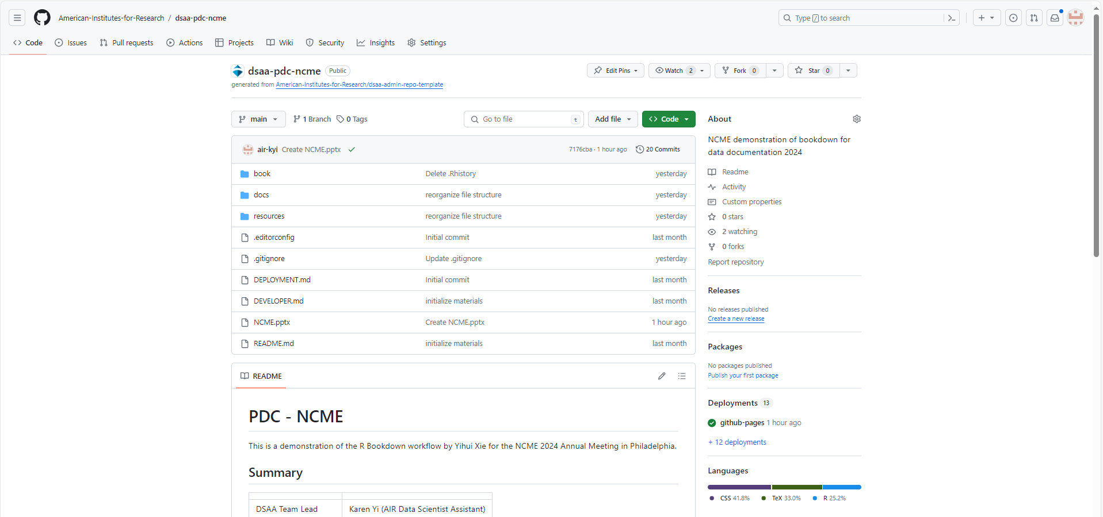
Try it yourself!
Clone our repository
Or, start your own bookdown project
Note. Placeholder for notes, sources, and permissions (if needed). “Note.” (including a period) is italicized.

Slide 13
SmartArt Graphic Sample
Input
Quantitative and qualitative
Evaluate
Iterative and strategic data evaluation
Outcome
Tested and vetted strategy

Slide 14
References
Xie, Y. 2022. bookdown: Authoring Books and Technical Documents with R Markdown. R package version 0.31.
Hicks, J., Circi, R., Yi, K., Adams, G. 2024. 2017 NAEP Grade 4 Mathematics Process Data Documentation. American Institutes for Research.

