Slide 1
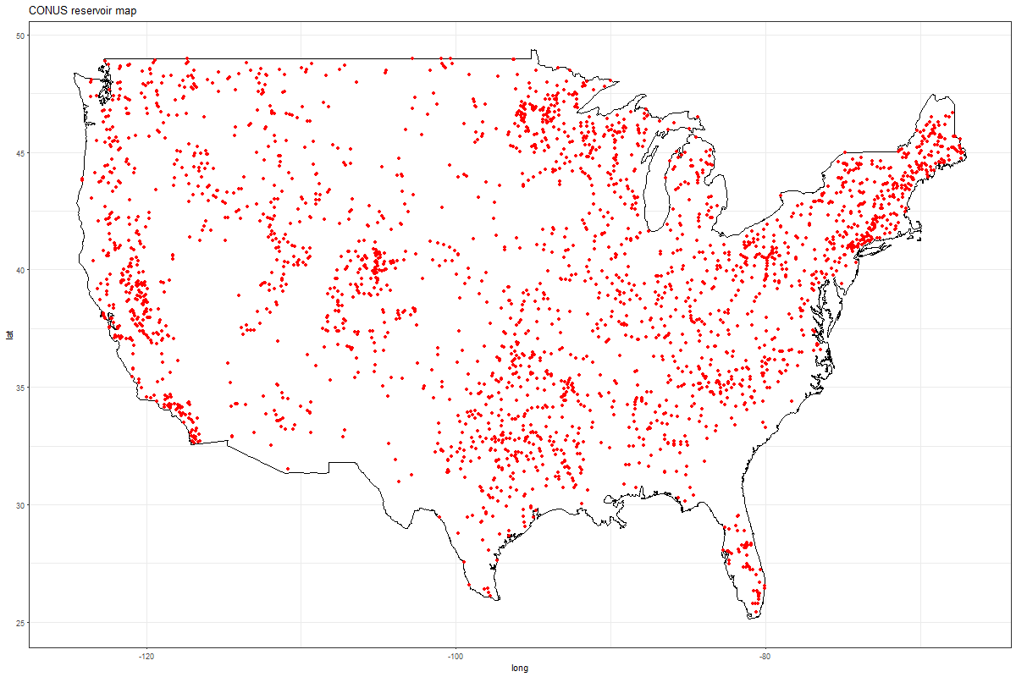
Basic maps

Slide 2
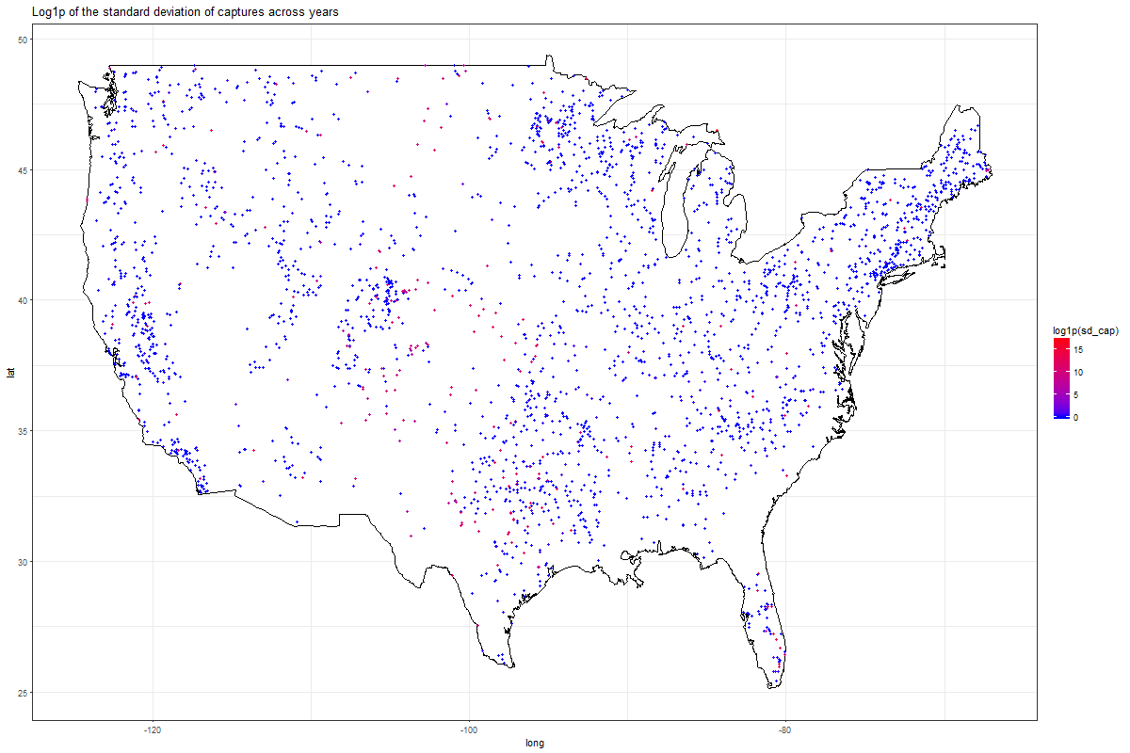

Slide 3
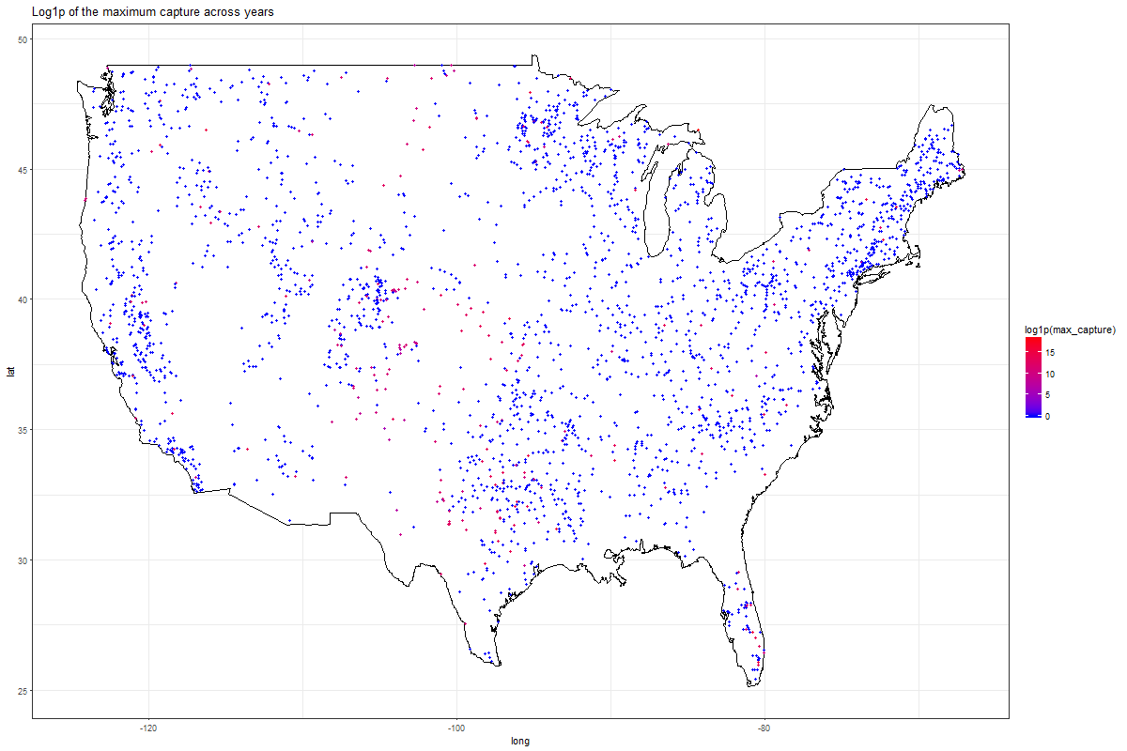

Slide 4


Slide 5
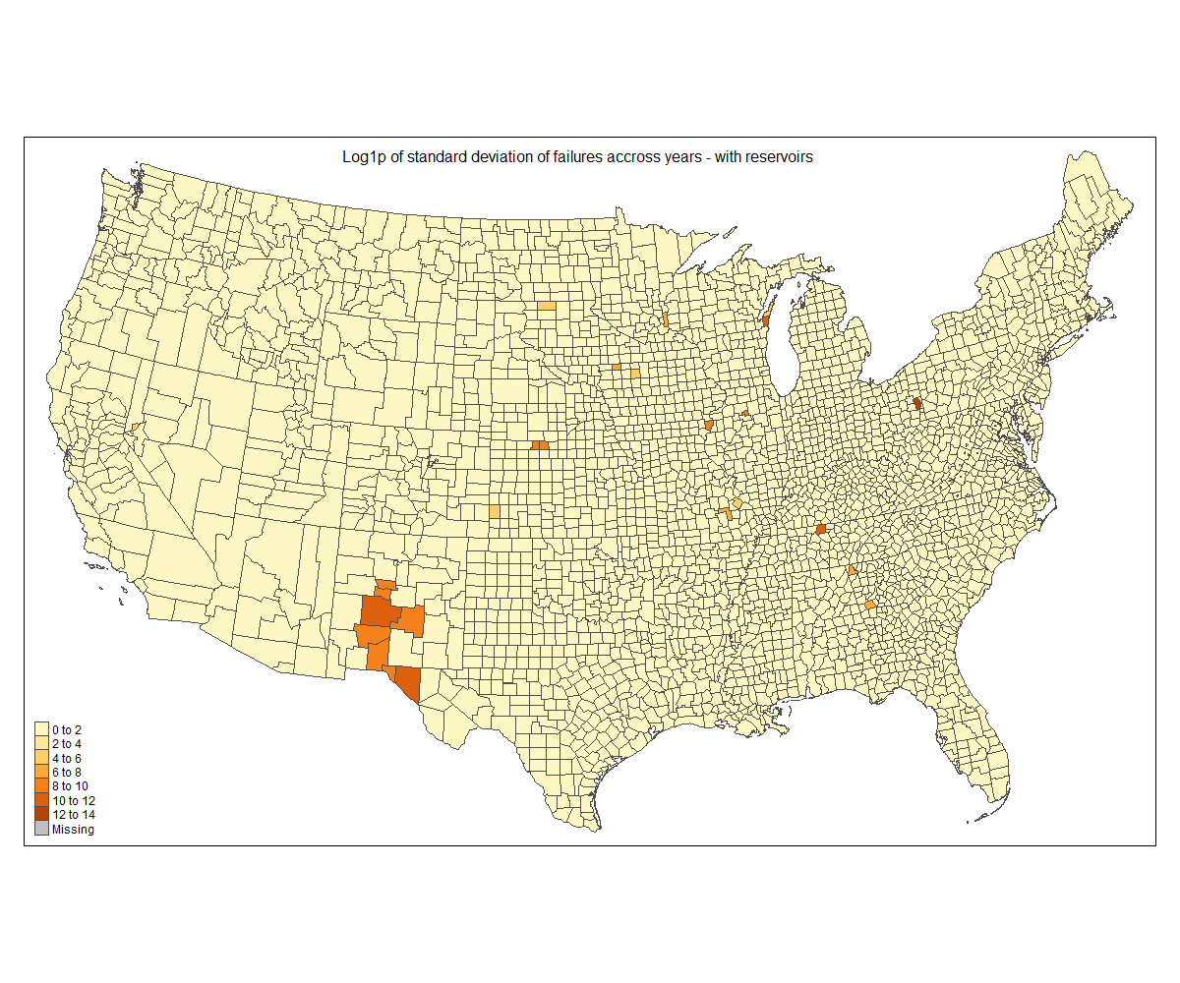
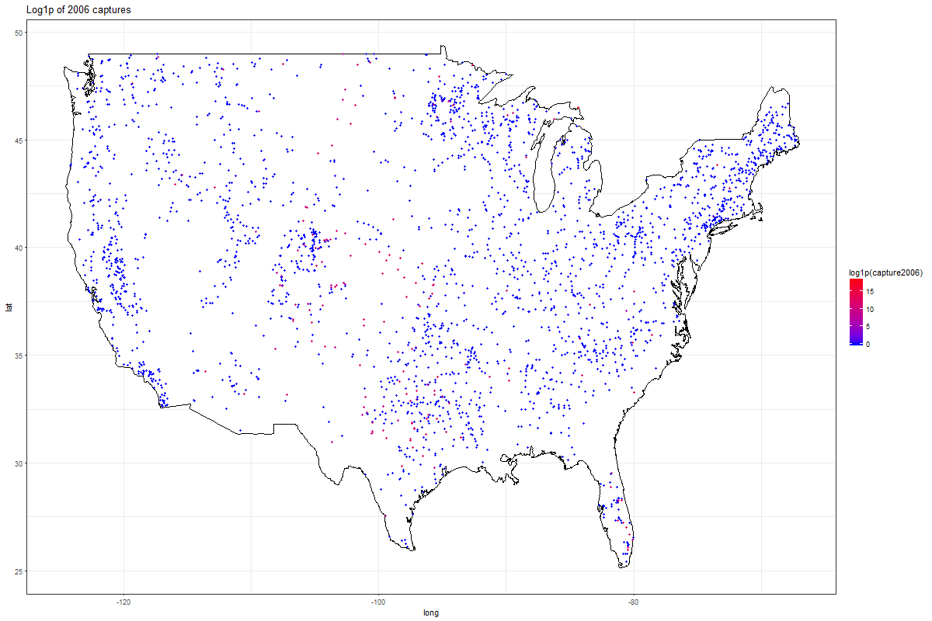

Slide 6
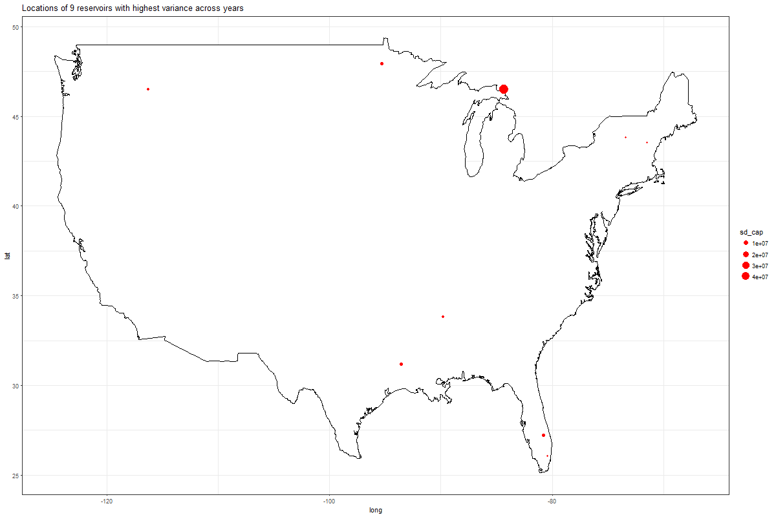

Slide 7
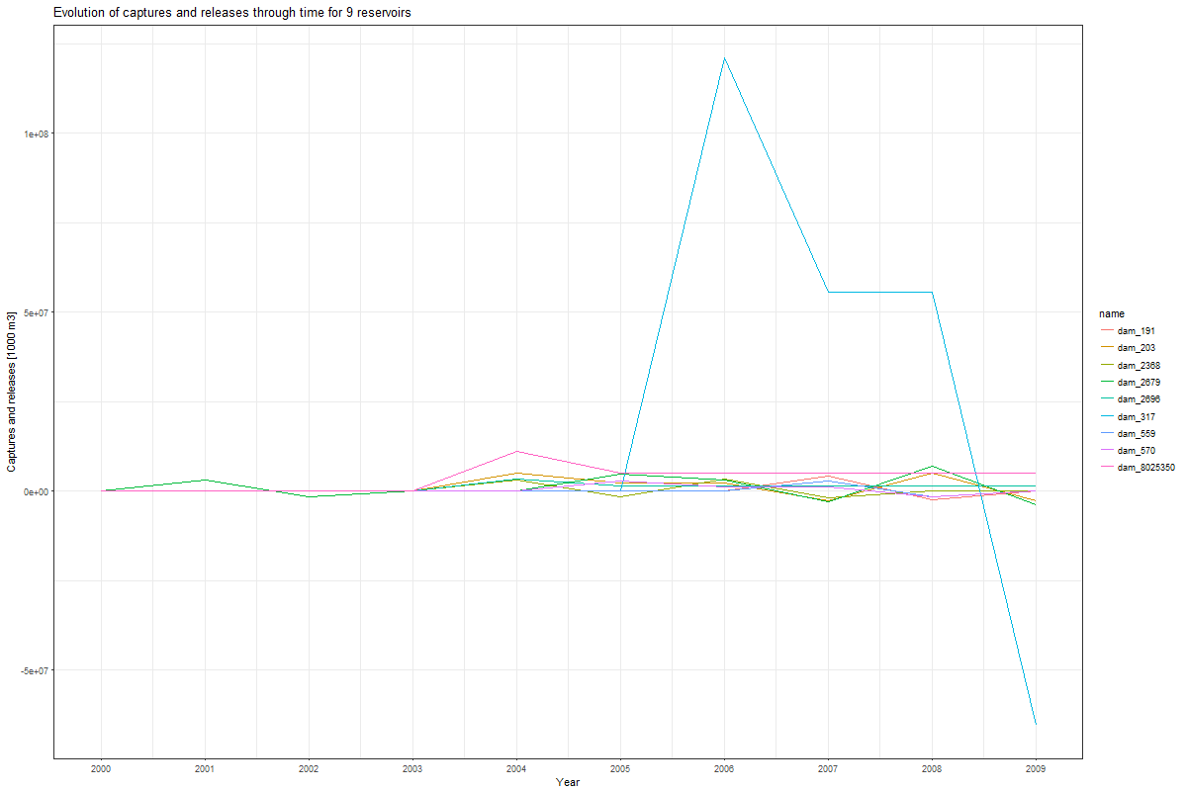
Looking at the 9 reservoirs with highest variance

Slide 8
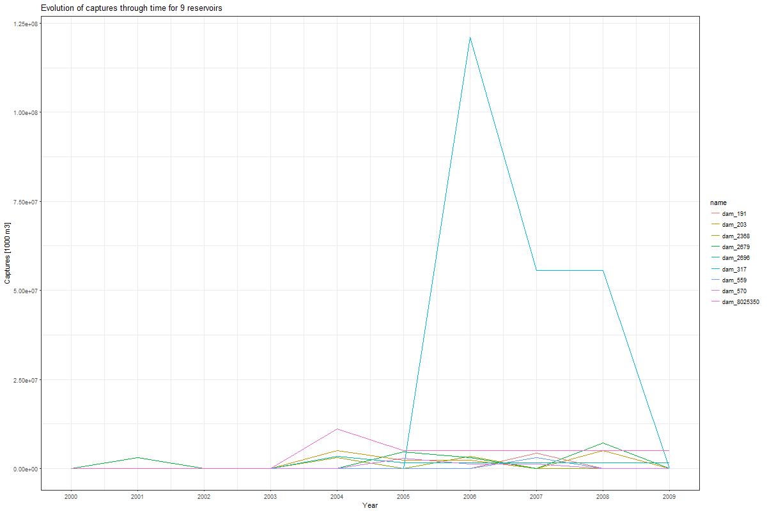

Slide 9
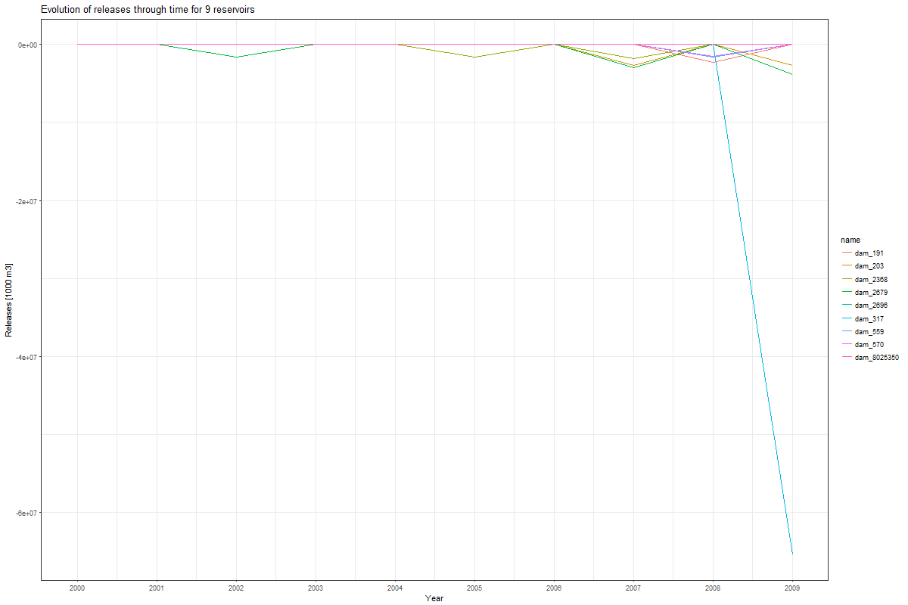

Slide 10
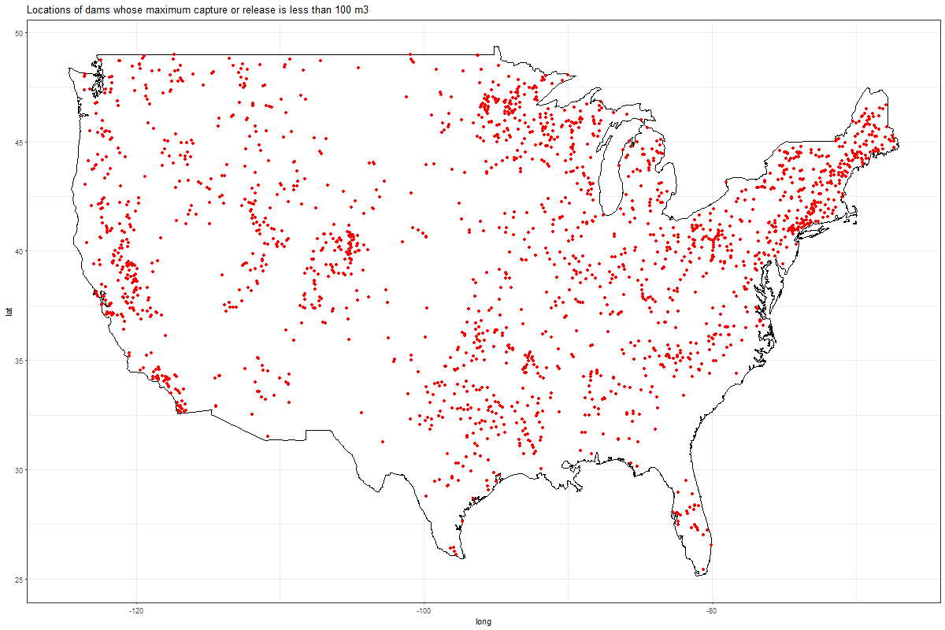
Attempting to find “inactive” threshold

Slide 11
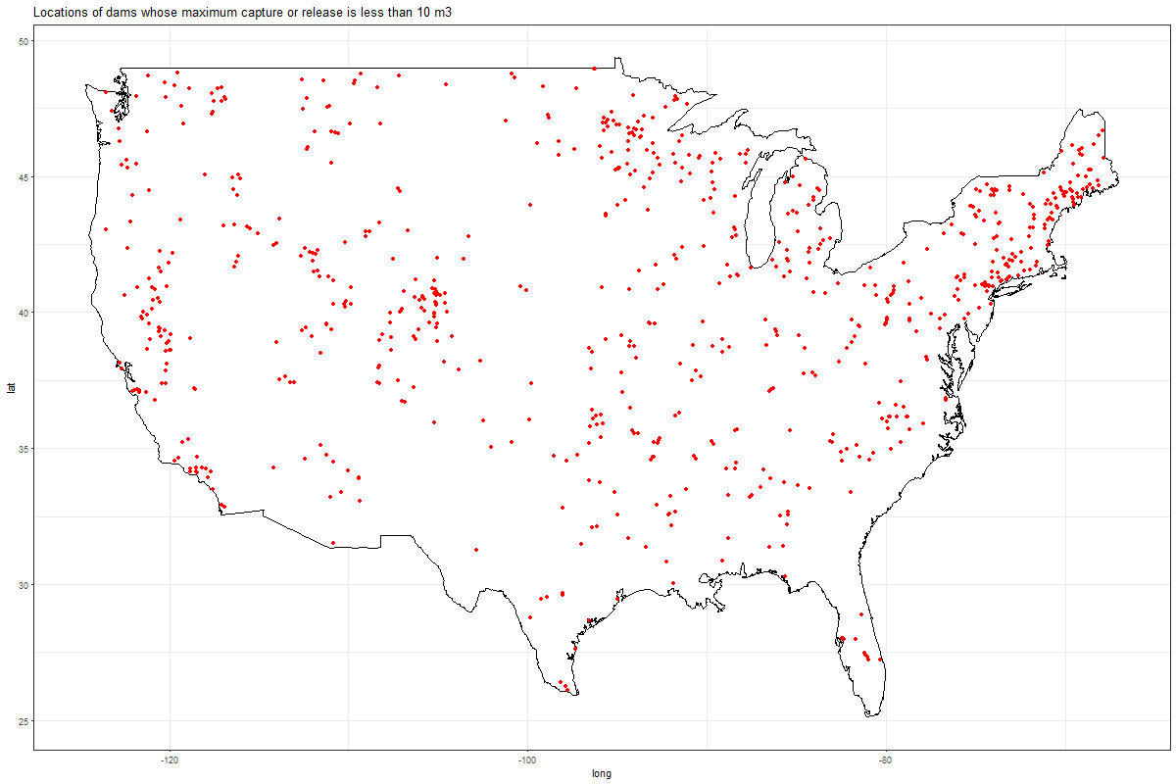

Slide 12
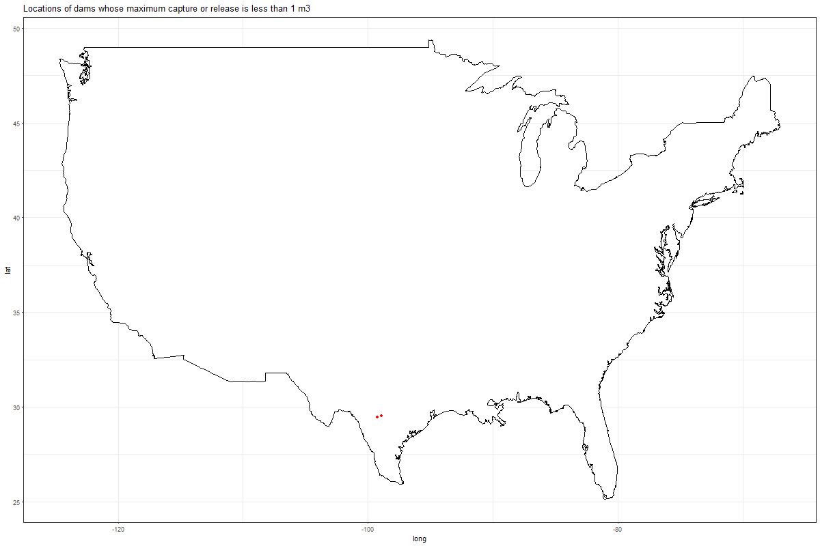

Slide 13
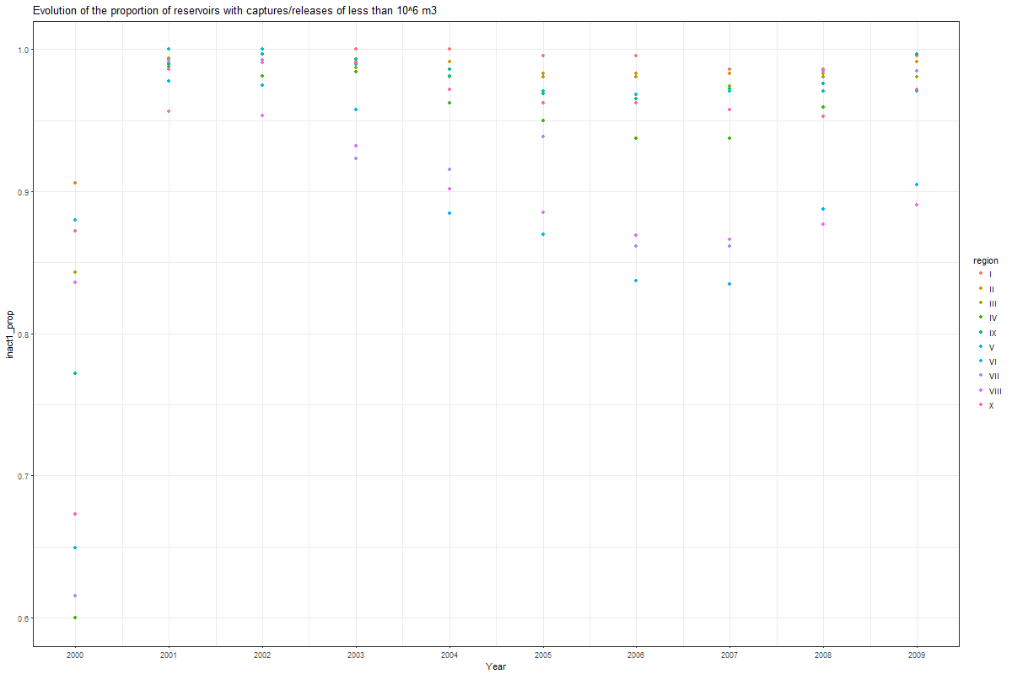
The evolution of the number of dams “inactive” does not really vary after 2001 when changing the threshold between 10^6 m3 and 1m3

Slide 14


Slide 15
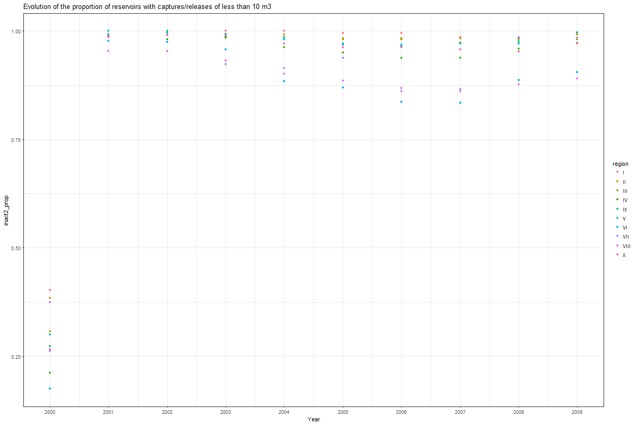

Slide 16


Slide 17
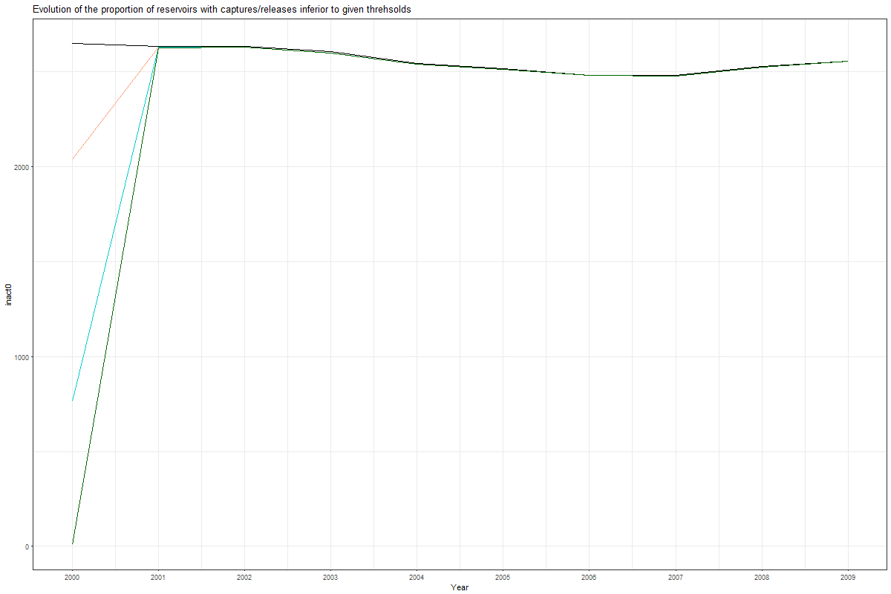

Slide 18
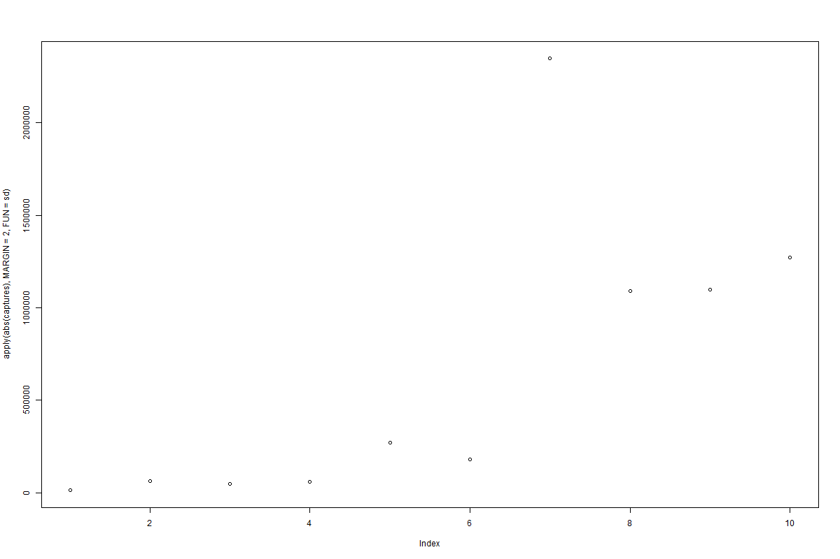
Yet catpures at the national level do vary in those years => lots of small dams simply get filled and then nothing? Error in my code still possible

Slide 19
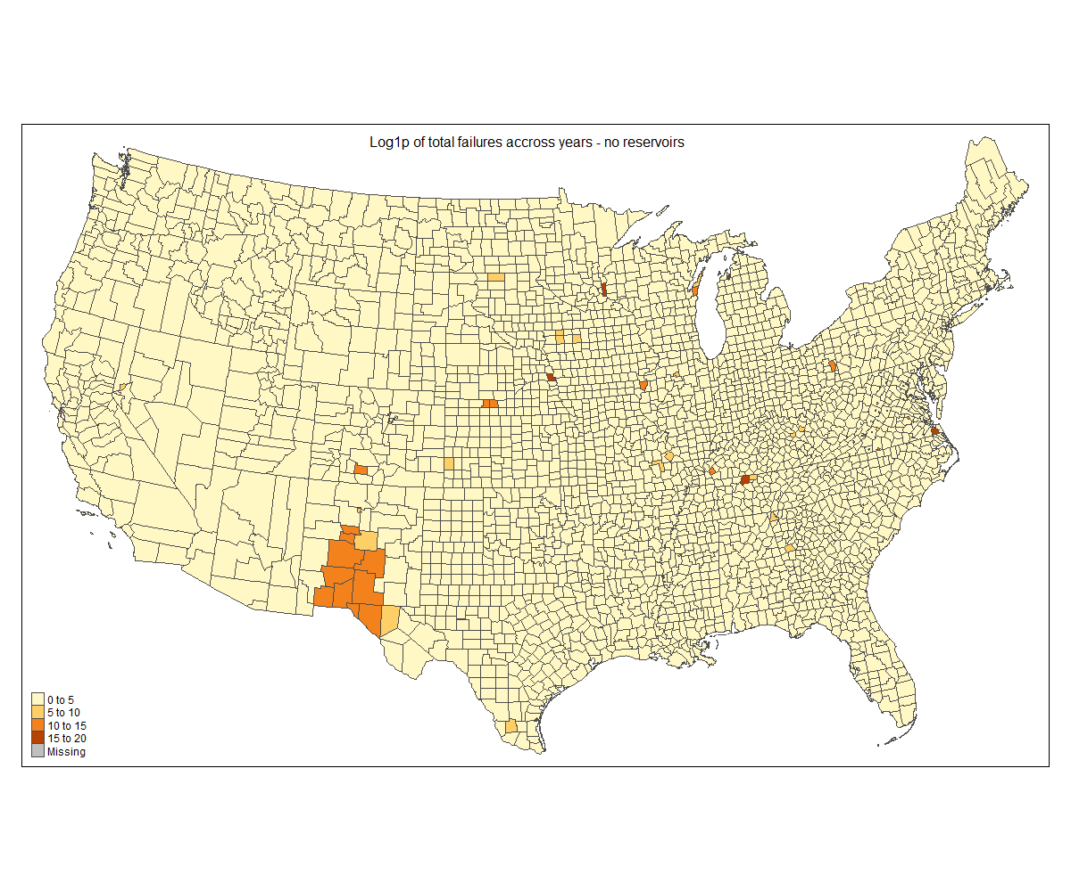
Coounty-level plots –already done

Slide 20


Slide 21
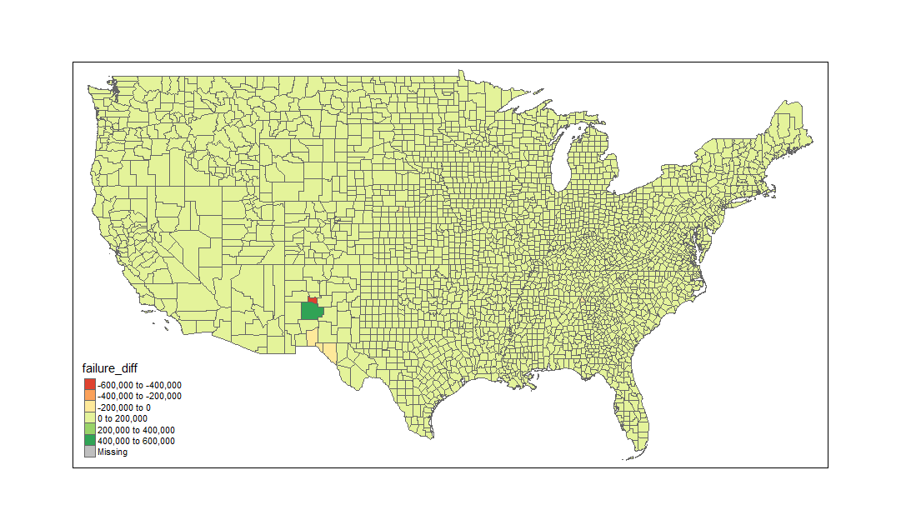
Not log scale

Slide 22


