Slide 1
Summarize-median precip data
output | optimize surface | optimize-allocation | optimize | simulate
crop production total | 1.88E+07 | 1.88E+07 | 2.58E+07 | 1.88E+07
 | 3.03E+06 | 3.03E+06 | 2.98E+06 | 3.03E+06
 | 4.64E+06 | 4.64E+06 | 1.21E+09 | 4.64E+06
 | 0.00E+00 | 0.00E+00 | 3.57E+08 | 0
 | 7.64E+07 | 7.64E+07 | 4.67E+09 | 7.64E+07
 | 3.53E+06 | 3.53E+06 | 3.29E+06 | 3.53E+06
 | 0.00E+00 | 0.00E+00 | 0.00E+00 | 0
 | 1.10E+05 | 1.10E+05 | 5.71E+08 | 1.10E+05
 | 5.09E+07 | 5.09E+07 | 9.54E+08 | 5.09E+07
total gw | 1.67E+05 | 5.63E+07 | 3.98E+04 | 1.67E+05
total sw | 3.41E+07 | 1.58E+09 | 5.49E+07 | 0.00E+00
water use total | 3.43E+07 | 1.64E+09 | 5.49E+07 | 1.67E+05
total water cost | 2.70E+08 | 9.51E+10 | 6.78E+07 | 2.70E+08
total revenue | 7.03E+09 | 7.03E+09 | 3.77E+11 | 7.03E+09
cultivationcost | 1.60E+09 | 1.60E+09 | 2.73E+10 | 1.60E+09
total benefit | 5.16E+09 | -8.96E+10 | 3.50E+11 | 5.16E+09
balance | -1.06E+08 | 1.50E+09 | 4.90E+06 | -1.39E+08
total water demand | 1.40E+08 | 1.40E+08 | 5.00E+07 | 1.39E+08

Slide 2
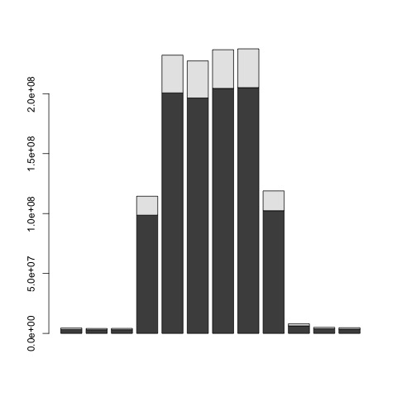
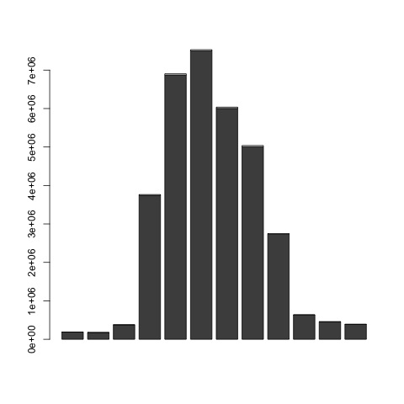
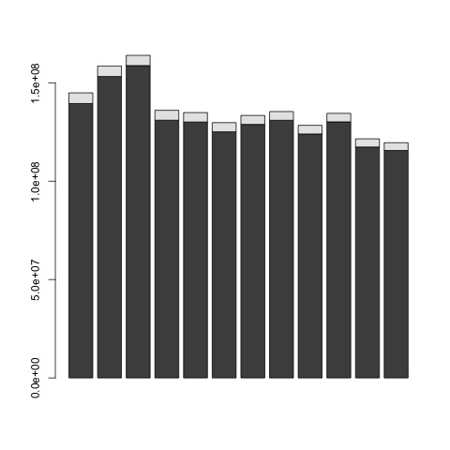
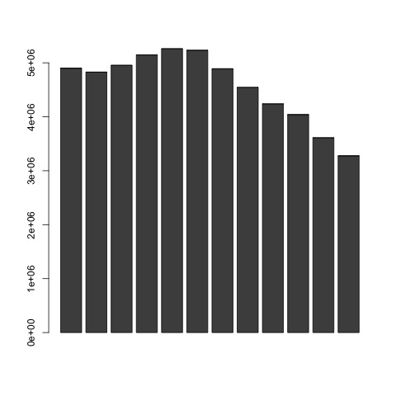
GW-SW monthly distribution
USGS
Optimize-SW
Optimize-Allocation
Optimize

Slide 3
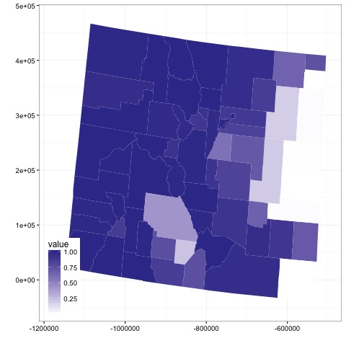
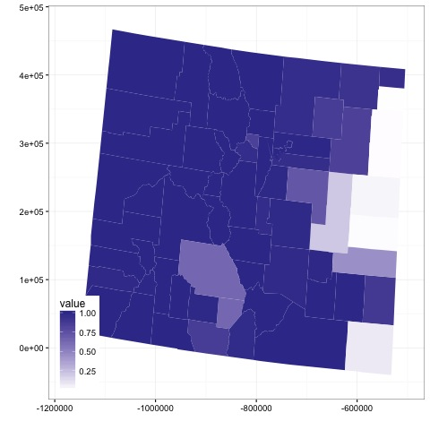
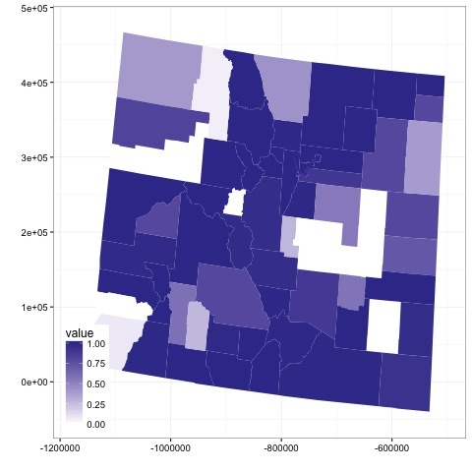
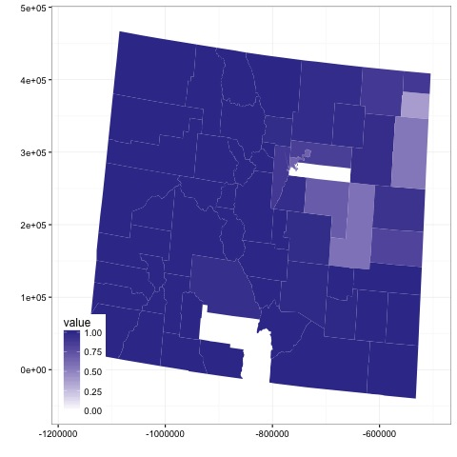
SW supply percentage

Slide 4
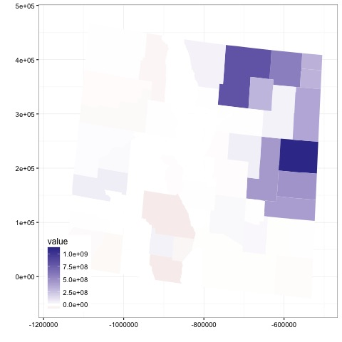
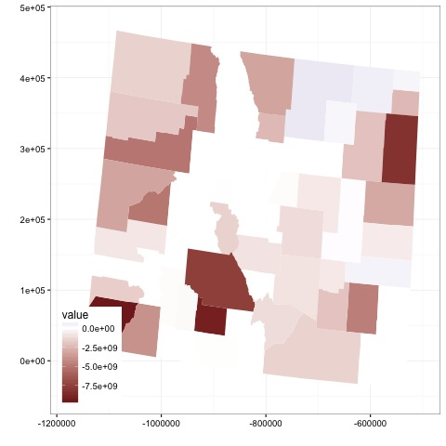
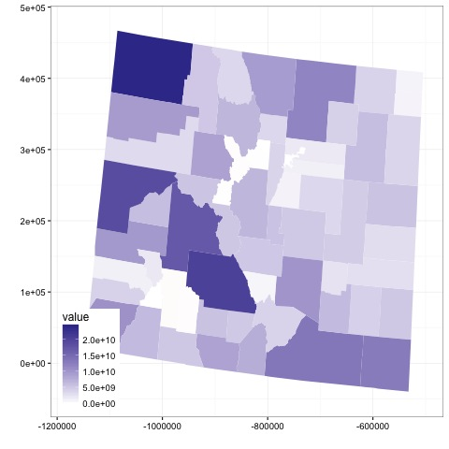
benefit

Slide 5
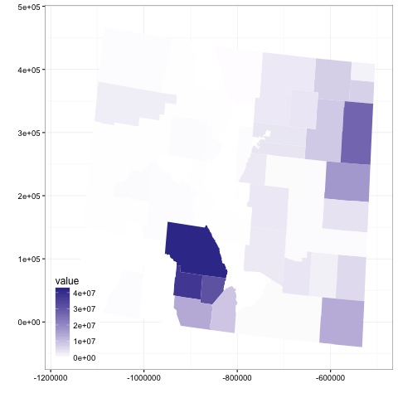
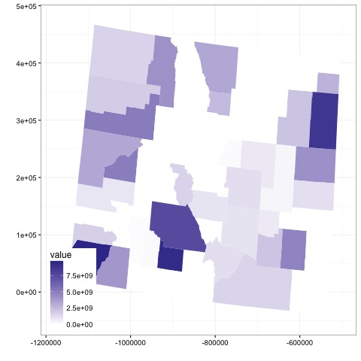
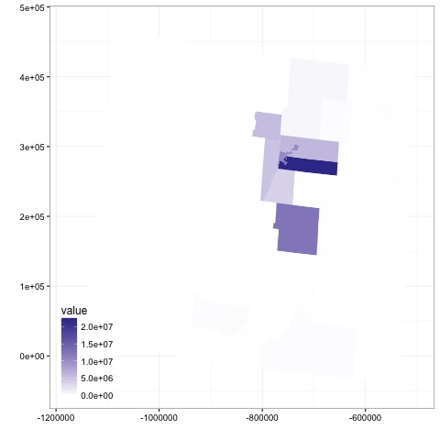
Water cost

Slide 6
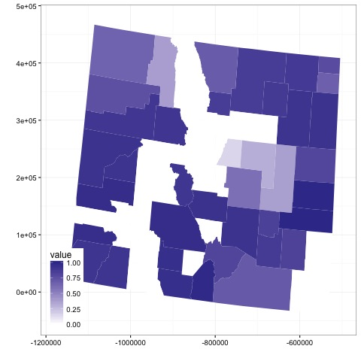
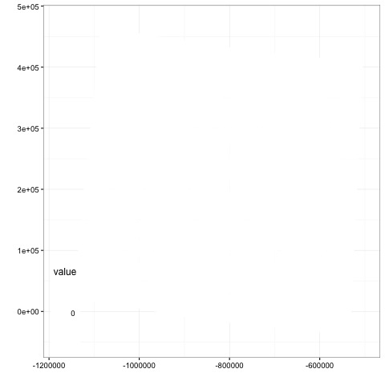
Irrigated area percent

