Slide 1

Master in Data Analytics
Capstone Project
Case study: The Look E-commerce
Amerigo Oddi
Matteo Palazzo
Riccardo Pompili

Slide 2
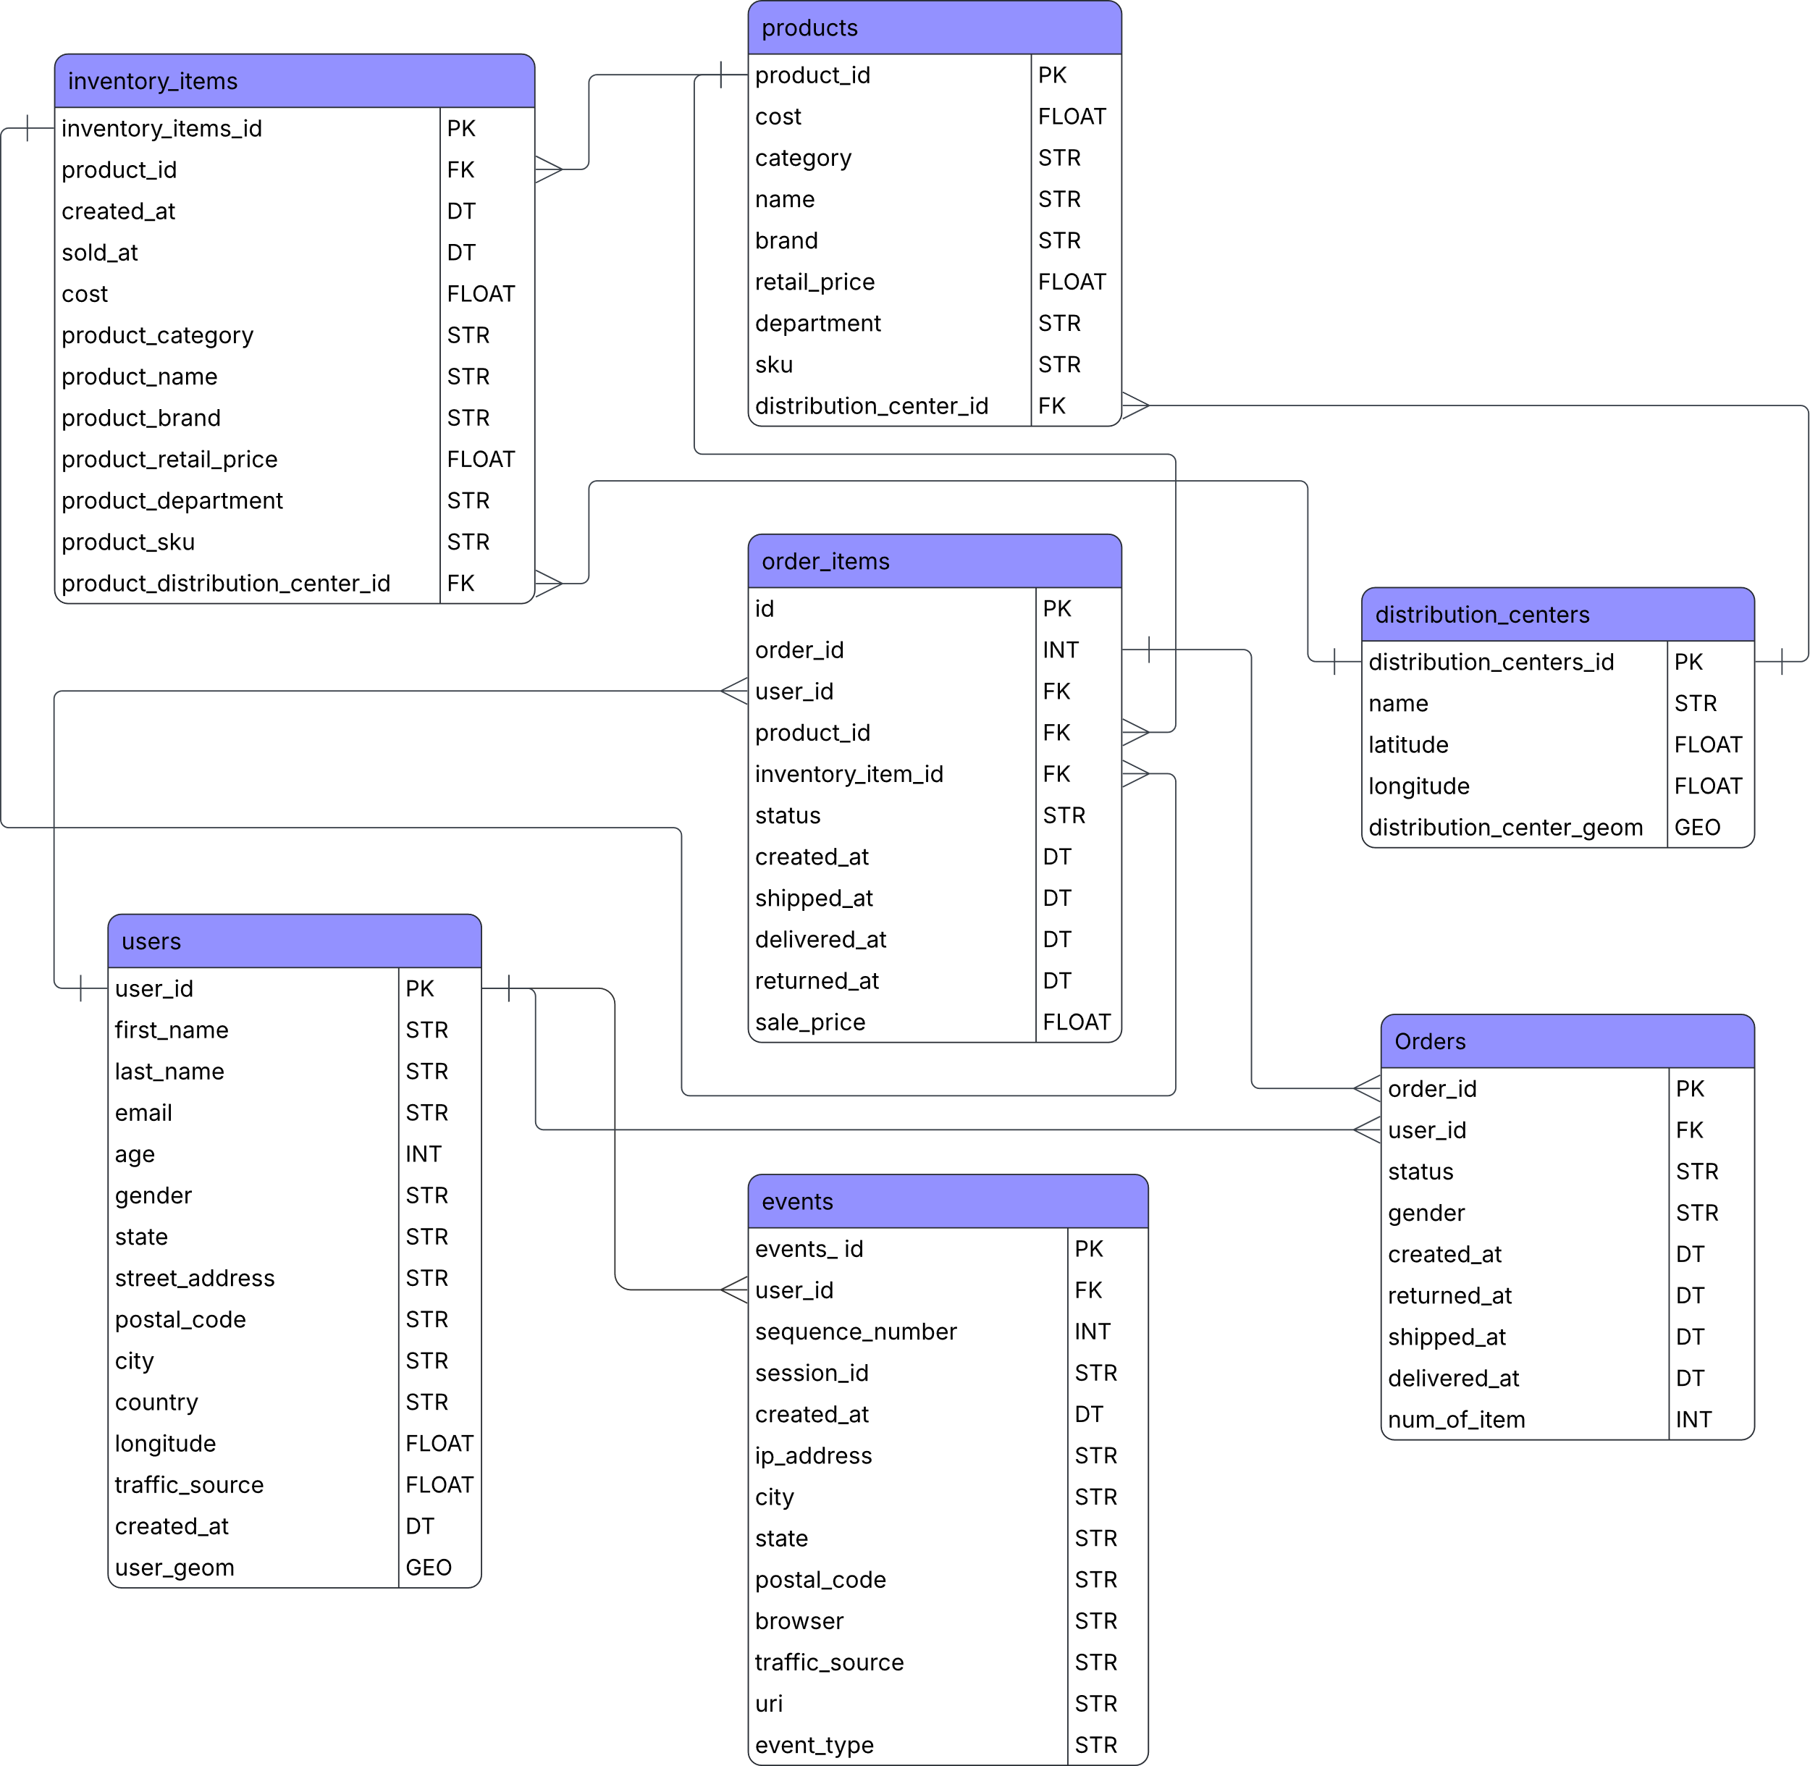
Star schema and data extraction
Dataframe preliminary analysis
Star schema
Data selection
SQL queries for data extraction and date format correction
.csv download

Slide 3

Data cleaning and analysis
.csv import
Format check
Data validation
Descriptive statistics
Supplementary columns calculation
.csv export

Slide 4


Data Visualization
Data import
KPI definition
Layout definition
Measure creation
Visuals configuration
Graphic adjustments

Slide 5
Statistical test
Permutation test: is e-mail more effective than AdWord?
ANOVA test: does delivery performance depends on distribution centers?

