Slide 1
Automobile Insurance System
BY - AMERTHEN S TRAINER - JAVEed

Slide 2
Project Overview
A full-stack application for managing automobile insurance policies.
Built with Angular (frontend) and Spring Boot (backend).
Integrates a MySQL database for data persistence.
Designed as a case study to demonstrate full-stack development skills.

Slide 3
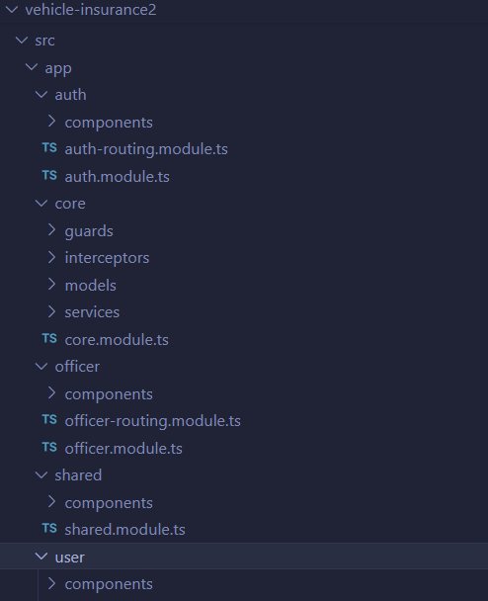
Project Architecture
Frontend:

Slide 4
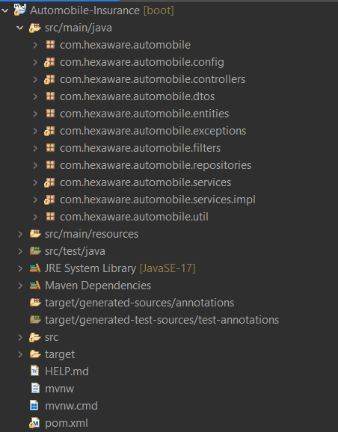
Project Architecture
Backend:

Slide 5
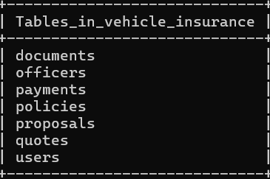
Project Architecture
Database:

Slide 6
Technologies used:
Frontend: Angular, TypeScript, HTML, CSS, Bootstrap.
Backend: Spring Boot, Java, RESTful APIs, JPA (Hibernate).
Database: MySQL.
Tools: Maven, VS Code, Node.js, npm, PowerShell (Windows).

Slide 7
Key Features
User registration and login.
Policy creation, viewing, and management.
Profile update functionality.
API-driven policy operations (e.g., POST /api/policies/policies).

Slide 8
Frontend Experience
Intuitive dashboard for policy management.
Form-based policy creation with validation.
Responsive design using Bootstrap.

Slide 9
Backend Operations
RESTful APIs for CRUD operations on policies.
MySQL integration for data storage.
Authentication and authorization (e.g., JWT support).

Slide 10
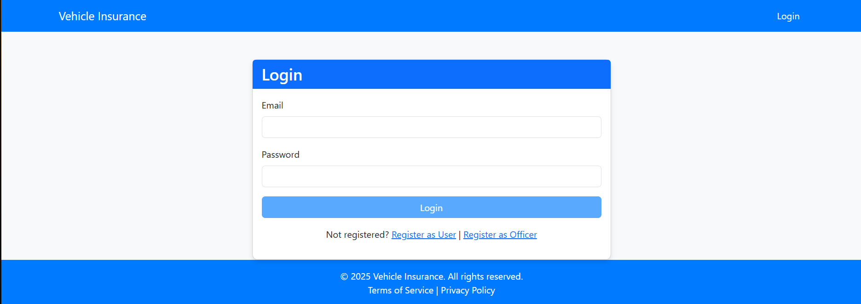
Glimpse of UI
Login Page:

Slide 11
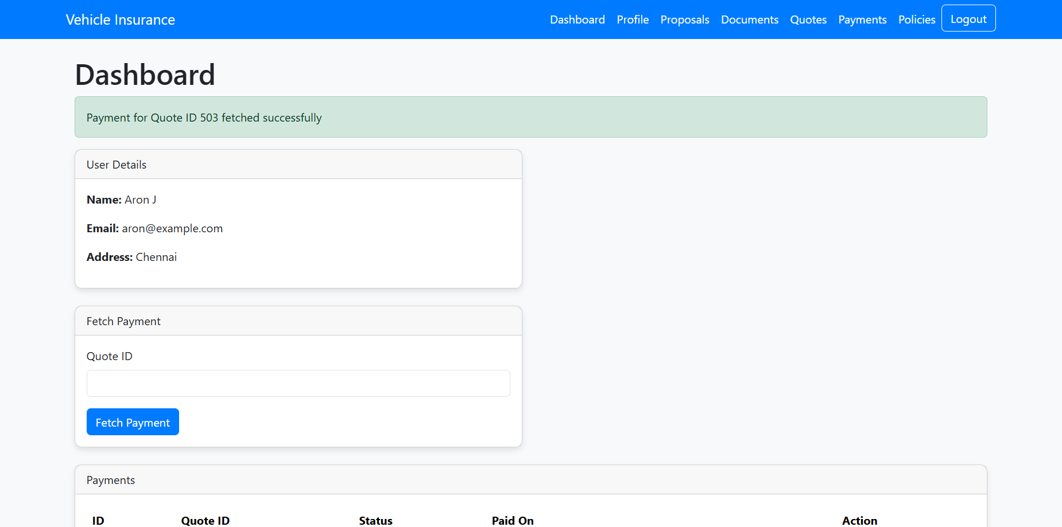
Glimpse of UI
Role_User Interface:

Slide 12
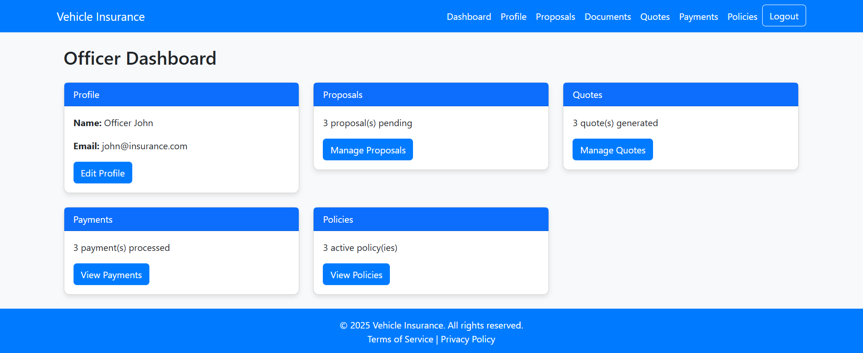
Glimpse of UI
Role_Officer Interface:

Slide 13
Conclusion
Successfully implemented a functional insurance management system.
Demonstrates full-stack development proficiency.
Future Scope: Add payment integration, enhance UI.

