Slide 1

Mask Recognition on Public Transport
CityU-EE Gifted Education Fund Programme: AIoT Coding, Engineering and Entrepreneurial Skills Education for Gifted Students
Using Electronic Payment Systems
Team Members (Project ID)
02 Ames Ng

Slide 2
Introduction
My project is really a simple one:
Recognising people’s face when they tap their octopus card / Alipay... when they get on public transport
If the system managed to find that the person did not wear a mask, it will stop the transaction and remind the person to wear the mask again.

Slide 3
Background & Motivation
Background:
Noticed Hong Kong is recovering from the pandemic in a faster way.
Realized that masks may not be a must in outdoor activities.
However, if HK decided to follow Singapore, we may still need to wear a mask in public transport.

Slide 4


Background & Motivation
Motivation:
I really wanted HK to be awaken from the dead during the pandemic
And even if there is a more powerful virus later affecting the whole world,
The rate of affection towards the economy will be less as this system reminds users daily
(Think how many times you ride public transport/make payments in a day!)

Slide 5

What is the target market?
98%
of aged 15-64 people in Hong Kong owns a octopus card
HK$203 Million
Transaction Rate per day
Targeted market:
Everyone in Hong Kong!
people take public transport per day before pandemic
5,000,000
Many statistics has shown that:
Wearing a mask is HIGHLY effective in preventing virus, no matter your age

Slide 6
Are there existing solutions?
Current solution is not so specified to Hong Kong,
Many solutions uses dataset provided by European people.
Recognizing Asians becomes hard
They use heavy coding knowledge even in a preinstalled app
No existing solution towards Hong Kong

Slide 7

What is your solution?
How does it work?
Training the model with photos of masked and unmasked people
Convert to a 224 x 224px image
Export as a .h5 model
Use OpenCV to start the webcam.
Integrate the above application to an application or Octopus sensor through a board (installed with camera)

Slide 8

Known difficulties and my solutions :
People may use their hand to cover their mouth to pretend wearing a mask
My Solution:
Training more unmasked data with hand covering the mouth, and if the AI is not confident in their recognition, it will try again

Slide 9
Known difficulties and my solutions :
Neither of the Electronic Paying systems are easy to intercept (at least in my level).
They are guarded with heavy securities, and it might be even illegal to check the transaction process.
My Solution:
Use NFC cards to ‘pretend’ Octopus cards in this demonstration
Easier to manipulate

Slide 10
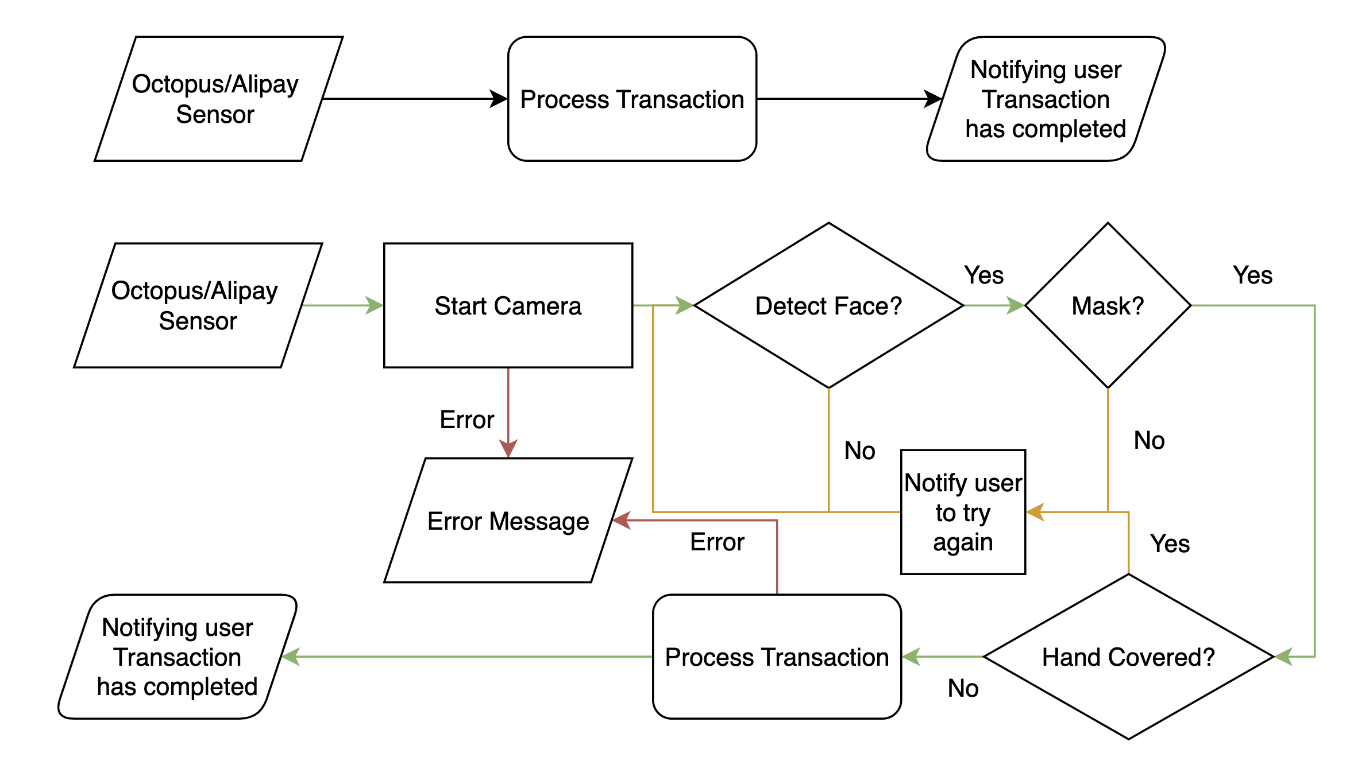
What is your solution?
Original:
My Solution:

Slide 11
Timeline
18/12
18-31/12
1/1-14/1
15/1-
Submission
Training Model
Integration of systems
Final Details

Slide 12

Future work
If this product is highly appreciated by the public,
I would love to develop this product to real life situations with the help of professionals.
Working with a company that has insights to Electronic Paying systems.

Slide 13
Thanks!
Any questions?
Contact details:
mramesng@gmail.com
https://ames.ml

