Slide 1


Development of ERP Tool: Forecast & BOM
By: Amey BHATKAR
Advisors: Olivier JEUSSET, Benjamin LEMOINE, Piotr KOROSTELEV
Jury: Christophe ROUVRAIS, Rabih HADDAD
Notes:
Voudrais commencer
Premier partie concerne l’entreprise et so activite
Expliquerai ensuite principale parties de la pres

Slide 2
Agenda
Introduction
Module 1: Forecast
Module 2: BOM
Validation
Conclusion
Background
Problems
Notes:
Voici le plan de la prese

Slide 3
Agenda
Introduction
Module 1: Forecast
Module 2: BOM
Validation
Conclusion
Background
Problems

Slide 4

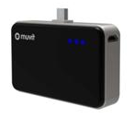

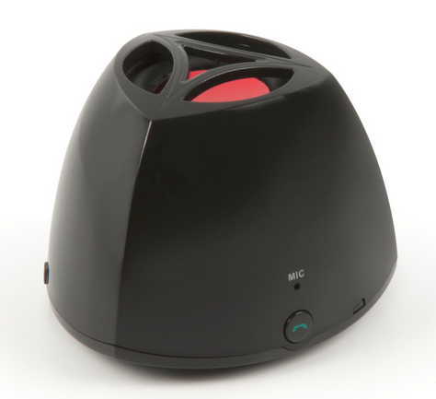
What we do!!!
Notes:
Je commence la prese par l’intro de l’entreprise, ses partenaire et quelques chiffres pour montrer sa croissance

Slide 5
Positioned at a pivotal point in Mobile Accessory Eco System.
About ascendeo France
Introduction
Notes:
Ascendeo vend principalement des accessoires pour mobile comme de houses de protection, des chargeurs, des ecouteurs, appareil Bluetooth etcetera

Slide 6
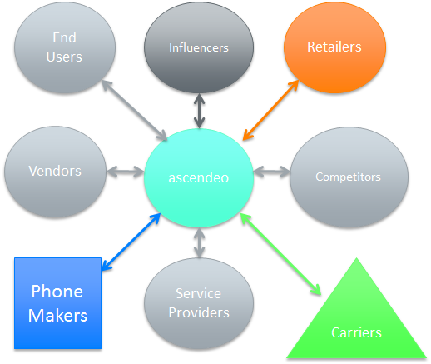
Introduction

Slide 7
Introduction
Positioned at a pivotal point in Mobile Accessory Eco System.
About ascendeo France
Main role to
analyze both demand & supply,
advice both sides,
maintain balanced interest of all eco system members.
Notes:
Unde des missions principals de l’entreprise est a’anaylser l’offer et la demande et de conseiller fournisseurs et clients

Slide 8
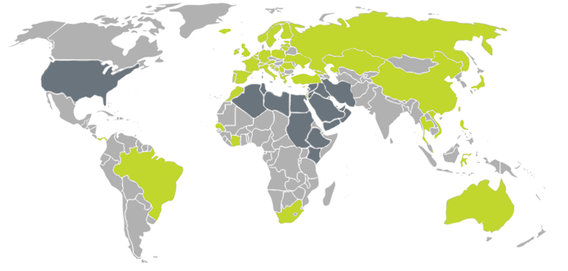
Introduction
European Partners
ascendeo France,
Celly, Italy,
ascendeo UK & Ireland,
Mconomy, The Netherlands,
InOffCom, Spain
Asian Partners
AshCloud, Shenzhen
Ascendeo HK, Dongguan
Tektos, Hong Kong
Notes:
A de mobreux partenaires repartis a travers l’eu et l’asie
La partenaires europeens sont…

Slide 9
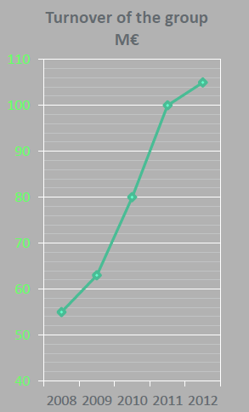
Some Figures
Finance
Strength
180+ in EU
104 M € revenue in 2012
8 M € EBITDA
160+ in China
Notes:
Voici quelques chiffres pour montrer la croissance jusqu’en 2012
La chiffre d’affaire est de …
Ils gerent 1809 employes en
Ils coordonnent aussi 160 employes chez notre principal partenaire en asie

Slide 10
Agenda
Introduction
Module 1: Forecast
Module 2: BOM
Validation
Conclusion
Background
Missions

Slide 11


All information stored in SAGE.
SAGE not accessible to all.
Need for ERP Tool
Missions

Slide 12
Missions
All information stored in SAGE.
SAGE not accessible to all.
Need for ERP Tool
Excel sheets not suitable.

Slide 13
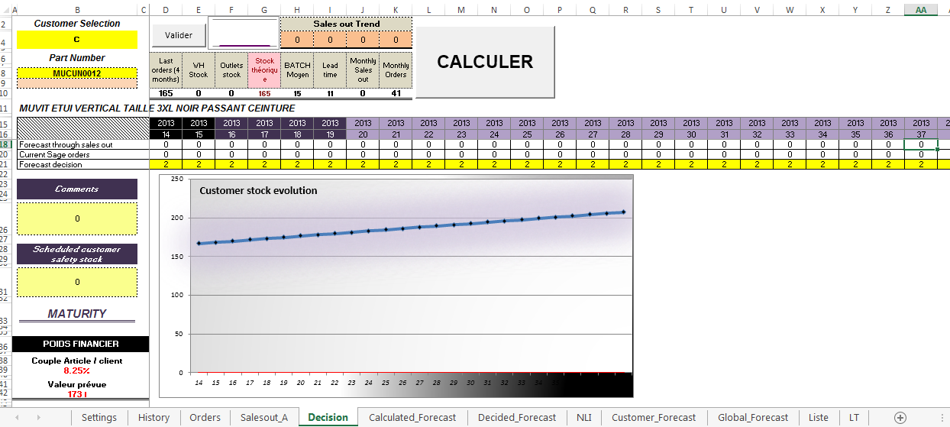
Missions
All information stored in SAGE.
SAGE not accessible to all.
Need for ERP Tool
Excel sheets not suitable.

Slide 14
Problems
All information stored in SAGE.
SAGE not accessible to all.
Need for ERP Tool
Excel sheets not suitable.
Need for a database and an online interactive tool.
Thus, the idea of the ERP tool.

Slide 15
Agenda
Introduction
Module 1: Forecast
Module 2: BOM
Validation
Conclusion
Background
Missions

Slide 16

Background
Gave a base to the ERP tool development.
Module 1: Forecast,
My Contribution
16 Database Tables,
Total of 15+ interactive pages.
Module 2: BOM,
200+ Database Tables
Currently 45+ interactive pages

Slide 17







Background
Technologies Used
Eclipse
PHP
MySQL
JavaScript / jQuery / Ajax
HTML / CSS

Slide 18
Agenda
Introduction
Module 1: Forecast
Module 2: BOM
Validation
Conclusion
Background
Problems

Slide 19
Module 1:
Forecast
Context
3 different types of forecasts for each customer – product couple,
the Calculated Forecast
the Global Forecast
the Decided Forecast
the Customer Forecast
1 final forecast for each product

Slide 20
Module 1:
Difficulties & Actions
The retrieval of all the data for a customer – product couple.
Forecast

Slide 21
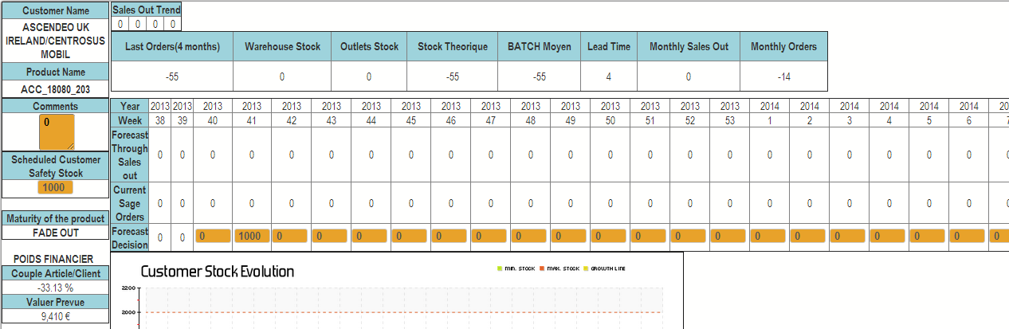
Module 1:
Difficulties
The retrieval of all the data for a customer – product couple.
Forecast

Slide 22
Module 1:
Difficulties
The retrieval of all the data for a customer – product couple.
Responsive graph.
Forecast

Slide 23
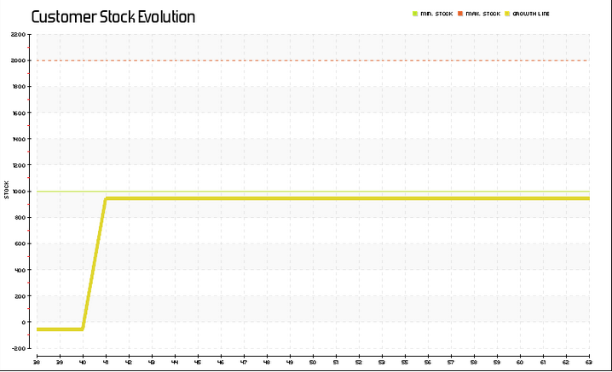
Module 1:
Difficulties
The retrieval of all the data for a customer – product couple.
Responsive graph.
Forecast

Slide 24
Module 1:
Forecast
Difficulties
The retrieval of all the data for a customer – product couple.
Responsive graph.
Listing of the product lists for each customer.

Slide 25
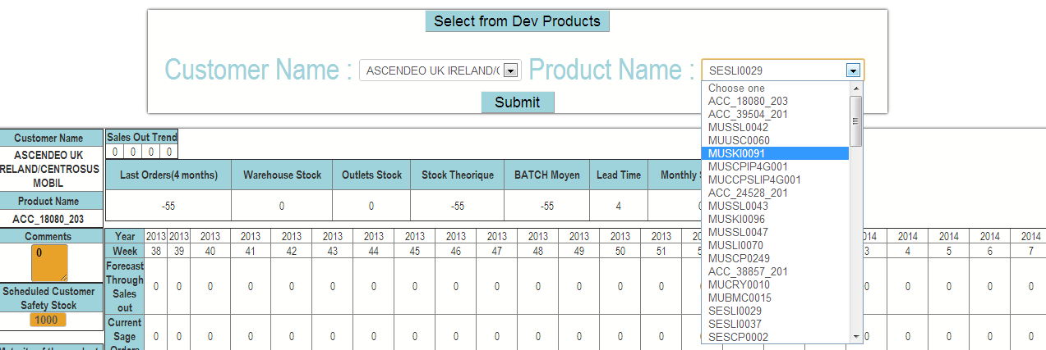
Module 1:
Forecast
Difficulties
The retrieval of all the data for a customer – product couple.
Responsive graph.
Listing of the product lists for each customer.
List Unique for each Customer

Slide 26
Module 1:
Forecast
Difficulties
The retrieval of all the data for a customer – product couple.
Responsive graph.
Listing of the product lists for each customer.
Populating the database.
Notes:
Last point because the only a small part but an important part of data comes from SAGE, rest we have to calculate and store.

Slide 27
Module 1:
Action
A web tool, whose functioning is almost similar to that in the excel sheets.
Forecast

Slide 28
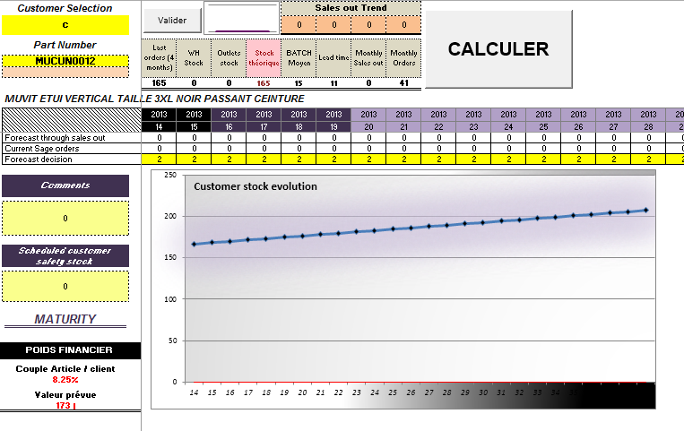
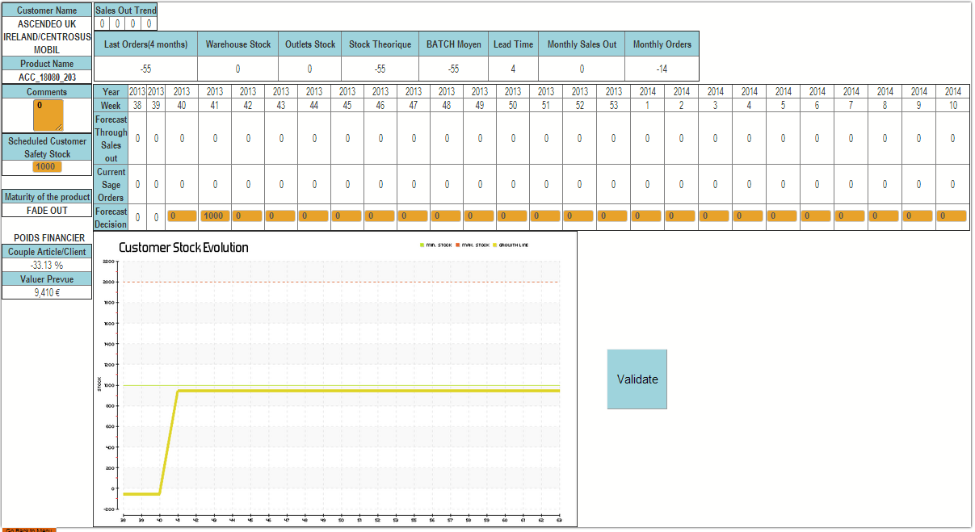
Module 1:
Forecast

Slide 29
Module 1:
Forecast
Action
A web tool, whose functioning is almost similar to that in the excel sheets.
Implemented access management.

Slide 30
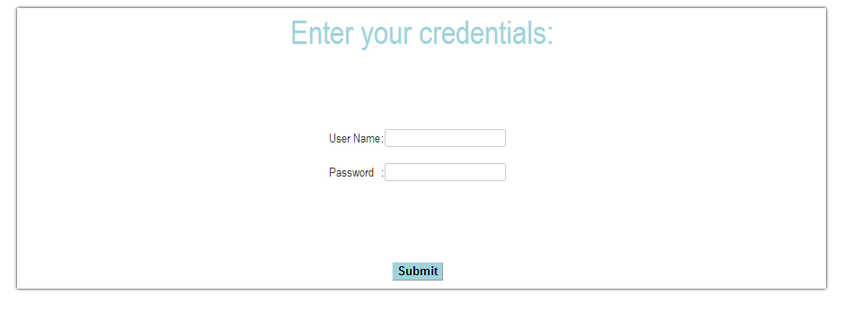
Module 1:
Forecast

Slide 31
Module 1:
Forecast
Action
A web tool, whose functioning is almost similar to that in the excel sheets.
Implemented access management.
Defined roles for each type of task.
Easy to handle and maintain.

Slide 32
Module 1:
Forecast
Result
http://mcaeadata.ascendeo.fr/forecast/

Slide 33
Agenda
Introduction
Module 1: Forecast
Module 2: BOM
Validation
Conclusion
Background
Problems

Slide 34
Module 2 :
BOM
Context
5 types of pages / interactions with each main entity present in the database,
the Problem pages.
the Display pages
the List pages
the Edit pages
the New / Create Pages

Slide 35
Difficulties
The implementation of the database.
The web pages.
Module 2 :
BOM

Slide 36
Module 2 :
Action
Defined roles to access different pages.
New entry for each entity.
BOM

Slide 37
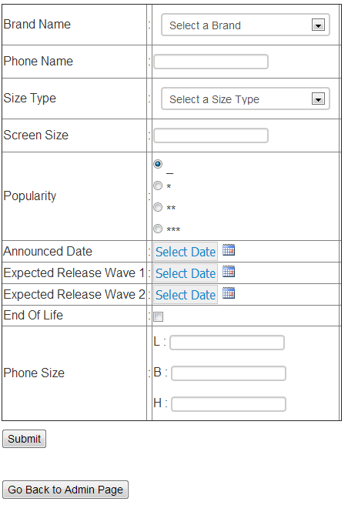
Module 2 :
BOM
New Phone Page

Slide 38
Module 2 :
Action
Defined roles to access different pages.
New entry for each entity.
Editing entries for few entities.
BOM

Slide 39
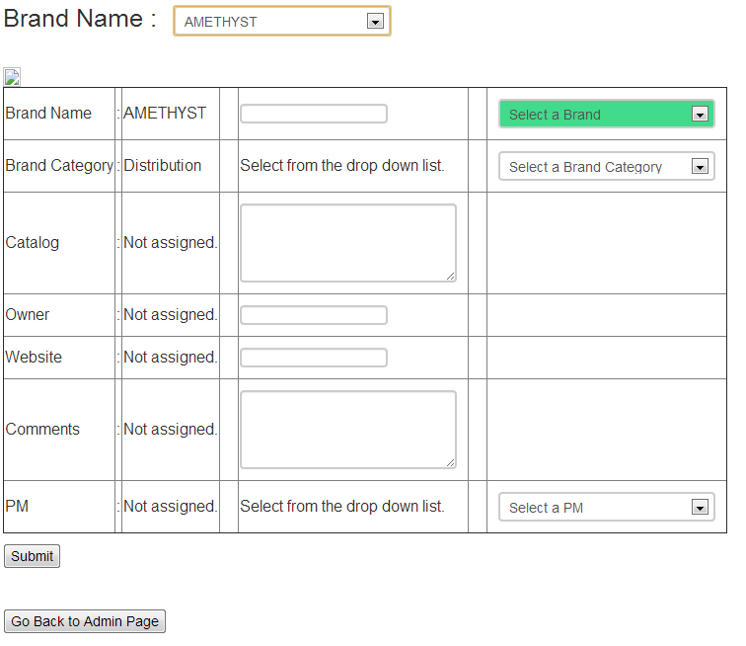
Module 2 :
BOM
Edit Brand Page

Slide 40
Module 2 :
BOM
Action
Defined roles to access different pages.
New entry for each entity.
Editing entries for few entities.
Displaying entries for few entities.

Slide 41
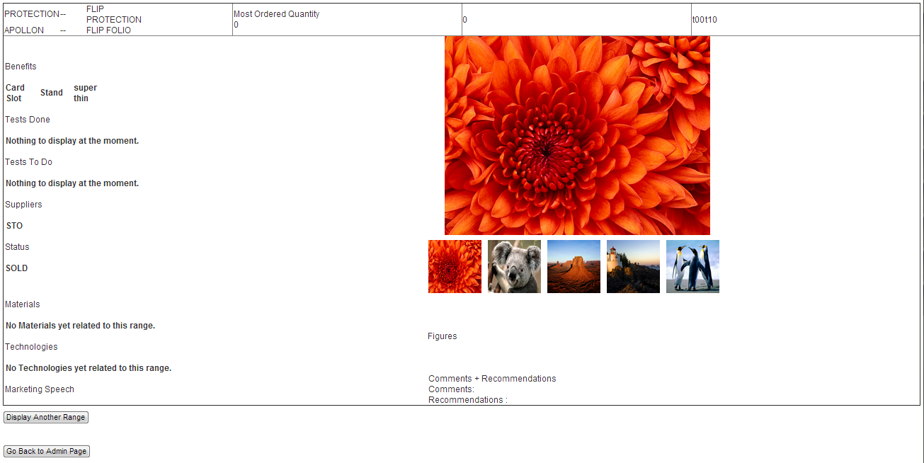
Module 2 :
BOM
Display Range Page

Slide 42
Module 2 :
BOM
Result
http://mcaeadata.ascendeo.fr/bom/

Slide 43
Agenda
Introduction
Module 1: Forecast
Module 2: BOM
Validation
Conclusion
Background
Problems

Slide 44
Validation
Forecast & BOM
Unit tests performed and validated.
Olivier and Benjamin validated the forecast tool.
Regular validations for the tools.
Olivier and Piotr validated the developed part of the BOM tool.

Slide 45
Agenda
Introduction
Module 1: Forecast
Module 2: BOM
Validation
Conclusion
Background
Problems

Slide 46
Conclusion
Lessons Learned
Efficient use of PHP + MySQL with JavaScript / jQuery / Ajax.
Better formatting with HTML / CSS.
Time Management and few more Management Aspects

Slide 47
Conclusion
Future Work
The actual ERP tool, with all the other aspects of product development.
Enrichment in Look and Feel.
More defined roles and access management.

Slide 48

Questions & Answers

Slide 49

Thank You!!!

