Slide 1


Slide 2
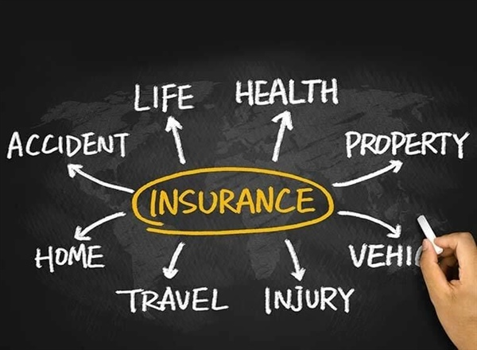
WHAT IS INSURANCE ?
Insurance is a means of protection from financial loss. It is a form of risk management, primarily used to hedge against the risk of a contingent or uncertain loss.

Slide 3
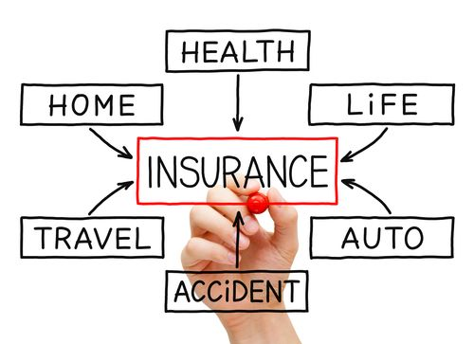
TYPES OF INSURANCE

Slide 4
INSURANCE CLAIM
The insurance claim process varies somewhat depending on the type of insurance.
You should examine your insurance policy so that you understand your rights and responsibilities, including:
Whether or not your policy covers the situation you’re dealing with
Applicable timelines for filing a claim (some instruct you to file a claim within 24 hours of the relevant incident)
Whether you have multiple types of policies that could cover the same thing (for example, an umbrella policy provides coverage in addition to certain existing policies)
If you have any deductibles that could apply to your situation (if the amount of your claim is less than your deductible, it may not be worth pursuing a claim which could raise your insurance rates)

Slide 5
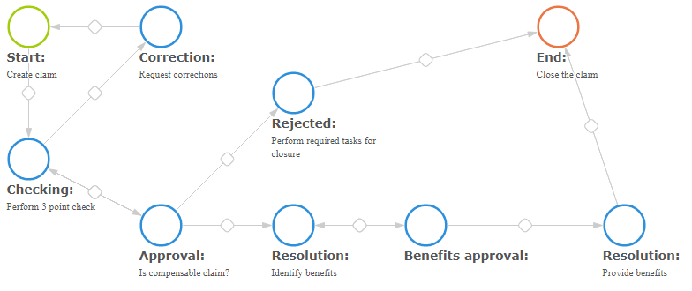
INSURANCE CLAIM PROCESS

Slide 6
PROBLEM STATEMENT
Insurance varies widely from customer to customer, and a deep understanding of various factors helps predict the likelihood of insurance claims.The aim is to predict the insurance claim based on the characteristics of the insured.

Slide 7
INFORMATION ABOUT DATASET
Variable | Definition
Age | Age of policyholder
Sex | Gender of policy holder
BMI | Body mass index, providing an understanding of body, weights that are relatively high or low relative to height, objective index of body weight (kg / m ^ 2) using the ratio of height to weight, ideally 18.5 to 25
Steps | Average walking steps per day of policyholder

Slide 8
Variable | Definition
Children | Number of children / dependents of policyholder
Smoker | Smoking state of policyholder
Region | The residential area of policyholder in the US
Charges | Individual medical costs billed by health insurance
Insurance Claim | Insurer will claim the insurance or not

Slide 9
Type | Variables
Independent Variables | Age, Sex, BMI, Steps, Children, Smoker, Region, Charges
Dependent Variable(Predicting) | Insurance Claim

Slide 10
DATA PREPARATION
Variable | Encoding
Sex | Female=0 Male=1
Smoker | Non-smoker=0 Smoker=1
Region | Northeast=0 Northwest=1 Southeast=2 Southwest=3
Insurance Claim | No=0 Yes=1

Slide 11
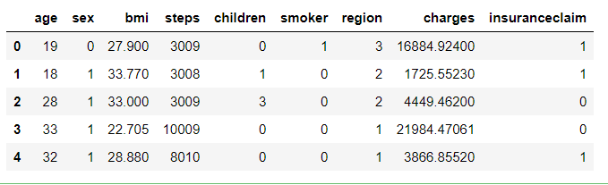
DATA EXPLORATION

Slide 12
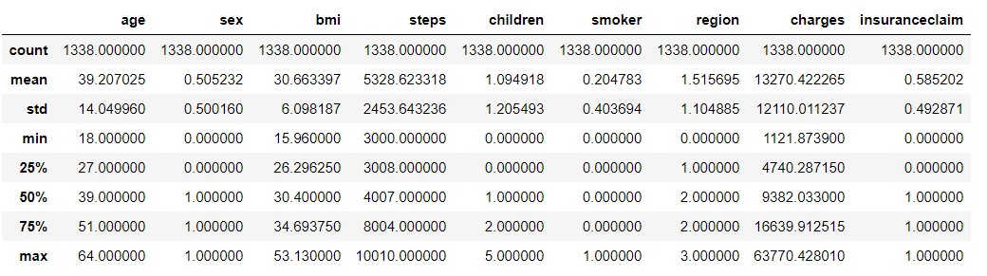
DATA SUMMARY

Slide 13
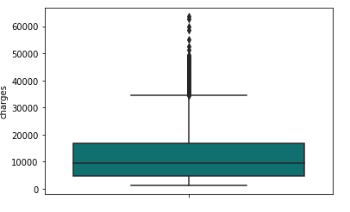
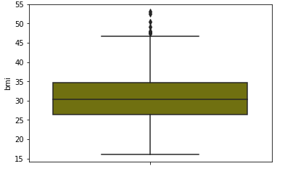
UNIVARIATE GRAPHS

Slide 14
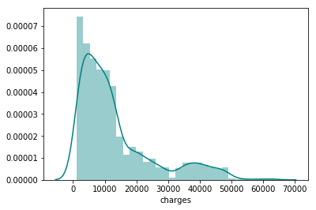
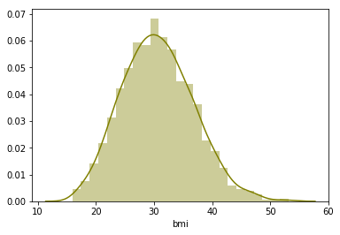
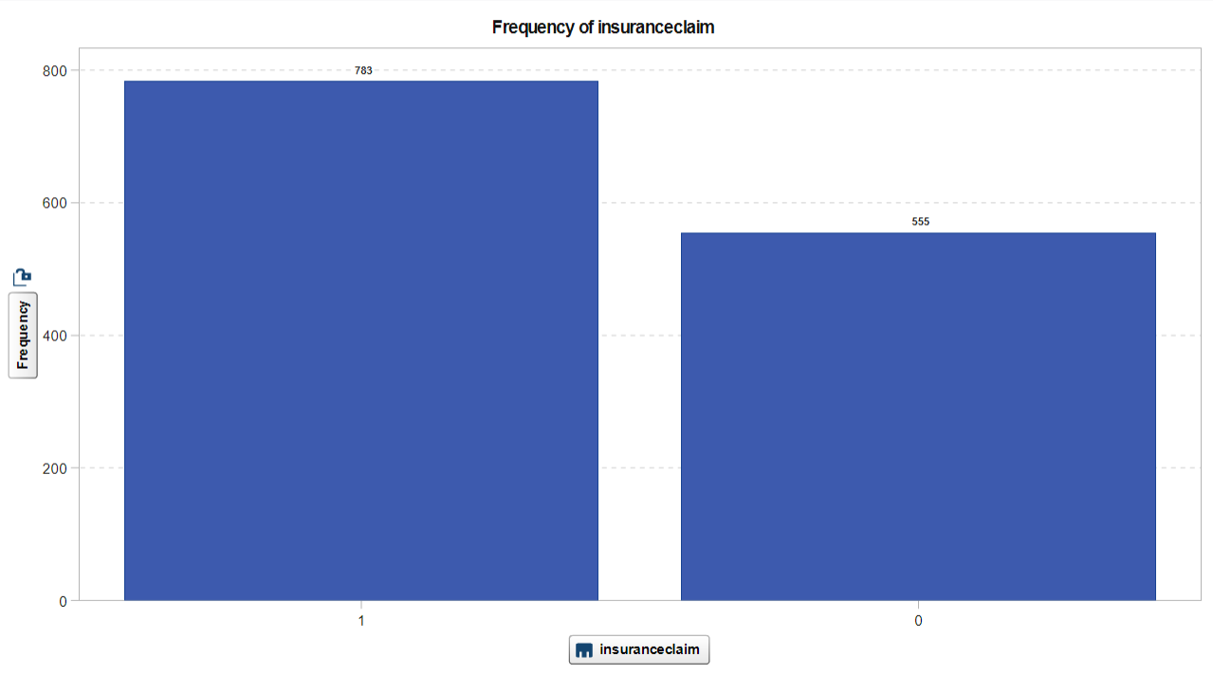

Slide 15
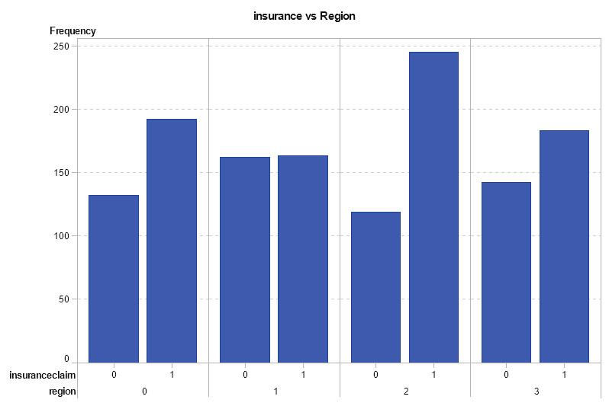
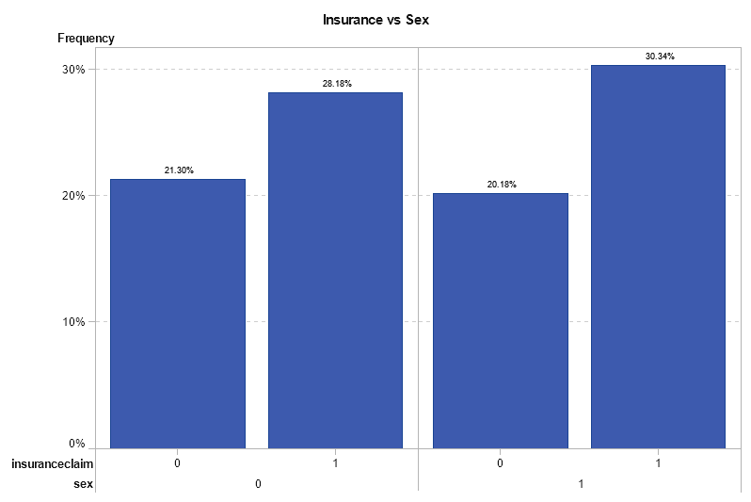
BIVARIATE GRAPHS

Slide 16
MODELS USED
Logistic Regression
K Nearest Neighbors
Decision Tree
Random Forest

Slide 17
MODELLING
- CONSIDERING ALL FEATURES

Slide 18
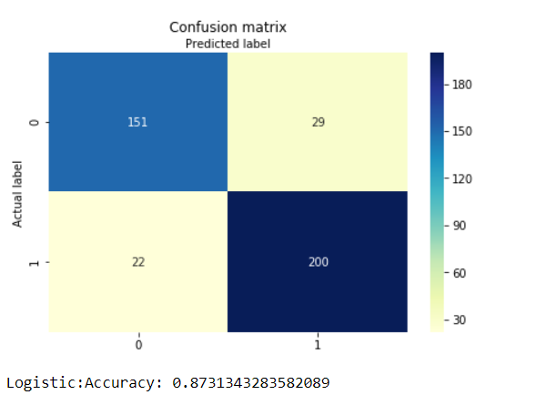
LOGISTIC REGRESSION
ACCURACY
Train Set: 88.35 %
Test Set: 87.83 %

Slide 19
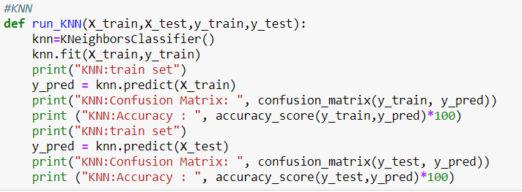
K- NEAREST NEIGHBORS
ACCURACY
Train Set: 77.77 %
Test Set: 68.15 %

Slide 20
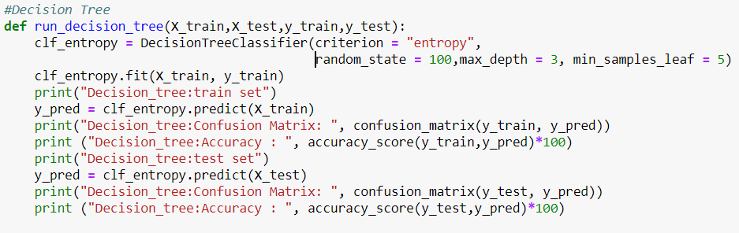
DECISION TREE
ACCURACY
Train Set: 84.61 %
Test Set: 85.57 %

Slide 21
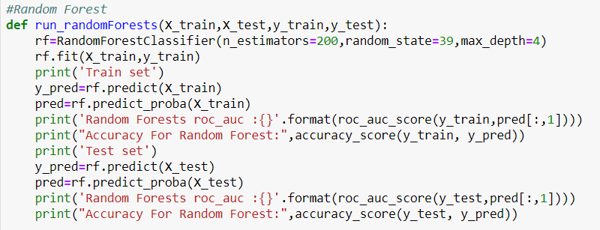
RANDOM FOREST
ACCURACY
Train Set : 91.34 %
Test Set : 91.04 %

Slide 22
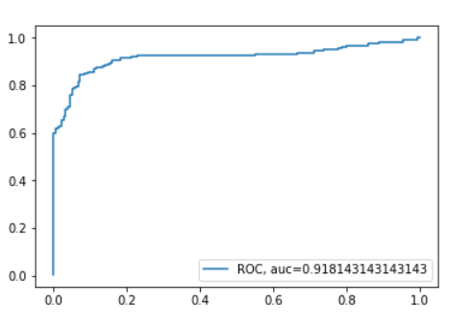
ROC CURVE

Slide 23
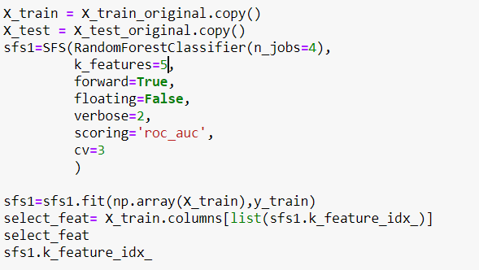
FEATURE SELECTION
METHOD - FORWARD STEP-WISE SELECTION
SIGNIFICANT FEATURES -
AGE
BMI
CHILDREN
SMOKER
CHARGES

Slide 24
MODELLING
-USING FEATURE SELECTION

Slide 25
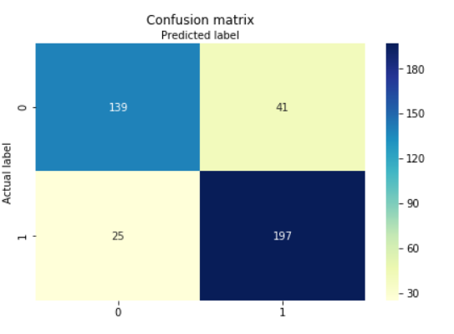
LOGISTIC REGRESSION
ACCURACY
Train Set: 85.04 %
Test set: 83.58 %

Slide 26
K- NEAREST NEIGHBORS
ACCURACY
Train Set: 77.77 %
Test Set: 68.15 %

Slide 27
DECISION TREE
ACCURACY
Train Set: 84.61 %
Test Set: 85.57 %

Slide 28

RANDOM FOREST
ACCURACY
Train Set : 92.09 %
Test Set : 92.78 %

Slide 29
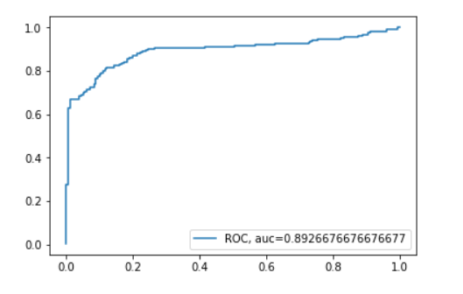
ROC CURVE

Slide 30
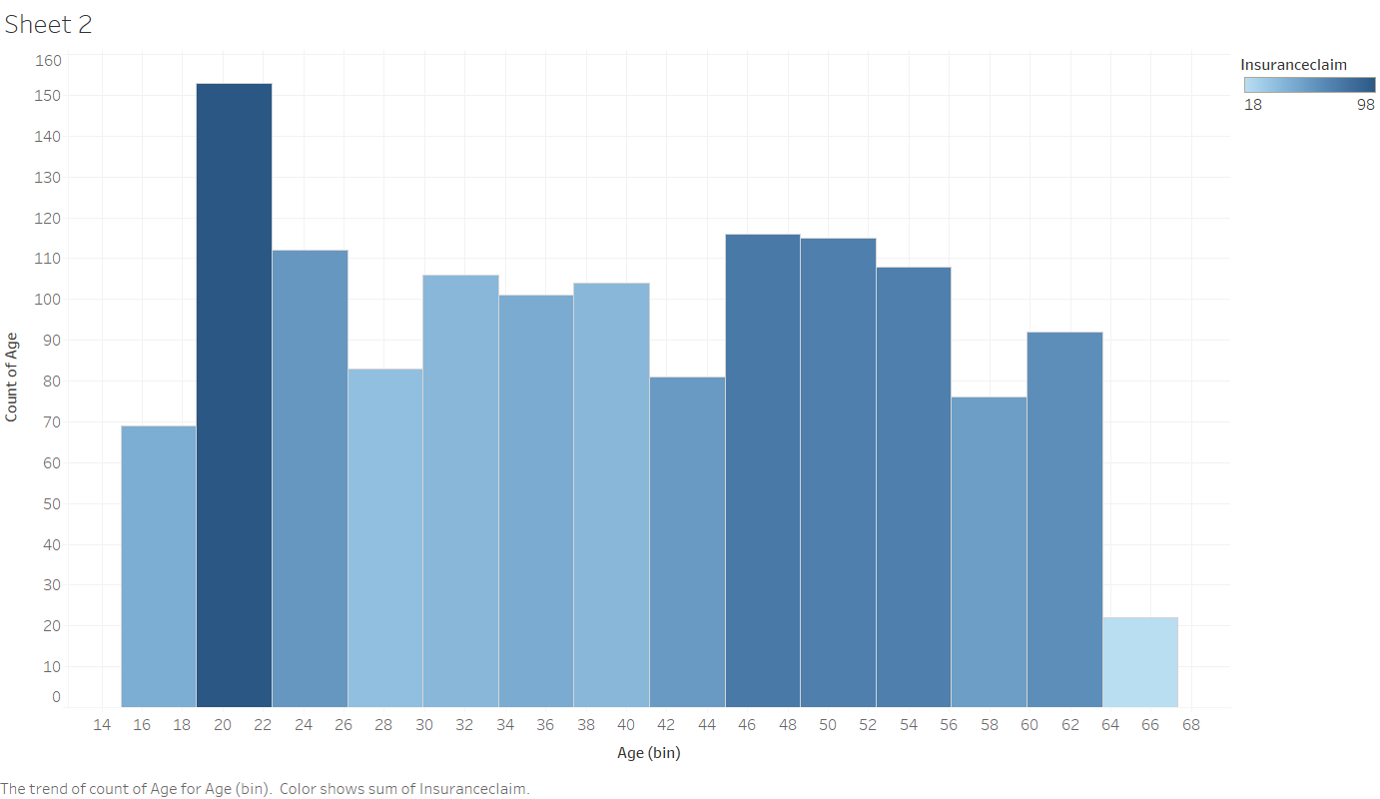
INTERPRETATION
From the graph we observe that there are more insurance claims made between 20-25yrs and above 42yrs of age.
Therefore we can conclude that with increase in age the claim for Insurance increases.

Slide 31
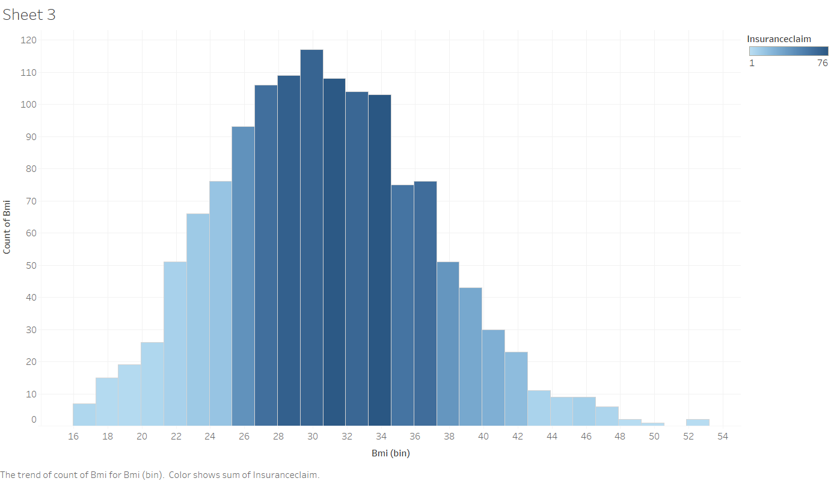
From the graph we observe that insurers with BMI value ranging between 24-44, are more likely to claim insurance.
Hence we conclude that insurers whose BMI is more than the healthy weight range(18.5-24.5) claim insurance frequently.

Slide 32
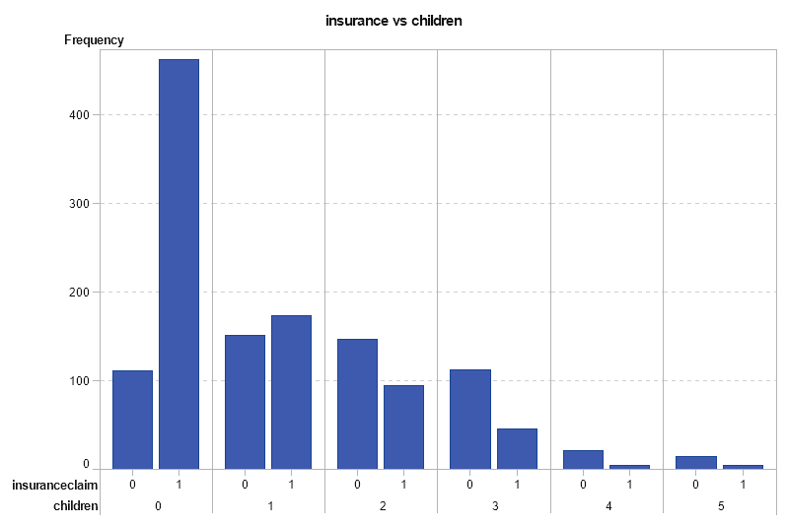
From the graph we observe that insurers having no children are more likely to claim insurance.
Therefore we can conclude that with increase in number of children, the claim for Insurance decreases.

Slide 33
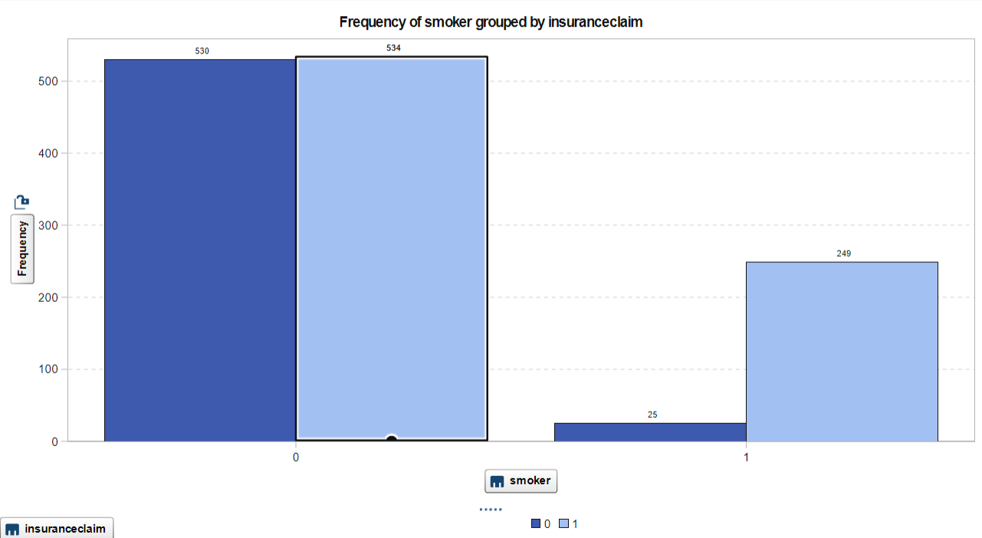
In the dataset, total number of non-smoker are 1064 and smokers are 274.
From the graph we observe that half of the non-smokers claim insurance whereas all the smokers are most likely claim insurance.

Slide 34
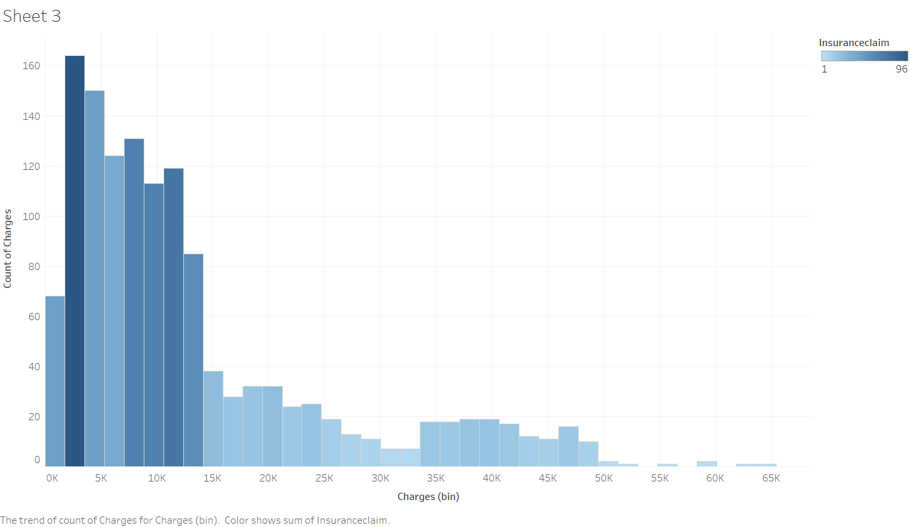
From the graph we observe that people who pay premium(charges) between 2K-15K, most probably claim insurance.

Slide 35
SOLUTION
1 . Southeast region should have higher premium.
2. As age is an important factor, the insurance company should have higher premium for customers having more age as there is more possibility for insurance claim.
3. Insurance company should themselves check height and weight of the customer while filling the insurance form so they can calculate BMI themselves.

Slide 36
THANK YOU
Ruhi Gupta (09)
Amey Mohite (14)
Vaishali Yadav (21)

