Slide 1
Section 5: Amazon Route 53
Module 5: Networking and Content Delivery
Notes:
Section 5: Amazon Route 53

Slide 2

Amazon Route 53
Is a highly available and scalable Domain Name System (DNS) web service
Is used to route end users to internet applications by translating names (like www.example.com) into numeric IP addresses (like 192.0.2.1) that computers use to connect to each other
Is fully compliant with IPv4 and IPv6
Connects user requests to infrastructure running in AWS and also outside of AWS
Is used to check the health of your resources
Features traffic flow
Enables you to register domain names
Amazon Route 53
Notes:
Amazon Route 53 is a highly available and scalable cloud Domain Name System (DNS) web service. It is designed to give developers and businesses a reliable and cost-effective way to route users to internet applications by translating names (like www.example.com) into the numeric IP addresses (like 192.0.2.1) that computers use to connect to each other. In addition, Amazon Route 53 is fully compliant with IPv6.
Amazon Route 53 effectively connects user requests to infrastructure running in AWS—such as Amazon EC2 instances, Elastic Load Balancing load balancers, or Amazon S3 buckets—and can also be used to route users to infrastructure that is outside of AWS.
You can use Amazon Route 53 to configure DNS health checks so you that can route traffic to healthy endpoints or independently monitor the health of your application and its endpoints.
Amazon Route 53 traffic flow helps you manage traffic globally through several routing types, which can be combined with DNS failover to enable various low-latency, fault-tolerant architectures. You can use Amazon Route 53 traffic flow’s simple visual editor to manage how your users are routed to your application’s endpoints—whether in a single AWS Region or distributed around the globe.
Amazon Route 53 also offers Domain Name Registration—you can purchase and manage domain names (like example.com), and Amazon Route 53 will automatically configure DNS settings for your domains.

Slide 3


Amazon Route 53 DNS resolution
Requests www.example.com
Checks with Route 53 for IP address
User
Returns IP address 192.0.2.0
DNS resolver
Returns IP address 192.0.2.0
Amazon Route 53
Notes:
Here is the basic pattern that Amazon Route 53 follows when a user initiates a DNS request. The DNS resolver checks with your domain in Route 53, gets the IP address, and returns it to the user.

Slide 4
Amazon Route 53 supported routing
Simple routing – Use in single-server environments
Weighted round robin routing – Assign weights to resource record sets to specify the frequency
Latency routing – Help improve your global applications
Geolocation routing – Route traffic based on location of your users
Geoproximity routing – Route traffic based on location of your resources
Failover routing – Fail over to a backup site if your primary site becomes unreachable
Multivalue answer routing – Respond to DNS queries with up to eight healthy records selected at random
Notes:
Amazon Route 53 supports several types of routing policies, which determine how Amazon Route 53 responds to queries:
Simple routing (round robin) – Use for a single resource that performs a given function for your domain (such as a web server that serves content for the example.com website).
Weighted round robin routing – Use to route traffic to multiple resources in proportions that you specify. Enables you to assign weights to resource record sets to specify the frequency with which different responses are served. You might want to use this capability to do A/B testing, which is when you send a small portion of traffic to a server where you made a software change. For instance, suppose you have two record sets that are associated with one DNS name: one with weight 3 and one with weight 1. In this case, 75 percent of the time, Amazon Route 53 will return the record set with weight 3, and 25 percent of the time, Amazon Route 53 will return the record set with weight 1. Weights can be any number between 0 and 255.
Latency routing (LBR) – Use when you have resources in multiple AWS Regions and you want to route traffic to the Region that provides the best latency. Latency routing works by routing your customers to the AWS endpoint (for example, Amazon EC2 instances, Elastic IP addresses, or load balancers) that provides the fastest experience based on actual performance measurements of the different AWS Regions where your application runs.
Geolocation routing – Use when you want to route traffic based on the location of your users. When you use geolocation routing, you can localize your content and present some or all of your website in the language of your users. You can also use geolocation routing to restrict the distribution of content to only the locations where you have distribution rights. Another possible use is for balancing the load across endpoints in a predictable, easy-to-manage way, so that each user location is consistently routed to the same endpoint.
Geoproximity routing – Use when you want to route traffic based on the location of your resources and, optionally, shift traffic from resources in one location to resources in another.
Failover routing (DNS failover) – Use when you want to configure active-passive failover. Amazon Route 53 can help detect an outage of your website and redirect your users to alternate locations where your application is operating properly. When you enable this feature, Amazon Route 53 health-checking agents will monitor each location or endpoint of your application to determine its availability. You can take advantage of this feature to increase the availability of your customer-facing application.
Multivalue answer routing – Use when you want Route 53 to respond to DNS queries with up to eight healthy records that are selected at random. You can configure Amazon Route 53 to return multiple values—such as IP addresses for your web servers—in response to DNS queries. You can specify multiple values for almost any record, but multivalue answer routing also enables you to check the health of each resource so that Route 53 returns only values for healthy resources. It's not a substitute for a load balancer, but the ability to return multiple health-checkable IP addresses is a way to use DNS to improve availability and load balancing.

Slide 5
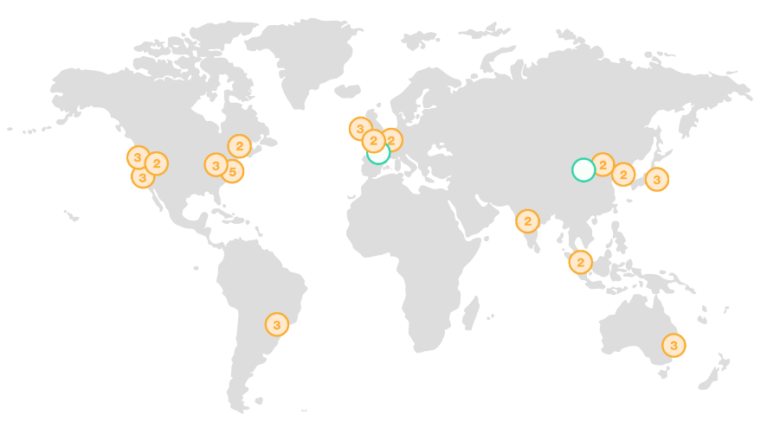

Use case: Multi-region deployment
Amazon Route 53
some-elb-name.us-west-2.elb.amazonaws.com
User
some-elb-name.ap-southeast-2.elb.amazonaws.com
Name | Type | Value
example.com | ALIAS | some-elb-name.us-west-2.elb.amazonaws.com
example.com | ALIAS | some-elb-name.ap-southeast-2.elb.amazonaws.com
Notes:
Multi-Region deployment is an example use case for Amazon Route 53. With Amazon Route 53, the user is automatically directed to the Elastic Load Balancing load balancer that’s closest to the user.
The benefits of multi-region deployment of Route 53 include:
Latency-based routing to the Region
Load balancing routing to the Availability Zone

Slide 6
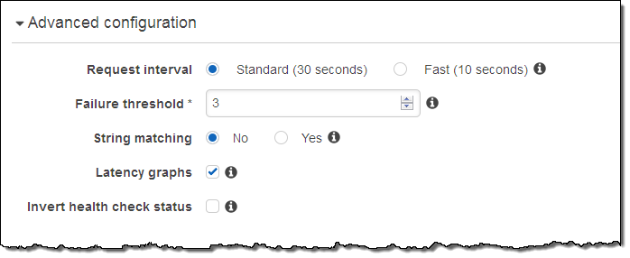
Amazon Route 53 DNS failover
Improve the availability of your applications that run on AWS by:
Configuring backup and failover scenarios for your own applications
Enabling highly available multi-region architectures on AWS
Creating health checks
Notes:
Amazon Route 53 enables you to improve the availability of your applications that run on AWS by:
Configuring backup and failover scenarios for your own applications.
Enabling highly available multi-Region architectures on AWS.
Creating health checks to monitor the health and performance of your web applications, web servers, and other resources. Each health check that you create can monitor one of the following—the health of a specified resource, such as a web server; the status of other health checks; and the status of an Amazon CloudWatch alarm.

Slide 7



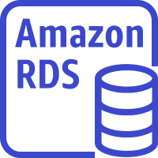

DNS failover for a multi-tiered web application
Record Sets
CNAME www
elastic_load_balancer Routing Policy = Failover
Record Type = Primary
Amazon S3 website Routing Policy = Failover
Record Type = Secondary
AWS Cloud
Availability Zone A
Availability Zone B
Auto Scaling group
Amazon EC2
Amazon EC2
Primary
User
Amazon Relational Database Service (Amazon RDS)
instance
Amazon Relational Database Service (Amazon RDS)
instance
Amazon Route 53
Secondary
Amazon S3 static website
Notes:
Here, you see how DNS failover works in a typical architecture for a multi-tiered web application. Route 53 passes traffic to a load balancer, which then distributes traffic to a fleet of EC2 instances.
You can do the following tasks with Route 53 to ensure high availability:
Create two DNS records for the Canonical Name Record (CNAME) www with a routing policy of Failover Routing. The first record is the primary route policy, which points to the load balancer for your web application. The second record is the secondary route policy, which points to your static Amazon S3 website.
Use Route 53 health checks to make sure that the primary is running. If it is, all traffic defaults to your web application stack. Failover to the static backup site would be triggered if either the web server goes down (or stops responding), or the database instance goes down.

Slide 8

Section 5 key takeaways
Amazon Route 53 is a highly available and scalable cloud DNS web service that translates domain names into numeric IP addresses.
Amazon Route 53 supports several types of routing policies.
Multi-Region deployment improves your application’s performance for a global audience.
You can use Amazon Route 53 failover to improve the availability of your applications.
Notes:
Some key takeaways from this section of the module include:
Amazon Route 53 is a highly available and scalable cloud DNS web service that translates domain names into numeric IP addresses.
Amazon Route 53 supports several types of routing policies.
Multi-Region deployment improves your application’s performance for a global audience.
You can use Amazon Route 53 failover to improve the availability of your applications.

Slide 9
Section 6: Amazon CloudFront
Module 5: Networking and Content Delivery
Notes:
Section 6: Amazon CloudFront
The purpose of networking is to share information between connected resources. So far in this module, you learned about VPC networking with Amazon VPC. You learned about the different options for connecting your VPC to the internet, to remote networks, to other VPCs, and to AWS services.
Content delivery occurs over networks, too—for example, when you stream a movie from your favorite streaming service. In this final section, you learn about Amazon CloudFront, which is a content delivery network (CDN) service.

Slide 10

Content delivery and network latency
Hop
Router
Hop
Hop
Origin server
Hop
Router
Router
Hop
Hop
Client
Router
Hop
User
Notes:
As explained earlier in this module when you were learning about AWS Direct Connect, one of the challenges of network communication is network performance. When you browse a website or stream a video, your request is routed through many different networks to reach an origin server. The origin server (or origin) stores the original, definitive versions of the objects (webpages, images, and media files). The number of network hops and the distance that the request must travel significantly affect the performance and responsiveness of the website. Further, network latency is different in various geographic locations. For these reasons, a content delivery network might be the solution.

Slide 11
Content delivery network (CDN)
Is a globally distributed system of caching servers
Caches copies of commonly requested files (static content)
Delivers a local copy of the requested content from a nearby cache edge or Point of Presence
Accelerates delivery of dynamic content
Improves application performance and scaling
Notes:
A content delivery network (CDN) is a globally distributed system of caching servers. A CDN caches copies of commonly requested files (static content, such as Hypertext Markup Language, or HTML; Cascading Style Sheets, or CSS; JavaScript; and image files) that are hosted on the application origin server. The CDN delivers a local copy of the requested content from a cache edge or Point of Presence that provides the fastest delivery to the requester.
CDNs also deliver dynamic content that is unique to the requester and is not cacheable. Having a CDN deliver dynamic content improves application performance and scaling. The CDN establishes and maintains secure connections closer to the requester. If the CDN is on the same network as the origin, routing back to the origin to retrieve dynamic content is accelerated. In addition, content such as form data, images, and text can be ingested and sent back to the origin, thus taking advantage of the low-latency connections and proxy behavior of the PoP.

Slide 12

Amazon CloudFront
Fast, global, and secure CDN service
Global network of edge locations and Regional edge caches
Self-service model
Pay-as-you-go pricing
Amazon CloudFront
Notes:
Amazon CloudFront is a fast CDN service that securely delivers data, videos, applications, and application programming interfaces (APIs) to customers globally with low latency and high transfer speeds. It also provides a developer-friendly environment. Amazon CloudFront delivers files to users over a global network of edge locations and Regional edge caches. Amazon CloudFront is different from traditional content delivery solutions because it enables you to quickly obtain the benefits of high-performance content delivery without negotiated contracts, high prices, or minimum fees. Like other AWS services, Amazon CloudFront is a self-service offering with pay-as-you-go pricing.

Slide 13
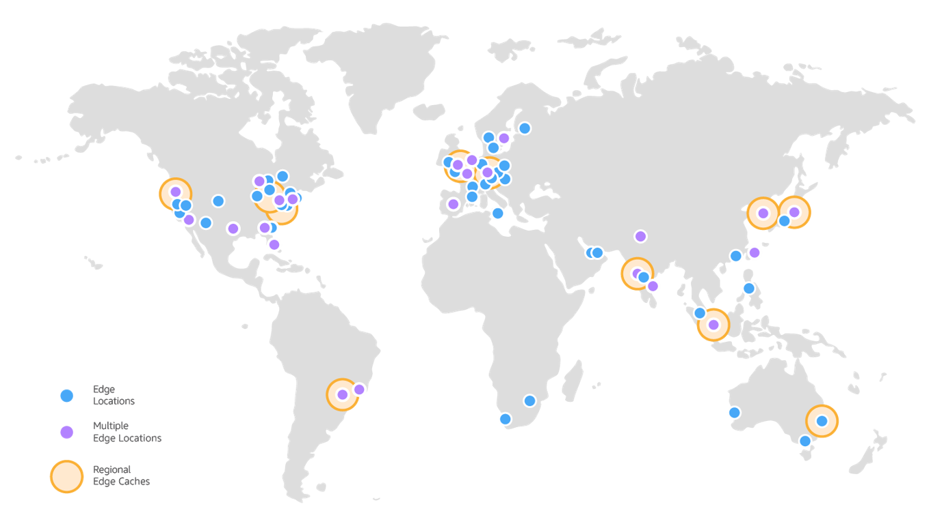
Amazon CloudFront infrastructure
Edge locations
Multiple edge locations
Regional edge caches
Edge locations – Network of data centers that CloudFront uses to serve popular content quickly to customers.
Regional edge cache – CloudFront location that caches content that is not popular enough to stay at an edge location. It is located between the origin server and the global edge location.
Notes:
Amazon CloudFront delivers content through a worldwide network of data centers that are called edge locations. When a user requests content that you serve with CloudFront, the user is routed to the edge location that provides the lowest latency (or time delay) so that content is delivered with the best possible performance. CloudFront edge locations are designed to serve popular content quickly to your viewers.
As objects become less popular, individual edge locations might remove those objects to make room for more popular content. For the less popular content, CloudFront has Regional edge caches. Regional edge caches are CloudFront locations that are deployed globally and are close to your viewers. They are located between your origin server and the global edge locations that serve content directly to viewers. A Regional edge cache has a larger cache than an individual edge location, so objects remain in the Regional edge cache longer. More of your content remains closer to your viewers, which reduces the need for CloudFront to go back to your origin server and improves overall performance for viewers.
For more information about how Amazon CloudFront works, see How CloudFront Delivers Content in the AWS Documentation.
https://wa.aws.amazon.com/wellarchitected/2020-07-02T19-33-23/wat.concept.edge-location.en.html

Slide 14
Amazon CloudFront benefits
Fast and global
Security at the edge
Highly programmable
Deeply integrated with AWS
Cost-effective
Notes:
Amazon CloudFront provides the following benefits:
Fast and global – Amazon CloudFront is massively scaled and globally distributed. To deliver content to end users with low latency, Amazon CloudFront uses a global network that consists of edge locations and regional caches.
Security at the edge – Amazon CloudFront provides both network-level and application-level protection. Your traffic and applications benefit through various built-in protections, such as AWS Shield Standard, at no additional cost. You can also use configurable features, such as AWS Certificate Manager (ACM), to create and manage custom Secure Sockets Layer (SSL) certificates at no extra cost.
Highly programmable – Amazon CloudFront features can be customized for specific application requirements. It integrates with Lambda@Edge so that you can run custom code across AWS locations worldwide, which enables you to move complex application logic closer to users to improve responsiveness. The CDN also supports integrations with other tools and automation interfaces for DevOps. It offers continuous integration and continuous delivery (CI/CD) environments.
Deeply integrated with AWS – Amazon CloudFront is integrated with AWS, with both physical locations that are directly connected to the AWS Global Infrastructure and other AWS services. You can use APIs or the AWS Management Console to programmatically configure all features in the CDN.
Cost-effective – Amazon CloudFront is cost-effective because it has no minimum commitments and charges you only for what you use. Compared to self-hosting, Amazon CloudFront avoids the expense and complexity of operating a network of cache servers in multiple sites across the internet. It eliminates the need to overprovision capacity to serve potential spikes in traffic. Amazon CloudFront also uses techniques like collapsing simultaneous viewer requests at an edge location for the same file into a single request to your origin server. The result is reduced load on your origin servers and reduced need to scale your origin infrastructure, which can result in further cost savings. If you use AWS origins such as Amazon Simple Storage Service (Amazon S3) or Elastic Load Balancing, you pay only for storage costs, not for any data transferred between these services and CloudFront.

Slide 15
Amazon CloudFront pricing
Data transfer out
Charged for the volume of data transferred out from Amazon CloudFront edge location to the internet or to your origin.
HTTP(S) requests
Charged for number of HTTP(S) requests.
Invalidation requests
No additional charge for the first 1,000 paths that are requested for invalidation each month. Thereafter, $0.005 per path that is requested for invalidation.
Dedicated IP custom SSL
$600 per month for each custom SSL certificate that is associated with one or more CloudFront distributions that use the Dedicated IP version of custom SSL certificate support.
Notes:
Amazon CloudFront charges are based on actual usage of the service in four areas:
Data transfer out – You are charged for the volume of data that is transferred out from Amazon CloudFront edge locations, measured in GB, to the internet or to your origin (both AWS origins and other origin servers). Data transfer usage is totaled separately for specific geographic regions, and then cost is calculated based on pricing tiers for each area. If you use other AWS services as the origins of your files, you are charged separately for your use of those services, including storage and compute hours.
HTTP(S) requests – You are charged for the number of HTTP(S) requests that are made to Amazon CloudFront for your content.
Invalidation requests – You are charged per path in your invalidation request. A path that is listed in your invalidation request represents the URL (or multiple URLs if the path contains a wildcard character) of the object that you want to invalidate from CloudFront cache. You can request up to 1,000 paths each month from Amazon CloudFront at no additional charge. Beyond the first 1,000 paths, you are charged per path that is listed in your invalidation requests.
Dedicated IP custom Secure Sockets Layer (SSL) – You pay $600 per month for each custom SSL certificate that is associated with one or more CloudFront distributions that use the Dedicated IP version of custom SSL certificate support. This monthly fee is prorated by the hour. For example, if your custom SSL certificate was associated with at least one CloudFront distribution for just 24 hours (that is, 1 day) in the month of June, your total charge for using the custom SSL certificate feature in June is (1 day / 30 days) * $600 = $20.
For the latest pricing information, see the Amazon CloudFront pricing page.
https://aws.amazon.com/cloudfront/pricing/?nc=sn&loc=3

Slide 16
Section 6 key takeaways
A CDN is a globally distributed system of caching servers that accelerates delivery of content.
Amazon CloudFront is a fast CDN service that securely delivers data, videos, applications, and APIs over a global infrastructure with low latency and high transfer speeds.
Amazon CloudFront offers many benefits.
Notes:
Some key takeaways from this section of the module include:
A CDN is a globally distributed system of caching servers that accelerates delivery of content.
Amazon CloudFront is a fast CDN service that securely delivers data, videos, applications, and APIs over a global infrastructure with low latency and high transfer speeds.
Amazon CloudFront offers many benefits, including:
Fast and global
Security at the edge
Highly programmable
Deeply integrated with AWS
Cost-effective

Slide 17
Module summary
In summary, in this module you learned how to:
Recognize the basics of networking
Describe virtual networking in the cloud with Amazon VPC
Label a network diagram
Design a basic VPC architecture
Indicate the steps to build a VPC
Identify security groups
Create your own VPC and added additional components to it to produce a customized network
Identify the fundamentals of Amazon Route 53
Recognize the benefits of Amazon CloudFront
Notes:
In summary, in this module you learned how to:
Recognize the basics of networking
Describe virtual networking in the cloud with Amazon VPC
Label a network diagram
Design a basic VPC architecture
Indicate the steps to build a VPC
Identify security groups
Create your own VPC and added additional components to it to produce a customized network
Identify the fundamentals of Amazon Route 53
Recognize the benefits of Amazon CloudFront

Slide 18
Complete the knowledge check
Notes:
Now, complete the knowledge check.

Slide 19
Sample exam question
Which AWS networking service enables a company to create a virtual network within AWS?
AWS Config
Amazon Route 53
AWS Direct Connect
Amazon VPC
Notes:
Look at the answer choices and rule them out based on the keywords that were previously highlighted.

Slide 20
Additional resources
Amazon VPC overview page
Amazon Virtual Private Cloud Connectivity Options whitepaper
One to Many: Evolving VPC Design AWS Architecture blog post
Amazon VPC User Guide
Amazon CloudFront overview page
Notes:
If you want to learn more about the topics covered in this module, you might find the following additional resources helpful:
Amazon VPC overview page
Amazon Virtual Private Cloud Connectivity Options whitepaper
One to Many: Evolving VPC Design AWS Architecture blog post
Amazon VPC User Guide
Amazon CloudFront overview page

Slide 21
Thank you
Notes:
Thanks for participating!

