Slide 1
INTERNET MARKETING
BCE BLACK BOOK
BY
Mayuresh Phansikar | TU3F1819102
Archit Konde | TU3F1819107
Amey Thakur | TU3F1819127
Mega Satish | TU3F1819139
Saakshi Deokar | TU3F1819140

Slide 2
INTERNET MARKETING
Outline 1 Introduction 2 Branding 3 Internet Marketing Research 4 E-mail Marketing 5 Promotions 6 E-business Advertising 6.1 Banner Advertising 6.2 Buying and Selling Banner Advertising 6.3 Media-Rich Advertising 6.4 Wireless Advertising 7 e-Business Public Relations 8 Business-to-Business (B2B) Marketing on the Web 9 Search Engines 9.1 META Tags 9.2 Search-Engine Registration

Slide 3
INTRODUCTION
We explore Internet marketing campaign components
Marketing research, advertising, promotions, public relations, search-engine registration
Website traffic generation
Keeping user profiles
Recording visits
Analyzing promotional and advertising results
Target market is the group of people toward whom it is most profitable to aim your marketing
Use Internet marketing with traditional marketing

Slide 4
BRANDING
Brand
Typically defined as a name, logo or symbol that helps one identify a company’s products or services
Customers’ experience can be considered part of its brand
Brand equity
Includes the value of tangible and intangible items, such as a brand and its monetary value over time, customer perceptions and customer loyalty to a company and its products or services
Internet-only businesses must develop a brand that customers trust and value
Brand uniformity will increase brand recognition

Slide 5
BRANDING
The Internet makes it difficult to protect a brand from misuse
Rumors and customer dissatisfaction can spread quickly
It is not difficult for people to use other companies’ logos on their sites or products illegally
Companies can attempt to protect their brands
Hiring people to surf the Web and look for news, rumors and other instances of brand abuse
Brand monitoring activities can be outsourced to companies such as eWatchBrand monitoring activities can be outsourced to companies such as eWatch and NetCurrents

Slide 6
INTERNET MARKETING RESEARCH
Marketing mix includes (4Ps):
Product or service details and development
Effective pricing
Promotion
Distribution
Traditional marketing research
Consists of focus groups, interviews, paper and telephone surveys, questionnaires and secondary research
Findings based on previously collected data
Online marketing research
Faster option for finding and analyzing industry, customer and competitor information
Provides relaxed and anonymous setting to hold focus-group discussions and distribute questionnaires

Slide 7
INTERNET MARKETING RESEARCH
Demographics
Statistics on human population, including age, sex, marital status and income
Psychographics
Can include family lifestyle, cultural differences and values
Segmentation
Can be based on age, income, gender, culture and common needs and wants
Traditional focus groups can allow customers to touch, smell and experience products or services

Slide 8
INTERNET MARKETING RESEARCH
Online focus groups
Conducted to allow current or potential consumers to present their opinions about products, services or ideas
Comfortable setting for participants
Leader of the focus group cannot interpret a participant’s body language as a form of communication
SurveySite
Online surveys
Conducted from Website or through email
InsightExpress.com, GoGlobal Technologies and QuickTake
Test your site and marketing campaign on a smaller scale with focus groups and trials
Data collected from a company’s Web site

Slide 9
INTERNET MARKETING RESEARCH
Evaluate campaign results
Measure costs and benefits of campaign
Helps with development of a budget for marketing activities
Identify growing and most profitable segments
Marketing-research firms
Forrester Research Forrester Research, Adknowledge Forrester Research, Adknowledge, Jupiter Communications Forrester Research, Adknowledge, Jupiter Communications and Media Metrix
Freeware and shareware
Both are no cost software distribution; however, shareware is distributed with the expectation of donations in return

Slide 10
INTERNET MARKETING RESEARCH
Pricing
Some products priced to reflect competition
High pricing to influence perception of high-value
Can use prices to position products and services on the Internet
Positioning includes affecting consumers’ overall views of a company and its products and services as compared to the way those customers view competitors’ products or services
Positioning strategies can be based on price, quality, use and competitors’ positions in the market
Distribution cost and time contributes to success or failure
Fulfillment
Execute orders correctly and ship products promptly

Slide 11
E-MAIL MARKETING
Fast, cheap, far-reaching
Define the reach
The span of people you would like to target, including geographic locations and demographic profiles
Determine the level of personalization
Personalized direct e-mail targets consumers with specific information and offers by using customer names, offering the right products at the right time and sending promotions
Response rate
Shows campaign success or failure by measuring the percentage of responses generated from the target market

Slide 12
E-MAIL MARKETING
Global businesses send translated e-mails
LogosLogos and AltaVista
Outsourcing
Parts of a company’s operations are performed by other companies
Used when unmanageable e-mail volume and inadequate staff or technical support
MessagemediaMessagemedia, Digital ImpactMessagemedia, Digital Impact, iLuxMessagemedia, Digital Impact, iLux, 24/7 Media Messagemedia, Digital Impact, iLux, 24/7 Media and e-Contacts
Audio, video and graphics
MindArrowMindArrow, inChorusMindArrow, inChorus and MediaRing.com
Customize based on receivers’ preferences and their readers’
A plug-in is a small application designed to extend the capabilities of another product, such as a Web browser

Slide 13
E-MAIL MARKETING
Improve customer service
Add an e-mail link to Web site
E-mail systems set up so that incoming e-mails will be sorted automatically and directed to the appropriate people
Track location of orders, inform customers of when to expect delivery and possible delays and providing information such as the carrier’s name
Permission-based marketing
A company can market its products and services to people who have granted permission
Internet mailing lists include contact information for people who have expressed interest in receiving information on certain topics

Slide 14
E-MAIL MARKETING
Opt-in e-mails are sent to people who "opt-in" to receive offers, information and promotions by e-mail
PostMasterDirect.com will send your e-mail campaign to those on a list who have expressed interest in your business category
Yesmail.com Yesmail.com and Xactmail.com create lists of people who have opted-in to receive information about a certain subject
Spamming
Mass e-mailing to customers who have not expressed interest
Can give your company a poor reputation

Slide 15
E-MAIL MARKETING
Traditional direct marketing
Includes sending information by mail and using telemarketers to contact prospective customers
Used in conjunction with e-mailing to reach largest audience
Direct mailing
often more expensive, more difficult to analyze and has lower response rate than direct e-mailing
Direct mail specialists: EletterDirect mail specialists: Eletter and MBS/Multimode
E-mail can arrive if recipients are busy or away, receivers can read e-mails at their convenience
Telemarketing
Can be more expensive than e-mailing
Offers benefit of being interactive
People likely to answer phone whereas can ignore e-mail

Slide 16
PROMOTIONS
Online and offline e-business promotions
Attract visitors to sites and may influence purchasing
Be sure customers are loyal to company, not reward program
Give away items that display company logo
Branders.com, iSwag.com
Frequent-flyer miles
Offered to consumers for making online purchases
Increase brand loyalty, offers a reason return visits
ClickRewards allows customers to accumulate ClickMiles
Points-based promotion
Customer performs a prespecified action and receives points to be redeemed for products, services, rebates, discounts, etc.
MyPoints

Slide 17
PROMOTIONS
Offer discounts when purchases are made online
Offer free trials
Online coupons for online shopping
Place coupons on sites to bring visitors to your site
Sites that advertise coupons include DirectCoupons, Coolsavings.com and valupage.com
Offer free promotional items: free.com, free2try.com and freeshop.com
Online promotional tutorial containing information on ways to promote your site found at Promotion World

Slide 18
E-BUSINESS ADVERTISING
Traditional
Television, movies, newspapers and magazines
Prime-time television slots most expensive times to air commercials
(monster.com advertisement)
Establish and continually strengthen branding
Brand is a symbol or name that distinguishes a company and its products or services from its competitors and should be unique, recognizable and easy to remember
Publicize URL on direct mailings and business cards
Online advertising
Place links on other sites, register with search engines

Slide 19
BANNER ADVERTISING
Banner ads
Located on Web pages, act like small billboards, usually contain graphics and an advertising message
Benefits include:
Increased brand recognition, exposure and possible revenue
Side panel ads or skyscraper banners
Advertisements that lie vertically on Web sites
Banner advertisements are losing their effectiveness
Industry has calculated click-through rates at around .5 percent
Place logo on banners, enhancing brand recognition

Slide 20
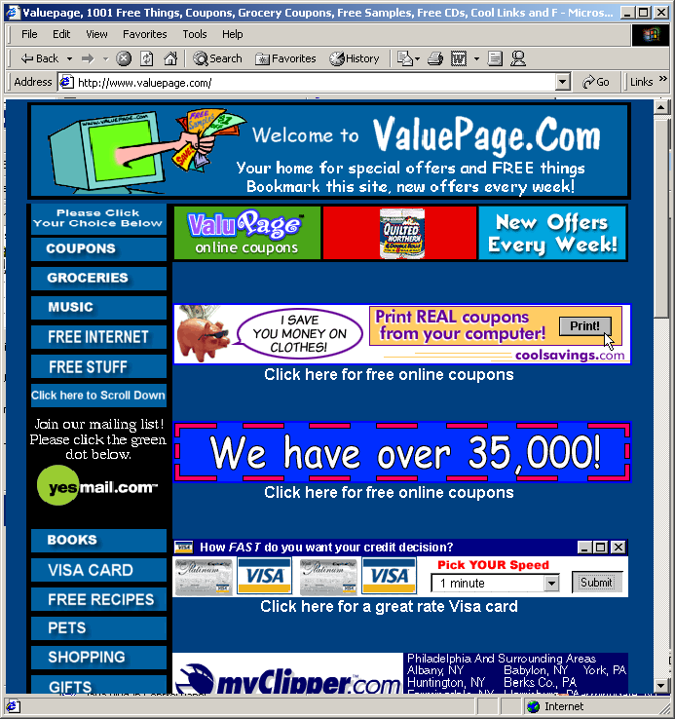
BANNER ADVERTISING
Banner Advertisements. (Courtesy of GaryCohn.com Marketing.)

Slide 21

BANNER ADVERTISING
Example of a panel ad. (Courtesy of Venture Capital Online, Inc.)

Slide 22
BANNER ADVERTISING
Inventive color schemes and movement
Flashing, scrolling text, pop-up boxes and color changes
Pop-up box is a window containing an advertisement that appears separate from the screen the user is viewing, pops up randomly or as a result of user actions (can have a negative effect due to their intrusive nature)
Determine the best position on sites for a banner
Web sites cluttered with ads annoy visitors
Space can be more expensive during high traffic
Exchanging banners with another site
AdbilityAdbility and BannerTips

Slide 23
BUYING AND SELLING BANNER ADVERTISING
Buy advertising space on sites that receive a large number of hits and target a similar market
Selling ad space provides additional income
Monthly charges for online advertising rarely used
CPM (cost per thousand)
A designated fee for every one thousand people who view the site on which your advertisement is located

Slide 24
BUYING AND SELLING BANNER ADVERTISING
Unique visitors versus total number of hits
Visiting any site registers one unique visit
Hits are recorded for each object that is downloaded
To determine the value of a Web site for advertising purposes, use the number of unique visitors, not total hits
Advertising payment options
Pay-per-click: you pay the host according to the number of click-throughs to your site
Pay-per-lead: you pay the host for every lead generated from the advertisement
Pay-per-sale: you pay the host for every sale resulting from a click-through

Slide 25
BUYING AND SELLING BANNER ADVERTISING
Selling advertising space
Provide appropriate contact information on your Web site
Register with organizations that will sell your space for you
These companies typically charge a percentage of the revenue you receive from the advertisements placed on your site
ValueClickValueClick, DoubleClickValueClick, DoubleClick, AdSmartValueClick, DoubleClick, AdSmart and LinkExchange

Slide 26
VALUE CHECK-BACK FEATURE
ValueClick acts as a broker for people who want to buy and sell advertising space
Gives you the option of targeting specific markets
To buy advertising through ValueClick:
Design a banner
Contact a representative of ValueClick to determine what program best fits your advertising needs
Pre-pay for the service based on the number of visitors you want to receive, a minimum fee is required

Slide 27
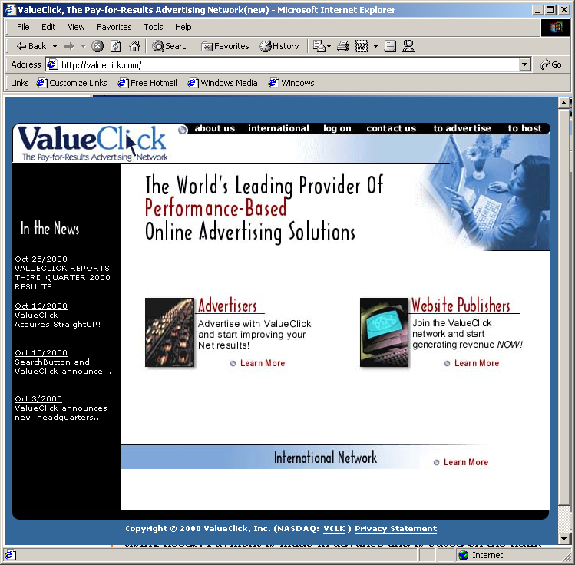
VALUECLICK FEATURE
ValueClick’s home page. (Courtesy of ValueClick, Inc.)

Slide 28
VALUECLICK FEATURE
Offers many segmented markets for advertising
Segmented markets are people or companies that are grouped together based on similar characteristics
Earnings depend on number of click-throughs resulting from the advertisements
Pays host monthly if revenues are greater than certain amount
Offers four options for publishing advertisements on your site
ValueClick Affiliate, Premium, AdVantage and AdVantage Plus programs

Slide 29
MEDIA-RICH ADVERTISING
Webcasting
Involves using streaming media to broadcast an event over the Web
Streaming video simulates television, streaming delivers a flow of data in real time.
Resource MarketingResource Marketing, Clear DigitalResource Marketing, Clear Digital, NavisiteResource Marketing, Clear Digital, Navisite, Cyber-Logics, www.streamingmedia.com and Macromedia
Many people have relatively slow Internet access
The slower the connection, the more disconnected the video appears
Victoria’s Secret Webcast most popular ever held on Web

Slide 30
MEDIA-RICH ADVERTISING
Bursting
There is a substantial build up of content at the receiving end, causing a video to appear smoother
Burst.com
Cross-media advertising or hybrid advertising
Involves using a combination of rich media (such as audio, video, images and animations) and traditional advertising forms (such as print, television and radio advertisements) to execute an advertising campaign
Involve consumers in the advertising process
Nike
WebRIOT, a game show on MTV
H2O Design H2O Design and Lot21

Slide 31
MEDIA-RICH ADVERTISING
Interactive television advertising
Allows people viewing television to interact with what they are seeing on the screen
Consumers have the ability to choose to learn more about an offer, make a purchase or even request that customer service representatives contact them
RespondTV

Slide 32
WIRELESS ADVERTISING
Wireless Internet in early stages
Advertising companies are preparing to take advantage of this medium
SkyGo
Wireless advertising company offering real-time wireless delivery and tracking of permission-based campaigns
Adbroadcast
Pays people who opt in to receive advertisements on cell phones
GeePS
Offers brick-and-mortar stores wireless advertising targeted toward specific markets
Sends relevant wireless ads to customers as they enter the proximity of a store

Slide 33
BUSINESS PUBLIC RELATIONS
Public relations (PR)
Keeps customers and company current on latest information about products, services and internal and external issues such as company promotions and consumer reactions
Methods
Chat sessions
Bulletin board
Special events or functions on Web site
Trade shows and exhibitions
Press releases (can be delivered over Web, PR Web)
Printing and distribution, MediaMap
Add link that connects to all press releases
Video clips
PR NewswirePR Newswire and Business Wire

Slide 34
E-BUSINESS PUBLIC RELATIONS
Crisis management
Another responsibility of PR, is conducted in response to problems the company is having
Bridgestore/Firestone, Inc.
Outsourcing public relations

Slide 35
BUSINESS TO BUSINESS (B2B) MARKETING ON THE WEB
(B2B) marketing
Consider distributors, resellers, retailers and partners
Selling to someone who is not the direct user
Usually more than one person involved in purchasing process
Businesses making large purchases depend on suppliers and expect reliability and delivery of quality products and services on time
Personalization
Intranets and extranets
Industry marketplaces
Construction.comConstruction.com, Worldwideretailexchange.com
Connect IncConnect Inc, Concur TechnologiesConnect Inc, Concur Technologies and Ariba

Slide 36
SEARCH ENGINES
Search-engine ranking important to bring consumers to a site
Method used by search engines to rank your Web site will determine how "high" your site appears in search results
Make sure all Web pages have been published on the Web and linked correctly
By registering with search engines a company will increase traffic to its site

Slide 37
META TAGS
META tag
An HTML tag that contains information about a Web page
Does not change how Web page is displayed
Can contain description of page, keywords and title of page
Most search engines rank your site by sending out a spider to inspect the site
The spider reads the META tags, determines the relevance of the Web page’s information and keywords and ranks the site according to that visit’s findings
Examine competitors’ sites to see what META tags they are using
Top ten results

Slide 38
SEARCH ENGINE REGISTRATION
Submit keywords and a description of business
Search engine will add information to its database
Registering will increase the possibility that a site will make an appearance in search-engine results
Many search engines do not charge a fee for registering
AltaVistaAltaVista, Yahoo!AltaVista, Yahoo!, LycosAltaVista, Yahoo!, Lycos, ExciteAltaVista, Yahoo!, Lycos, Excite, GoogleAltaVista, Yahoo!, Lycos, Excite, Google and Ask Jeeves
Ask Jeeves uses natural-language technology that allows people to enter their search subjects in the form of questions
Metasearch engines
Aggregate results from a variety of search engines
Metacrawler and FrameSearch.net

Slide 39
SEARCH ENGINE REGISTRATION
WHAT IS SEARCH ENGINE REGISTRATION (SER)?
Search Engine Registration is the step of submitting your site to search engines to let them know that it exists. Registering your website then gives search engines the opportunity to “crawl” and index your website. This is what allows your website to begin appearing on search engines so that potential customers can discover it.

Slide 40
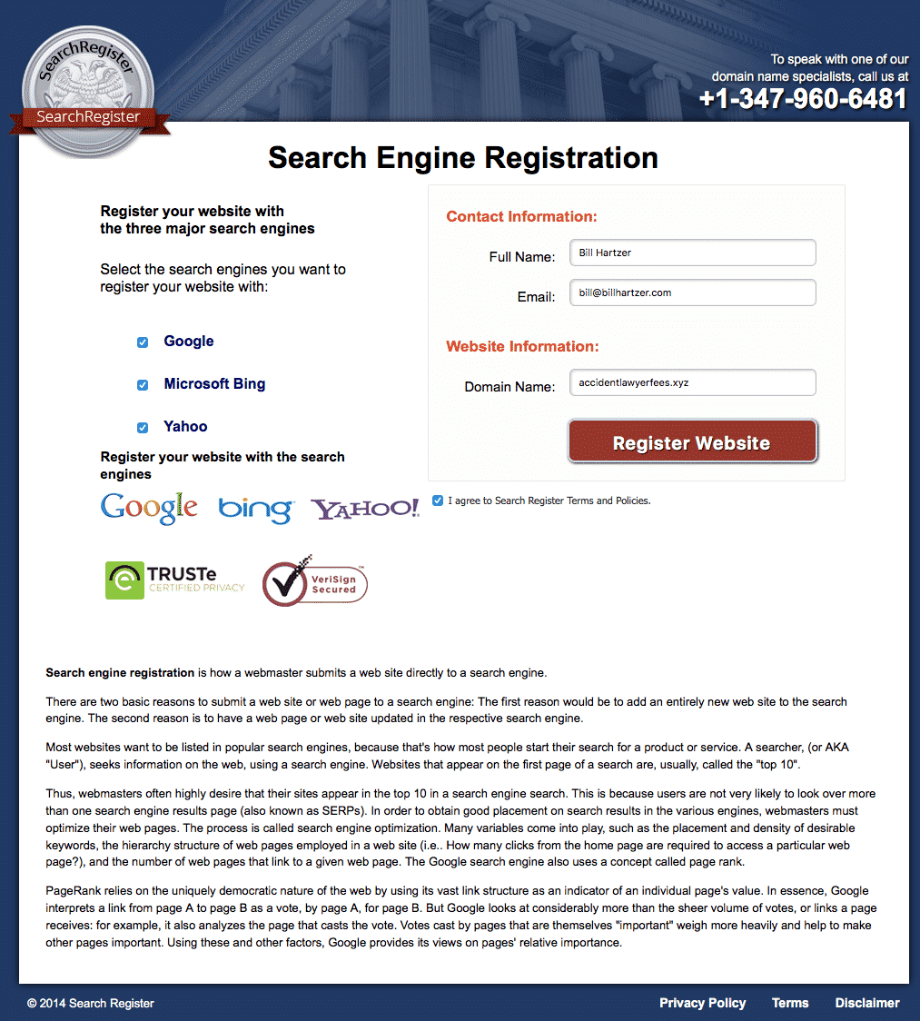
SEARCH ENGINE REGISTRATION

