Slide 1
Performance Testing Process
Record User Scenarios
Parameterize Test Scripts
Group User Scenarios
Create Load Scenarios
Simulate and Execute Load
Analyze Test Results
Reports

Slide 2
Browser
Server
First HTTP Request
Rendered App
Computes the State
Acts as SPA
Browser
Browser

Slide 3

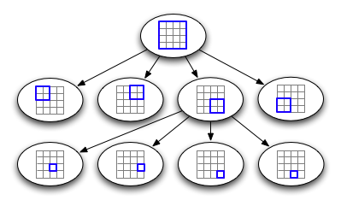

QuadTree
Front-end
API Routes

Slide 4
The Big Bang Model
Time
Efforts
Big
Bang
QuadTree
Visualizer
Resources

Slide 5
Author’s Name | Title and Year of Publication | Findings
Qing Cai, Yimin Zhou | A quadtree-based hierarchical clustering a method for visualizing large point dataset, 2016 | This paper introduces a new clustering method with quadtree spatial indexing. It explains a grid-based, partitioning, hierarchical clustering method on quadtree file system storage.
Clifford A. Shaffer, Hanan Samet | Optimal quadtree construction algorithms, 1987 | In this paper, an algorithm for constructing a quadtree in time proportionate to the number of blocks in a given picture is described.
Irene Gargantini | An effective way to represent quadtrees, 1982 | This paper proposes a new structure very similar to a quadtree, called a “linear quadtree” and different algorithms used to represent that structure. The linear quadtree saves 66% of the computer storage required by regular quadtrees.

