Slide 1
1, 2, 3, 4, 5, 6
7, 8, 9, 10, 11
R1
12, 13
R2
14

Slide 2
1, 2, 3, 4, 5, 6
R1
7, 8, 9, 10, 11
R2
12, 13, 14
FLOW GRAPH

Slide 3
Training Data:
Photo
?
Sketch
?
Generated Sketch
(Sketch, Label)
(
,
Cloud
)
Batch Pool

Slide 4
Input Data (X)
Model
Predictions
Output Data (Y)
Update Model
Error

Slide 5
Input Data (X)
Model
Predicted Classification

Slide 6
Model
Generated Examples

Slide 7
Random Input
Generator
Real Images
Sample
Sample
Discriminator
Generator
Loss
Discriminator Loss

Slide 8
Random Input
Generator
Real Images
Sample
Sample
Discriminator
Backpropagation
Generator
Loss
Discriminator Loss

Slide 9
Random Input
Generator
Real Images
Sample
Sample
Discriminator
Generator
Loss
Discriminator Loss
Backpropagation

Slide 10
Random Input
Generator
Real Images
Sample
Frontend
Python Flask Server
Linear Regression Model

Slide 11
Random Input Vector
Additional Information
Input
Example
Additional Information
Generator
Model
Discriminator
Model
Generated Example
Binary Classification
(Real/Fake)

Slide 12
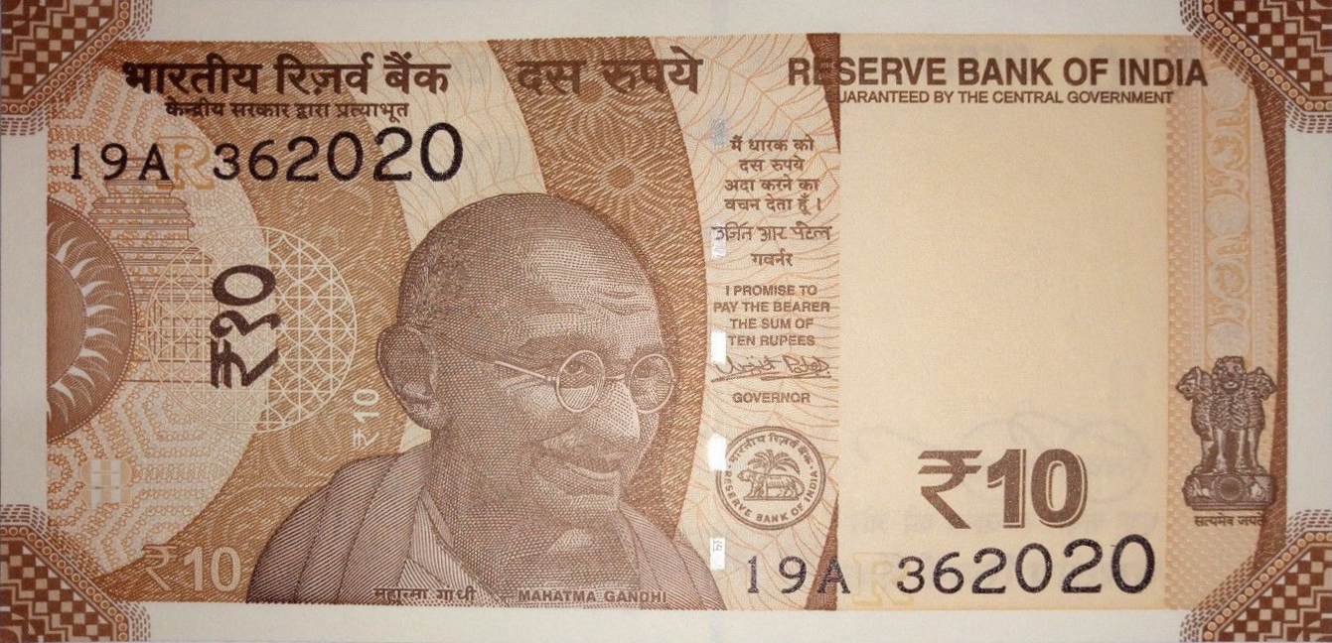
Generated Data
Discriminator
Real Data
FAKE
REAL

Slide 13
Generated Data
Discriminator
Real Data
RESERVE BANK OF INDIA
FAKE
REAL
₹10

Slide 14
Generated Data
Discriminator
Real Data
REAL
REAL

Slide 15
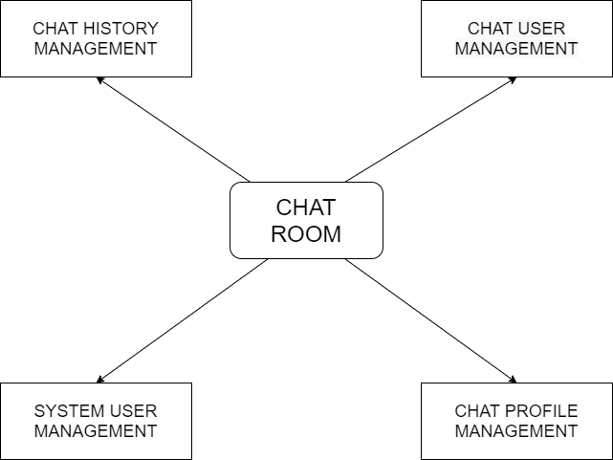
CHAT HISTORY MANAGEMENT
CHAT USER MANAGEMENT
CHAT ROOM
SYSTEM USER MANAGEMENT
CHAT PROFILE MANAGEMENT

Slide 16
