Slide 1
This presentation equips professionals familiar with Amazon Web Services (AWS) with the key concepts required to get started with Google Cloud. The presentation compares Google Cloud with AWS and highlights the similarities and differences between the two. In addition, presentation provides mappings of AWS concepts and terminology to the corresponding products, concepts, and terminology on Google Cloud.
Notes:
Notes done slide 1

Slide 2
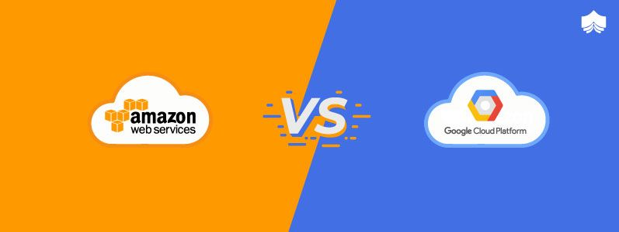

Slide 3


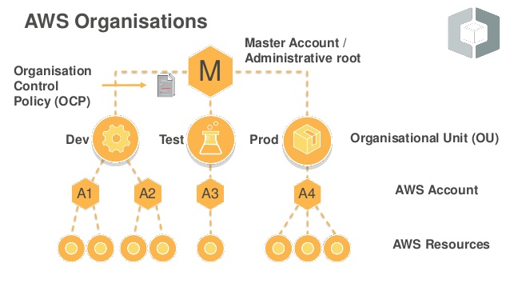
Google cloud vs AWS billing
Google cloud
organization
Folders
Projects
Resources

Slide 4
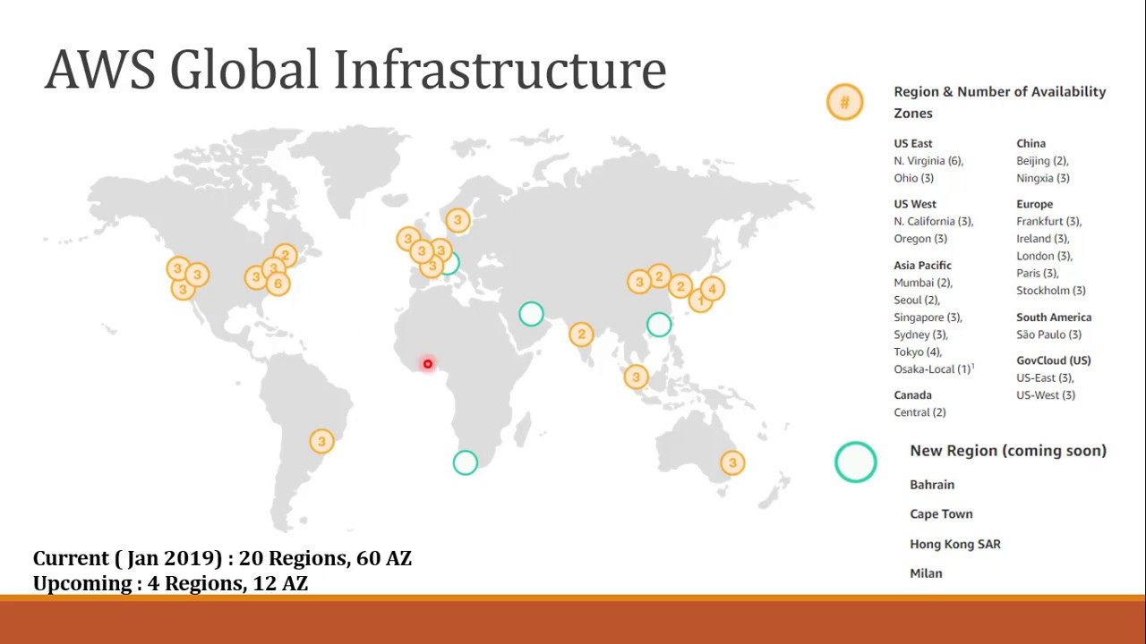
Current (2021) : 25 Regions, 81 AZ
Upcoming : 9 Regions, 27 AZ

Slide 5
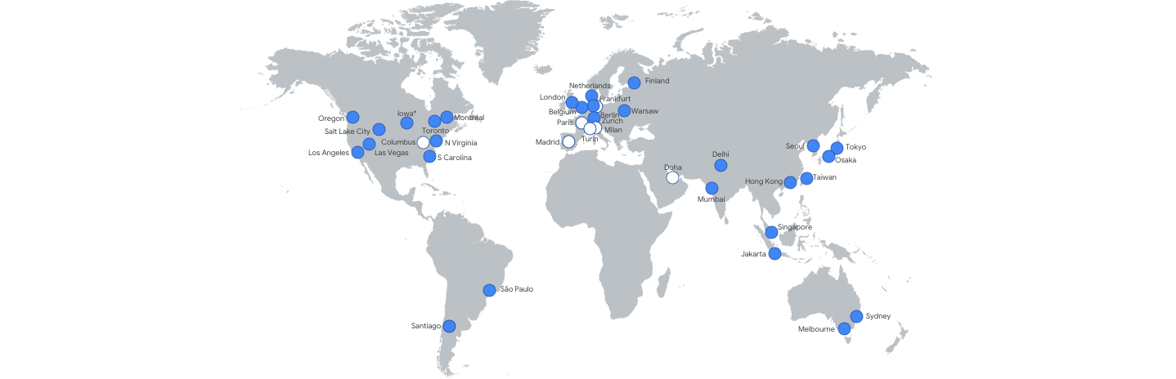
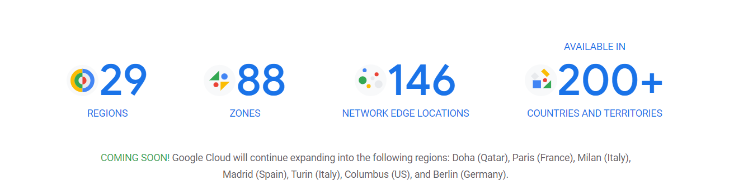
Google Cloud Platform Global Infrastructure

Slide 6


Identity And Access Management
Cloud IAM
In AWS we have IAM service to create users, groups and assign permissions to them.
We can assign permissions to users and groups by attaching IAM Policies to them.
For AWS services there are IAM roles.
GCP has Cloud IAM to create users and groups.
This resource is similar to AWS IAM service, the only difference is in GCP we have to attach IAM roles to assign permissions.

Slide 7
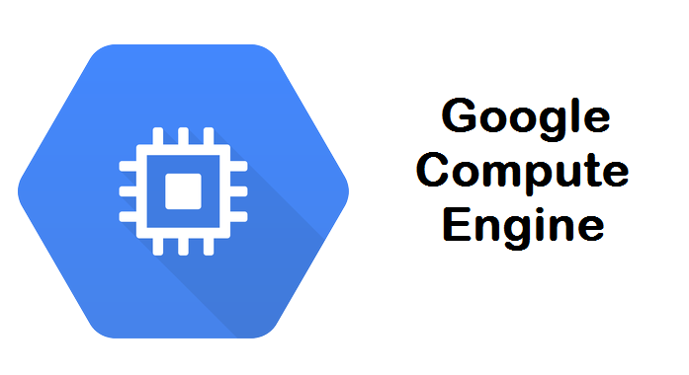
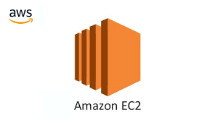
Compute Services
In GCP compute engine is used for virtual machines.
Machine Types:- General Purpose (E2, N2, N2D, N1), Compute Optimized (C), Memory Optimized (M).
In GCP we have a option to create custom VM were we can configure vCPU, memory, storage according to our requirements.
Pricing Models:- Preemptible VM, Custom VM.
Compared to AWS spot instances there are preemptible VM’s in GCP.
Compute Engine is a zonal resource.
Amazon EC2 is a service which is used for virtual machines.
Machine Types:- General purpose (M), Memory Optimized (R, X1), Compute Optimized (C), Storage Optimized (I, d, h1).
Pricing Models:- On Demand, Reserved Instances, Spot Instances.
EC2 is a regional service.

Slide 8
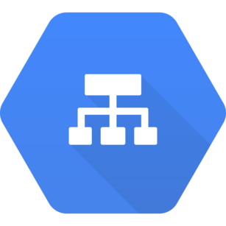
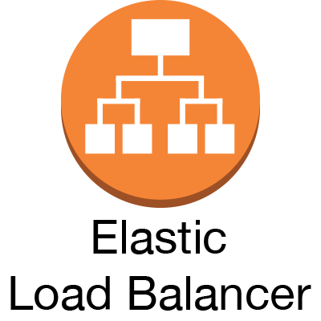
Load Balancing
Google Cloud Load Balancer
AWS offers 3 types of load balancer – Classic load balancer, Application load balancer and Network load balancer.
AWS ELB service offers path based routing, Health checks for instances.
It also supports session affinity known as stickiness.
GCP offers 4 types of load balancers – HTTP/HTTPS, TCP/UDP, SSL Proxy load balancer, TCP Proxy load balancer.
GCP load balancer also supports path based routing it is known as content aware load balancing.
Supports health checks and session affinity as well.

Slide 9
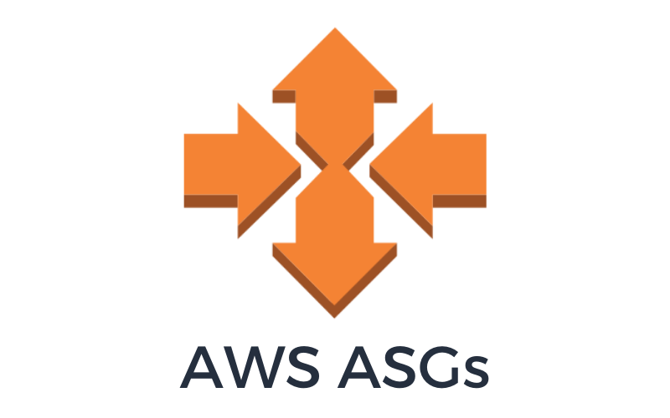
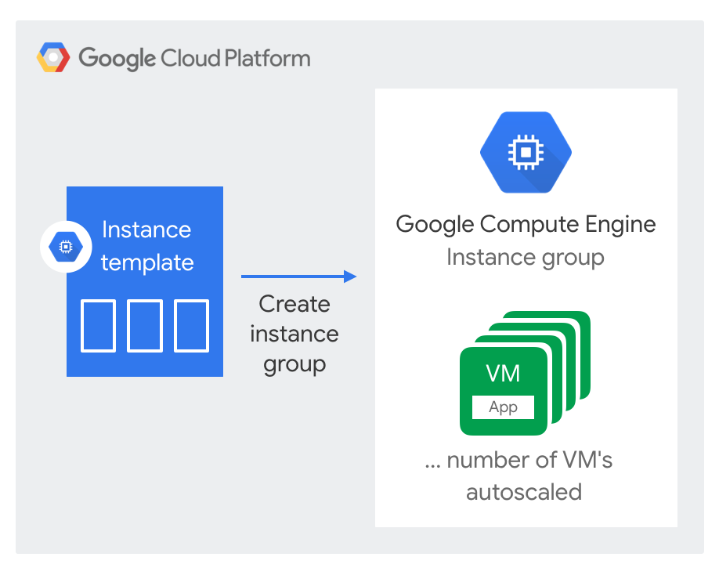
Autoscaling Services
AWS offers two types of scaling for servers. Horizontal and Vertical Scaling.
AWS has 2 types of scaling policies:-
Dynamic Scaling
Predictive Scaling
GCP has Instance Group for scaling of servers.
There are two types of instance groups:-
Managed Instance Groups – Used for autoscaling. It has identical instance resources. These are zonal or regional in nature.
Unmanaged Instance Groups - Can not be used for autoscaling, as it has non – identical instance resources.

Slide 10
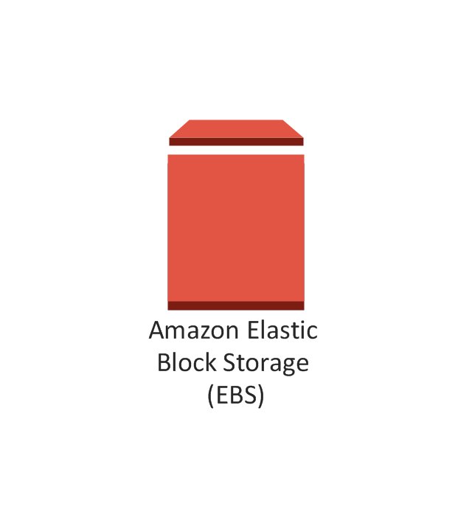

Block Storage
Google Cloud Disks
AWS offers Elastic Block Storage (EBS) for block storage purposes.
EBS supports maximum volume size of 64TB.
It supports SDD and HDD volumes.
General Purpose SSD — Provides a balance of price and performance.
Provisioned IOPS SSD — Provides high performance for mission-critical, low-latency, or high-throughput workloads.
Throughput Optimized HDD — A low-cost HDD designed for frequently accessed, throughput-intensive workloads.
Cold HDD — The lowest-cost HDD design for less frequently accessed workloads.
GCP offers disks for block storage. It’s a zonal resource
There are 2 types of disks in GCP:- Persistent and Local SSD.
Persistent Disks:- Used for snapshots, supports SSD and HDD. Can be resized even when the instance is running. Supports automatic encryption. Maximum size per disk can be up to 64TB.
Local SSD:- Local SSDs have higher throughput and lower latency than persistent disks. Maximum size per disk can be up to 375GB.

Slide 11
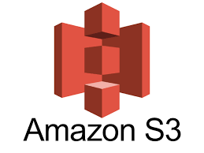
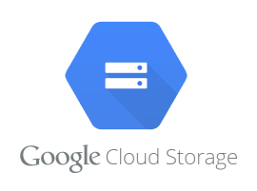
Object Storage
AWS offers simple storage service(S3) for object storage.
It has concept of bucket and objects, we can create buckets and upload our data in the form of objects. It supports data replication, versioning and encryption.
We can configure ACL to restrict access to our data.
There are 6 types of Storage classes in S3
S3 Standard
Intelligent Tiering
Standard IA
One Zone-IA
S3 Glacier
Glacier Deep Archive
We can create lifecycle policies for transition, archive or delete objects after specific period of time.
Google cloud offers Cloud Storage for object storage.
It has similar concepts as AWS S3, here also we can create buckets and objects. Supports versioning and encryption. We can also configure ACL.
There are 4 types of storage classes in cloud storage
Standard Storage
Nearline Storage
Coldline Storage
Archive

Slide 12

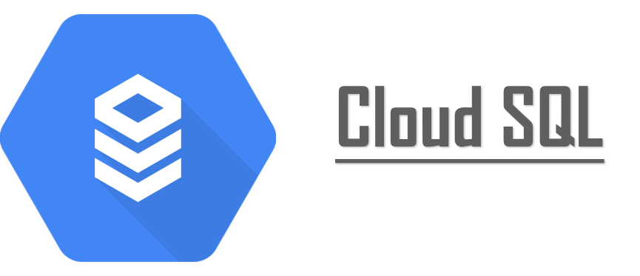
Database Services
AWS offers Amazon Relational Database Service for Database.
RDS supports 6 database engines – Postgres, MySQL, MariaDB, Oracle, Microsoft SQL Server, Aurora.
It has feature of automated backups there are daily full backup, read replicas for read performance.
We can create 5 read replicas within AZ, cross AZ or cross region.
GCP offers Cloud SQL service for Database.
Cloud SQL supports 3 database engines – MySQL, PostgreSQL, SQL Server.
It also supports the feature of automated backups and read replicas for read performance.
For MySQL we can create failover replica to create HA environment. In case of PostgreSQL we can create failover replica, we have to enable HA option in configurations.

Slide 13
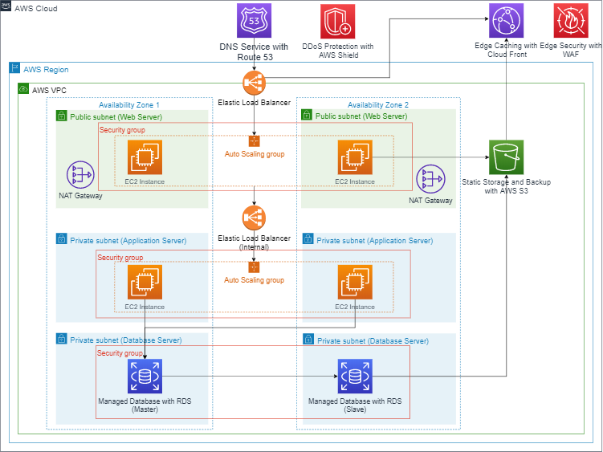
AWS VPC

Slide 14
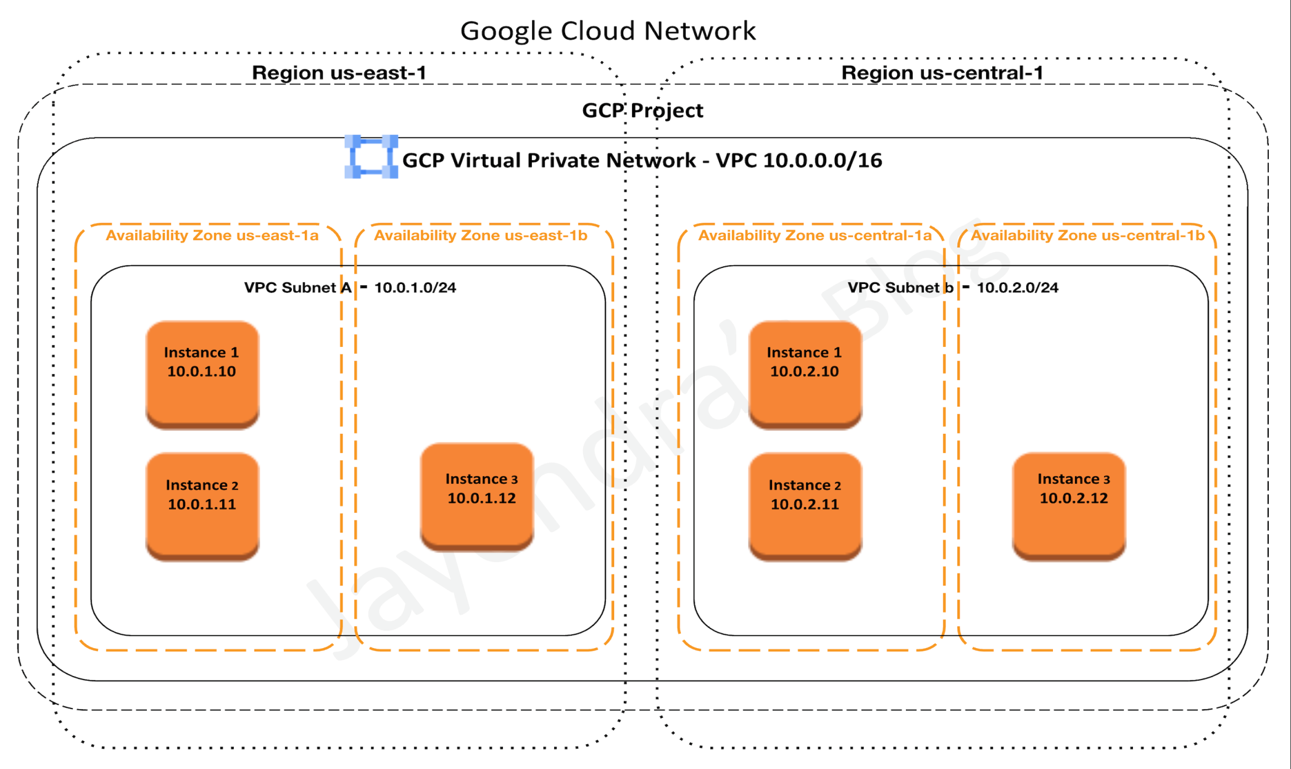
GCP VPC

Slide 15
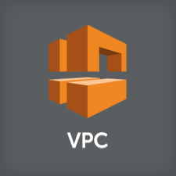

Virtual Private Cloud
For AWS VPC is a regional service.
We can create 5 VPC’s per region.
Subnets are spread across AZ’s.
NACL and Security are global.
In Google cloud VPC is a global service.
We can create 15 VPC’s per project.
GCP offers 3 types of VPC’s:- Default, Automatic and Custom
Subnets are in regions.
Firewall rules are global

Slide 16

Thank You

