Slide 1
PREDICTING EMPLOYEE JOB SWITCH:
AN ATTRITION FORECASTING MODEL
Presented by Amey Borkar (AB70967N)
GitHub Link: https://github.com/Amey771/Capstone_Project
Demo Link: https://capstoneproject-ameyborkar.streamlit.app/

Slide 2
OVERVIEW
Problem Statement
Methodology
Objectives
Results
Data
Conclusions
Challenges
Future Scope
Preprocessing
Live Demo
EDA
Q & A

Slide 3
PROBLEM STATEMENT
The core aim of this project is to develop a predictive tool that helps HR professionals identify employees at risk of leaving, using machine learning and explainable AI techniques.
What problem are we solving?
High employee turnover leads to increased costs and loss of talent.
Most companies only react to attrition after it happens.
Why is this important?
Early prediction of attrition helps HR build proactive retention strategies.
Helps reduce rehiring costs and improve organizational stability.
Who cares?
HR teams
Talent acquisition/retention managers
Business leaders

Slide 4
OBJECTIVES
Build an accurate predictive model
Use Machine Learning model(s) to classify employees likely to switch jobs
Target: minimum 75% accuracy on unseen data
Identify the key drivers of attrition
Leverage SHAP values to uncover which features influence risk
Provide both global (overall) and local (per prediction) explanations
Develop an interactive and interpretable web app
Deploy on Streamlit with user inputs (sliders, dropdowns)
Display prediction + SHAP explanation
Integrate a chatbot that explains predictions using natural language (OpenAI-powered)
Make insights actionable
Help HR teams understand patterns and tailor retention strategies
Allow real-time what-if simulations (e.g., “what if this employee worked fewer overtime hours?”)

Slide 5
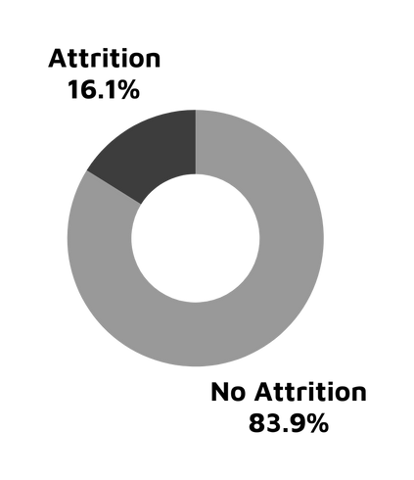
DATA
Primary Dataset Used: IBM HR Analytics Employee Attrition & Performance
Source: IBM
Records: ~1500 employees
Features: 45 columns
Target Variable: Attrition (Yes/No)
Key Feature Categories:
Demographic: Age, Gender, Education, Marital Status
Job Role: JobLevel, Department, JobRole, OverTime
Performance: MonthlyIncome, JobSatisfaction, PerformanceRating
Tenure: TotalWorkingYears, YearsAtCompany, YearsWithCurrManager
Class Imbalance Challenge:
~16% attrition vs. 84% No Attrition
Addressed using scale_pos_weight during XGBoost training

Slide 6
CHALLENGES (DATA)
Scraping Challenges:
While exploring alternate datasets, I attempted to scrape additional data from public company sources (LinkedIn, Glassdoor, etc.).
The scraped data was largely inconsistent, with missing values, formatting issues, and lack of labeled attrition targets.
Augmentation Challenges:
I also experimented with data augmentation, using statistical duplication and synthetic variation techniques.
However, these approaches failed to preserve realistic distributions for key features like MonthlyIncome, OverTime, and JobLevel.
Due to these constraints, I dropped the idea of augmentation and used the clean, consistent IBM dataset as the final choice.

Slide 7
PREPROCESSING
Initial Preprocessing Steps:
Handled missing values and duplicates
Dropped redundant or non-informative columns
Encoding Categorical Variables:
Applied One-Hot Encoding
Feature Scaling:
Scaled continuous features
Used StandardScaler
Kept raw values for tree-based models like XGBoost (to retain SHAP interpretability)
Feature Selection:
Analyzed feature importance and correlation to reduce redundancy
Final feature set: 45 model-ready inputs
Prepared default values (median/mode) for UI integration in Streamlit

Slide 8
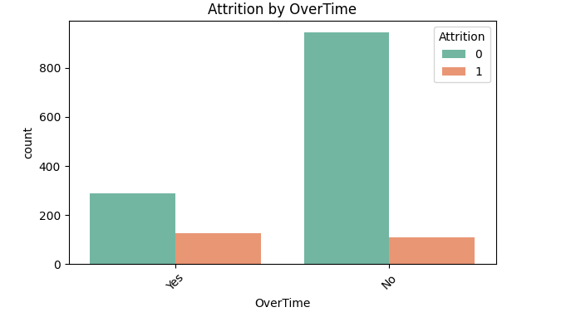
EDA: CATEGORICAL FEATURES
OverTime: Employees working overtime show significantly higher attrition.

Slide 9
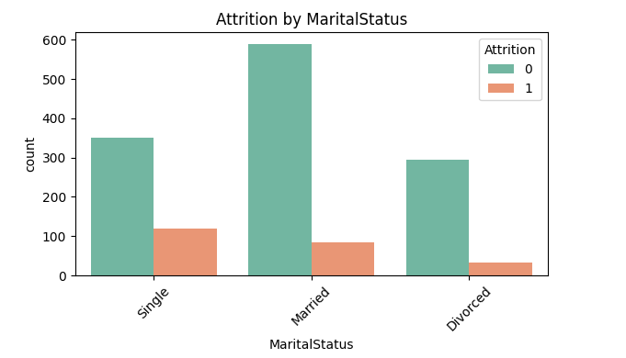
EDA: CATEGORICAL FEATURES
MaritalStatus: Single employees tend to leave more often than married or divorced employees.

Slide 10
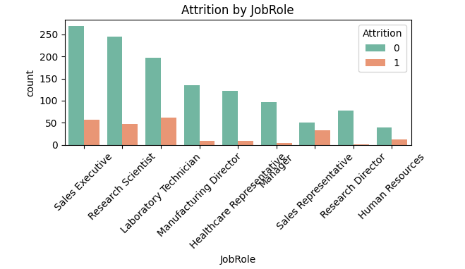
EDA: CATEGORICAL FEATURES
JobRole: Higher attrition observed among Sales Executives, Research Scientist and Laboratory Technicians.

Slide 11
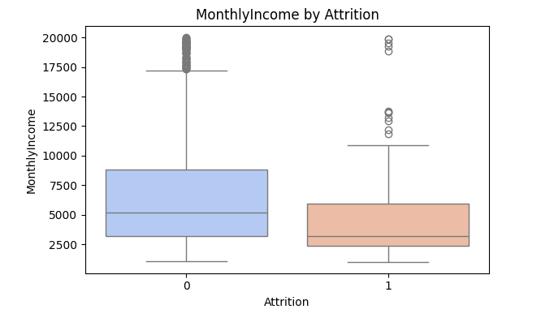
EDA: NUMERICAL FEATURE
MonthlyIncome: Employees with lower salaries are more prone to leave.

Slide 12
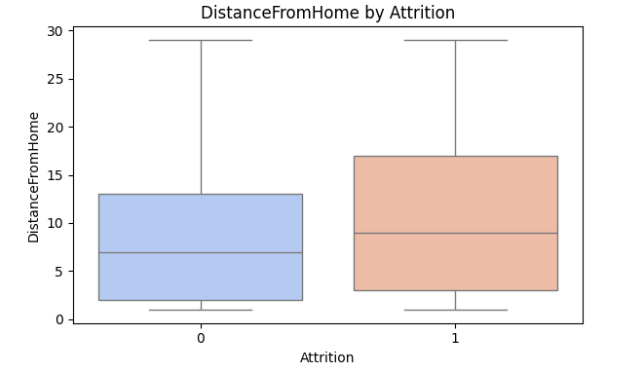
EDA: NUMERICAL FEATURE
DistanceFromHome: Attrition is higher among those living farther from work.

Slide 13
METHODOLOGY
Models
Pipeline
Random Forest:
Good performance
But lacked transparency for individual predictions.
XGBoost:
High accuracy
Handles class imbalance well
Integrates seamlessly with SHAP for explainability.
Train-Test Split: 80-20
Class Imbalance Handling:
Used scale_pos_weight in XGBoost to counter ~16% positive class
simple, fast, and effective.
Resampling changes the data
Hyperparameter Tuning:
Applied RandomizedSearchCV
Tuned n_estimators, max_depth, learning_rate, etc.

Slide 14
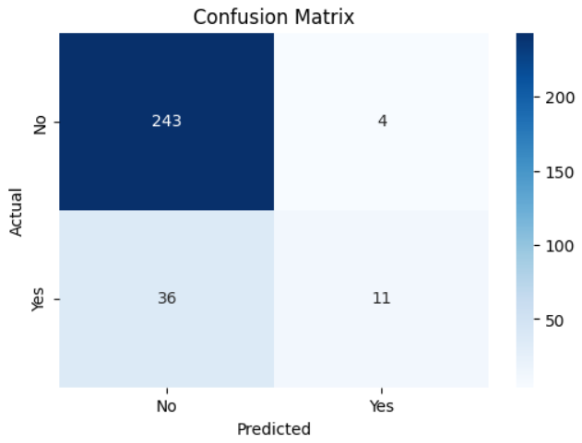
RESULTS
Model Performance:
Accuracy: 88%
Precision: 0.85
Recall: 0.86
F1 Score: 0.83
ROC-AUC Score: 0.81
Confusion Matrix: Low false negatives, which is crucial for identifying at-risk employees
The model correctly identifies employees likely to leave, while minimizing false alerts.

Slide 15
RESULTS
Why XGBoost + SHAP?
XGBoost delivers strong predictive performance
SHAP adds interpretability — both global (feature ranking) and local (individual reasons for prediction)
Threshold-Based Custom Logic:
A custom 35% probability threshold was set to classify "Attrition Risk"
This allows HR teams to interpret the model’s predictions with practical decision-making in mind
Helps balance risk identification without over-flagging employees
SHAP Interpretation In Action
Global SHAP Summary: Top contributors visualized with mean SHAP values
Local SHAP Explanations: Provided per prediction through the Streamlit app
“Why this employee is at risk?” → Answered visually + via LLM-powered chatbot

Slide 16
RESULTS
Rank | Feature | Impact Type
1 | MonthlyIncome | Negative (↓ risk with ↑ income)
2 | OverTime | Positive (↑ risk when yes)
3 | JobSatisfaction | Negative (↓ risk with ↑ satisfaction)
4 | TotalWorkingYears | Negative (early career = higher risk)
5 | DistanceFromHome | Positive (↑ risk with ↑ distance)

Slide 17
CONCLUSION
Key Takeaways:
Employee attrition is predictable using machine learning when the right data is available.
XGBoost, combined with SHAP explainability, achieved high accuracy (~88%) while remaining interpretable and actionable.
The project highlights critical drivers of attrition like OverTime, Job Satisfaction, and Monthly Income — enabling HR to act early.
How the Solution Helps:
For HR Teams: Identifies at-risk employees before they resign, enabling targeted retention strategies.
For Decision Makers: Offers a transparent tool with visual explanations to support ethical and informed action.
For Business Strategy: Aligns workforce stability with financial and operational goals.

Slide 18
FUTURE SCOPE
Real-time HR data integration from internal systems (e.g., Workday, BambooHR)
Historical dashboards to track attrition trends over time
Automated reporting (PDF/CSV export with individual predictions)
Multi-company generalization using transfer learning or federated data
Ethical guardrails: Adding alerts when the model may show bias or overconfidence

Slide 19
LIVE APP DEMO
Streamlit Web App: (link)
Interactive Prediction UI
Users can adjust inputs like JobSatisfaction, OverTime, and MonthlyIncome using sliders, dropdowns, and numeric fields
Upon clicking Predict Attrition Risk, the app returns:
A clear prediction (Yes/No)
Probability score
Risk classification using the 35% threshold logic
SHAP-Based Explanations
Real-time feature impact for every prediction
Highlights “why” this particular employee might leave
Includes bar charts of feature contributions (local SHAP values)
AI Assistant Chatbot
Integrated OpenAI-powered LLM chatbot
Answers only questions related to attrition predictions
Designed to support HR teams by explaining results in plain English

Slide 20
Q & A
Thank You!
I appreciate your time and attention throughout this presentation.
I’m happy to answer any questions, discuss implementation ideas, or explore future enhancements.

Slide 21
Thank You
For your attention

