Slide 1

Direct Donate system
-Amey Kelekar

Slide 2
Agenda
Problem
Solution
Benefits
Business Model

Slide 3
Problem
Problem with any current charity system is:
Involvement of sub-contractors and third-party people
Chances of Corruption
Riddled with bureaucracy.
Direct Donate System eliminates the above problems. Direct donate System provides money directly to recipient.

Slide 4
Solution
A Donor Donates Money through Direct Donate Website.
Direct Donate identifies recipient based on the government census data/ public records.
Field team goes and collect the digital data of the recipient.
The same data is verified to check the eligibility of the recipient.
Donate Money electronically to the recipient
Recipients collect the money from nearest vendor in their locality.
Recipients can then use the money the way they want to.

Slide 5
Benefits
Direct donate system removes sub-contractor or third party person and thus eliminates bureaucracy, corruption and fraud.
Since funds are transferred to the recipient electronically, it reduces mismanagement of funds.
Since every person involved in a process is responsible to handle only a specific task, it reduces chances of fraud.

Slide 6
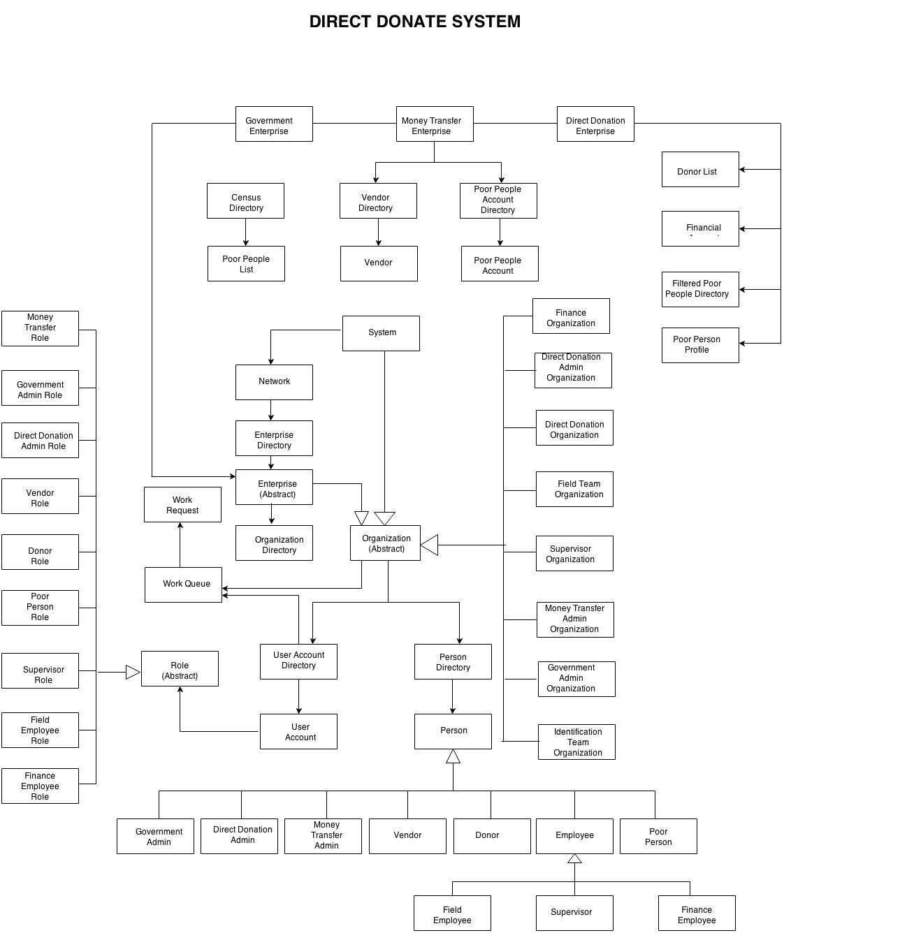
Business model

Slide 7
THANK YOU

