Slide 1
IOS Final Project Oven Fresh

Slide 2
OvenFresh Background
OvenFresh is a small cake shop back in India owned by my friend’s mother.
It has a wide range of cakes and different types of Indian Sweets.
The shop only accepts orders and delivery to nearby areas only and payment mode as of now is cash on delivery.
Even though the business is small but it is very fast-growing and expanding.
In order to grow and stay up with the market, the store need to have some kind of website and mobile application.
I believe it would be great if I implement my iOS skills and help my friend to have an app to grow his business

Slide 3
Application Flow
Customer enters the application and selects product from two categories: cake and sweets.
Customer adds or removes different products to his cart.
Once finalize, customer can proceed to checkout
Then customer can enter his login credentials or register as a new user
Once registered or logged in, customer can see his final amount and select the option cash on delivery to complete the order.

Slide 4
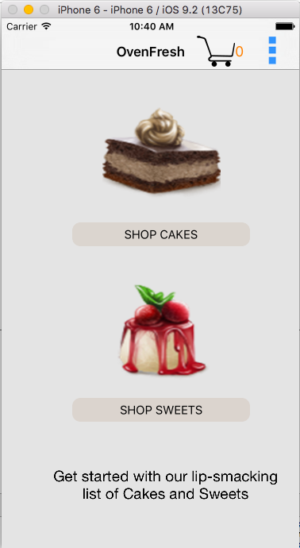
Screen shots

Slide 5
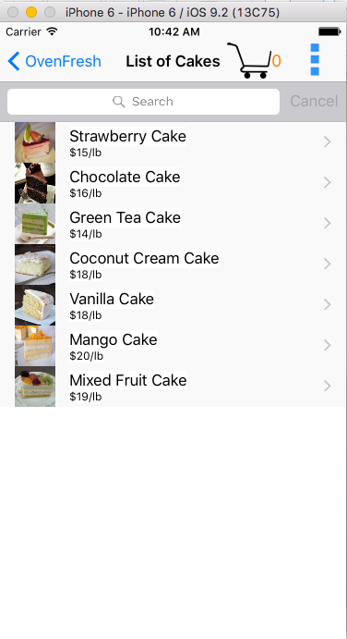

Slide 6
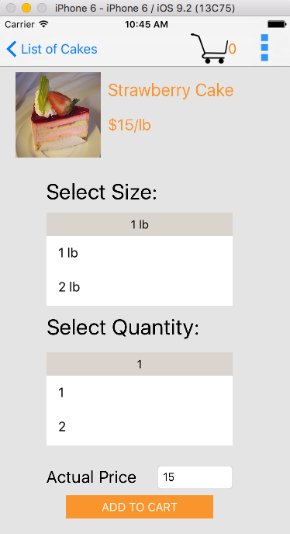

Slide 7
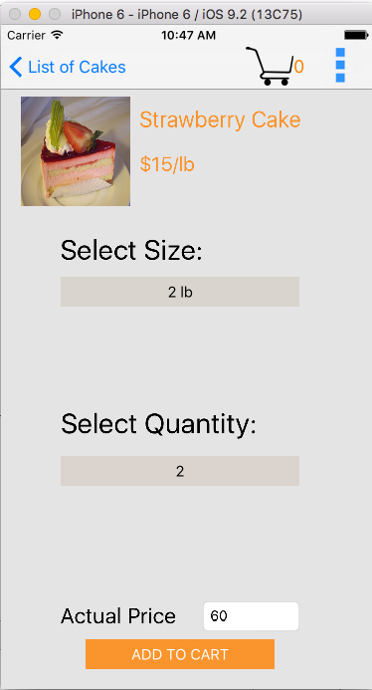

Slide 8
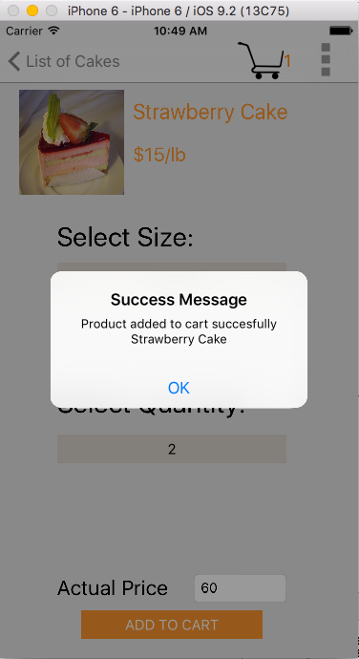

Slide 9
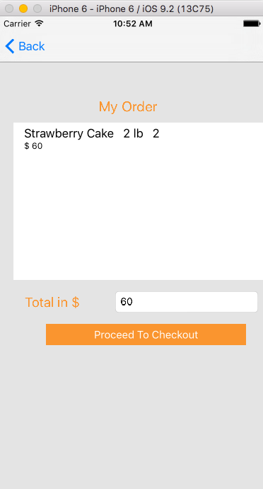

Slide 10
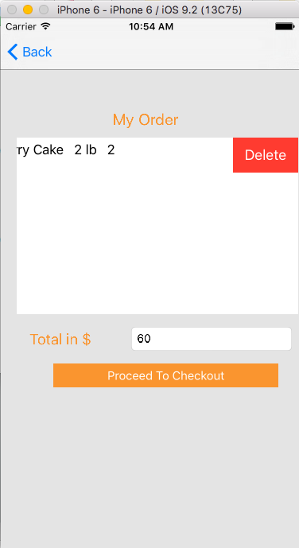

Slide 11
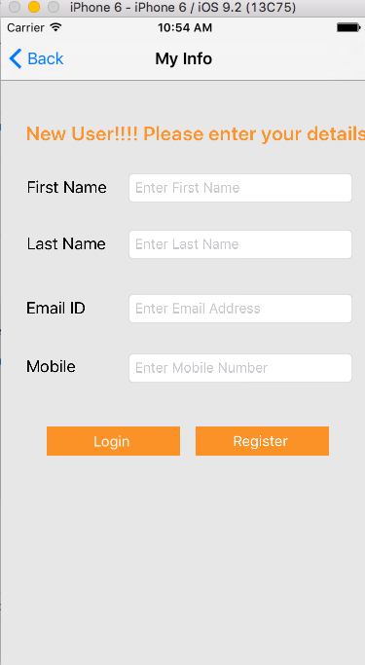

Slide 12
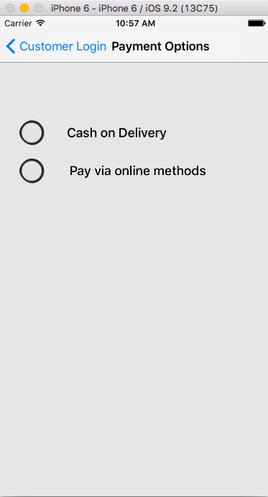

Slide 13
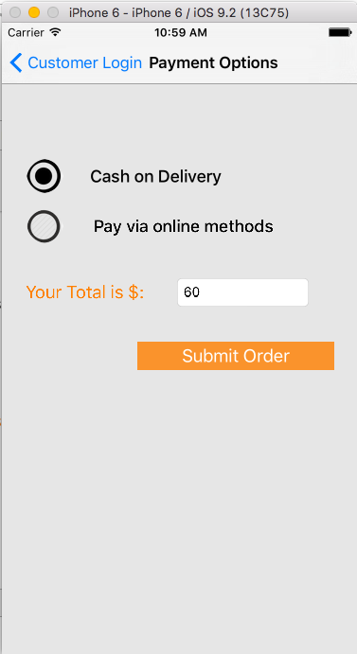

Slide 14
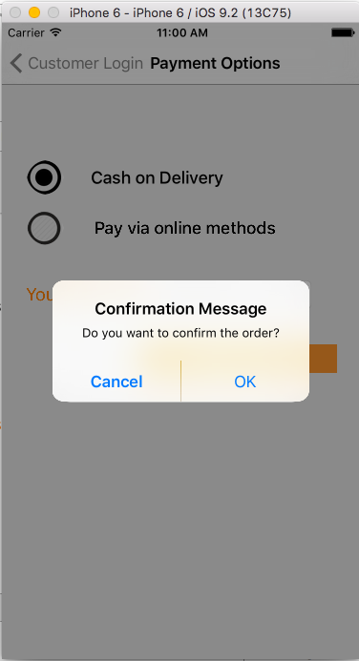

Slide 15
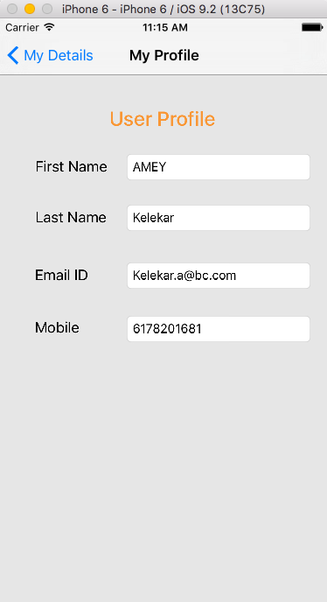

Slide 16
Future Scope
As of now the OvenFresh only accepts cash on delivery, once the business grows need to support online payment methods like payPal and Apple Pay.
As of now since the payment is via cash, there is no option to cancel or modify order once placed. But as the business grows definite scope to implement this feature.
As of now limited details fetched to a create a customer profile.
Implementation of push notification to notify the customer about his delivery status.

Slide 17
Limitations
No support for a single common navigation bar throughout the project.
Multiple clicks in some cases to reach to a specific view in page.
Definitely need a better UI to impress the customer, need to think from user experience point of view.

Slide 18
Thank You

